Slide 1
A FOCUS ON EFFICIENCY AND SAVINGS
WE’RE ALWAYS WORKING TO HELP YOU SAVE.

Slide 2
A Focus on Efficiency and Savings
a cutting-edge ice-level sensor that reduces water and energy consumption while keeping fresh ice ready in the bin
ENERGY STAR-QUALIFIED EQUIPMENT
a wide selection of qualified models, many of which are eligible for rebates from local utility companies
TOTAL COST OF OWNERSHIP
one of the industry’s lowest lifecycle costs, helping operators boost their ROI
VARI-SMART™ ULTRASONIC BIN LEVEL CONTROL

Slide 3
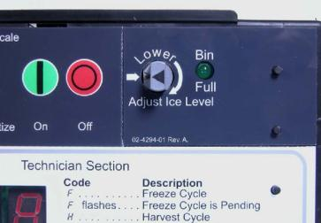
It’s Easy to Operate
Vari-Smart™ Ice Level Control
Optional ultrasonic ice level control sensor allows operators to manually adjust ice levels
Keeps just the right amount of freshly made ice in the bin
Helps save water and energy
Connects to existing controller
Ideal for seasonal changes in ice needs or if you’re planning to sanitize the bin
Also provides faster ice turnover or for operating your machine in lower-cost energy periods

Slide 4
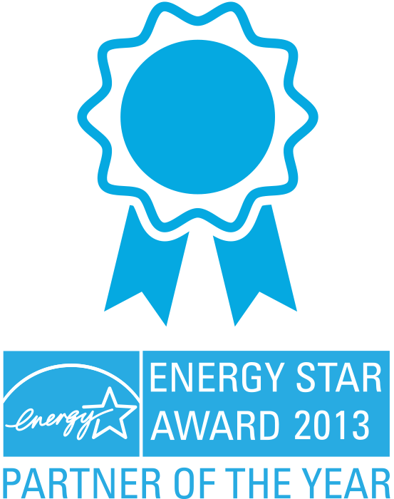
A Focus on Efficiency and Savings
a cutting-edge ice-level sensor that reduces water and energy consumption while keeping fresh ice ready in the bin
ENERGY STAR-QUALIFIED EQUIPMENT
a wide selection of qualified models, many of which are eligible for rebates from local utility companies
TOTAL COST OF OWNERSHIP
one of the industry’s lowest lifecycle costs, helping operators boost their ROI
VARI-SMART™ ULTRASONIC BIN LEVEL CONTROL
*Multiple Year Winner*

Slide 5
Scotsman’s DOE Plan
Save up to $150 per year on increased energy savings
Average efficiency gain of 8% on flake and nugget, 5% for cubers
Scotsman models exceed 2018 DOE Standard by 9% on average (up to 32% for select models)
3 year engineering project improved:
Parts commonality
Manufacturing efficiency
Minimum Impact to our Customers
Same basic design with better efficiency
Same model number nomenclature
Same refrigerant
Same ice forms

Slide 6
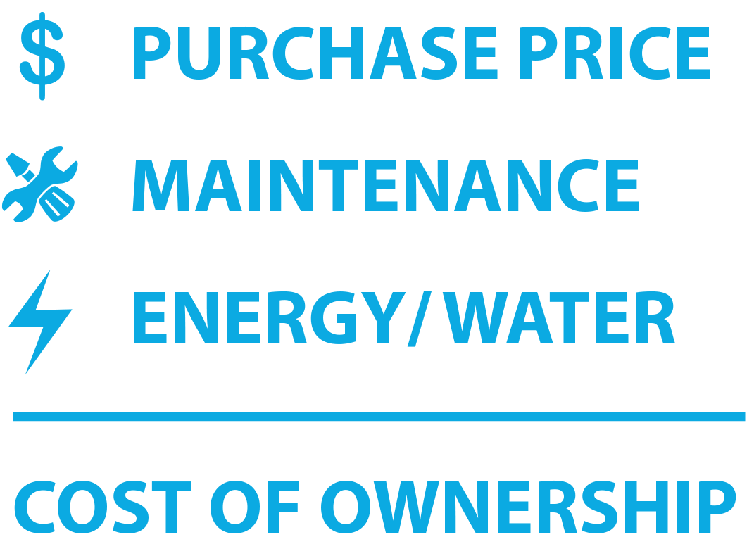
A Focus on Efficiency and Savings
a cutting-edge ice-level sensor that reduces water and energy consumption while keeping fresh ice ready in the bin
ENERGY STAR-QUALIFIED EQUIPMENT
a wide selection of qualified models, many of which are eligible for rebates from local utility companies
TOTAL COST OF OWNERSHIP
one of the industry’s lowest lifecycle costs, helping operators boost their ROI
VARI-SMART™ ULTRASONIC BIN LEVEL CONTROL

Slide 7
Total Cost of Ownership
Acquisition Costs of Equipment
Maintenance and Other Ongoing Costs of Equipment (can be 2 to 20 times greater)
When Comparing Equipment… Make Sure to Consider:
Long term costs of maintenance (labor and repairs)
Energy and water

Slide 8
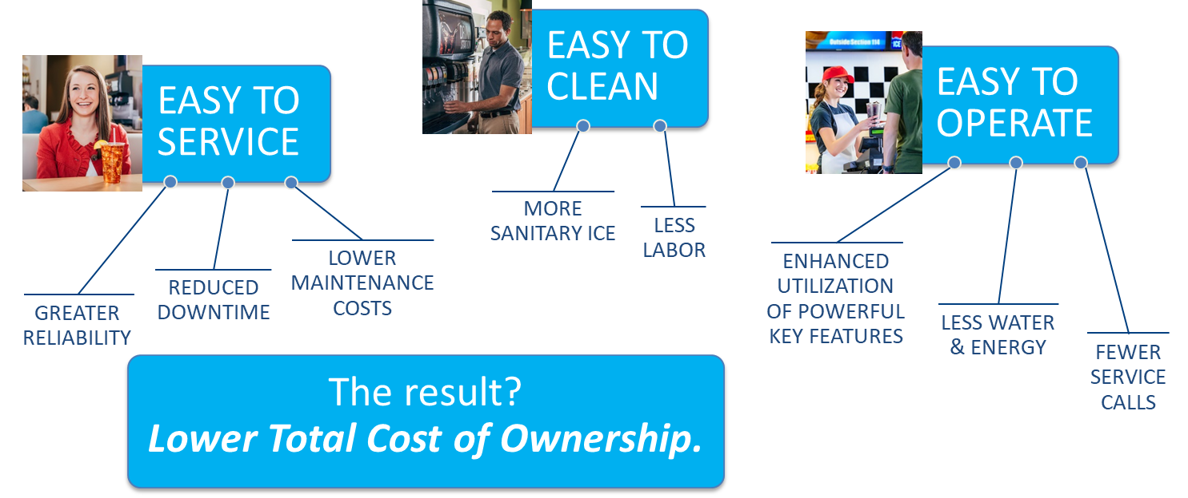
It’s All About Customer Satisfaction
Scotsman’s cube, flake and nugget ice machines are designed with one goal in mind: Total customer satisfaction

Slide 9
