Slide 1
SCOTSMAN ICE: AN INTRODUCTION
HIGHLY EFFICIENT, SUPERIOR-PERFORMING ICE SYSTEMS

Slide 2
Scotsman Ice: an introduction
REAL INNOVATION
SMART MANUFACTURING
INTUITIVE CONTROL
HIGH
EFFICIENCY
The Ice People, 100% mindshare dedicated to ice solutions…It’s how we’re giving today’s operators the power to do more.
As we continue to strive for operational excellence, we are only committed to the design, engineering, sale and support of high performance ice machines.
We’re proud of our award-winning U.S. manufacturing, the user-friendly functionality of our ice systems and the world-class support we provide our customers. When it comes to superior performance at every step, Scotsman delivers.

Slide 3
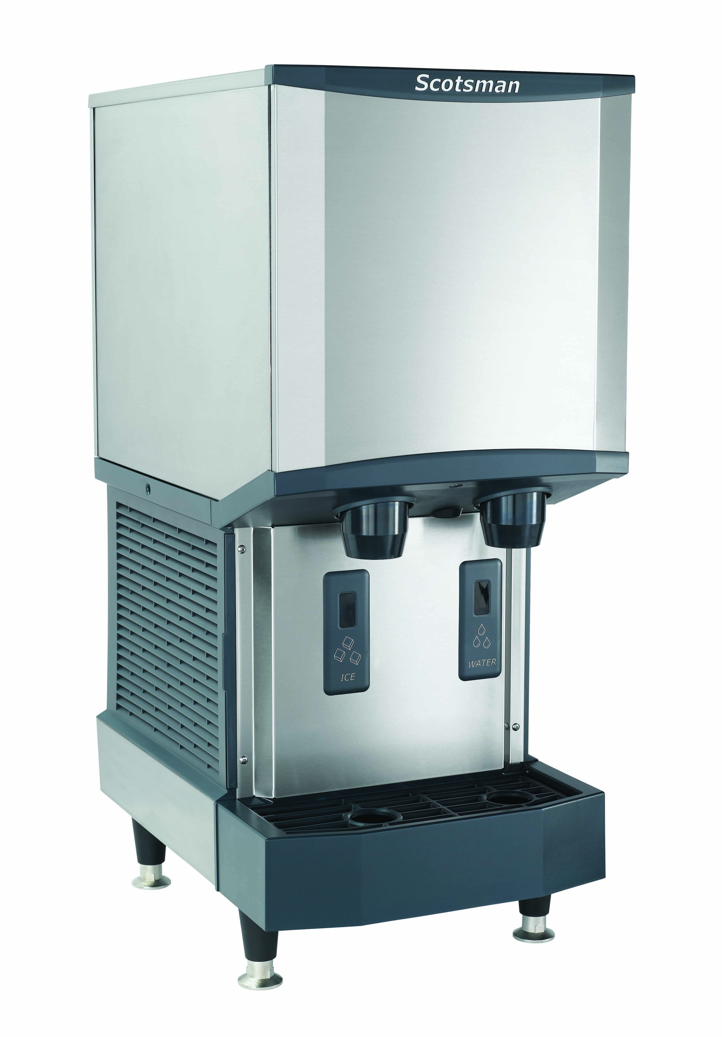
A tradition of real innovation
NUGGET ICE: THE ORIGINAL CHEWABLE ICE®
a customer favorite, popular worldwide for its soft, unique texture
SMART-BOARD® TECHNOLOGY
a powerful tool that uses advanced diagnostics and remote troubleshooting to minimize downtime
Meridian Series Ice and Water Dispensers
Highly reliable ice and water dispenser utilizing sealed bearing technology for maximum uptime.

Slide 4
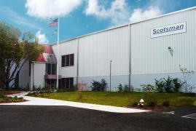
A commitment to smart manufacturing
COMMITMENT TO TOTAL QUALITY
run testing, rigorous audits and our ISO9001:2008 certification help ensure that every machine is built to last
RECOGNIZED AS AN INDUSTRY LEADER
distinctions such as the ENERGY STAR Partner of the Year Award, the Excellence in Product Design Award and being named a Shingo Award finalist exemplify our company-wide focus on setting high standards
99% OF OUR EQUIPMENT IS MANUFACTURED IN AMERICA

Slide 5
An intuitive sense of control
SELF-MONITORING PRODIGY PLUS® SYSTEM
a powerful solution that gives operators total peace of mind that they will always get the ice they need — when they need it
WATERSENSE ADAPTIVE PURGE CONTROL
a smarter way to optimize water consumption and keep your machine running efficiently and reliably
INSTANT ACCESS AT YOUR FINGERTIPS
our QR code technology offers one-step access to service manuals, warranty history information and more

Slide 6
A focus on efficiency and savings
VARI-SMART™ ULTRASONIC BIN LEVEL CONTROL
a cutting-edge ice-level sensor that reduces water and energy consumption while keeping fresh ice ready in the bin
ENERGY STAR-QUALIFIED EQUIPMENT
a wide selection of qualified models, many of which are eligible for rebates from local utility companies
TOTAL COST OF OWNERSHIP
one of the industry’s lowest lifecycle costs, helping operators boost their ROI

