Slide 1
INTRODUCING XSAFETM SANITATION SYSTEM
ENSURES SANITARY OPERATION, IMPROVED CLEANABILITY.

Slide 2
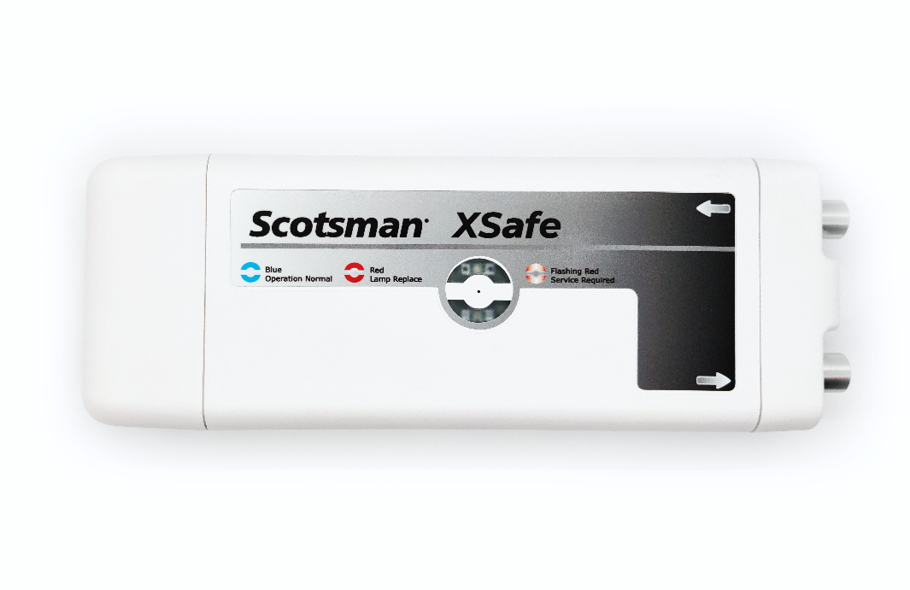
XSafeTM Sanitation System
NEW!
XSafeTM Sanitation System: Retrofit solution now available
Scotsman’s sanitation system uses UV-C light to generate a potent mixture of photoplasma, negatively charged ions, and ozone that help destroy viruses, bacteria, and other harmful contaminants. This mixture passes through the food zone of the ice maker, helping protect ice machine surfaces and ice in the bin.

Slide 3
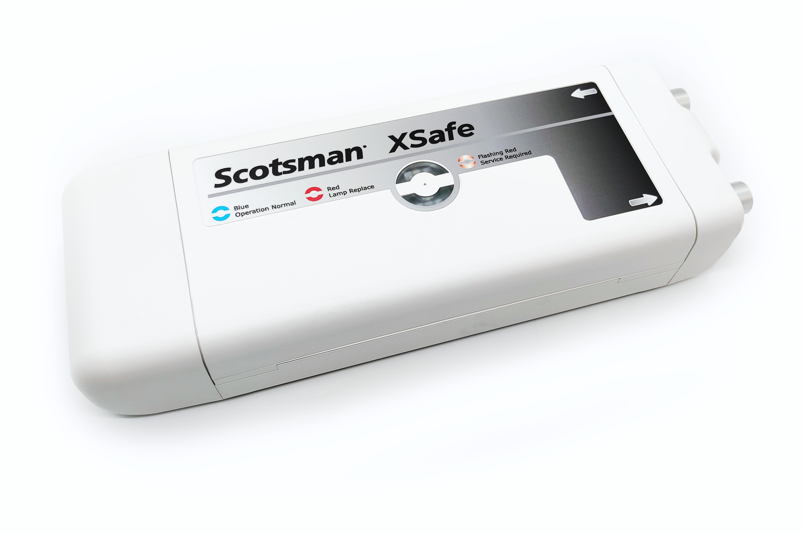
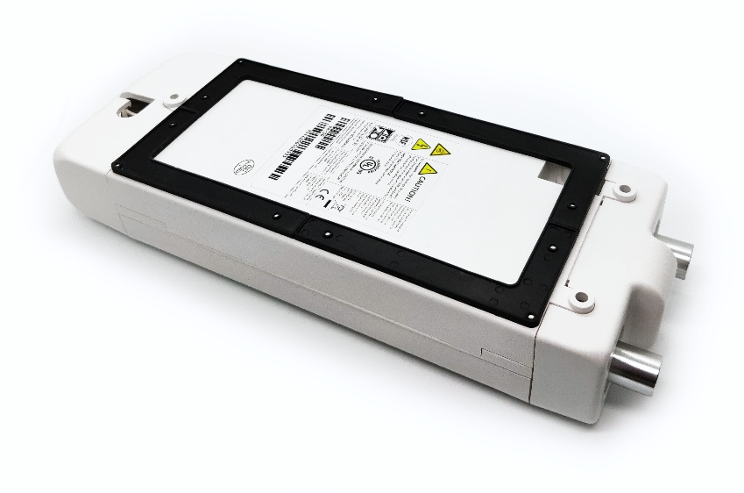
New Product Release Information
XSafeTM Sanitation System
Estimated shipping release by end of September
List Price: $736.00
Product Notes:
Installed as a retrofit solution for any Scotsman modular ice machine
External device sits on top of ice machine
Field install only
Estimated install time: 45-60 minutes

Slide 4
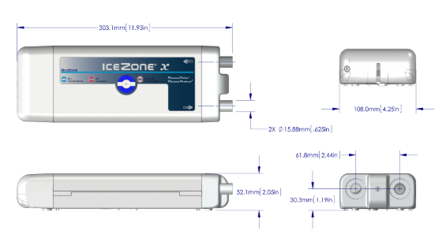
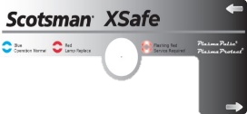
XSafeTM Sanitation System: Overview
Can be installed as a retrofit solution for any Scotsman modular ice machine
XR-30
Helps reduce cleaning costs
Enhances sanitary operation
Replacement Bulb: SCBULBXR30
Input Voltage: 100-240V
Input Frequency: 50/60Hz
Output Voltage: 12V DC
Amperage: 0.8 Amp
Electrical Consumption: 9.6W
Dimensions: 11.9” x 4.25” x 2.05”
(W x D x H)

Slide 5
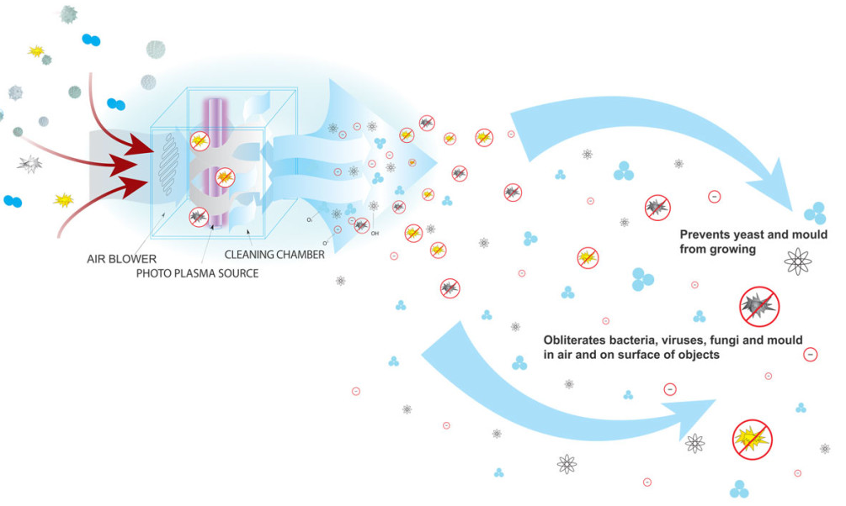
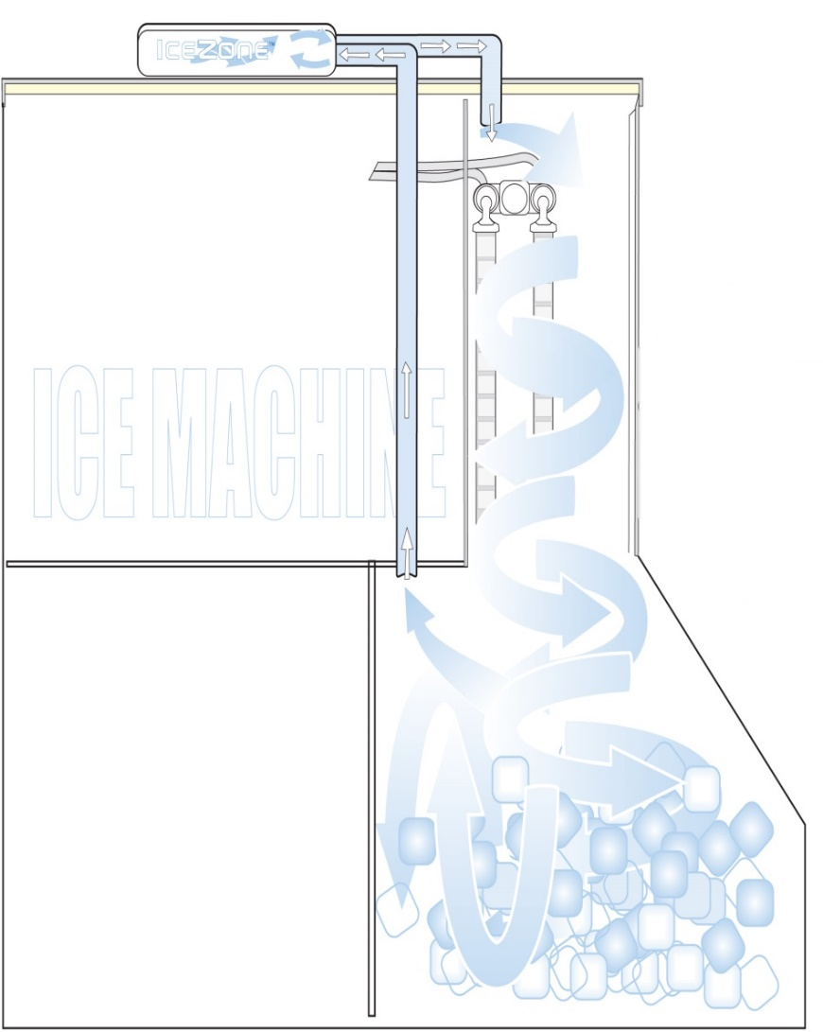
XSafeTM Sanitation System: The Science
How It Works
Ozone and other oxidants (photoplasma) are generated in the air after passing through a powerful UV-C lamp; A small fan circulates the photoplasma throughout the ice machine/bin
Helps sanitize the air and surfaces within the ice machine/bin
Completely automated and chemical-free cleaning system
Helps prevent yeast and mold growth
Attacks bacteria, viruses, fungi, and mold in the air and on surfaces
Ice Machine
Storage Bin

Slide 6
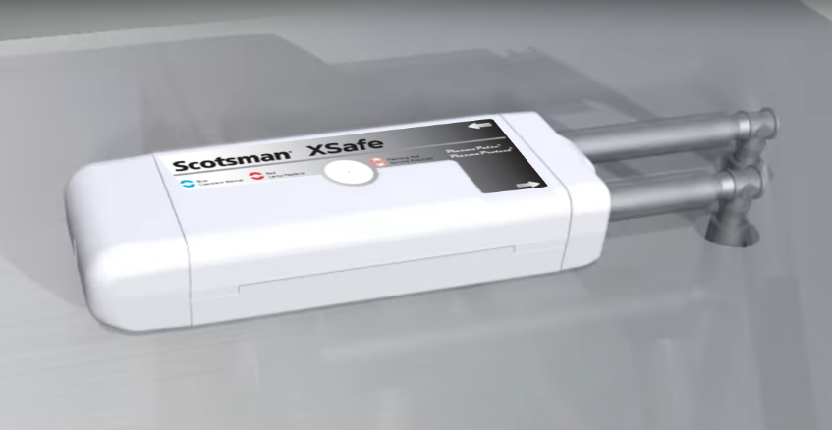
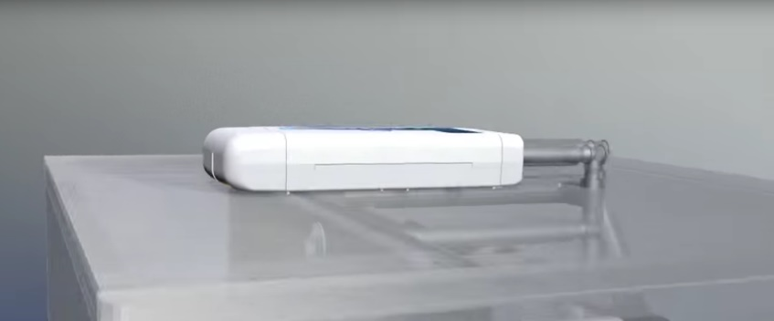
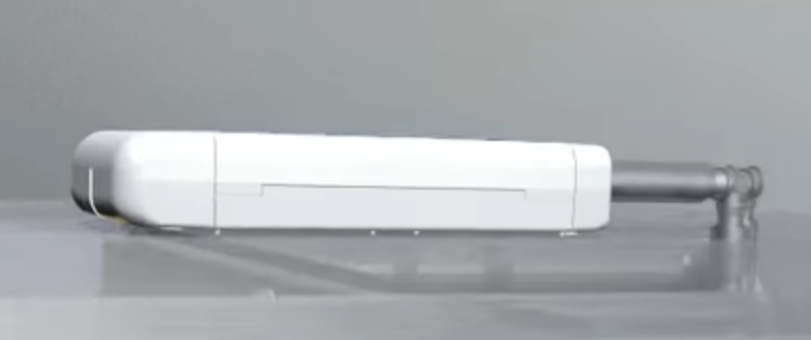
XSafeTM Sanitation System: The Benefits
Features & Benefits
Food Safety – Ice is FOOD!
Defends against viruses, bacteria, and fungi
Helps prevent the formation of slime, mold, and yeast
Consistent coverage of natural, chemical-free ozone (O₃)
Guards against health code infractions
Easier, Lower Cost Cleanings
Frequency of cleanings can be reduced
Effective in hard-to-reach areas, which may reduce manual cleaning time
Keeps the food zone and bin cleaner longer
Makes wipe downs easier and faster
Extend & Improve Machine Performance
The lifetime operation of the ice machine can be extended
A cleaner machine can enhance performance and efficiency

Slide 7
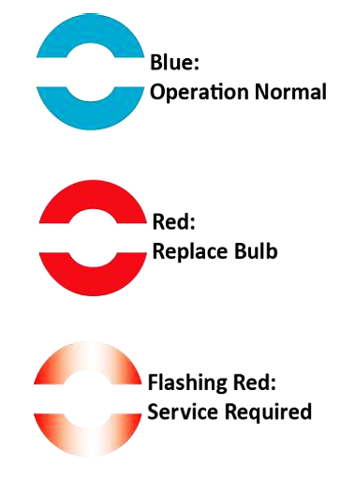
XSafeTM Sanitation System: Operation
Easy, Intuitive Operation
Installation Overview
Can be retrofitted on existing units already in use
Compatible with any Scotsman modular ice machine
Easy install, typically requires less time than a full cleaning
XSafeTM unit placed on top of ice head with vented air flow to circulate sanitized ozone throughout the ice machine/bin
Operational Status Indicator Lights
3 tiers of light signals keep operators informed of status
Replace bulb light eliminates guesswork
Replacement Bulb Part Number: SCBULBXR30

