Slide 1
INTRODUCING XSAFE® SANITATION SYSTEM
®
ENSURES SANITARY OPERATION, IMPROVED CLEANABILITY.

Slide 2
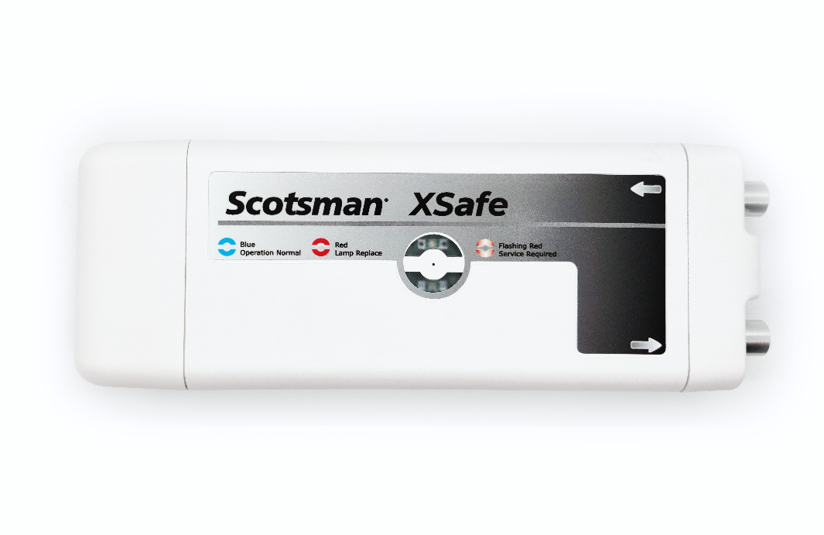
XSafe® Sanitation System
XSafe® Sanitation System: Retrofit solution now available
Scotsman’s sanitation system uses high power UVGI light to create a highly reactive mixture of oxygen which is continuously circulated in the air throughout the ice machine. This treated air passes over exposed components inhibiting the growth of viruses and bacteria.
®

Slide 3
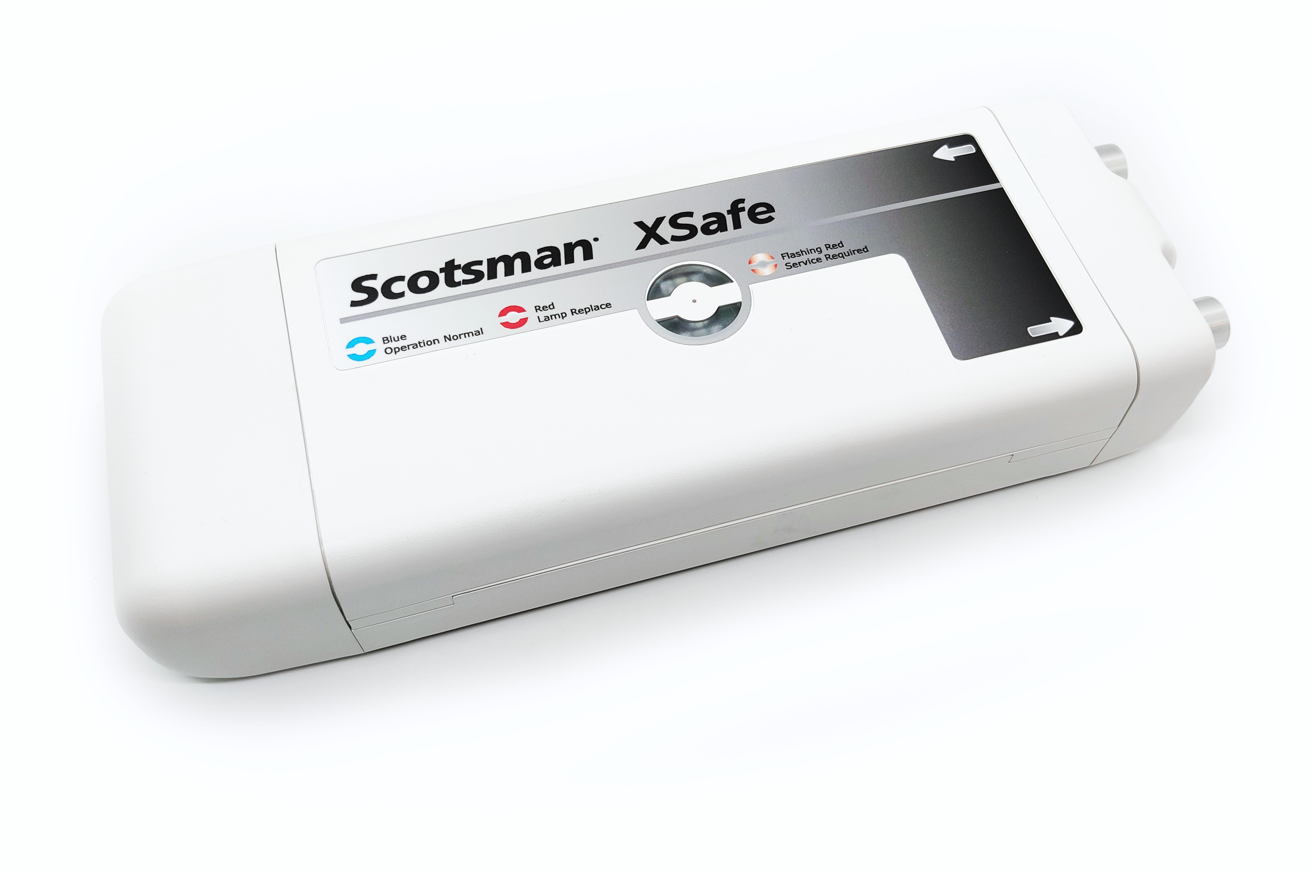
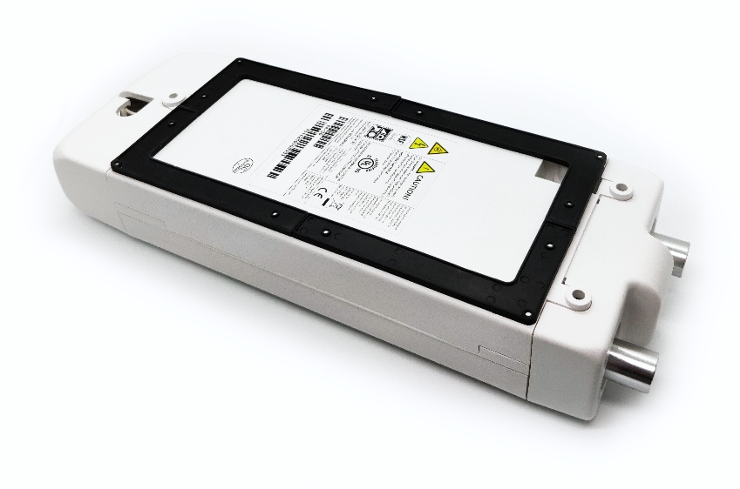
Product Release Information
XSafe® Sanitation System
Product Notes:
Installed as a retrofit solution for any Scotsman modular ice machine
External device sits on top of ice machine
Field install only
Estimated install time: 45-60 minutes
®
®

Slide 4
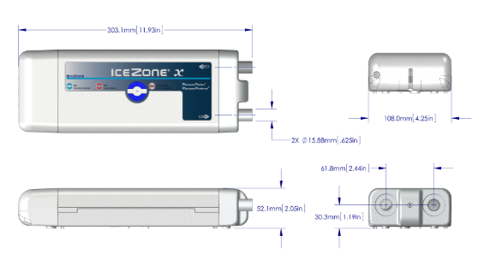
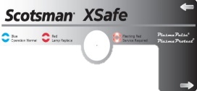
XSafe® Sanitation System: Overview
Can be installed as a retrofit solution for any Scotsman modular ice machine
®
XR-30
Helps reduce cleaning costs
Enhances sanitary operation
Replacement Bulb: SCBULBXR30
Input Voltage: 100-240V
Input Frequency: 50/60Hz
Output Voltage: 12V DC
Amperage: 0.8 Amp
Electrical Consumption: 9.6W
Dimensions: 11.9” x 4.25” x 2.05”
(W x D x H)
®

Slide 5
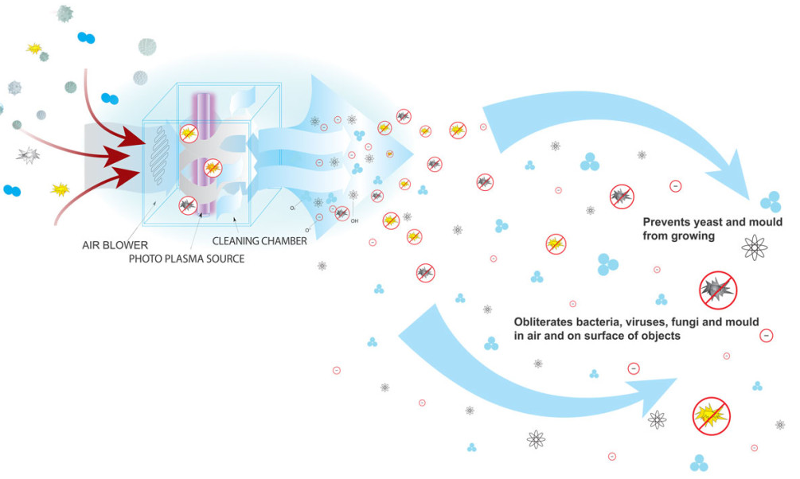
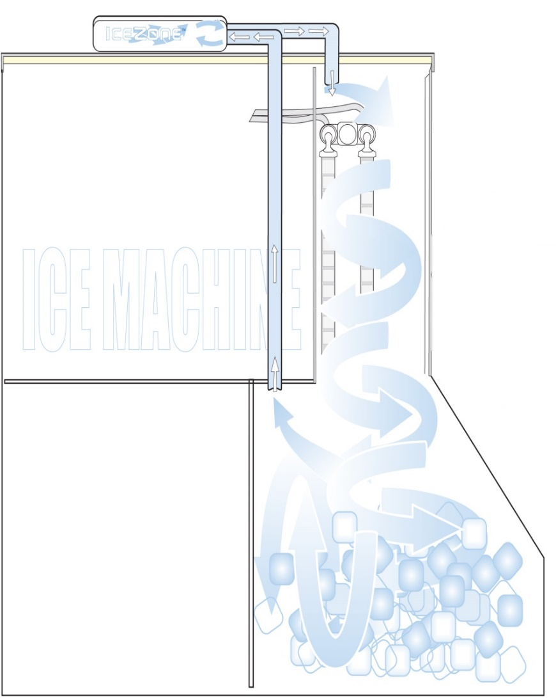
XSafe® Sanitation System: The Science
How It Works
Ozone and other oxidants are generated in the air after passing through a powerful UVGI light source; A small fan circulates the reactive oxygen throughout the ice machine/bin
Helps sanitize the air and surfaces within the ice machine/bin
Completely automated and chemical-free cleaning system
Helps prevent yeast and mold growth
UVGI LIGHT SOURCE
Attacks bacteria, viruses, fungi, and mold in the air and on surfaces
®
Ice Machine
Storage Bin

Slide 6
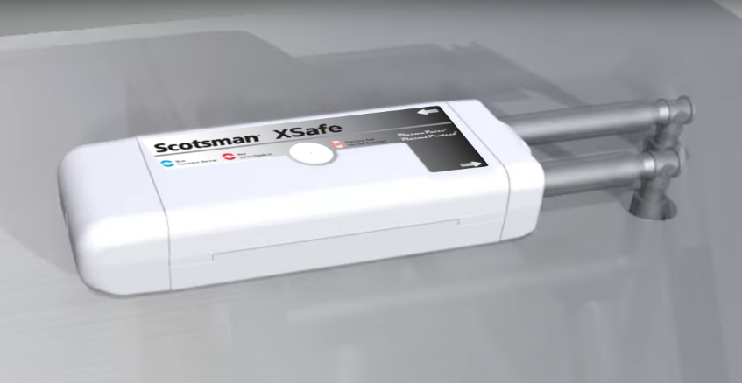
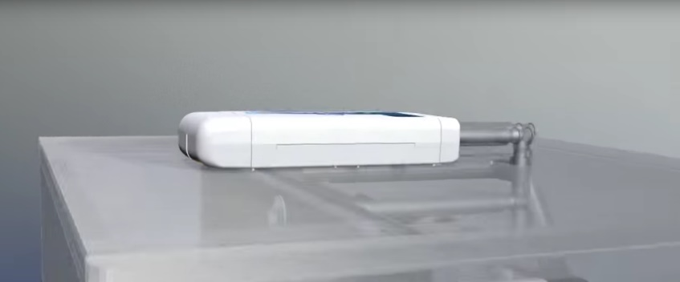
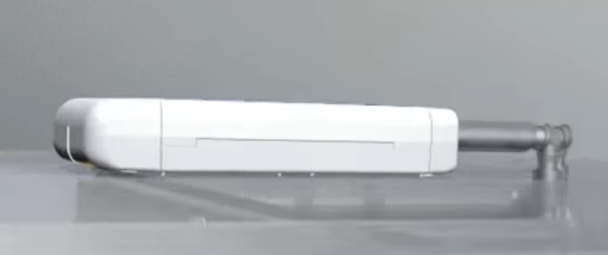
XSafe® Sanitation System: The Benefits
Features & Benefits
Food Safety – Ice is FOOD!
Defends against viruses, bacteria, and fungi
Helps prevent the formation of slime, mold, and yeast
Consistent coverage of natural, chemical-free ozone (O₃)
Guards against health code infractions
Easier, Lower Cost Cleanings
Frequency of cleanings can be reduced
Effective in hard-to-reach areas, which may reduce manual cleaning time
Keeps the food zone and bin cleaner longer
Makes wipe downs easier and faster
Extend & Improve Machine Performance
The lifetime operation of the ice machine can be extended
A cleaner machine can enhance performance and efficiency
®

Slide 7
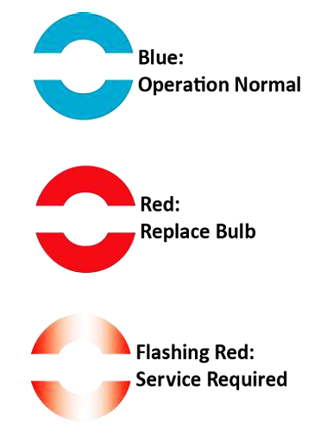
XSafe® Sanitation System: Operation
Easy, Intuitive Operation
Installation Overview
Can be retrofitted on existing units already in use
Compatible with any Scotsman modular ice machine
Easy install, typically requires less time than a full cleaning
XSafe® unit placed on top of ice head with vented air flow to circulate sanitized ozone throughout the ice machine/bin
Operational Status Indicator Lights
3 tiers of light signals keep operators informed of status
Replace bulb light eliminates guesswork
Replacement Bulb Part Number: SCBULBXR30
®

