Slide 1
A COMMITMENT TO SMART MANUFACTURING
WE’RE DEDICATED TO TOTAL QUALITY FROM THE GROUND UP.

Slide 2
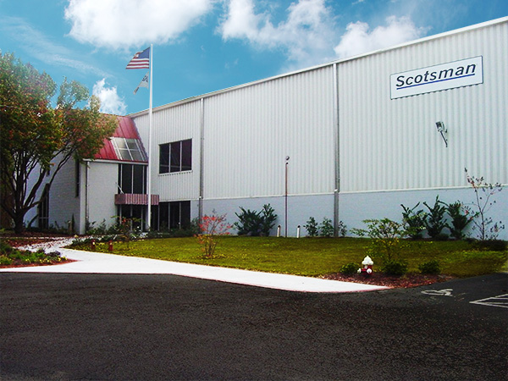
A Commitment to Smart Manufacturing

Slide 3
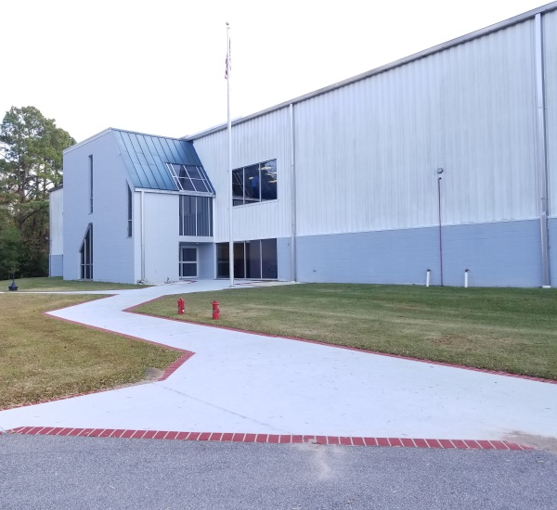
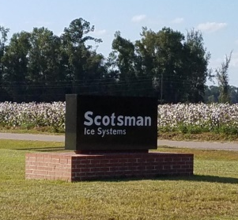
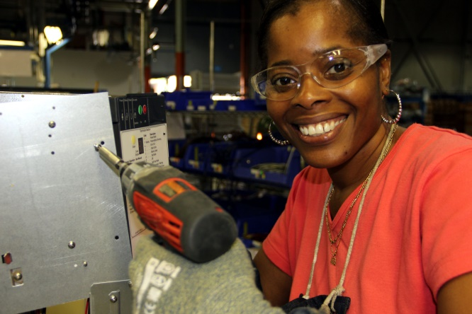
Award Winning Manufacturing Facility
Fairfax, South Carolina - Plant Built For Scotsman in 1980
ISO 9001:2015
Named Top 25 Factory in U.S. By Industry Week
288,000 sq. ft. Manufacturing Facility
Dist. Center Purchased In 1986 (80,000 sq. ft.)
Produce 90,000 - 100,000 units / year
Produces 360 SKUs
Cubers
Flakers / Nuggets
Undercounter Products
Dispensers
Bins
Home Ice Machines
Manufacturing Operations
Sheet metal
Rotocast Molding
Assembly, Test, Packout

Slide 4
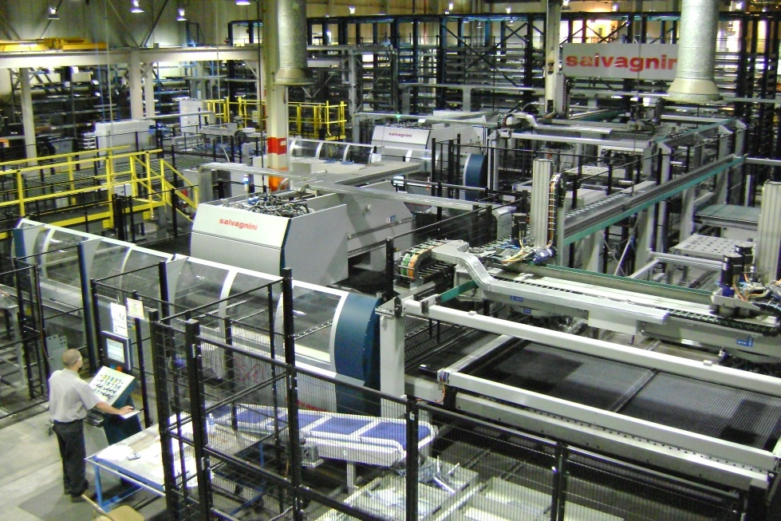
Scotsman Cost Containment Initiatives
Lean Manufacturing
Reducing Waste (TPM)
Level Load Production
Increased Quality
Helps manage seasonality
Cost / Sustaining Projects
FMS / Steel Optimization
Component Commonality
Quality Improvements
ISO 9001:2015
UL, NSF, ETL, CE

