Slide 1
A TRADITION OF REAL INNOVATION
OUR HISTORY INFORMS OUR FUTURE.

Slide 2
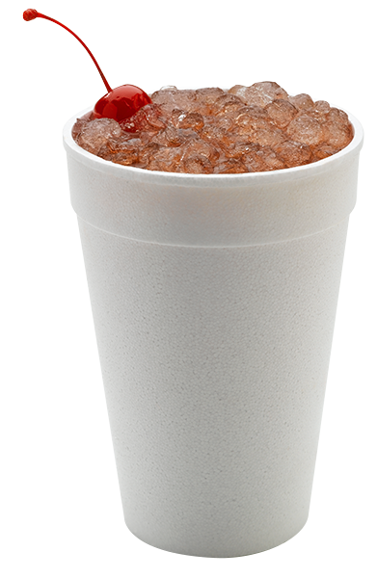
A Tradition of Real Innovation
NUGGET ICE: THE ORIGINAL CHEWABLE ICE®
a customer favorite, popular worldwide for its soft, unique texture
SMART-BOARD® TECHNOLOGY
a powerful tool that uses advanced diagnostics and remote troubleshooting to minimize downtime
Meridian Series Ice and Water Dispensers
Highly reliable ice and water dispenser utilizing sealed bearing technology for maximum uptime

Slide 3
Nugget is Now Easier to Clean & Operate
Smaller operational footprint
Thanks to the newly relocated air filter, all Prodigy Plus 22” and 30” units now require minimal side clearance
Allows machine to be placed directly beside walls and other equipment, maximizing valuable kitchen space
Many Prodigy Plus models feature the smallest operational footprints in the industry
Front-located air filter
Ensures proper clearance and breathability for maximum energy efficiency
Easily rinsed and reused, and also dishwasher safe
Better visibility keeps regular cleaning top-of-mind for operators

Slide 4
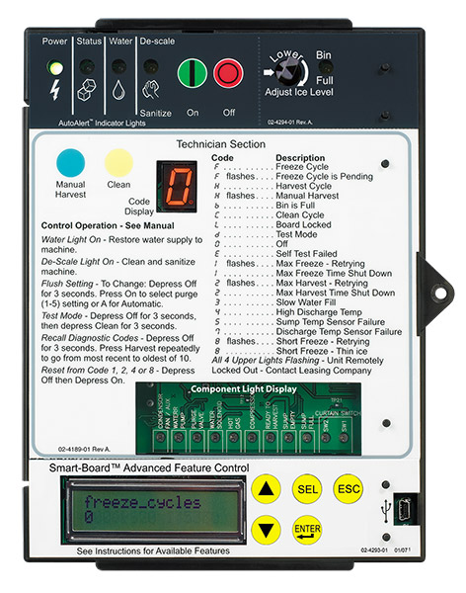
A Tradition of Real Innovation
NUGGET ICE: THE ORIGINAL CHEWABLE ICE®
a customer favorite, popular worldwide for its soft, unique texture
SMART-BOARD® TECHNOLOGY
a powerful tool that uses advanced diagnostics and remote troubleshooting to minimize downtime
Meridian Series Ice and Water Dispensers
Highly reliable ice and water dispenser utilizing sealed bearing technology for maximum uptime

Slide 5
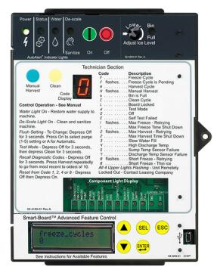
It’s Easier to Service
Auto-Alert™ Control Board
Instant and Intuitive Notifications
Power, Status, No Water, Time to Clean
Easy to see across the room
Minimize downtime, reduce service calls
LED code for easy diagnosis
Self Test mode for easy diagnosis

Slide 6
It’s Easier to Service
Smart-Board™ Advanced Feature Module
Optional advanced feature provides NAFEM data protocol on screen for early alert and fast diagnosis of operating issues
Allows for programming bin levels, checking cleaning history and runtime, and more
Technicians can download data directly through the USB port, or use the serial number to check performance via a dedicated website
Scotsman can retrofit existing field units with this exclusive technology

Slide 7
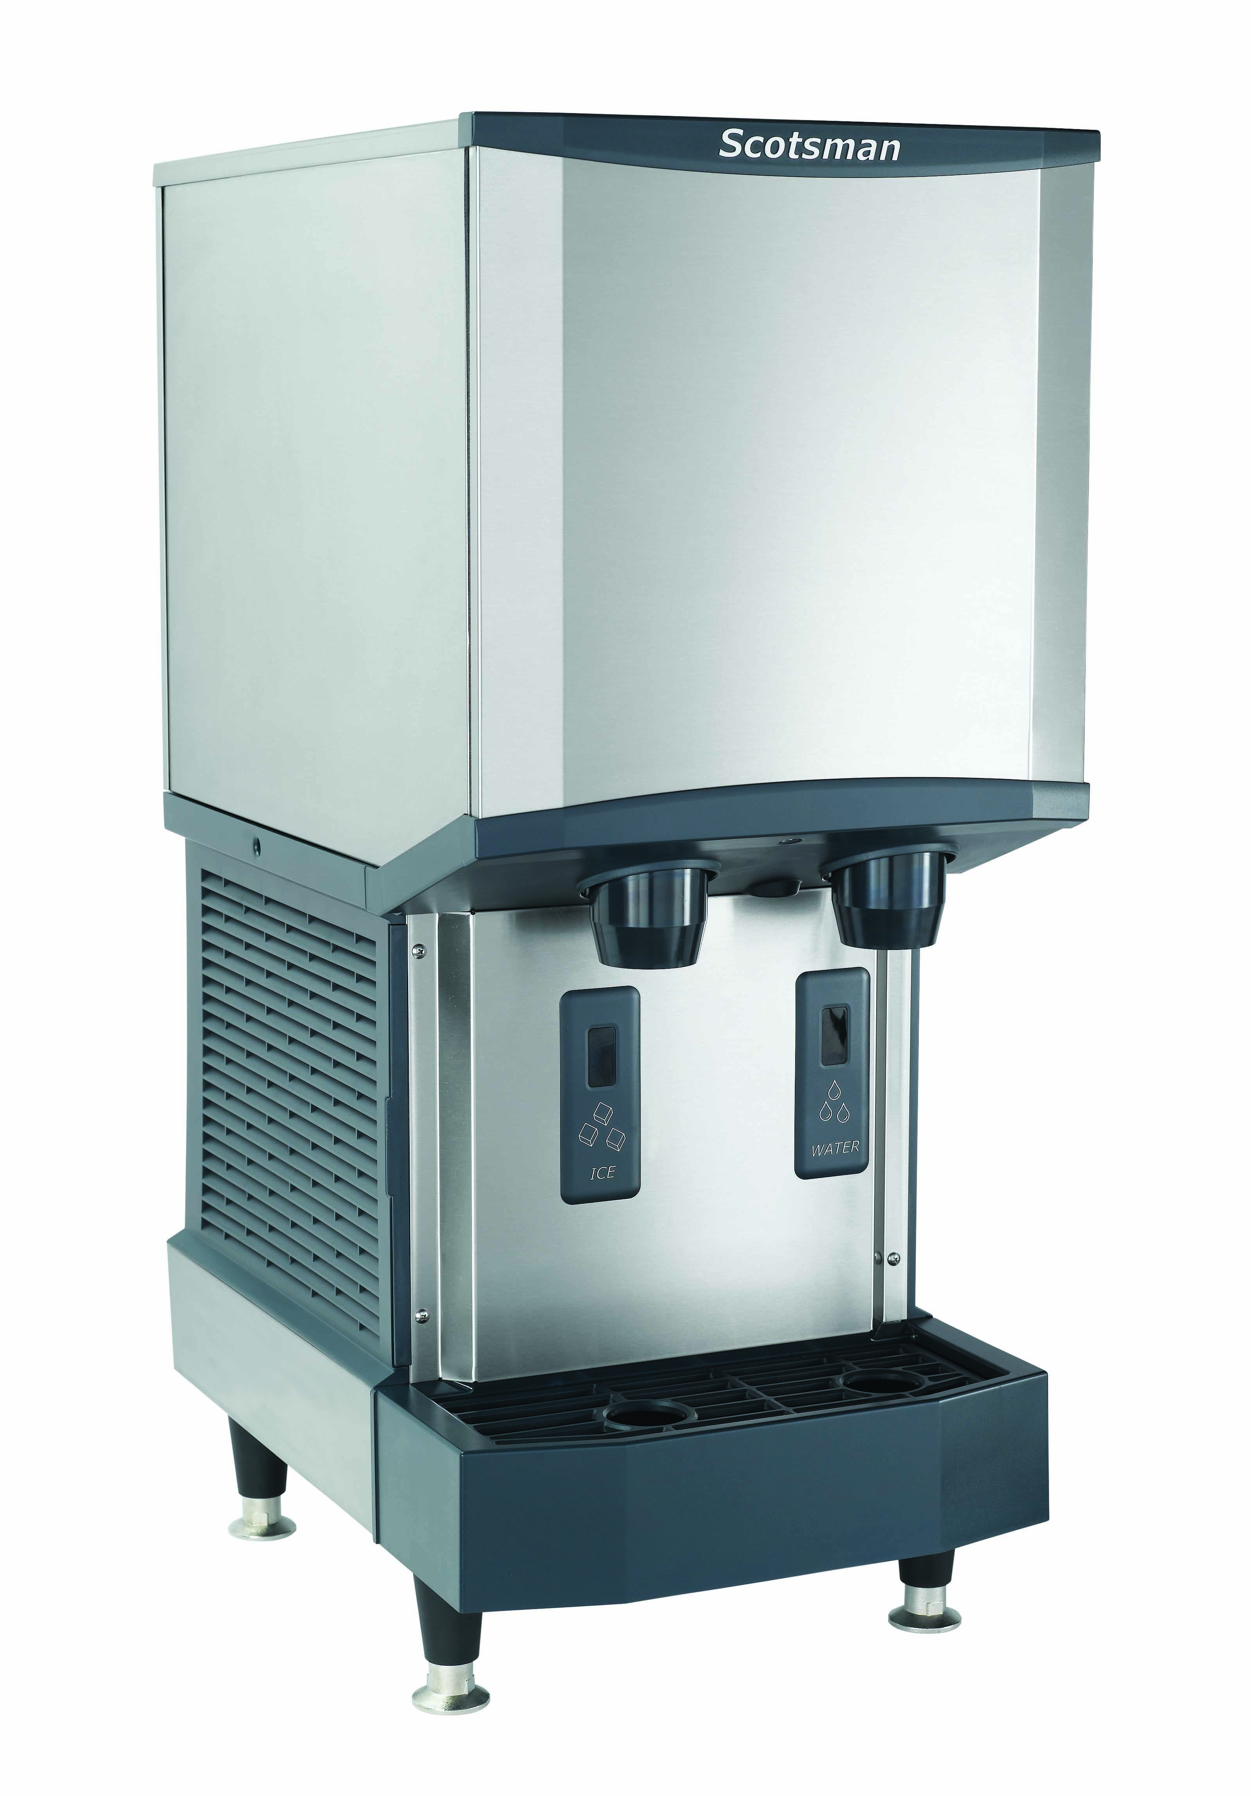
A Tradition of Real Innovation
NUGGET ICE: THE ORIGINAL CHEWABLE ICE®
a customer favorite, popular worldwide for its soft, unique texture
SMART-BOARD® TECHNOLOGY
a powerful tool that uses advanced diagnostics and remote troubleshooting to minimize downtime
Meridian Series Ice and Water Dispensers
Highly reliable ice and water dispenser utilizing sealed bearing technology for maximum uptime

Slide 8
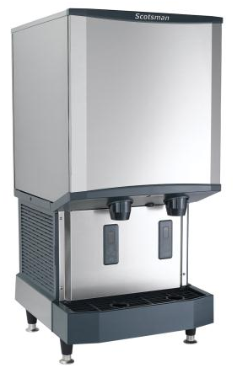
Introducing the Meridian™ Series
Born out of extensive market research, Meridian™ was developed with space, production and installation in mind — combining Scotsman’s trusted reliability and time-saving serviceability with new innovations to deliver the softest, most satisfying ice on the market.

Slide 9
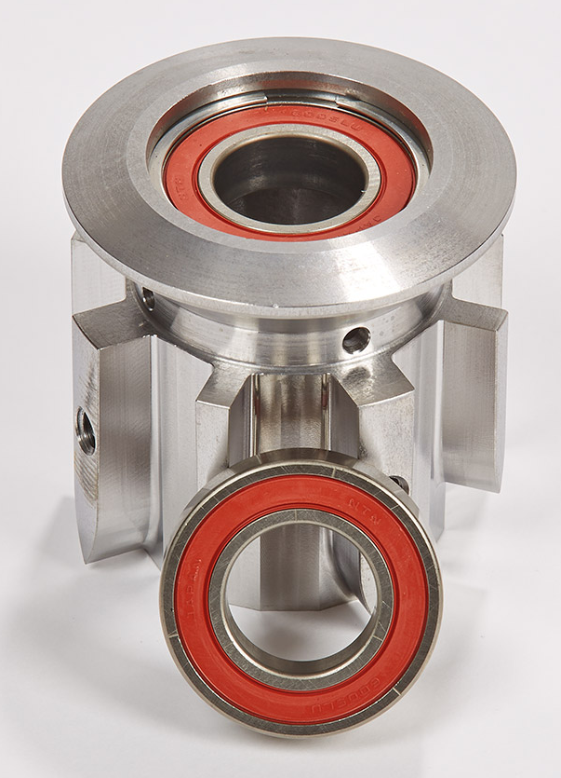
Superior Reliability
Maintenance Free Bearing
The Problem: Components used to create compressed ice require maintenance for routine checks, specifically with wearable parts like bearings
Innovation: Meridian™ models feature an all-new proprietary maintenance free bearing, fully sealed with a high-tech polymer that lubricates and eliminates the need for greasing (launched in 2015)
Exclusive technology uses no wearable parts and no grease, which decreases potential service and maintenance issues
Continued Innovation: As a result of the successful Meridian™ launch, this proprietary maintenance free bearing is now being expanded into the new Essential Series Undercounter Nugget & Flake Models

Slide 10
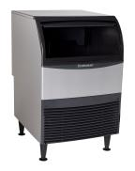
The Essential Series: The Best Choice
UF424 (Replaces AFE424)
Air and water cooled
50 and 60 Hz options
Optional KUFM24 floor mount kit
Capacity: 310 @ 90°/70°
440 @ 70°/50°
Storage: 80 lb.
Dimensions: 24” x 28.5” x 39”
Includes legs, scoop, and 5.5’ power cord
UN324
Air and water cooled
50 and 60 Hz options
Optional KUFM24 floor mount kit
Capacity: 266 @ 90°/70°
340 @ 70°/50°
Storage: 80 lb.
Dimensions: 24” x 28.5” x 39”
Includes legs, scoop and 5.5’ power cord
Notes:
24” Undercounter Flake/Nugget:
Replaces AFE424
More Reliable
Stainless Steel freezer design
Sealed bearings
Stainless steel evaporator
3 year warranty
More Attractive
Essential style cabinet with new graphics
24” wide cabinet
Easy to Service
External air filter
New electronic controls

