Slide 1
AN INTUITIVE SENSE OF CONTROL
WE GIVE YOU THE POWER TO DO MORE.

Slide 2
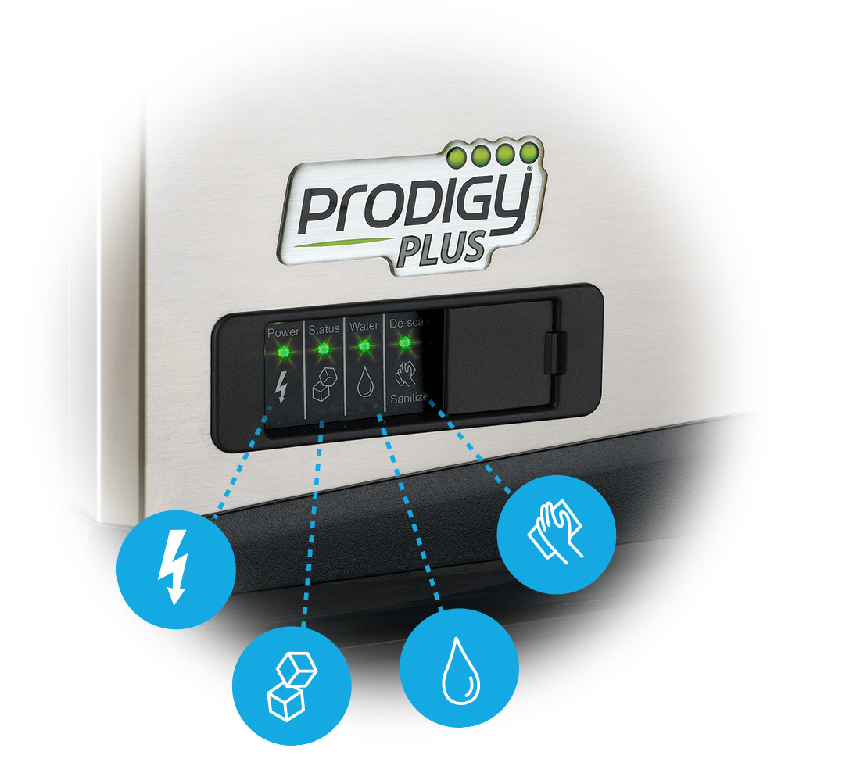
An Intuitive Sense of Control
SELF-MONITORING PRODIGY PLUS® SYSTEM
a powerful solution that gives operators total peace of mind that they will always get the ice they need — when they need it
WATERSENSE ADAPTIVE PURGE CONTROL
a smarter way to optimize water consumption and keep your machine running efficiently and reliably
INSTANT ACCESS AT YOUR FINGERTIPS
our QR code technology offers one-step access to service manuals, warranty history information and more

Slide 3
It’s Easy to Service
AutoAlert™
Innovative LED indicator lights keep operators informed of unit’s status
Signals staff when it’s time to descale, sanitize and more
Relocated to the lower left corner of the panel for better visibility
Each of the 4 lights labeled with an easy-to-identify icon
Instantly diagnose issues when warning lights appear

Slide 4
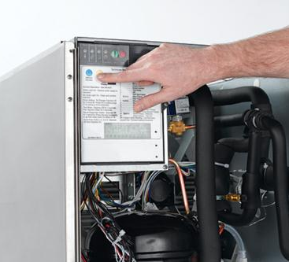
It’s Easy to Clean
One-Touch Cleaning
Scotsman makes ice head cleaning more efficient than ever with Prodigy Plus one-touch cleaning capability
Employees can start the cleaning process with a single push of a button
No additional selections or time-consuming oversight required; simply power machine back on after cleaning cycle is complete

Slide 5
An Intuitive Sense of Control
SELF-MONITORING PRODIGY PLUS® SYSTEM
a powerful solution that gives operators total peace of mind that they will always get the ice they need — when they need it
WATERSENSE ADAPTIVE PURGE CONTROL
a smarter way to optimize water consumption and keep your machine running efficiently and reliably
INSTANT ACCESS AT YOUR FINGERTIPS
our QR code technology offers one-step access to service manuals, warranty history information and more

Slide 6
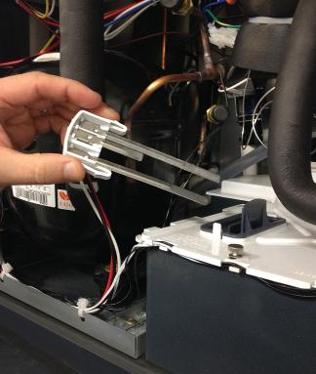
It’s Easy to Operate
Patented WaterSense Technology
Automatically adjusts based on water supply quality
Exclusive feature helps reduce scale buildup for more sanitary ice
Reliable sensor adjusts water purge at end of each cycle to flush excess minerals
Automatically flushes the system to extend time between cleanings
Operators can save water and energy where water conditions are better filtered by recirculating clean, pre-chilled water back into the ice-making process

Slide 7
An Intuitive Sense of Control
SELF-MONITORING PRODIGY PLUS® SYSTEM
a powerful solution that gives operators total peace of mind that they will always get the ice they need — when they need it
WATERSENSE ADAPTIVE PURGE CONTROL
a smarter way to optimize water consumption and keep your machine running efficiently and reliably
INSTANT ACCESS AT YOUR FINGERTIPS
our QR code technology offers one-step access to service manuals, warranty history information and more

Slide 8
It’s Easy to Service
Quick Response (QR) code
Every Prodigy Plus unit features a QR code that connects customers to vital unit specific information
Helps reduce downtime and frequency of service calls
Convenient front panel location eliminates need to remove unit’s front cover
Optional bezel cover available to prevent tampering or unauthorized access
QR code leads to a warranty registration page, auto-populated with the corresponding serial number
Parts lists, cleaning instructions, manuals and warranty history are all available

Slide 9
It’s Easy to Service
Quick Response (QR) code
Operators and service technicians can use their smart phone to scan the QR code to access instant warranty and technical information specific to that model
The product serial number will automatically populate the page
SCAN WITH YOUR SMART PHONE
Scanning Tip:
Some recent phone updates allow you to use your phone’s built-in camera app to scan QR Code

