Slide 1
A TEAM OF GLOBAL ICE EXPERTS
YOUR TRUSTED PARTNER IN ICE.

Slide 2
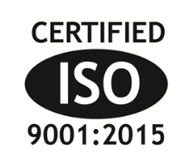
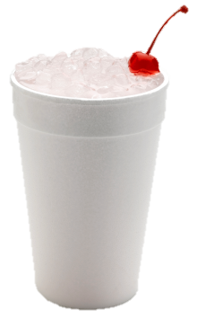
Scotsman’s History
1950: Scotsman brand first used
1952: Flake ice introduced
1981: The Original Chewable Ice – Nugget Ice was introduced by Scotsman
1982: Scotsman production starts at Fairfax, South Carolina facility
1999: Scotsman acquired by Enodis
2001: Scotsman ISO 9001:2000 certified (Now ISO 9001:2015)
2001: Enodis Ice Group formed
2009: Scotsman Industries acquired by Warburg Pincus
2012: Scotsman Industries acquired by Ali Group

Slide 3
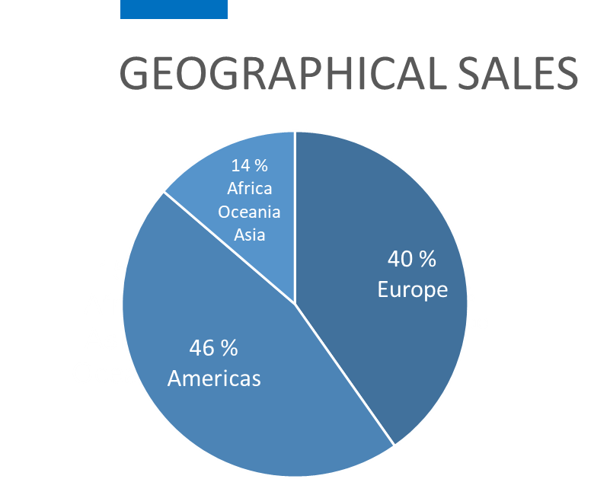
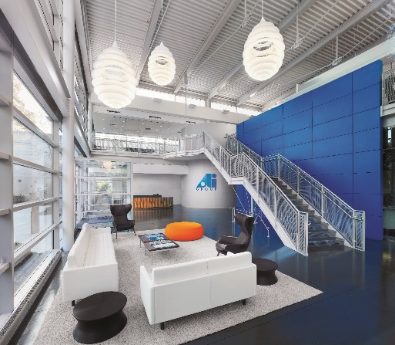
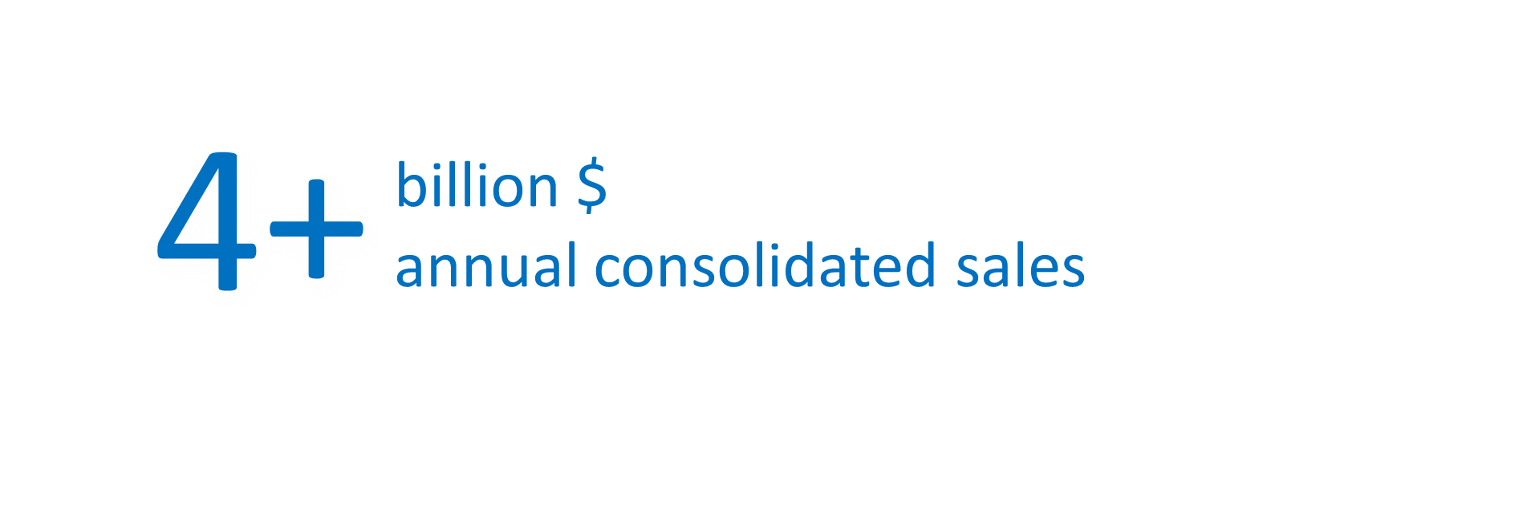
At a Glance
Founded in 1963
Headquarters in Milan, Italy and North American HQ based in Chicago, IL
Commercial Food Cooking, Preparation Equipment
Develops, manufactures, markets and services a broad line of equipment
More Than 100 Years of Traditions & Engineering Excellence
Decentralized Method of Operations
Companies all operate independently
Highly Specialized Product Lines
Each business is generally regarded as a leader in its market segment
Engineering & Development of State-of-the-Art Equipment
In-Depth Knowledge of Local Markets
Worldwide Brands | 114
Manufacturing Facilities | 75
Manufacturing Locations | 17 Countries
Sales & Service Offices | 75
Employees | 14,500+
Employee Locations | 34 Countries
Countries Ali Group Services & Distributes to | 100+

Slide 4
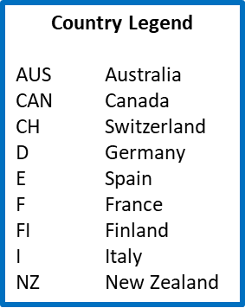
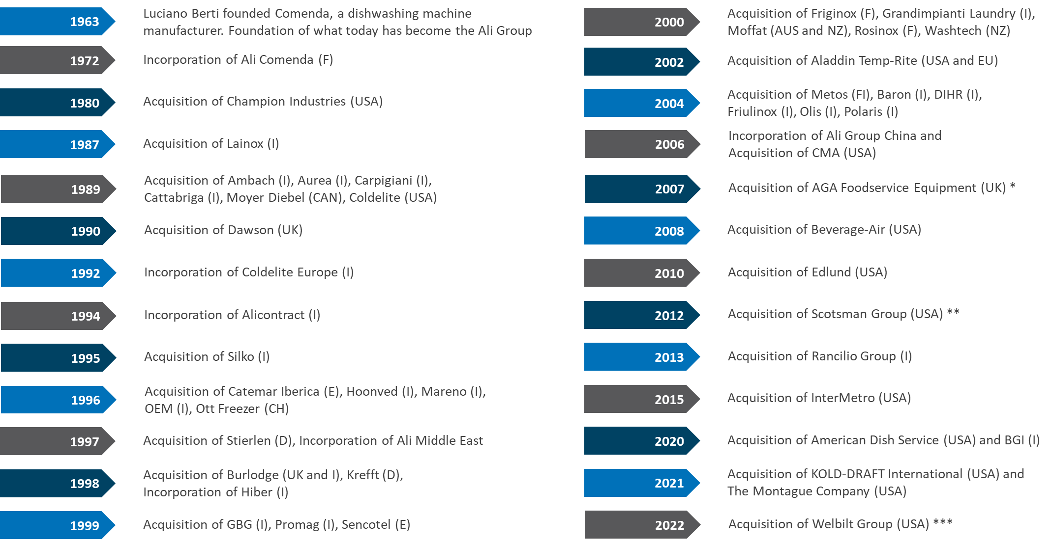
Our History
(*) Companies composing the AGA Foodservice Equipment Group: Adamatic, Amana, Belshaw, Victory (USA), Falcon, Miller’s, Mono, Serviceline, Williams (UK), Bertrand-Puma, Bongard, CFI, Pavailler (F), Eloma (D), Esmach (I)
(**) Companies composing the Scotsman Group: CastelMac, Ice-O-Matic and Scotsman Ice
(***) Companies composing the Welbilt Group: Cleveland, Coffee Queen, Convotherm, Crem, Crystal Tips, Dean, Delfield, Expobar, Fabristeel, Frymaster, Garland, Inducs, Koldtech, Kolpak, Lincoln, McCann’s, Merco, Merrychef, Multiplex, RDI, Servend, Spengler, SunFire, U.S. Range, Welbilt FitKitchen, Welbilt KitchenCare, Welbilt KitchenConnect

Slide 5
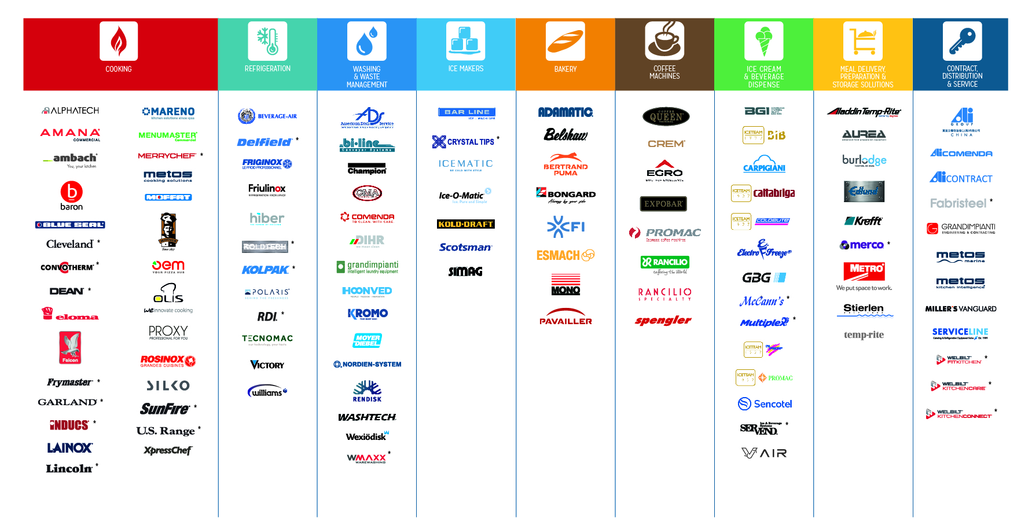
Our Brands - Worldwide
Notes:
114 brands worldwide

Slide 6
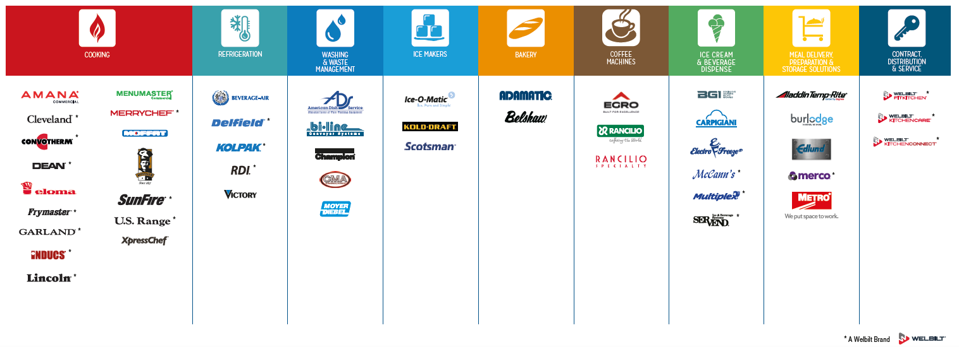
Our Brands – North America

Slide 7
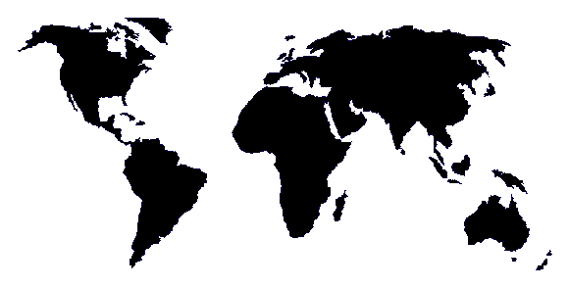
Global Coordination… Regional Infrastructure
THE SCOTSMAN GLOBAL PLATFORM
▲
▲
▲
Vernon Hills, IL
▲
▲
Spain
Italy
Fairfax, SC
India
▲
▲
▲
China
Dubai
Singapore
▲
▲
▲
South Africa
▲
sales office / distribution / service manufacturing / engineering / distribution
11 sales and/or distribution centers
Over 1,000 distributors globally
More than 10,000 trained service techs
Regional manufacturing:
Americas 1, EMEA 2 and Asia Pacific 1
Globally approved product made locally
*Lead Time, Freight, Currency and Duty Advantages from Regional Coverage

Slide 8
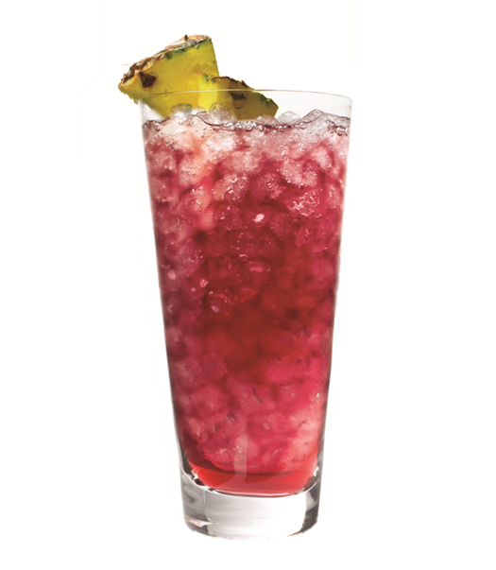
Scotsman Ice: The Best Choice
Your Trusted Partner in ICE
Operator Focused for a Worry-Free Experience
Singular focus on ICE
Distribution Network
Dedicated National and International Distributors
Local Stock, Local Expertise
Superior After Sales Service and Technical Support
Over 150 years of combined experience
Heavy Investment in R&D organization
Headquarters in Vernon Hills, IL
91,000 sq. ft. Administration, Training, R&D Facility
Manufacturing facility in Fairfax, SC
288,000 sq. ft. ISO 9001:2015 certified plant
Supports North American markets

