Slide 1
Big Opportunity. Small Unit. Essential Flake and Nugget.

Slide 2
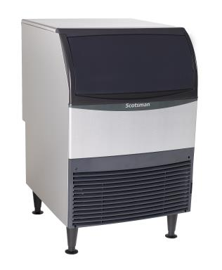
The New Essential Series – UF/UN Models
Nugget and flake ice. Now available in a smaller unit.
Get the nugget and flake ice your customers love anywhere you need it with Scotsman’s new Essential Nugget and Essential Flaker. With a proven freezer design and sealed bearings—you’ll have everything your facility requires in a more compact design.

Slide 3
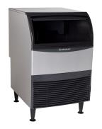
The Essential Series: the best choice
UF424
Air and water cooled
50 and 60 Hz options
Optional KUFM24 floor mount kit
Capacity: 307 @ 90/70
440 @ 70/50
Storage: 80 lbs.
Dimensions:
24” x 28.5” x 39”
Includes legs, scoop and 5.5’ power cord
UN324
Air and water cooled
50 and 60 Hz options
Optional KUFM24 floor mount kit
Capacity: 266 @ 90/70
340 @ 70/50
Storage: 80 lbs.
Dimensions:
24” x 28.5” x 39”
Includes legs, scoop and 5.5’ power cord

Slide 4
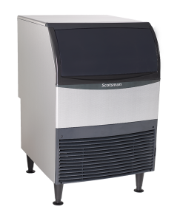
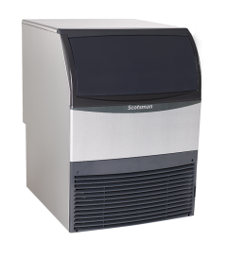
Compact Design
With legs
Without legs
The Essential Nugget and Flaker units feature a compact design that allows them to fit into many different applications.
39”
33.5”
With use of KUFM24 floor mount kit
24”
24”
Essential’s backside features a unique utility chase that provides clearance along the wall for tight installs.

Slide 5
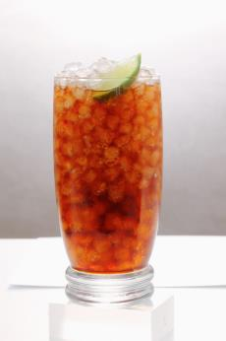
Customer Favorite—Nugget Ice
The Essential UN324 provides customer favorite nugget ice in an undercounter unit.
Scotsman’s proprietary
H2 nugget ice is soft, easy to chew and slow-melting, and it absorbs the flavor of beverages.
NUGGET ICE

Slide 6
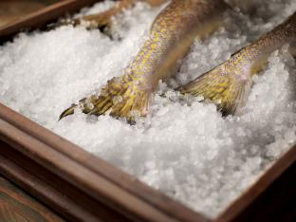
Fast Cooling—Flake Ice
The Essential UF424 delivers fast-cooling flake ice in a reliable undercounter unit.
Flake ice is a smart choice for applications ranging from blended cocktails and salad bars to produce, seafood and meat displays. Flake ice is also popular for therapeutic use in healthcare facilities.
FLAKE ICE

Slide 7
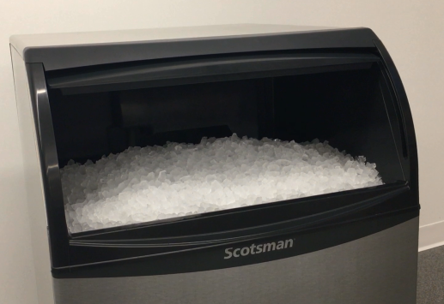
Ice Capacity You Can Count On
Essential machines provide the amount of ice you need in a small unit.
Nugget (UN324)
Produces up to 340 lbs. (154 kg) per day and stores 80 lbs. (36 kg)
Flaker (UF424)
Produces up to 440 lbs. (200 kg) per day and stores 80 lbs. (36 kg)

Slide 8
Superior Reliability

Slide 9
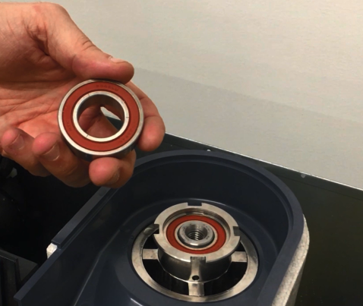
Increased Reliability with Greaseless Bearings
Essential Flaker and Nugget units feature proprietary greaseless bearings, which are fully sealed with a high-tech polymer that lubricates the system and eliminates the need for greasing.
Essential ice machines have no wearable parts and no grease, decreasing potential service and maintenance issues.

Slide 10
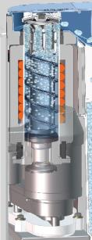
Heavy-duty Stainless Steel Components
Scotsman Nugget and Flake undercounter units feature an extremely reliable stainless-steel evaporator and durable stainless-steel auger.

Slide 11
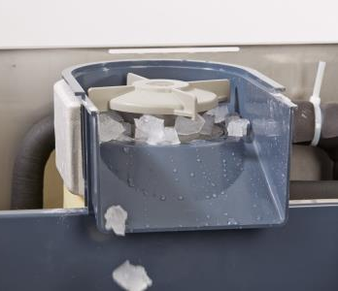
Energy Efficiency
Essential’s high efficiency refrigeration system exceeds 2018 DOE requirements.
The system also meets new US federal energy efficiency requirements and US Safe Drinking Act low lead requirements.

Slide 12
Competitive Comparison
FLAKE
Manufacturer | Model # | 90°/70° Prod | 70°/50° Prod | Bin Storage Capacity | Size (W x D x H) | kWh
Scotsman | UF424A-1A | 307 | 440 | 80 | 24x28.5x39 | 4.61
Manitowoc | RF-0385A | 273 | 332 | 90 | 29x27x42 | 6.32
Hoshizaki | F-330BAJ | 243 | 330 | 80 | 24x26x39 | 5.91
Follett | UFC425A80 | 325* | 425 | 75 | 23.5x26x33 | 5.40*
NUGGET
Manufacturer | Model # | 90°/70° Prod | 70°/50° Prod | Bin Storage Capacity | Size (W x D x H) | kWh
Scotsman | UN324A-1A | 266 | 340 | 80 | 24x28.5x39 | 5.47
Manitowoc | RNS-0385 | 248 | 302 | 90 | 29x27x40 | 6.89
Hoshizaki | F-330BAJ-C | 214 | 320 | 80 | 24x26x39 | 7.30
Follett | UMC425A80 | 325* | 425 | 75 | 23.5x26x33 | 5.40*
* Information from Follett website. Not AHRI certified.

Slide 13
Manufactured in the U.S.A.
All Scotsman machines are manufactured and tested at our award-winning facility in South Carolina to ensure you get a reliable machine that works exactly like it should.

Slide 14
3-Year Parts and Labor Warranty
With the Essential series, Scotsman provides a 3-year parts and labor warranty on all components.
3-year parts and labor warranty on all components
5-year parts warranty on the compressor
Warranty valid in North, South & Central America for commercial installations
Residential applications :
1 year parts and labor

Slide 15
Easy to Use and Maintain

Slide 16
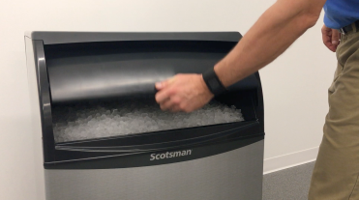
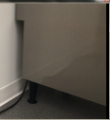
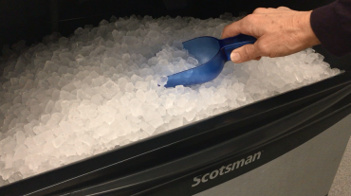
Convenient Slide-Up Door
Essential machines feature a slide-up door that provides convenient and easy access to the ice bin.

Slide 17
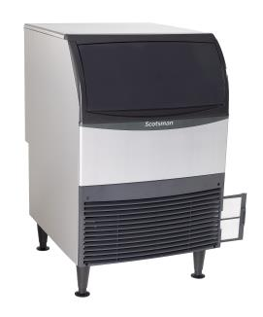
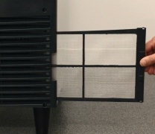
External Filter
The external filter makes cleaning easy for increased efficiency.
Filter location makes accessing, rinsing and reusing fast and easy
Better visibility keeps regular cleaning top of mind, ensuring maximum performance and optimal sanitation
No tools required for removal, unlike the competition

Slide 18
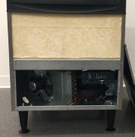
Front Access to Key Components
The easily-removable front panel allows for quick access to critical components.

Slide 19
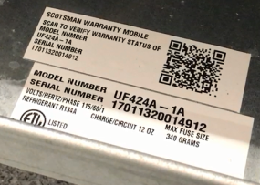
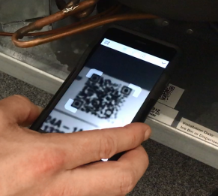
Industry Exclusive QR Code
Each Essential machine features a unique QR code that provides instant access to important information.
Parts manuals
Service manuals
Warranty details
This information is accessible from smart phones and tablets.

Slide 20
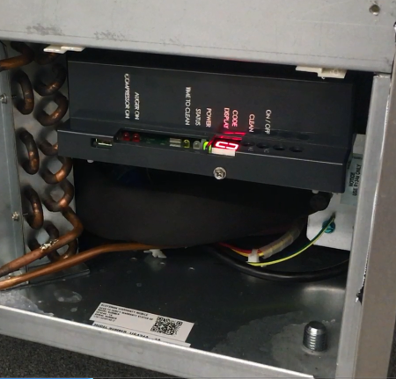
State-of-the-Art Electronic Control Panel
Intuitive Diagnostics
Internal LED indicator lights alert staff when descaling and sanitizing are needed
Warning lights feature a seven-segment display that shows critical diagnostics for easy reference
Test mode activates key components to check for potential issues

Slide 21
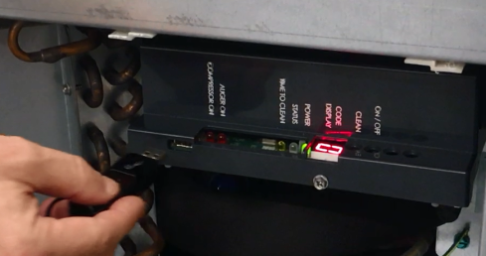
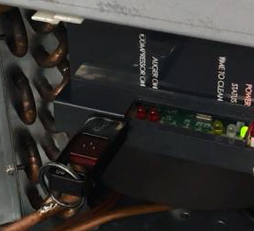
Easy Software Updates
The Essential Nugget and Flaker machines feature a USB port that allows for easy software updates.

Slide 22
Why Scotsman?

Slide 23
Our Passion for Ice
A history of helping operators improve their bottom line.
Since 1950, we have been developing innovative ice machines that feature cutting-edge technology and produce several types of ice. We ensure that you’ll never have to worry about having the perfect ice exactly when you need it. Through award-winning manufacturing, a variety of ice forms and dependable product functionality, Scotsman offers everything you need to improve your bottom line and keep customers happy.

Slide 24
Why Scotsman?
99% U.S. manufactured
Part of Ali Group North America, the largest and fastest-growing group of foodservice companies in the world
ISO9001:2008 certified

Slide 25
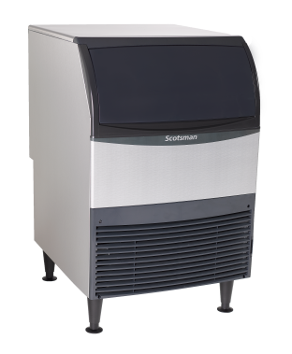
Big Opportunity. Small Unit.
Nugget and flake ice. Now available in a smaller unit.
scotsman-ice.com

