Slide 1


INTRODUCING: HID207
COMPACT ICE & WATER DISPENSER
VERSATILE, EMPHASIZING HEALTH & WELLNESS WITH SIMPLE OPERATION & SUPERIOR RELIABILITY.

Slide 2

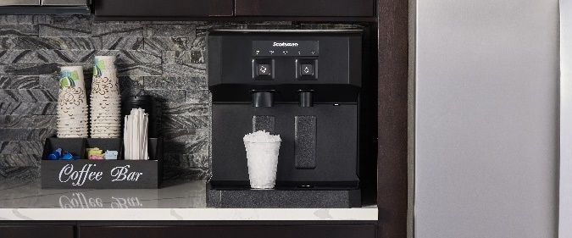
HID207: Launch Kit
Our Most Complete Content Package, Again.
Now available for download:
Resource Center -> Product Information
Contains:
Product Photography
  Includes environmental photography, product feature shots, 360° imagery, ice form images, and more
Literature & Sales Presentations
All Specification Data, Compatible Accessories
A+ Enhanced Content
  Visual based sales graphics that are ideal for ecommerce
Video
Excel Product Data Spreadsheet
  Helps to link which files correspond to each model
  Includes product copy, UPC/GTINs
2 NEW MODELS
SHIPPING SPRING 2024:
Series expansion, adding versatility for compact countertop applications
Smallest unit, most economic price point in HID lineup
Touch-free & push-button dispensing options available

Slide 3
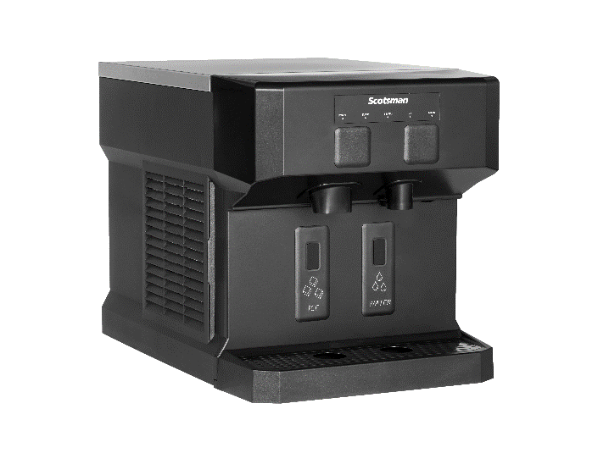


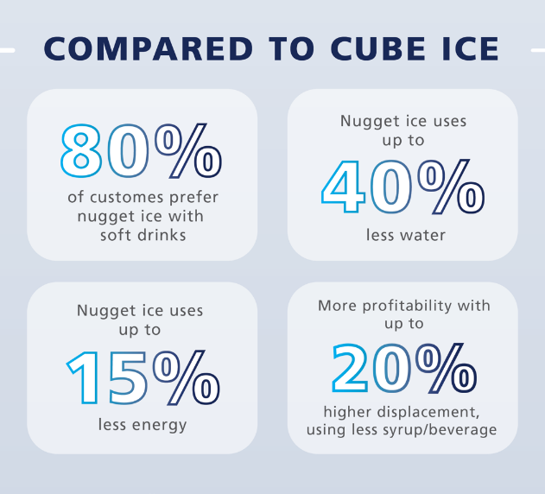


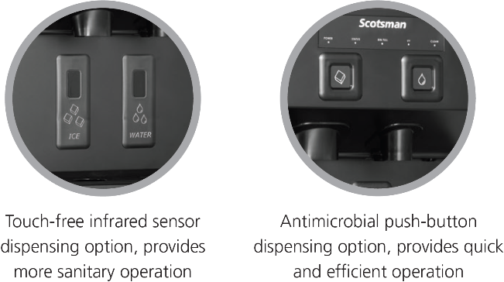

HID207: Overview
Operational Excellence
Dispenses Original, Chewable Nugget Ice
  Smallest, softest, most chewable nugget ice
  Up to 20% softer than competition for optimal mouthfeel
Environmental Responsibility
  Quiet operation for increased comfort in workplace or hospitality environments
    Due to improved condenser fan and elimination of noisy harvest cycles
  Uses R-290 refrigerant with zero ozone depletion potential, low GWP
HID207
Air-Cooled Only
60 Hz Only
*Ice only configuration available with included snap-on panels
Capacity: 160 @ 90°/70°
196 @ 70°/50°
Storage: 7 lb.
Dimensions: 16” x 23.4” x 17.5”
Optional 4” leg kit available
HID207AX-1
HID207ABX-1
Includes 6’ power cord with NEMA 5-15P plug

Slide 4
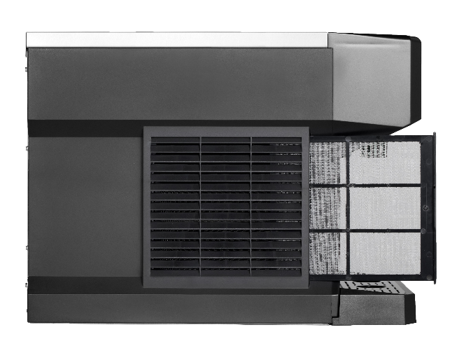
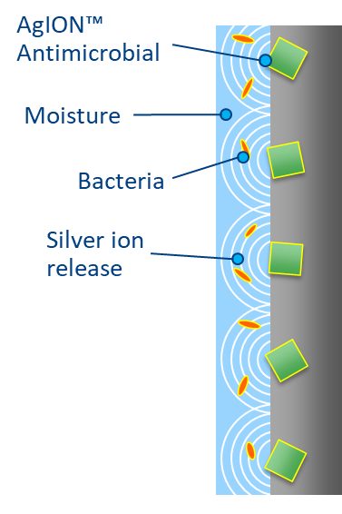
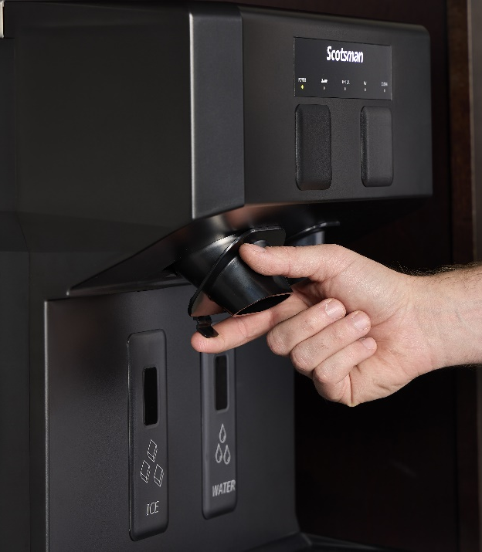
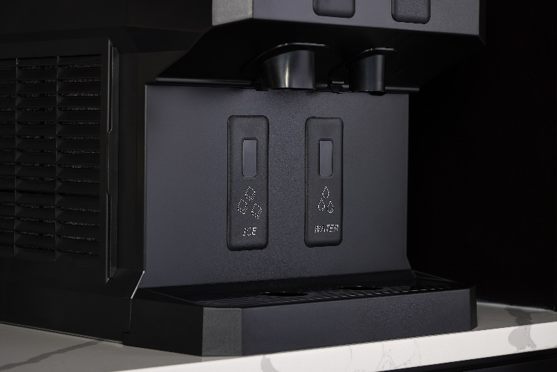

HID207: Health & Wellness
Health & Wellness
UV-LED Sanitation
  Internal UV module actively treats intake to ensure clean, refreshing ice and water
Sanitary Design
  AgION® antimicrobial technology is molded into key components to help inhibit the growth of microbes, bacteria, mold, and algae
  Sealed refrigeration system minimizes outside airborne contamination
Easily Removeable Components
  Fully removable air filter, chutes, sink, grill, and bin allow for easy cleaning and maintenance
Purpose-Built Spout Design
  Angled front housing provides visibility and easy access for cleaning of spouts and splash panel

Slide 5
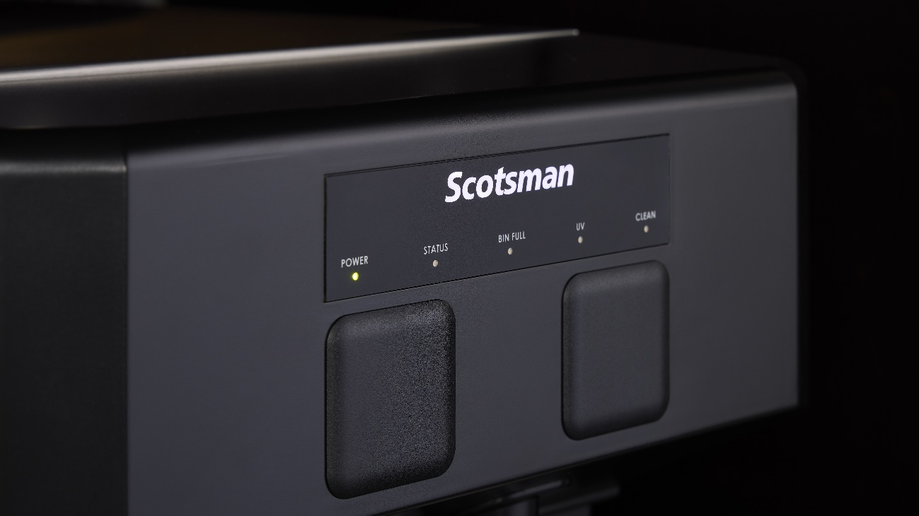

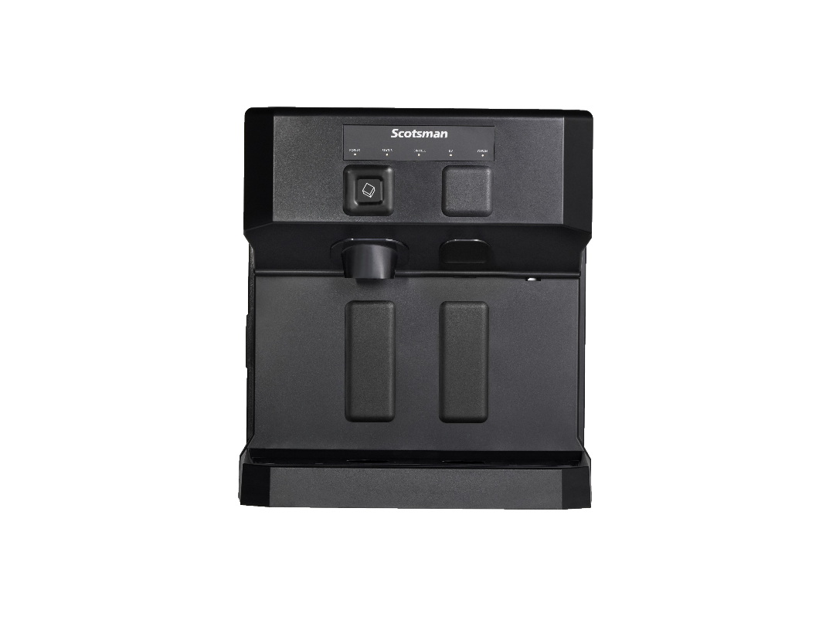
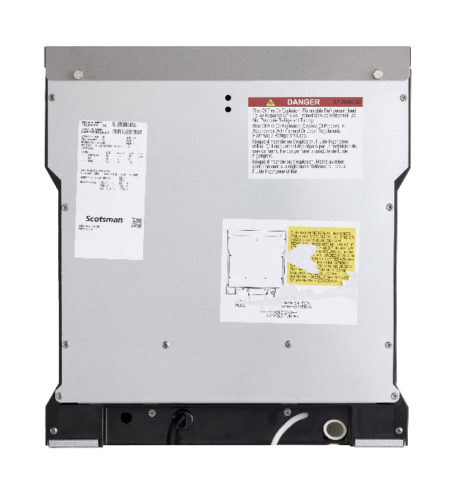

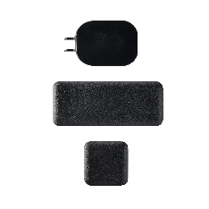
HID207: Ease of Use
Ease of Use
AutoAlert™ Indicator Panel
  Intuitively displays relevant machine status that is visible across the room
SmoothStream™ Water Dispensing Technology
  Combined with illuminated dispensing to reduce splashing while keeping the machine and surrounding areas clean
Compact Design
  Features unique contoured sides for enhanced breathability and tight installs
  Recessed utility chase for tight installs
ADA Compliant Dispensing Area
  Touch-free and push-button models meet ADA reach range requirements
Flexible Configuration
  Ice only configuration available with included snap-on panels

Slide 6
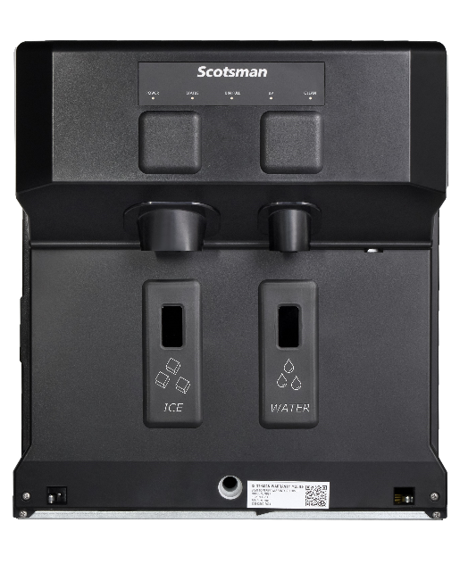
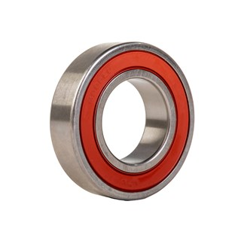
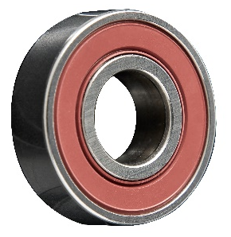
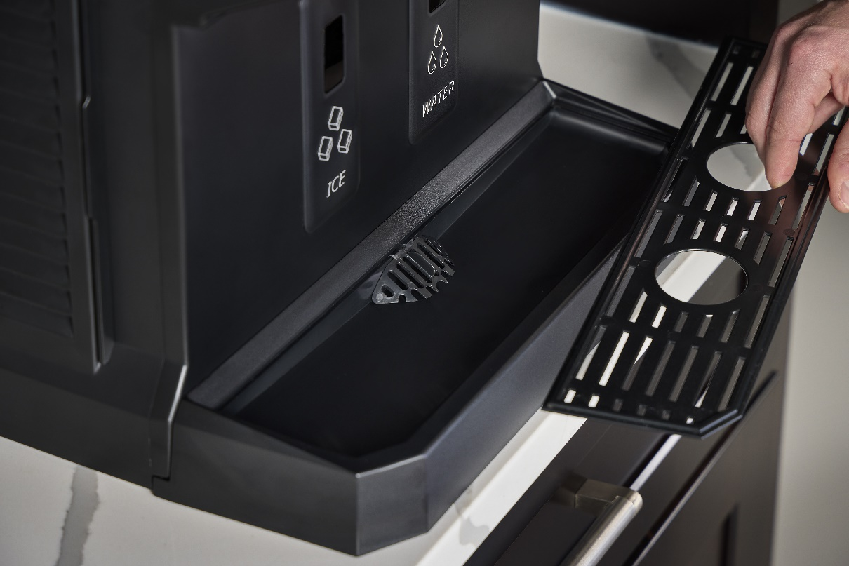

HID207: Enhanced Reliability
Enhanced Reliability
Sealed, Maintenance-Free Bearings
  Reduces preventative maintenance and extends unit longevity
Maximum Uptime
  Integrated drain cover and consolidated drain ensures reliable operation
  Unit-specific QR code for easy access to service manuals, cleaning instructions, warranty history, and other machine information
Heavy-Duty Internal Components
  Durable stainless-steel evaporator and auger
Category Best Warranty
  3-year parts and labor on all components
  5-year parts on compressor and condenser
  Designed, Engineered, Assembled in USA
    100% of machines are run tested before shipment

Slide 7
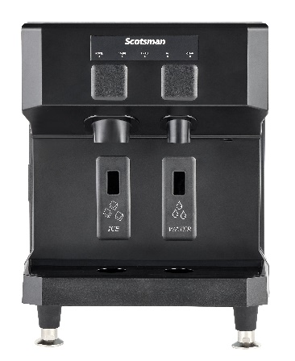
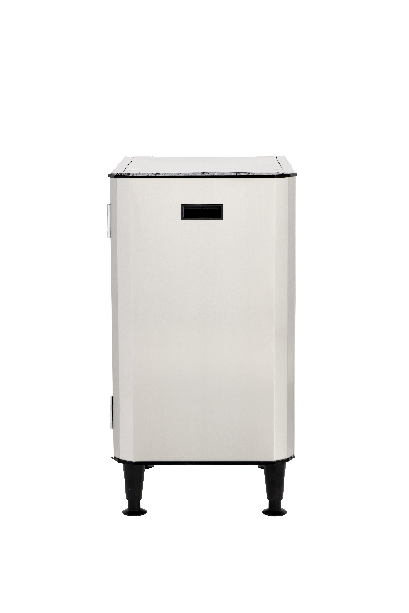
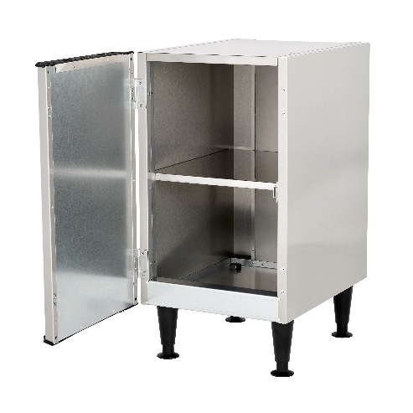
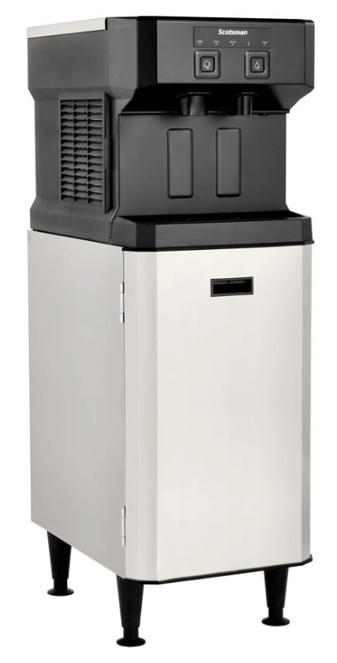
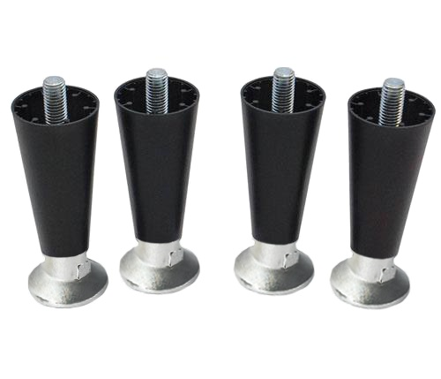
HID207: Accessories
KLP24A Adjustable Legs
Optional 4” adjustable legs for easy cleaning beneath unit
HSTCD16-A Machine Stand
Optional machine stand allows for freestanding configuration
“CD”: Compact Dispenser
Reversible Door + Storage Shelf
Includes 6” adjustable legs
Service Kits:
Touch-Free to Push-Button Conversion
Push-Button to Touch-Free Conversion

Slide 8
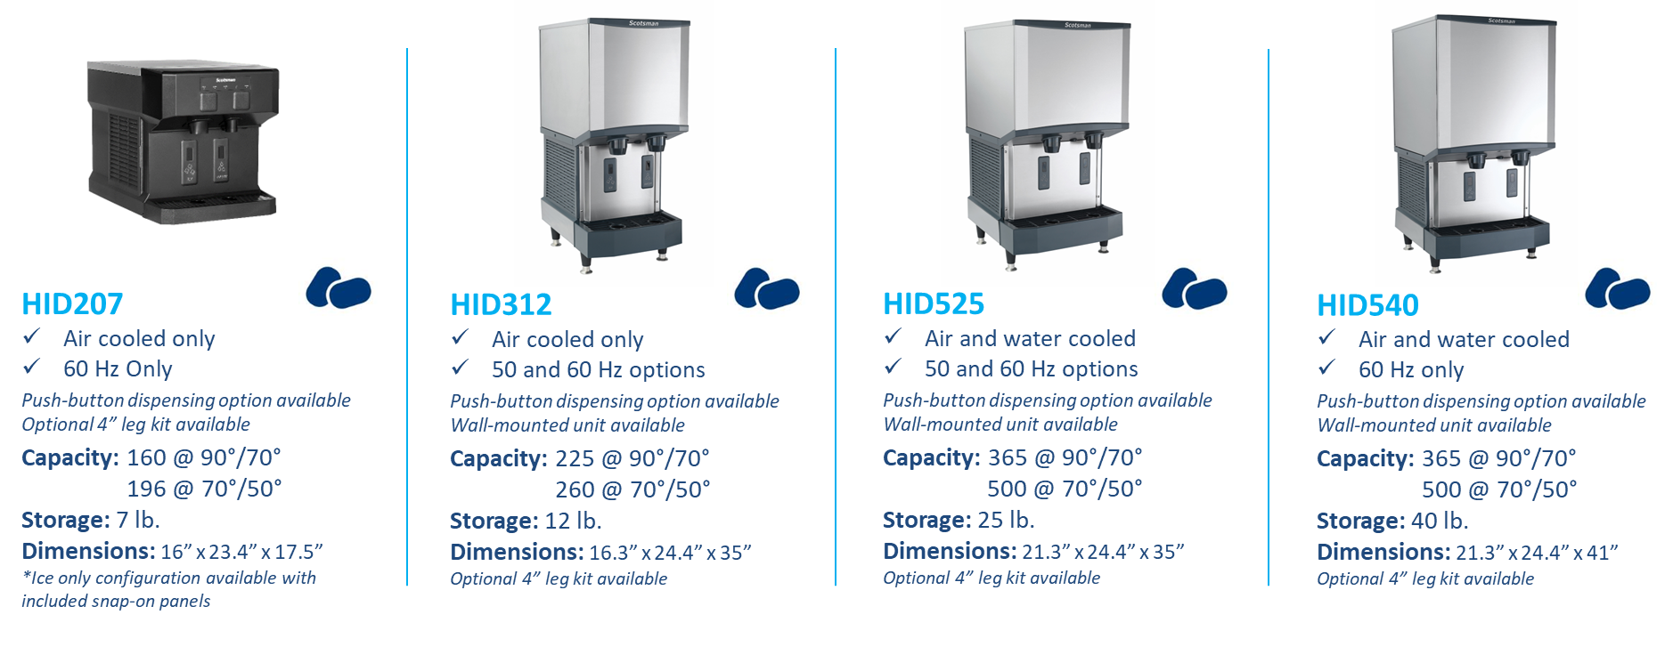
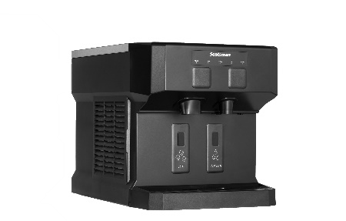




Ice & Water Dispensers: Overview
All models include power cord with NEMA 5-15P plug

Slide 9
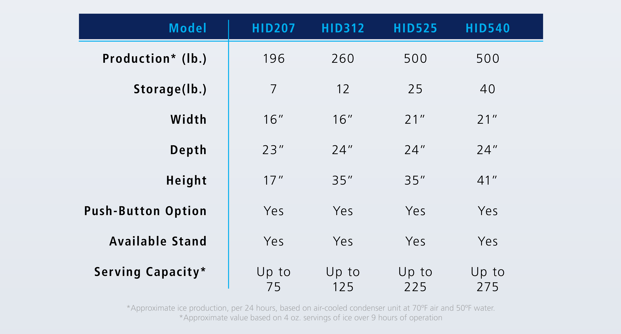
Ice & Water Dispensers: Overview
COMPACT
TRADITIONAL

Slide 10



