Slide 1
Ali at a Glance
Ali S.p.A. is an Italian corporation with its headquarters in Milan, Italy and North American operations based in Chicago, Illinois
Founded in 1963 by Luciano Berti, current Chairman
Filippo Berti, current Chief Executive Officer
One of the world’s largest designers, manufacturers, marketers and servicers of a broad line of commercial and institutional foodservice equipment
Comprised of 76 successful brands employing 10,000+ people in 30 countries
Distribution in 100+ countries
Operates 57 production plants in 14 countries
Broad range of customers, including major restaurants and hotel chains, independent restaurants, hospitals, bakeries, ice cream parlors, coffee shops, schools, airports, correctional institutions, canteens, etc.
The Company operates through many decentralized, independent operating companies
High degree of specialization in specific product lines
Each business is generally regarded as a leader in its segment of the market
Emphasis on engineering and the development of state-of-the-art equipment

Slide 2
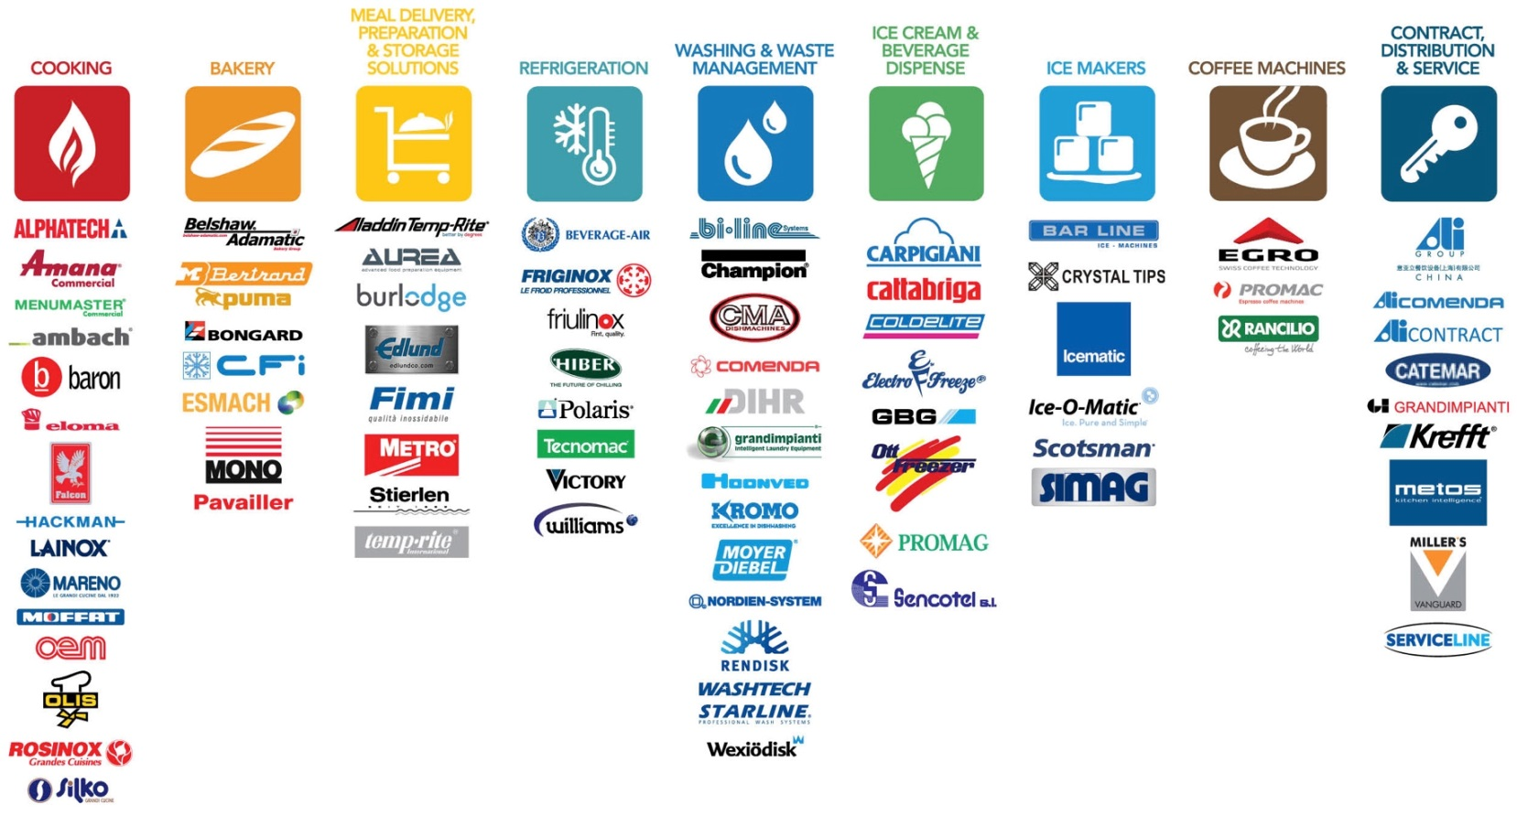
Our brands – worldwide

Slide 3
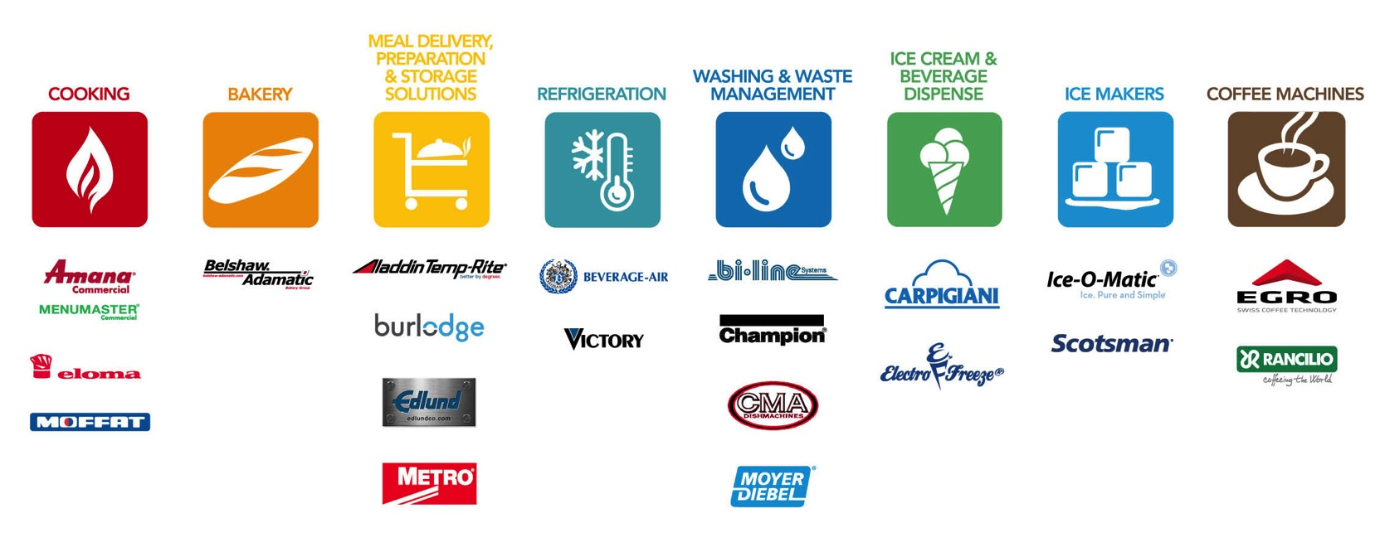
Our brands – north america

