Slide 1
INTRODUCING PRODIGY PLUS

Slide 2
Introducing Prodigy Plus
In 2006, Scotsman introduced Prodigy, a revolutionary collection of features backed by innovative technology.

Slide 3
Introducing Prodigy Plus
In 2006, Scotsman introduced Prodigy, a revolutionary collection of features backed by innovative technology.
With original Prodigy technology, operators had the power to prevent unnecessary downtime, decrease labor, water and energy costs, and serve sanitary ice.

Slide 4
Introducing Prodigy Plus
In 2006, Scotsman introduced Prodigy, a revolutionary collection of features backed by innovative technology.
With original Prodigy technology, operators had the power to prevent unnecessary downtime, decrease labor, water and energy costs, and serve sanitary ice.
Now, after nearly a decade of real-world experience, thousands of models sold and invaluable feedback from our customers, Scotsman is proud to announce the next generation in ice-making technology.

Slide 5
Introducing Prodigy Plus
In 2006, Scotsman introduced Prodigy, a revolutionary collection of features backed by innovative technology.
With original Prodigy technology, operators had the power to prevent unnecessary downtime, decrease labor, water and energy costs, and serve sanitary ice.
Now, after nearly a decade of real-world experience, thousands of models sold and invaluable feedback from our customers, Scotsman is proud to announce the next generation in ice-making technology.
Introducing Prodigy Plus, a whole new approach to ice-making that puts customers first…

Slide 6
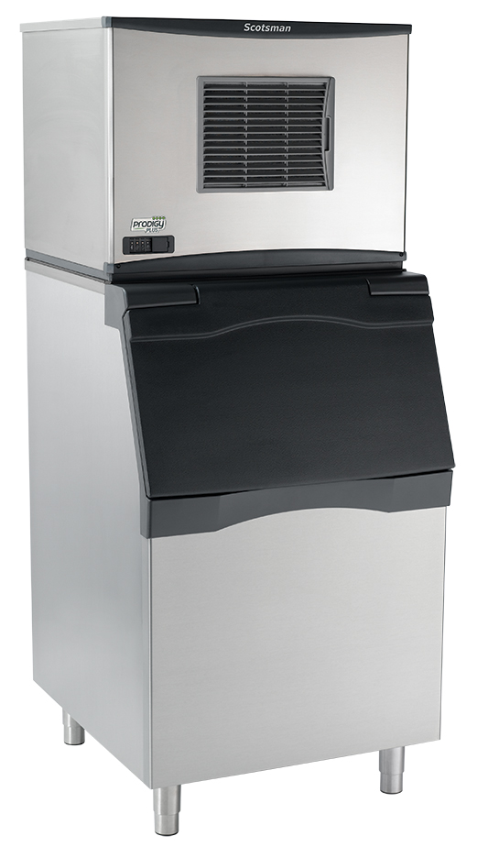
Introducing Prodigy Plus
Born out of extensive market research, Prodigy Plus makes it easy to access key information, maintain your equipment and realize significant cost savings over time.

Slide 7
The Prodigy Plus difference
+ One-touch cleaning reduces labor costs and saves time
+ Self-aligning front panel for easy access to key components
Patented Harvest Assist efficiently moves cube ice to the bin
+ Front-located air filter for more efficient operation
Smart-Board™ advanced feature module available for additional diagnostic capabilities
+ AutoAlert™ indicator lights for better visibility
+ Industry-exclusive QR code instantly connects users to service information
Optional Vari-Smart™ ice level control allows operators to customize ice levels
Antimicrobial protection guards internal surfaces between cleanings
Patented WaterSense purge control automatically reduces scale buildup
A full range of water- and energy-saving features
+ Operational footprint among the industry’s smallest

Slide 8
PRODIGY PLUS: EASY TO SERVICE

Slide 9
It’s easy to service
Regular maintenance is part of owning any piece of equipment
Prolonged downtime is not an option
Ease of maintenance is critical to ensuring a reliable platform

Slide 10
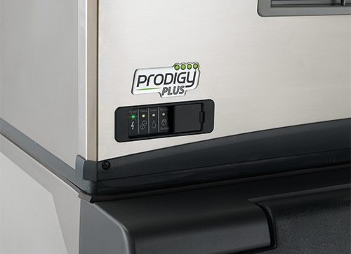
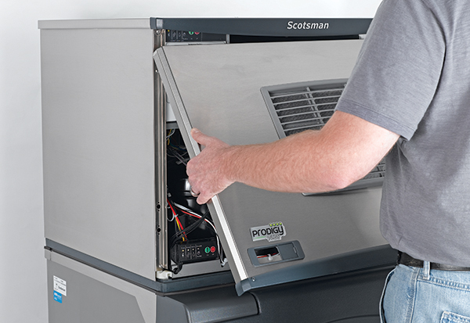
It’s easy to service
Self-aligning front panel
Easy maintenance with Prodigy Plus begins with the redesigned front panel
More durable and robust, it features captured screws located within reach along the bottom of the panel
Panel provides fast access to key components, including the diagnostics control board

Slide 11
It’s easy to service
AutoAlert™
Innovative LED indicator lights keep operators informed of unit’s status
Signals staff when it’s time to descale, sanitize and more
Relocated to the lower left corner of the panel for better visibility
Each of the 4 lights labeled with an easy-to-identify icon
Instantly diagnose issues when warning lights appear.

Slide 12
It’s easy to service
Quick Response (QR) code
Every Prodigy Plus unit features a QR code that connects customers to vital information about their specific unit
Helps reduce downtime and frequency of service calls
Convenient front panel location eliminates need to remove unit’s front cover
Optional bezel cover available to prevent tampering or unauthorized access
QR code leads to a warranty registration page, auto-populated with the corresponding serial number
Parts lists, cleaning instructions, manuals and warranty history are all available

Slide 13
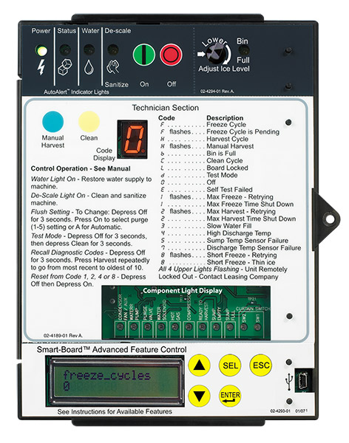
It’s easy to service
Smart-Board™ advanced feature module
Optional advanced feature provides NAFEM data protocol on screen for early alert and fast diagnosis of operating issues
Allows for programming bin levels, checking cleaning history and runtime, and more
Technicians can download data directly through the USB port, or use the serial number to check performance via a dedicated website
Scotsman can retrofit existing field units with this exclusive technology

Slide 14
PRODIGY PLUS: EASY TO CLEAN

Slide 15
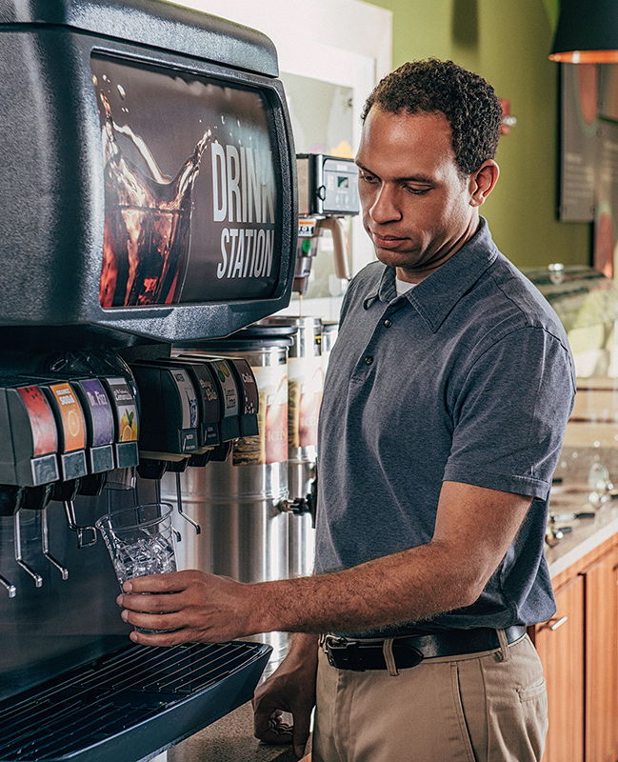
It’s easy to clean
Ice machines play a critical role in the health and safety of every kitchen
Regular cleaning is a crucial part of upkeep no matter how new or advanced the unit
Fast yet effective cleaning is essential to ensure safe conditions and a reliable unit

Slide 16
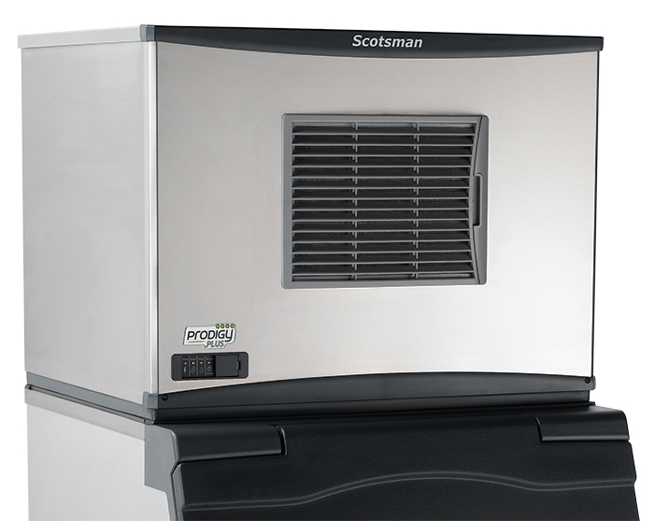
It’s easy to clean
Front-located air filter
Air filter has been relocated to the front on all 22” and 30” air-cooled Prodigy Plus cubers, making access quick and easy for all Prodigy Plus units
Ensures proper clearance and breathability for maximum energy efficiency
Easily rinsed and reused, and also dishwasher safe
Better visibility keeps regular cleaning top-of-mind for employees

Slide 17
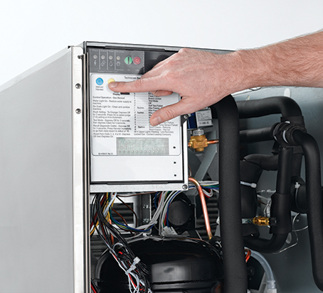
It’s easy to clean
One-touch cleaning
Scotsman makes ice head cleaning more efficient than ever with Prodigy Plus one-touch cleaning capability on cubers
Employees can start the cleaning process with a single push of a button
No additional selections or time-consuming oversight required; simply power machine back on after cleaning cycle is complete

Slide 18
It’s easy to clean
Built-in antimicrobial protection
Prodigy Plus units are designed to ensure customer safety at all times, even between cleanings
Scotsman products feature AquaArmor with AgION™, a silver-based antimicrobial compound molded directly into key components
Helps inhibit the growth of undesirable microbes, bacteria, mold and algae
AgION Antimicrobial
Moisture
Bacteria
Silver ion release

Slide 19
PRODIGY PLUS: EASY TO OPERATE

Slide 20
It’s easy to operate
Today’s foodservice operators have enough to keep up with — the ice machine shouldn’t be a distraction or a burden
Operators need easy-to-use equipment that helps them get the most out of their purchase
Scotsman builds every Prodigy Plus unit to be easy to service, easy to clean and easy to operate

Slide 21
It’s easy to operate
Patented Harvest Assist
Once ice cubes form within the evaporator plate, a patented process using a minimal amount of hot gas and an exclusive probe ensures that ice is easily and efficiently delivered to the bin.
Uses minimal energy

Slide 22
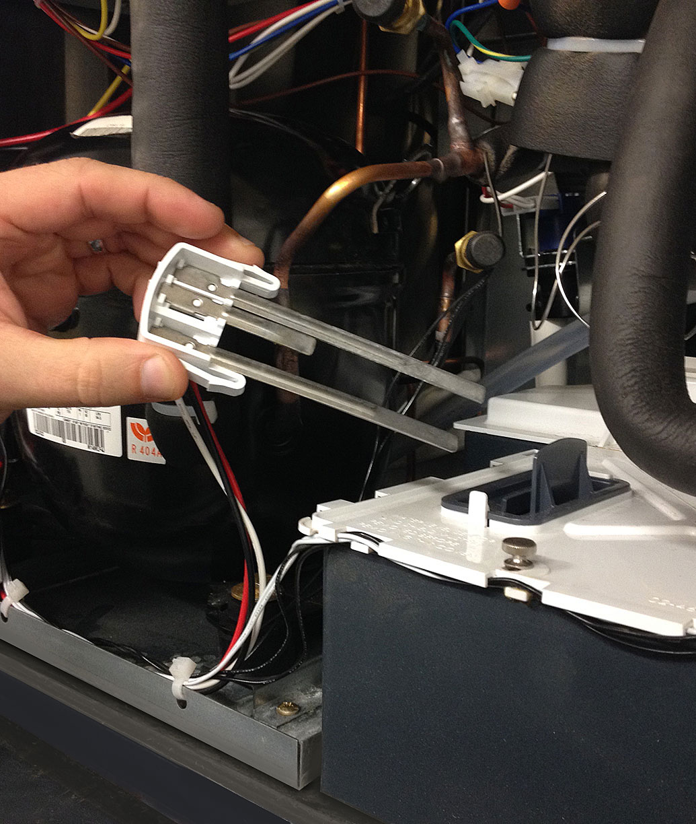
It’s easy to operate
Patented WaterSense Technology
Automatically adjusts based on water supply quality
Exclusive feature helps reduce scale buildup for more sanitary ice
Reliable sensor adjusts water purge at end of each cycle to flush excess minerals
Automatically flushes the system to extend time between cleanings
Operators can save water and energy where water conditions are better filtered by recirculating clean, pre-chilled water back into the ice-making process

Slide 23
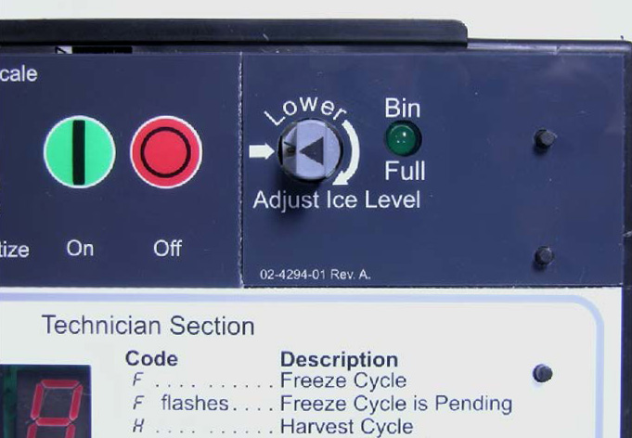
It’s easy to operate
Vari-Smart™ ice level control
Optional ultrasonic ice level control sensor allows operators to manually adjust ice levels
Keeps just the right amount of freshly made ice in the bin
Helps save water and energy
Connects to existing controller
Ideal for seasonal changes in ice needs or if you’re planning to sanitize the bin. Also provides faster ice turnover or for operating your machine in lower-cost energy periods.

Slide 24
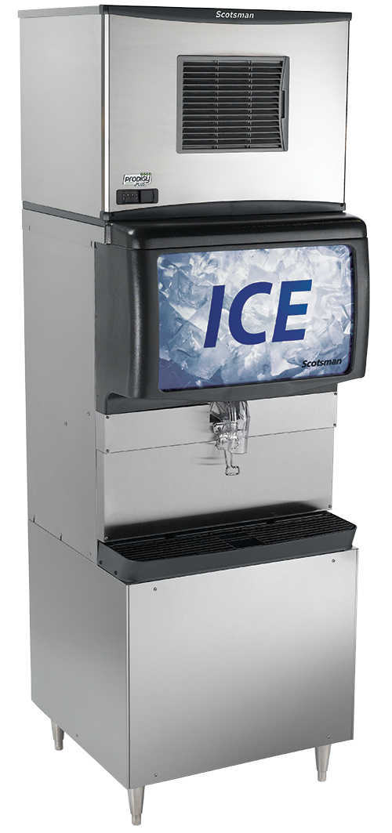
It’s easy to operate
Smaller operational footprint
Thanks to the newly relocated air filter on cubers, all Prodigy Plus 22” and 30” units now require minimal side clearance
Allows machine to be placed directly beside walls and other equipment, maximizing valuable kitchen space
Many Prodigy Plus models feature the smallest operational footprints in the industry

Slide 25
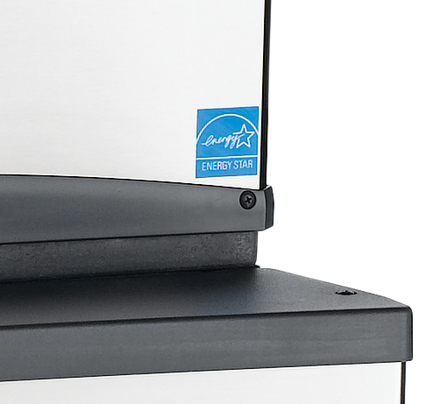
It’s easy to operate
ENERGY STAR-qualified models
Scotsman has always been committed to efficiency, specifically water and energy savings
Many Prodigy Plus units are ENERGY STAR-qualified
2013 & 2012 ENERGY STAR Partner of the Year, 2011 ENERGY STAR Excellence in Energy-Efficient Product Design Award

Slide 26
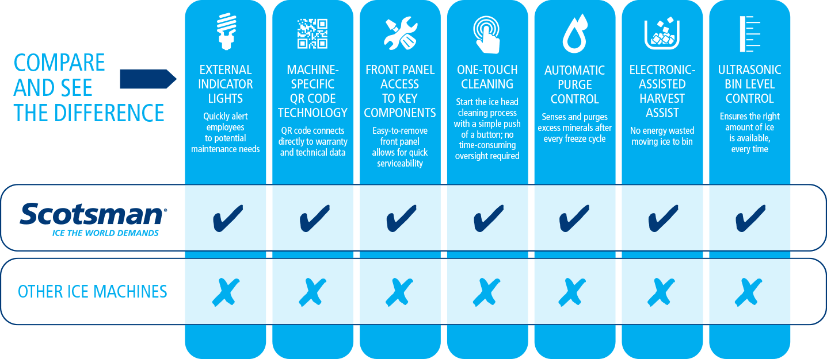
It’s the complete package

Slide 27
It’s all about customer satisfaction
Prodigy Plus cube, flake and nugget ice machines are designed with one goal in mind: Total customer satisfaction
EASY TO CLEAN
EASY TO OPERATE
EASY TO SERVICE
MORE SANITARY ICE
LESS
LABOR
LOWER MAINTENANCE COSTS
ENHANCED
UTILIZATION OF POWERFUL KEY FEATURES
REDUCED
DOWNTIME
GREATER RELIABILITY
LESS WATER & ENERGY
FEWER SERVICE CALLS
The result?
Lower total cost of ownership.

Slide 28
Why Scotsman?
Scotsman Ice is the only manufacturer that delivers Prodigy Plus performance, standard on every unit.
99% U.S. manufactured
Part of Ali Group North America, the largest and fastest-growing group of foodservice companies in the world
ISO9001:2008 certified

Slide 29
Why Scotsman?
We’re proud to already serve a growing roster of national and global QSR, convenience store, hospitality and restaurant chains.

Slide 30
Prodigy Plus: the best choice
Discover Prodigy Plus technology
today — available on all modular cube, flake and nugget ice machines.
Only from

