Slide 1
INTRODUCING: Prodigy ELITE® MODULAR CUBE
ELITE RELIABILITY WITH A SIMPLIFIED EXPERIENCE FOR MAXIMUM UPTIME

Slide 2
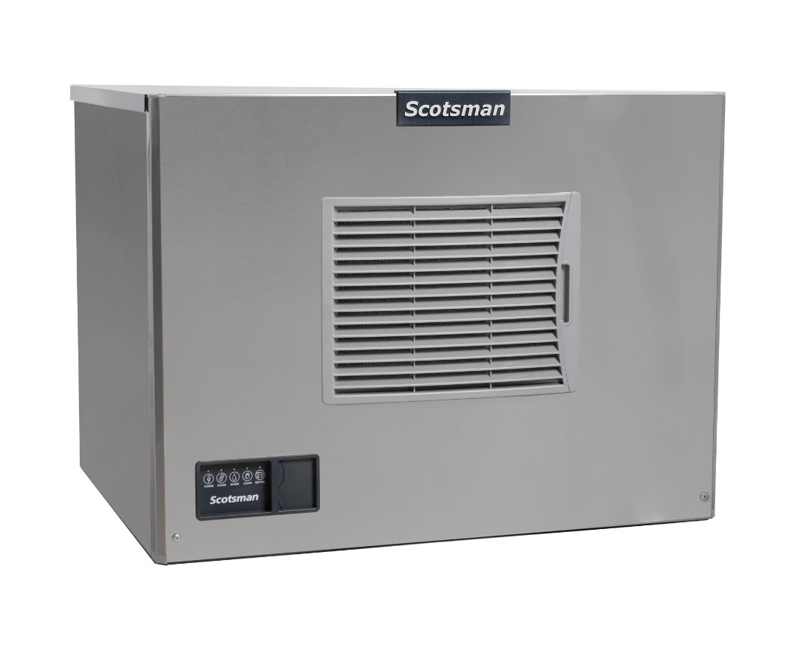
Prodigy ELITE® Modular Cube
More Reliable Than Ever: MC models now available
Prodigy ELITE® Modular Cube Ice Machines build upon the reliability of the Prodigy Plus® family, with the introduction of preservation mode, redesigned sensors, and an innovative mobile app. The ICELINQ® mobile app offers a simplified experience to ensure intuitive operation, cleaning, and maintenance for maximum uptime and reliability.

Slide 3
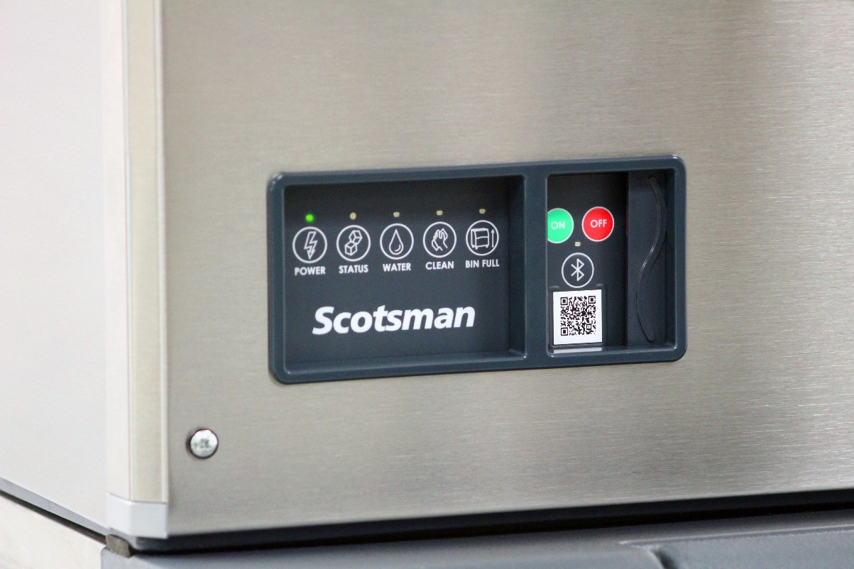
Prodigy ELITE® - What’s New
AutoAlert™ Indicator Panel
Enhanced display with BIN FULL light
Illuminates green when bin is full
Includes addition of Bluetooth® button and LED indicator for pairing with Scotsman’s ICELINQ® mobile app
Updated graphics for better visibility
New sliding door covers ON/OFF/Bluetooth® buttons
Each unit also includes a “door filler” to prevent tampering (if applicable)
Instantly diagnose issues when warning lights appear

Slide 4
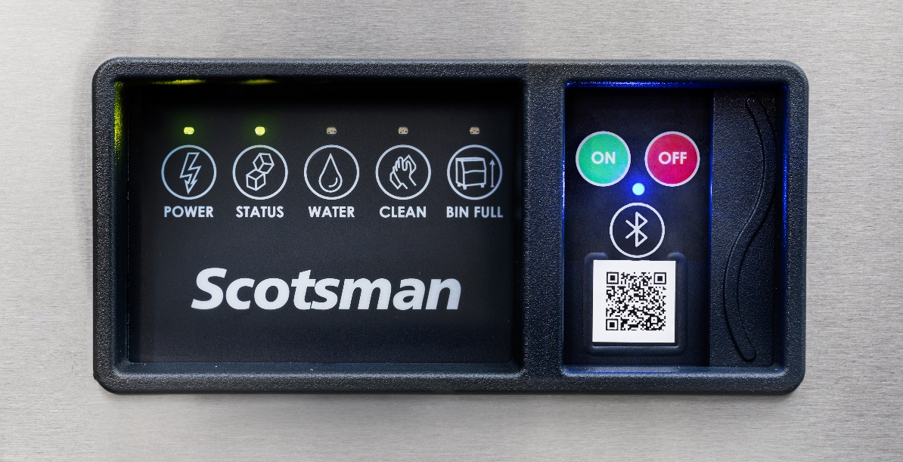
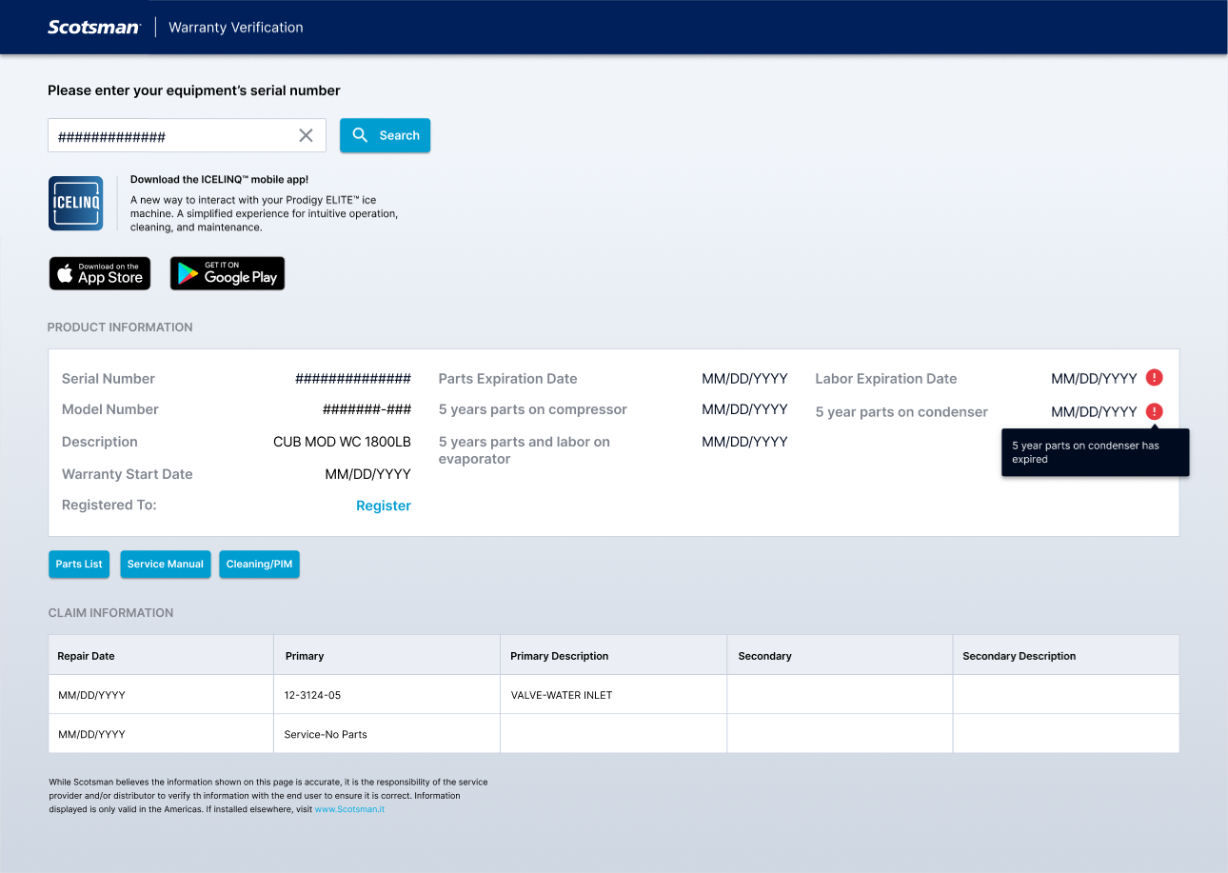
Prodigy ELITE® - What’s New
Unit Specific QR Code
The QR code can be found on the AutoAlert™ panel, among multiple other locations on unit
QR codes direct users to a redesigned warranty page
Optimized for desktop and mobile viewing
Features convenient download links for ICELINQ® mobile app
®
®
®
®

Slide 5
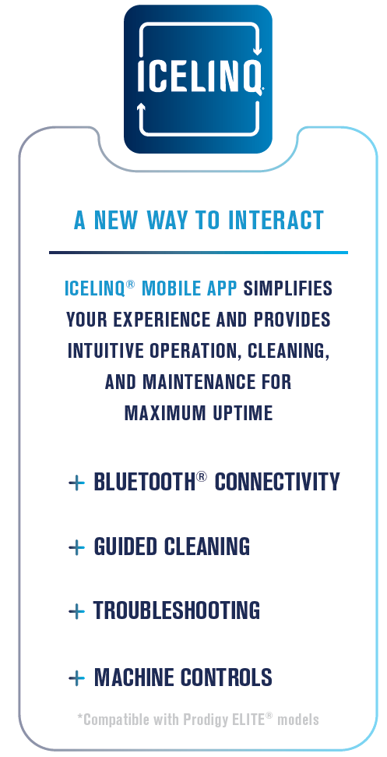
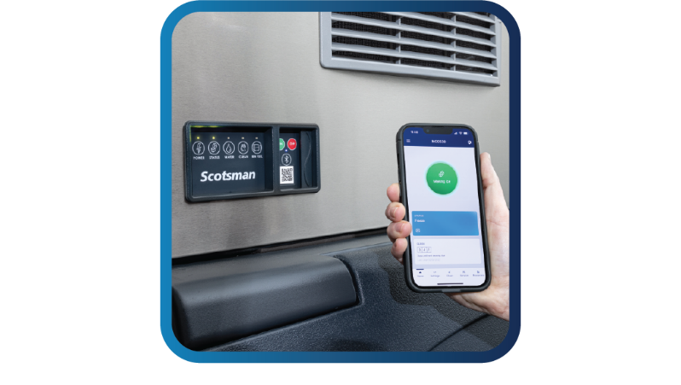
Prodigy ELITE® - What’s New
Scotsman ICELINQ® Mobile App
New way to interact with an ice machine
A simplified experience ensures intuitive operation, cleaning, and maintenance for maximum uptime and reliability
Compatible with all Prodigy ELITE® models
Bluetooth® based connectivity for easy “local” pairing without removing panels
App available on Apple App Store and Google Play Store for all mobile devices

Slide 6
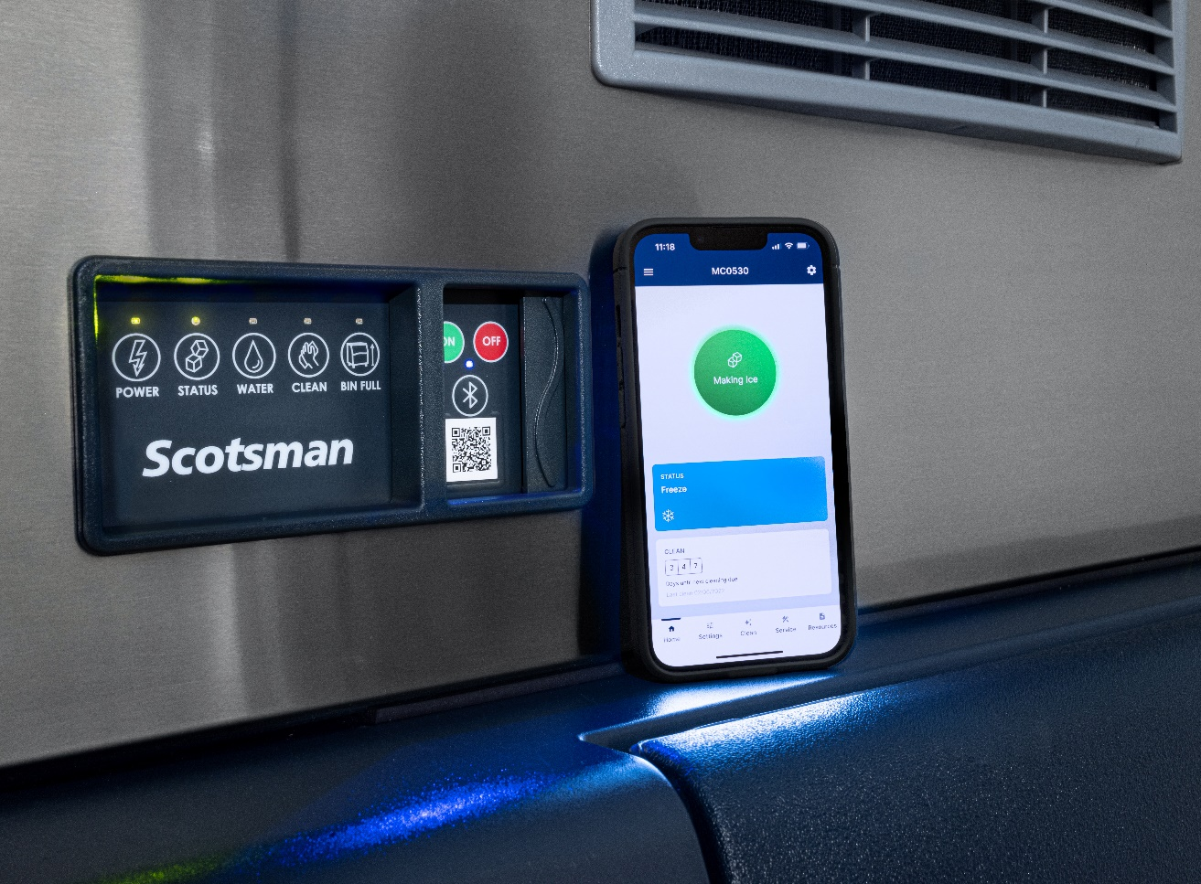
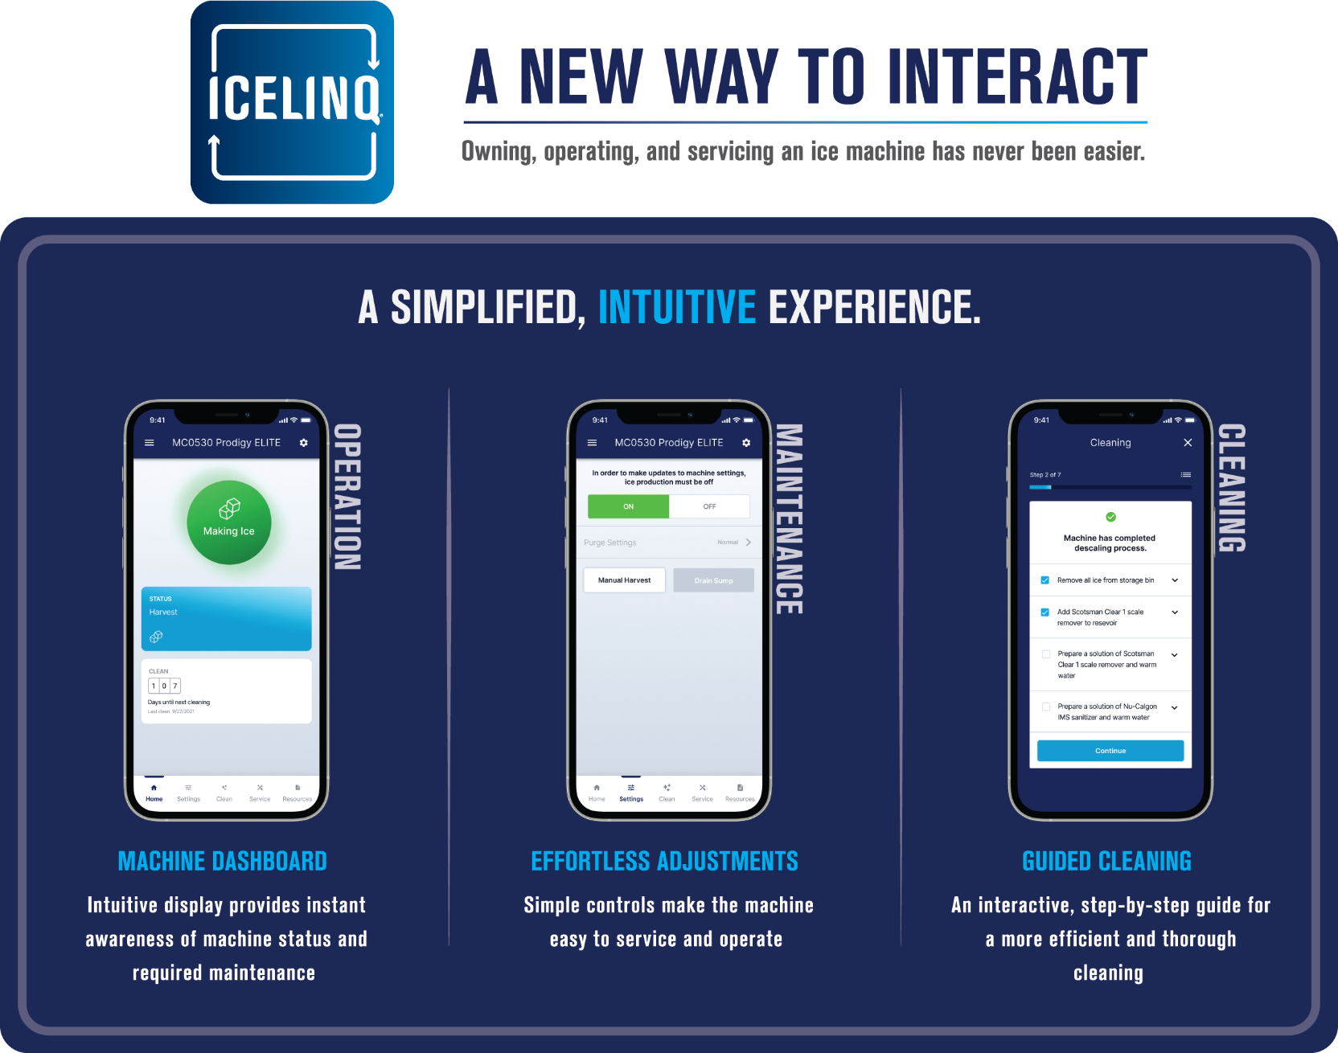
Prodigy ELITE® - What’s New

Slide 7
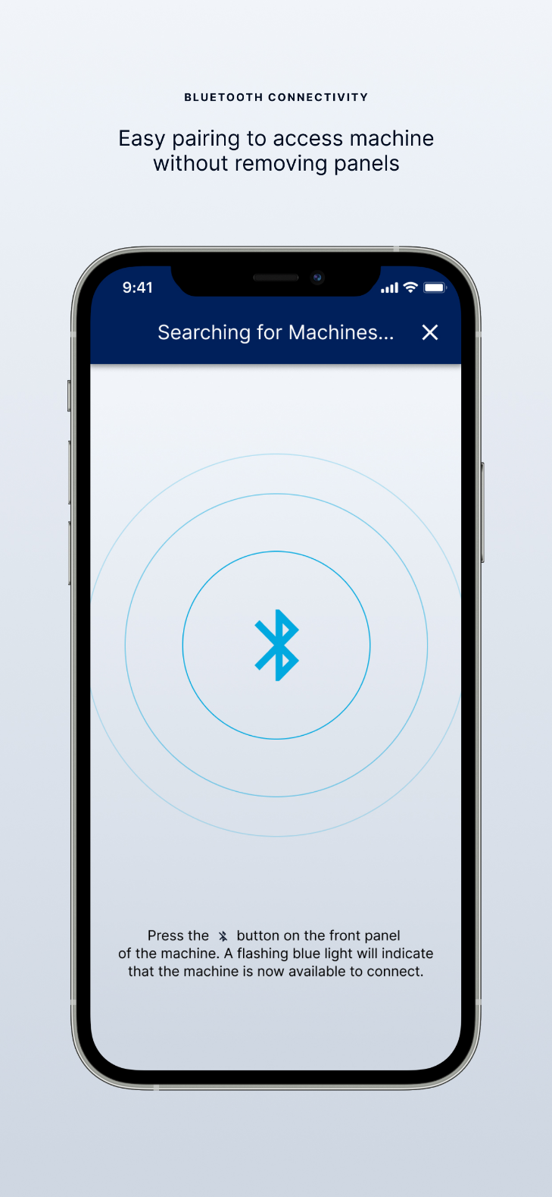
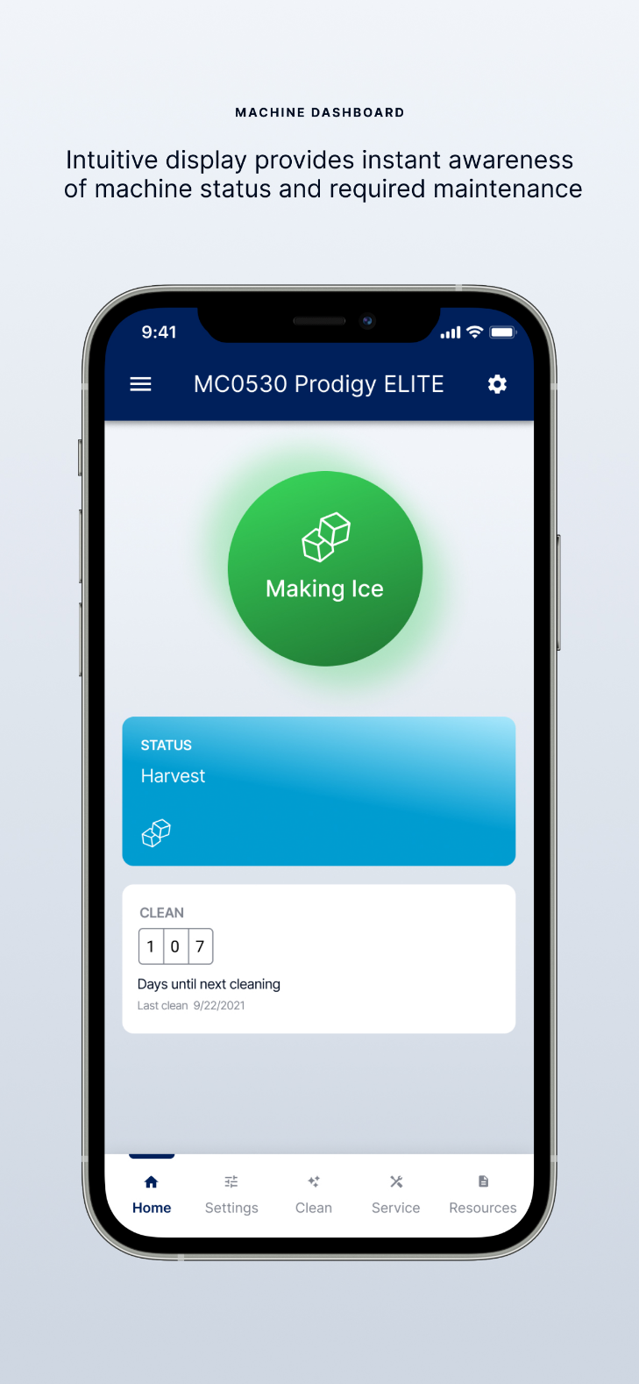
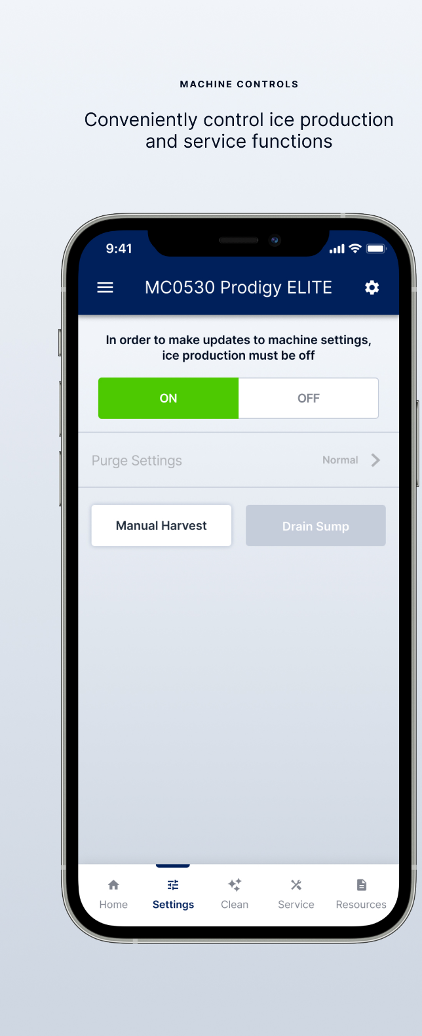
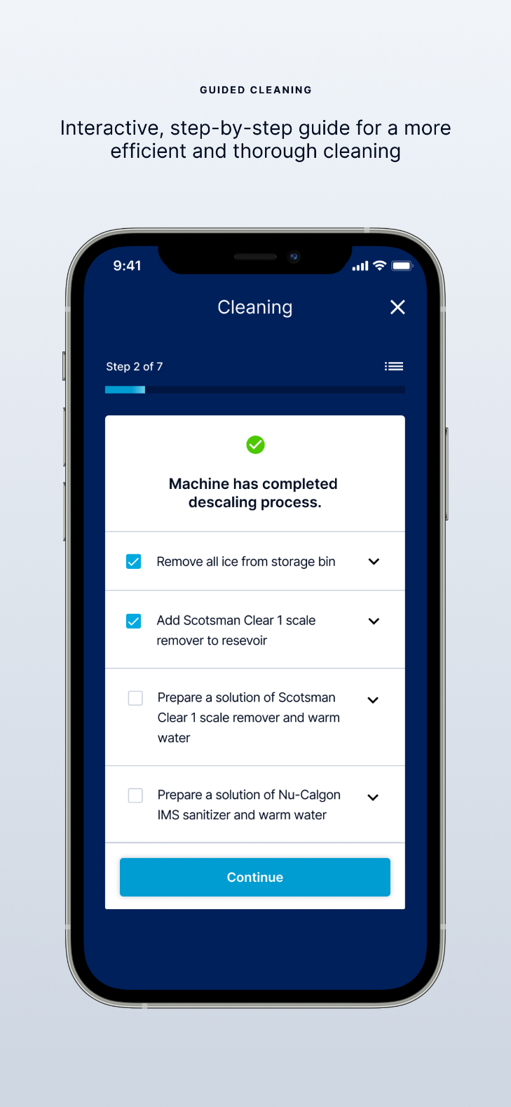
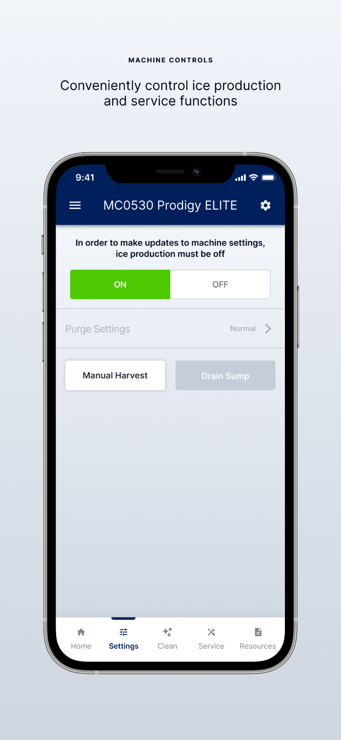
Prodigy ELITE® - What’s New
Bluetooth® Connectivity
Machine Dashboard
Guided Cleaning
Machine Controls

Slide 8
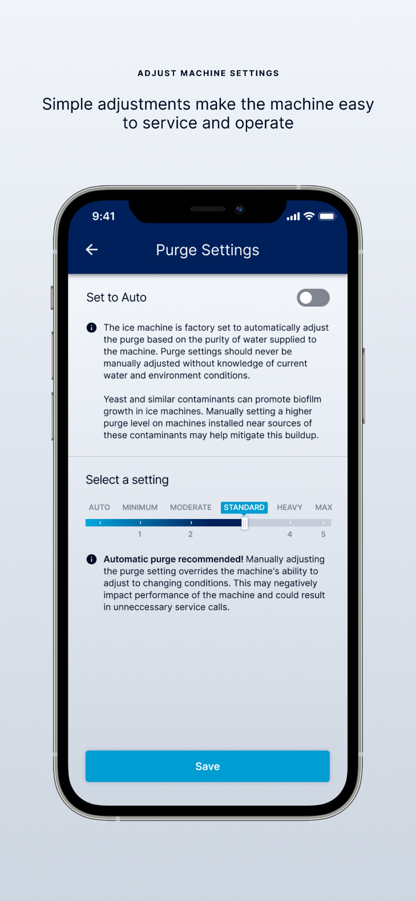
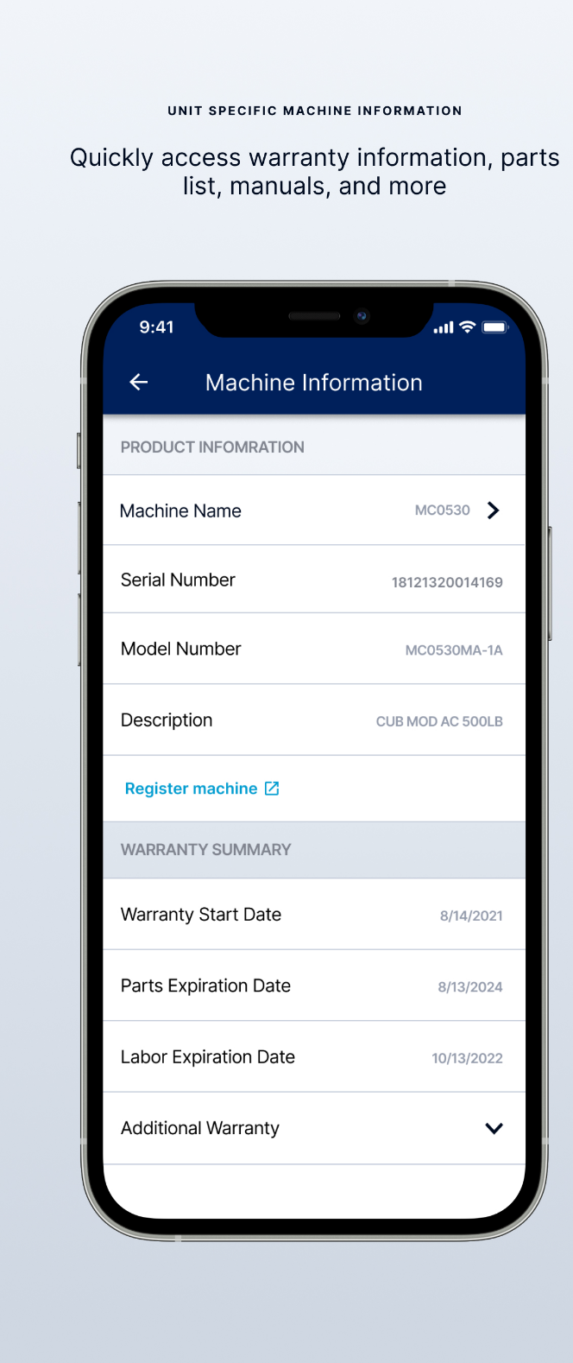
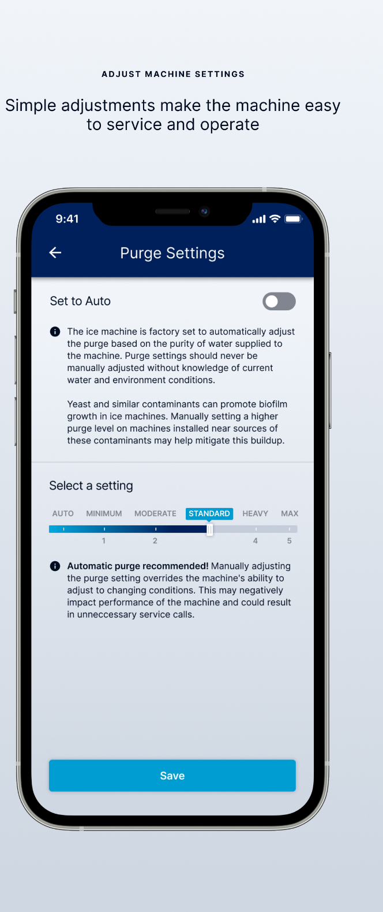
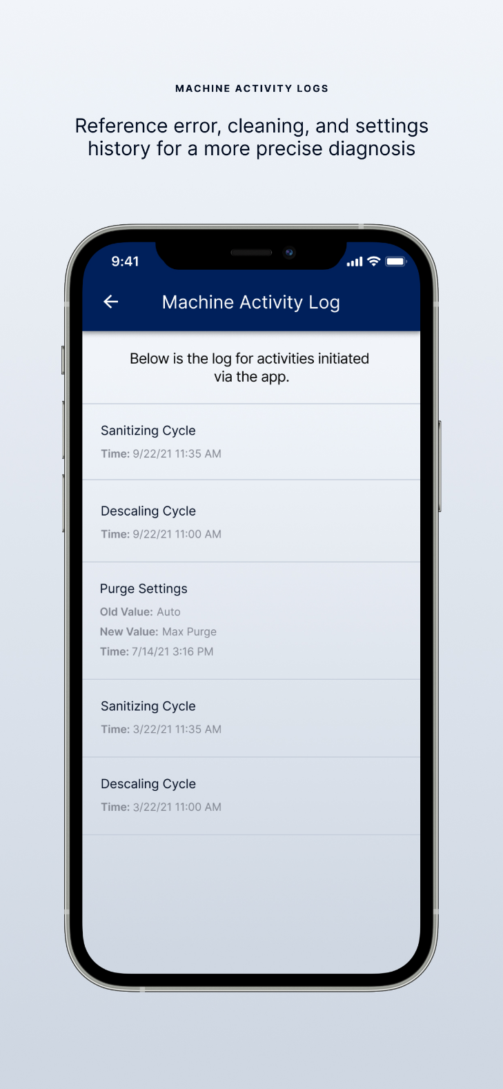
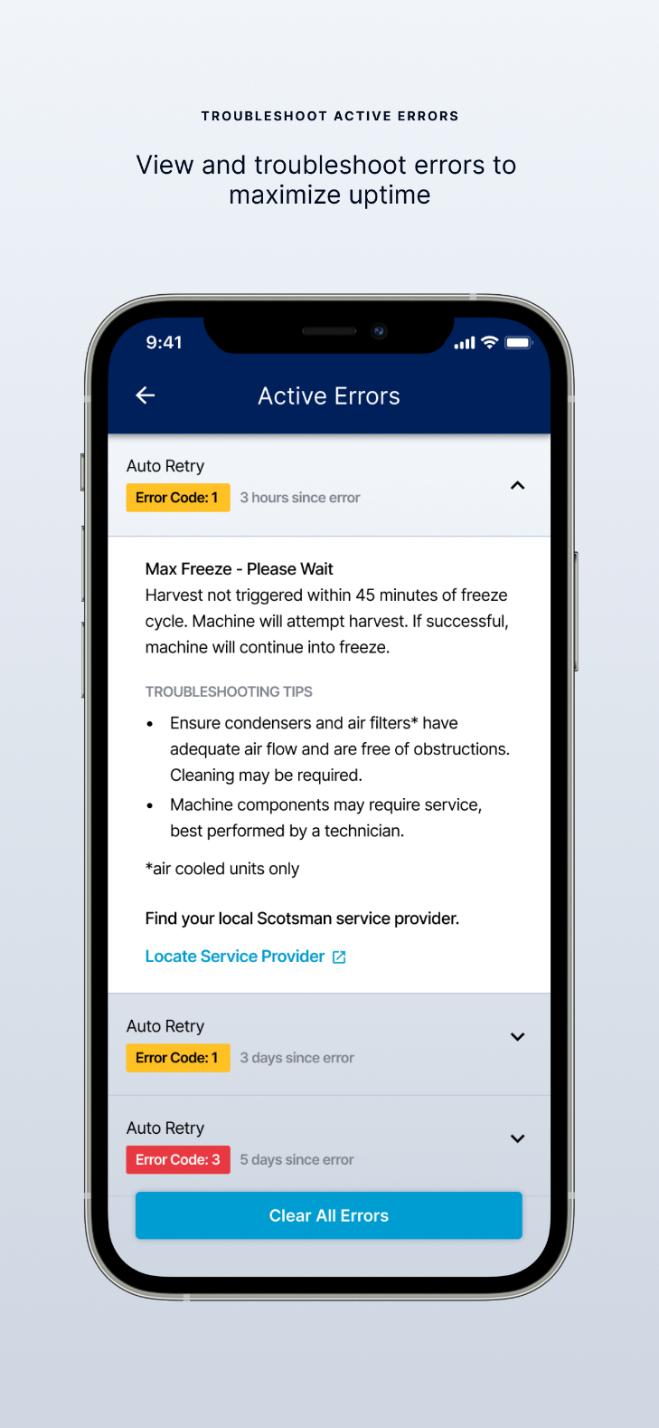
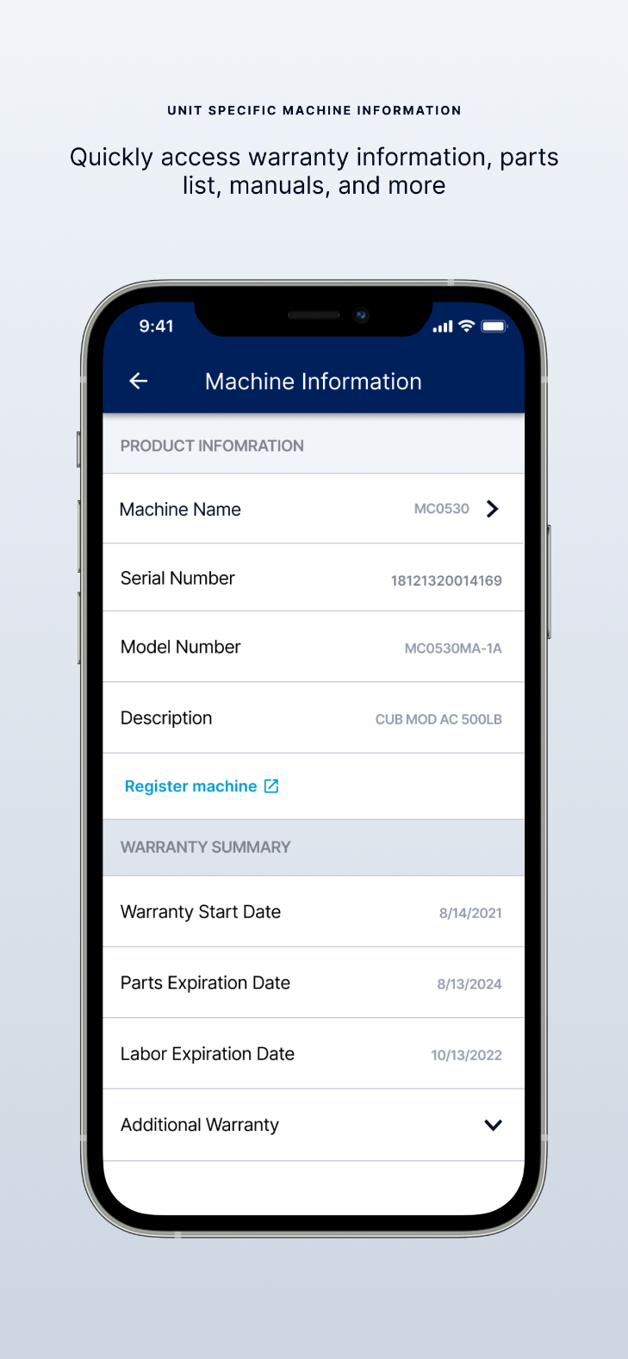
Prodigy ELITE® - What’s New
Adjust Machine Settings
Machine Activity Logs
Troubleshoot Errors
Unit Specific Information

Slide 9
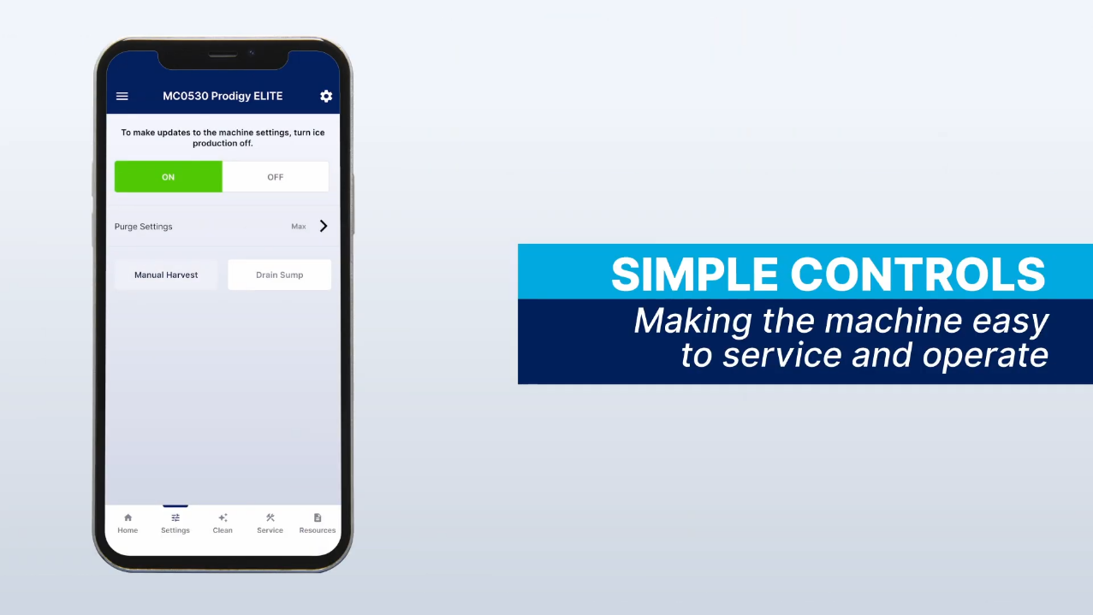
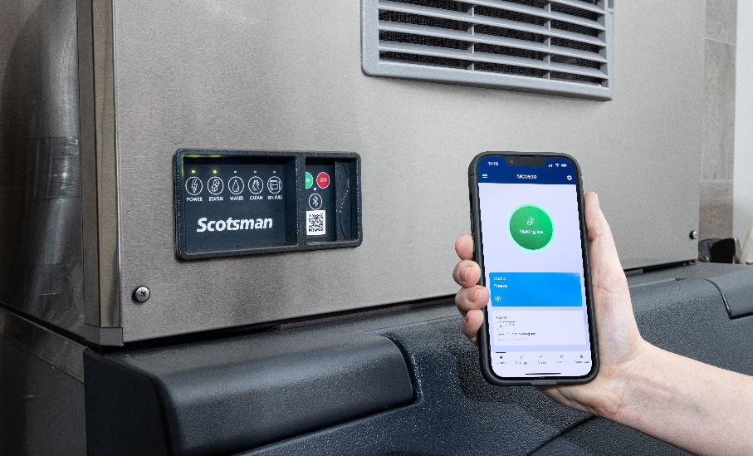
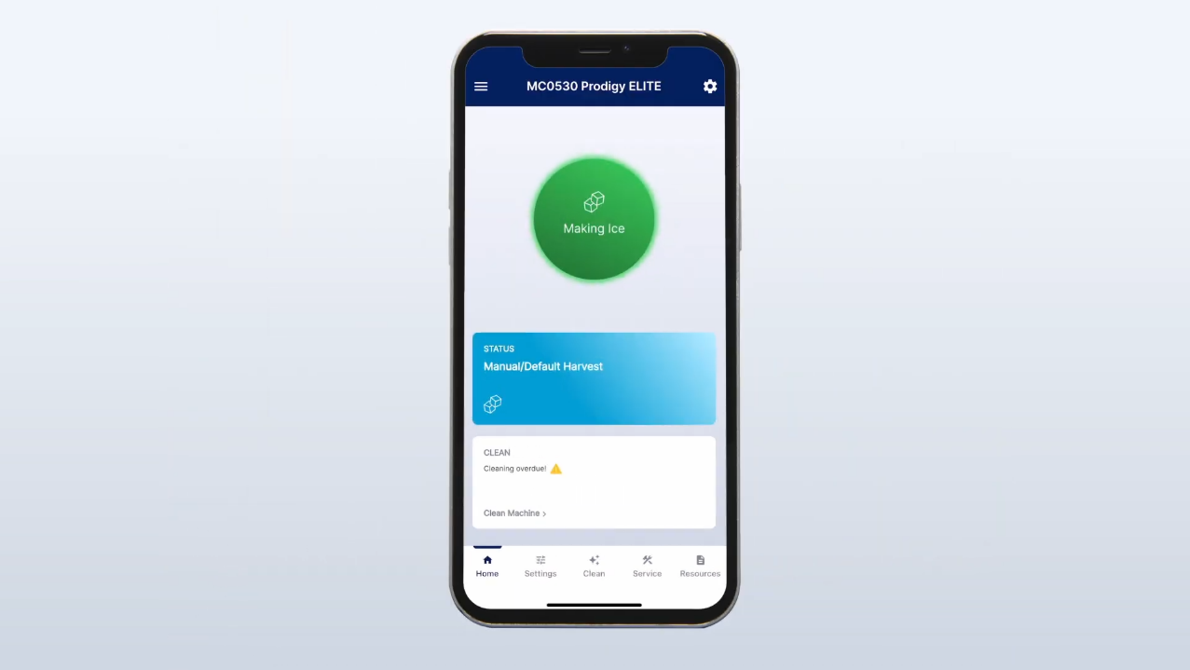
Prodigy ELITE® - What’s New
Prodigy ELITE® Videos
Scotsman ICELINQ® - A New Way To Interact
Scotsman Modular Cube - Introducing Prodigy ELITE®
Scotsman ICELINQ® - Powerfully Simple (App Demo)

Slide 10
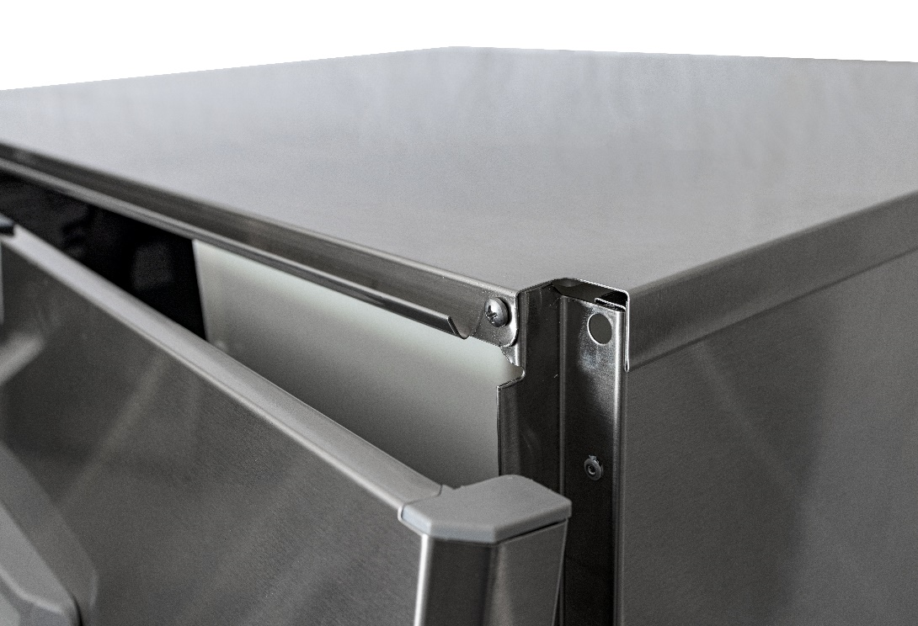
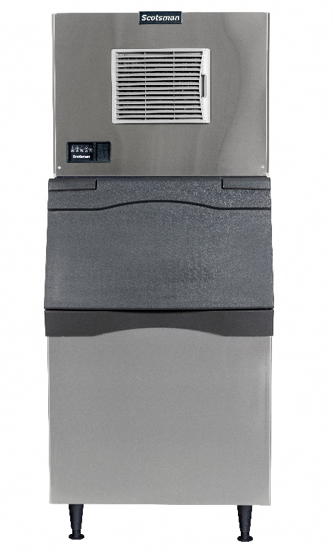
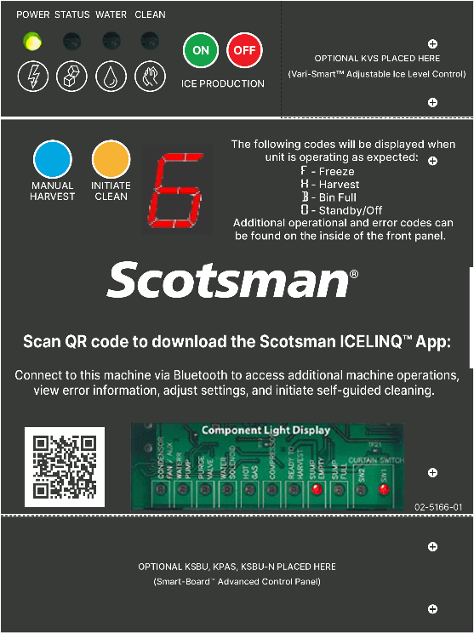
Prodigy ELITE® - What’s New
Easy Access, Refined Aesthetics
New refined exterior look, no more top and bottom trim strips
Front panel features “hook & latch” system and quarter turn captured screws for easy internal access
Internal control panel includes 16-segment display and updated overlay graphics for an improved user experience

Slide 11
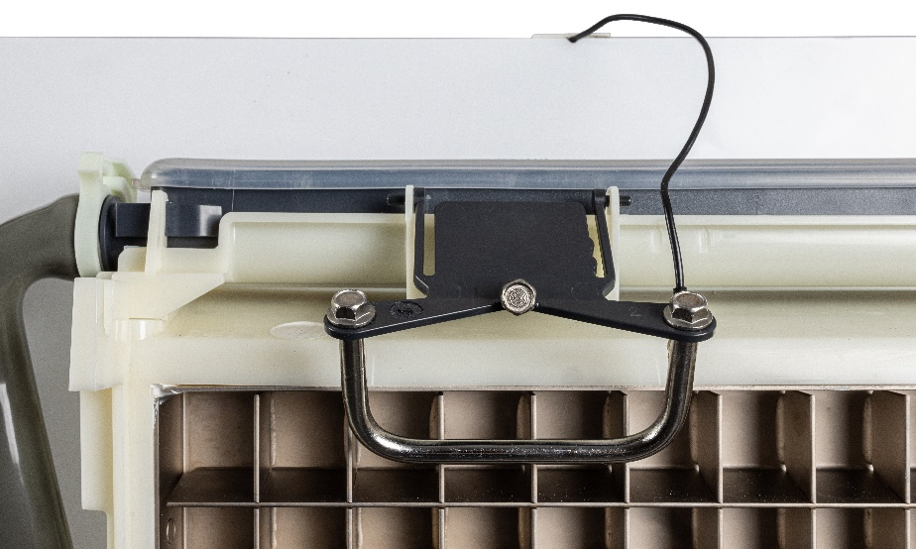
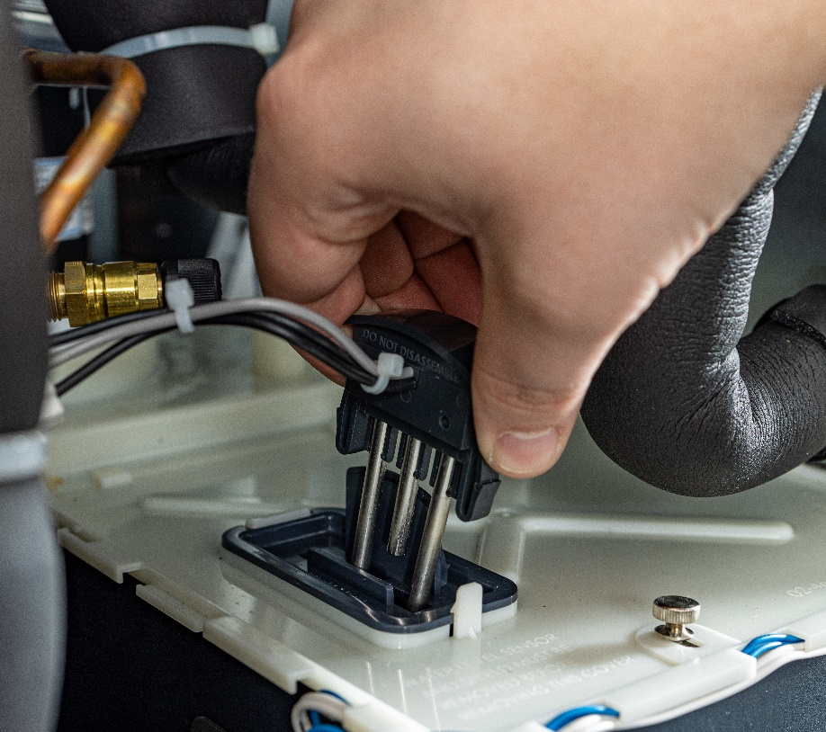
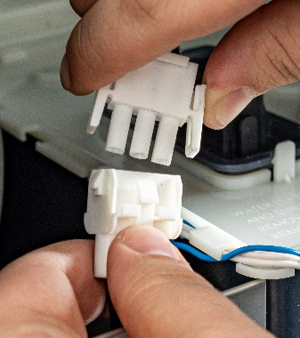
Prodigy ELITE® - What’s New
Upgraded Sensor Design
Ice Thickness Sensor
U-shaped sensor allows sensor bracket to sit above splash line, minimizing scale buildup and reducing the potential for premature/false sensor readings
Smooth sensor and sensor bracket with rounded edges for improved cleanability
In-line connector for easy removal during maintenance
Eliminates the need to disassemble for cleaning
Water Level Sensor (WaterSense)
Robust cylindrical probes replace stamped plate for increased durability
Closed housing shields connectors, which reduces corrosion risk and eliminates the need to disassemble for cleaning
Cleaning only requires a simple wipe down of probes
In-line connector for easy removal during maintenance

Slide 12
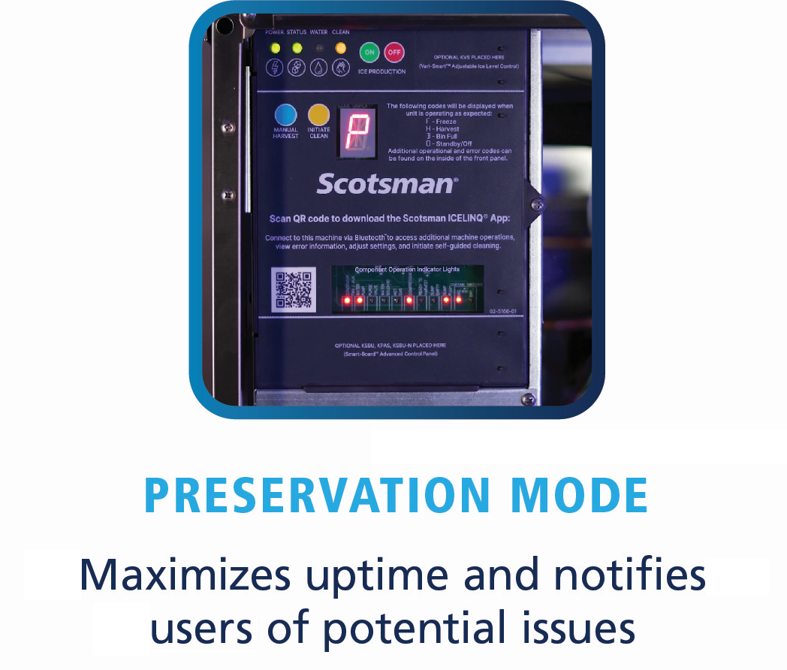
Prodigy ELITE® - What’s New
Preservation Mode
Acts as a general failsafe/added redundancy for maximum uptime and instant awareness
If freeze/harvest anomalies occur (often due to lack of maintenance), the unit will intelligently switch into Preservation Mode instead of shutting down
Preservation Mode will allow the machine to operate using a timer-based freeze/harvest cycle until sensors/components can be properly cleaned
The timer-based freeze/harvest cycle may vary in length by model
Operators will be notified via AutoAlert™ (blinking amber CLEAN light), 16-segment display on the controller, and in the Scotsman ICELINQ® app
While Preservation Mode can serve as an interim solution to continue making ice, it is still recommended that the machine is cleaned and/or serviced as soon as possible

Slide 13
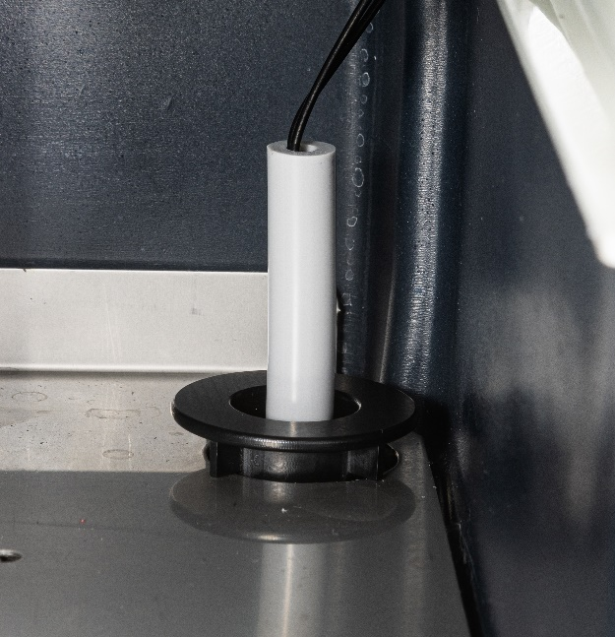
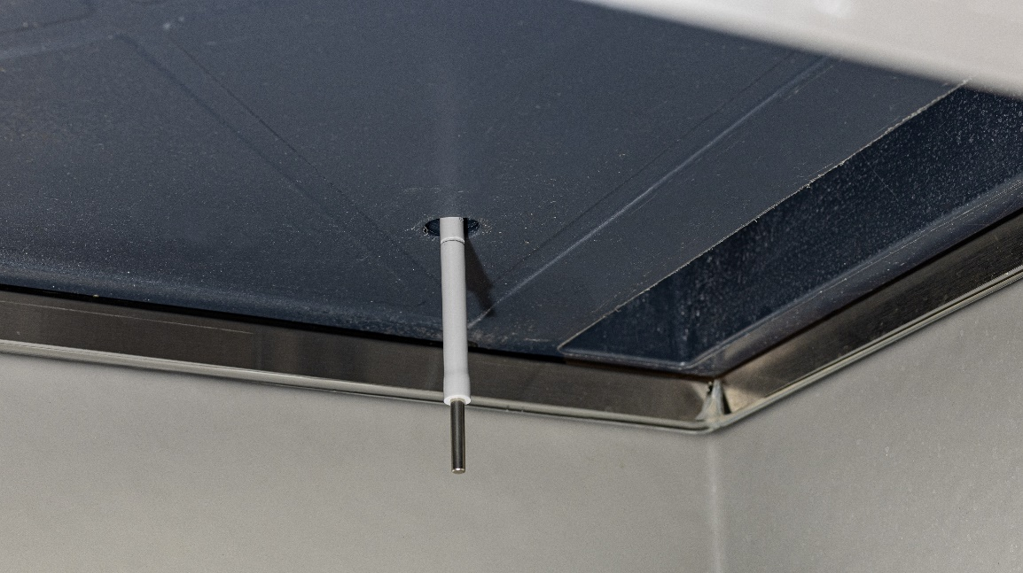
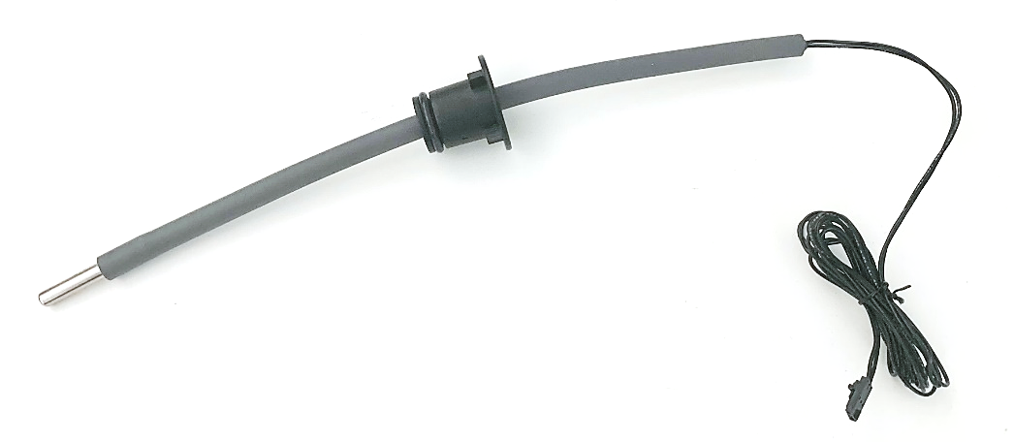
Prodigy ELITE® - Optional Accessories
KBILC: Basic Ice Level Control
More economical solution for dispensing applications
KVS remains an “advanced” option, providing more setpoints, precision, and programmability (when paired with Smart-Board™)
Simple installation, only requires PH screwdriver for panel removal and controller access
Robust, flexible tubing protects sensor and allows it to self-correct position after disturbance from agitation for more reliable bin level sensing
Tube is notched at 3 recommended setpoints for easy adjustment
These standardized setpoints will work for most dispenser applications
ONLY COMPATIBLE WITH PRODIGY ELITE® MODULAR CUBE MODELS
Notes:
KBILC is NOT backwards compatible with Prodigy Plus Cube, Flake/Nugget models, as they have different connectors in controller.

Slide 14
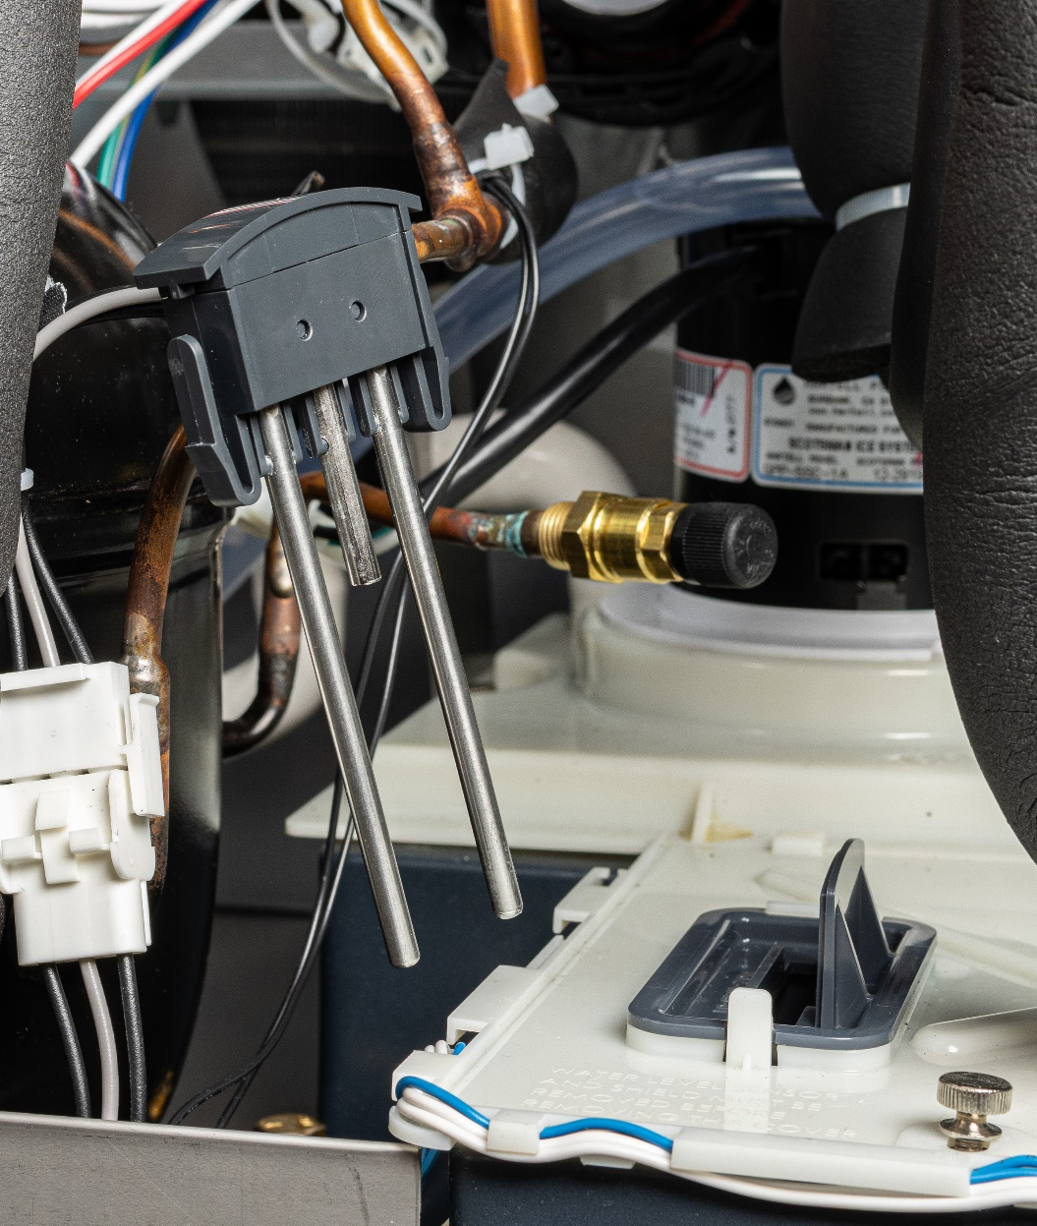
Prodigy ELITE® - Sanitary Design
Patented WaterSense Technology
Automatically adjusts based on water supply quality
Exclusive feature helps reduce scale buildup for more sanitary ice
Reliable sensor adjusts water purge at end of each cycle to flush excess minerals
Automatically flushes the system to extend time between cleanings
Operators can save water and energy where water conditions are better filtered by recirculating clean, pre-chilled water back into the ice-making process

Slide 15
Prodigy ELITE® - Sanitary Design
Built-In Antimicrobial Protection
Prodigy ELITE® units are designed to always ensure customer safety, even between cleanings
Scotsman products feature AquaArmor with AgION™, a silver-based antimicrobial compound molded directly into key components
Helps inhibit the growth of undesirable microbes, bacteria, mold and algae
AgION™ Antimicrobial
Moisture
Bacteria
Silver ion release

Slide 16
Prodigy ELITE® - Ease of Use
Patented Harvest Assist
Once ice cubes form within the evaporator plate, a patented process using a minimal amount of hot gas and an exclusive probe ensures that ice is efficiently delivered to the bin
Uses minimal energy

Slide 17
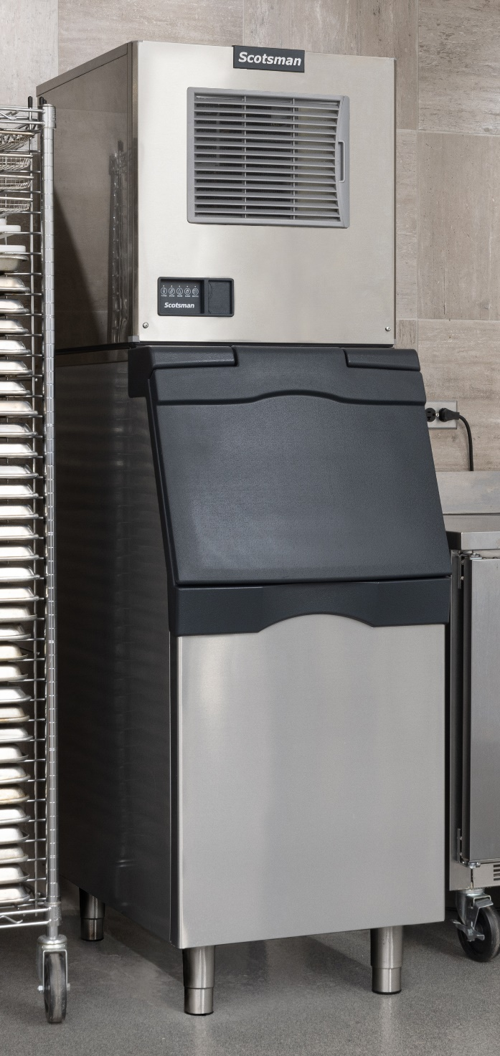
Prodigy ELITE® - Ease of Use
Front-Located, Removable Air Filter
Ensures proper clearance and breathability for maximum energy efficiency
Easily rinsed and reused, also dishwasher safe
Better visibility keeps regular cleaning top-of-mind for operators
Smaller Operational Footprint
Due to the front facing air filter, all Prodigy ELITE® 22” and 30” units only require minimal side clearance
Allows machine to be placed directly beside walls and other equipment, maximizing valuable kitchen space
Many Prodigy ELITE® models feature the smallest operational footprints in the industry

Slide 18
Prodigy ELITE® - ELITE Reliability
Standing Behind Our Quality
100% of units are quality checked before leaving Scotsman's ISO 9001:2015 certified plant in Fairfax, South Carolina
3-year parts and labor warranty on all components
5-year parts and labor warranty on evaporator
5-year parts warranty on compressor and condenser
Warranty valid in North, South & Central America for commercial installations
Residential applications:
1-year parts and labor

Slide 19
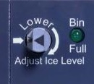
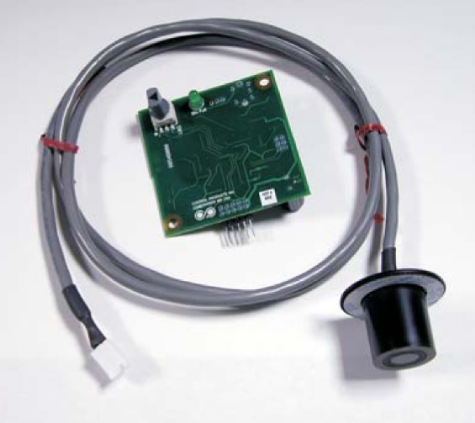
Prodigy ELITE® - Optional Accessories
Vari-Smart™ Ice Level Control
Optional ultrasonic ice level control sensor (KVS) allows operators to manually adjust ice levels
Keeps just the right amount of freshly made ice in the bin – 16 setpoints
Helps save water and energy
Connects to existing controller
Ideal for seasonal changes in ice needs or if you’re planning to sanitize the bin
Leverage programmability capabilities (when paired with Smart-Board™)
Also provides faster ice turnover or for operating your machine in lower-cost energy periods

Slide 20
Prodigy ELITE® - Optional Accessories
Smart-Board™ Advanced Feature Module
Optional advanced feature provides NAFEM data protocol on screen for early alert and fast diagnosis of operating issues
Allows for programming bin levels, checking cleaning history and runtime, and more
Technicians can download data directly through the USB port, or use the serial number to check performance via a dedicated website
Scotsman can retrofit existing field units with this exclusive technology
KVS: Vari-Smart™ Ice Level Control
KSBU: Smart-Board™
KSBU-N: Smart-Board™
(Network Capable)
KPAS: Advanced Sustainability Kit
(KSBU-N + KVS)

Slide 21
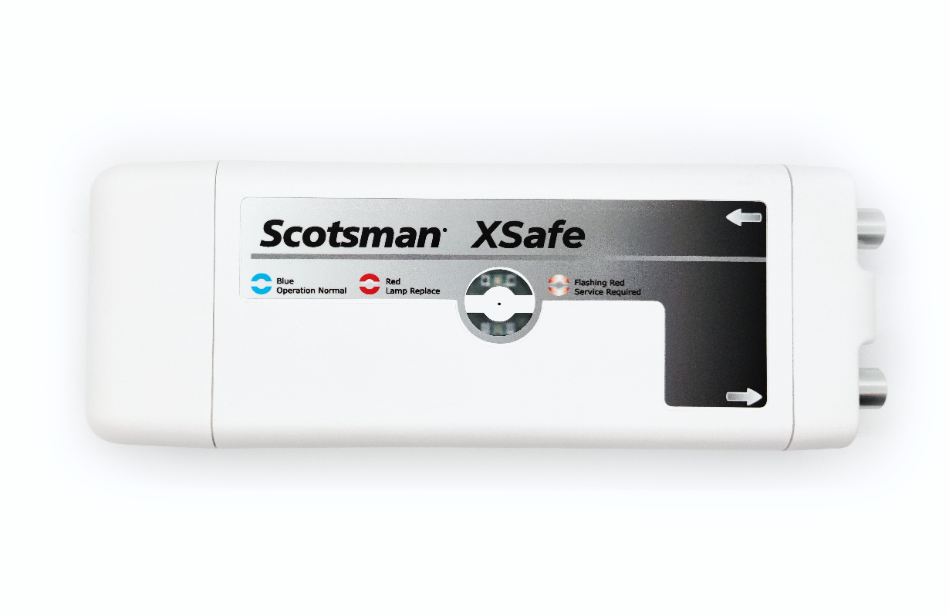
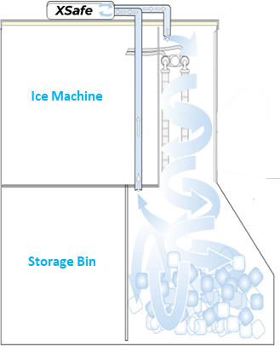
Prodigy ELITE® - Optional Accessories
How It Works
Ozone and other oxidants (photoplasma) are generated in the air after passing through a powerful UV-C lamp; A small fan circulates the photoplasma throughout the ice machine/bin
Helps sanitize the air and surfaces within the ice machine and bin
Completely automated and chemical-free cleaning system
XSafe® Sanitation System
®
XR-30
Helps reduce cleaning costs
Enhances sanitary operation
Replacement Bulb: SCBULBXR30
Input Voltage: 100-240V
Input Frequency: 50/60Hz
Output Voltage: 12V DC
Amperage: 0.8 Amp
Electrical Consumption: 9.6W
Dimensions: 11.9” x 4.25” x 2.05”
(W x D x H)
Certifications:
®

Slide 22
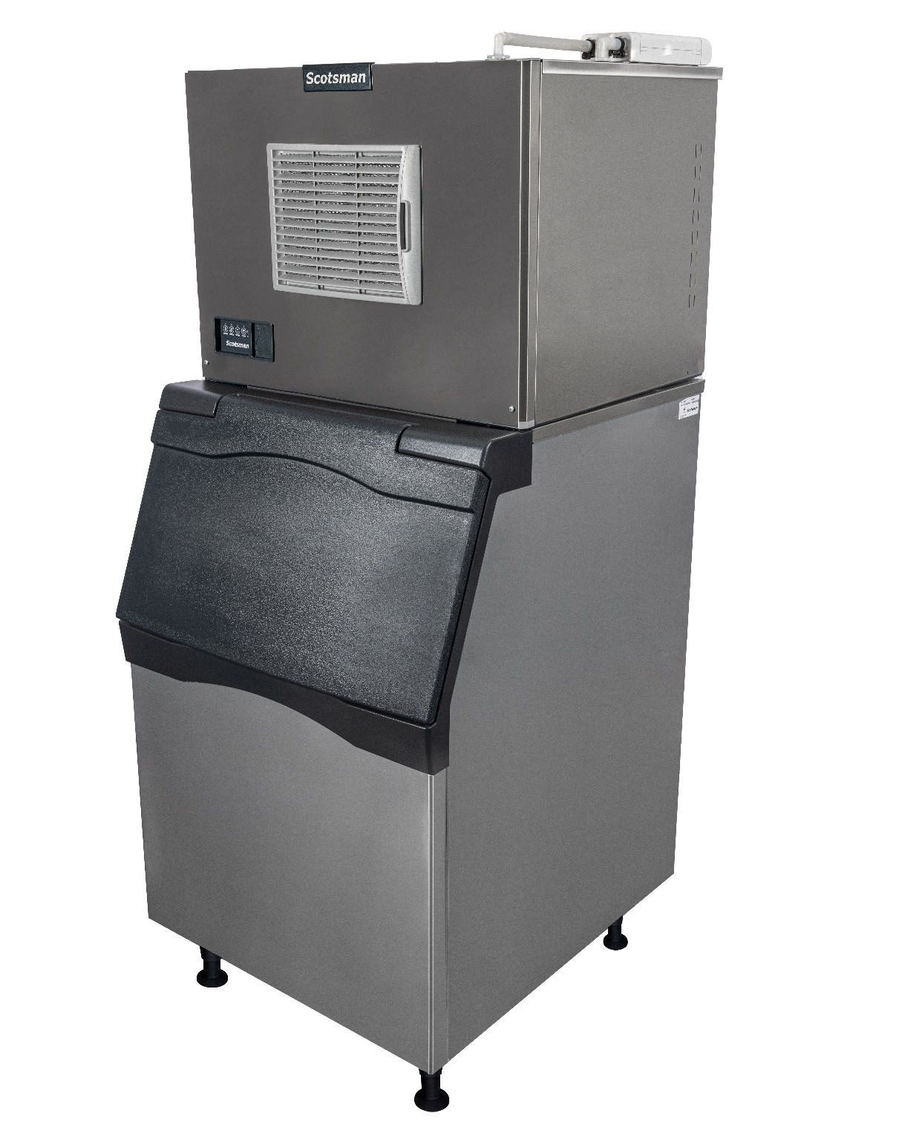
Prodigy ELITE® - Optional Accessories
XSafe® Sanitation System
Food Safety – Ice is FOOD!
Defends against viruses, bacteria, and fungi
Helps prevent the formation of slime, mold, and yeast
Consistent coverage of natural, chemical-free ozone (O₃)
Guards against health code infractions
Easier, Lower Cost Cleanings
Frequency of cleanings can be reduced
Effective in hard-to-reach areas, which may reduce manual cleaning time
Keeps the food zone and bin cleaner longer
Makes wipe downs easier and faster
Extend & Improve Machine Performance
The lifetime operation of the ice machine can be extended
A cleaner machine can enhance performance and efficiency

Slide 23
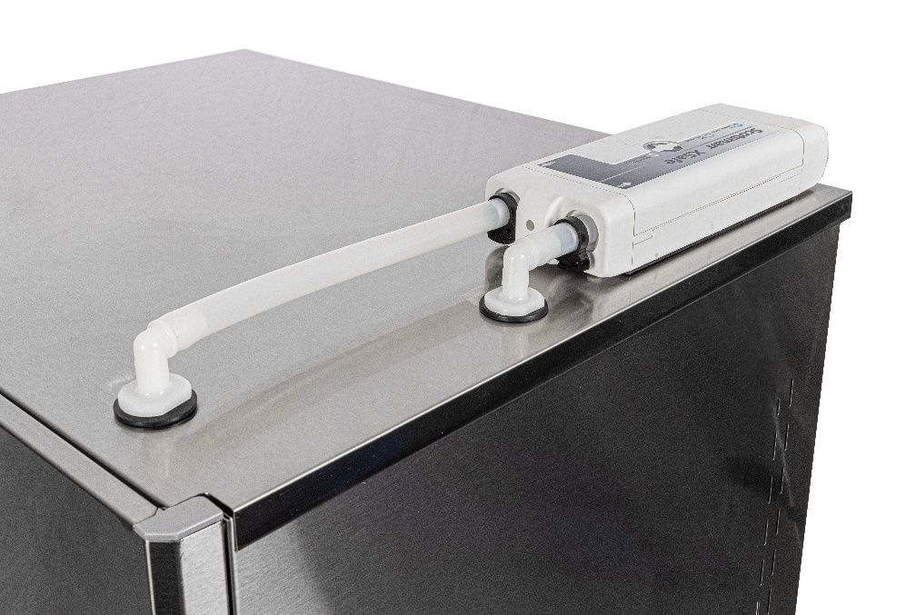
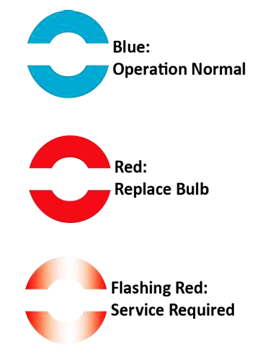
Prodigy ELITE® - Optional Accessories
Easy, Intuitive Operation
Installation Overview
Can be retrofitted on existing units already in use
Compatible with any Scotsman modular ice machine
Easy install, typically requires less time than a full cleaning
XSafe® unit placed on top of ice head with vented air flow to circulate sanitized ozone throughout the ice machine/bin
Operational Status Indicator Lights
3 tiers of light signals keep operators informed of status
Replace bulb light eliminates guesswork
Replacement Bulb Part Number: SCBULBXR30

