Slide 1


INTRODUCING
MODULAR CUBERS
EASY TO SERVICE, CLEAN AND OPERATE.

Slide 2
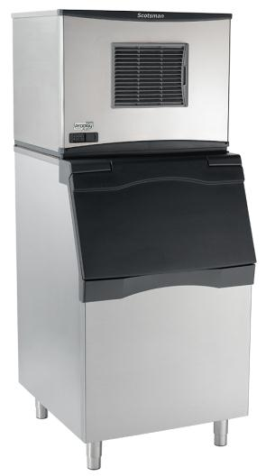
The Prodigy Plus Difference
+ One-touch cleaning reduces labor costs and saves time
+ Self-aligning front panel for easy access to key components
+ Patented WaterSense purge control automatically reduces scale buildup
+ Front-located air filter for more efficient operation
Smart-Board™ advanced feature module available for additional diagnostic capabilities
+ AutoAlert™ indicator lights for better visibility
+ Industry-exclusive QR code instantly connects users to service information
Optional Vari-Smart™ ice level control allows operators to customize ice levels
Antimicrobial protection guards internal surfaces between cleanings
Patented Harvest Assist efficiently moves cube ice to the bin
A full range of water- and energy-saving features
Operational footprint among the industry’s smallest

Slide 3
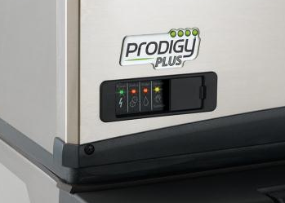
It’s Easy to Service
AutoAlert™
Innovative LED indicator lights keep operators informed of unit’s status
Signals staff when it’s time to descale, sanitize and more
Relocated to the lower left corner of the panel for better visibility
Each of the 4 lights labeled with an easy-to-identify icon
Instantly diagnose issues when warning lights appear

Slide 4
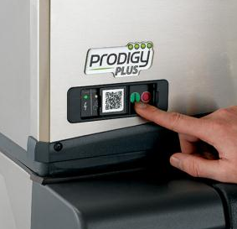
It’s Easy to Service
Quick Response (QR) code
Every Prodigy Plus unit features a QR code that connects customers to vital unit specific information
Helps reduce downtime and frequency of service calls
Convenient front panel location eliminates need to remove unit’s front cover
Optional bezel cover available to prevent tampering or unauthorized access
QR code leads to a warranty registration page, auto-populated with the corresponding serial number
Parts lists, cleaning instructions, manuals and warranty history are all available

Slide 5
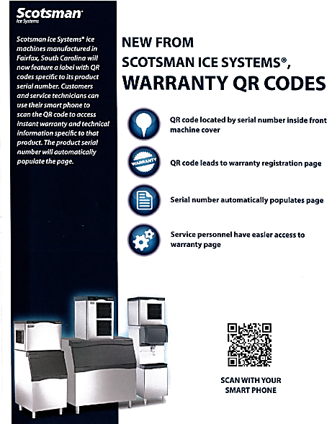
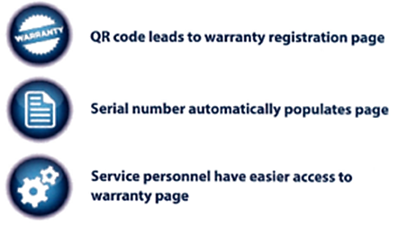
It’s Easy to Service
Quick Response (QR) code
Operators and service technicians can use their smart phone to scan the QR code to access instant warranty and technical information specific to that model
The product serial number will automatically populate the page
SCAN WITH YOUR SMART PHONE
Scanning Tip:
Some recent phone updates allow you to use your phone’s built-in camera app to scan QR Code

Slide 6
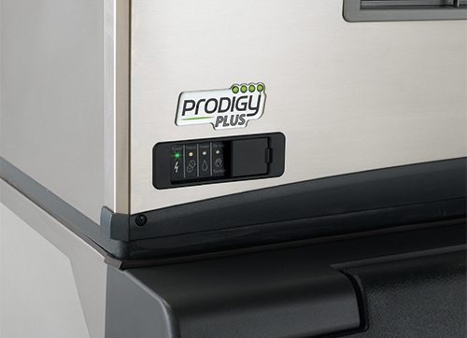
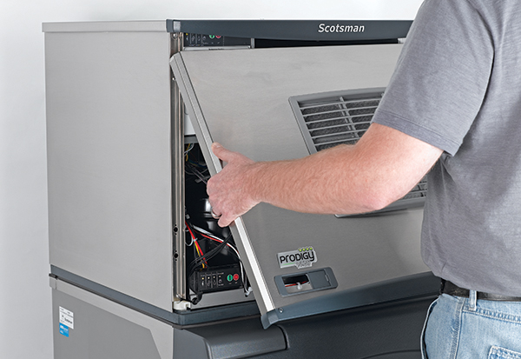
It’s Easy to Service
Self-Aligning Front Panel
Easy maintenance with Prodigy Plus begins with the redesigned front panel
More durable and robust, it features captured screws located within reach along the bottom of the panel
Panel provides fast access to key components, including the diagnostics control board

Slide 7
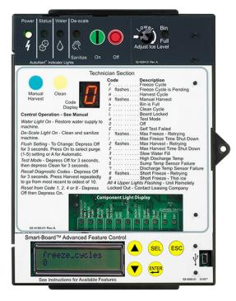
It’s Easy to Service
Auto-Alert™ Control Board
Instant and Intuitive Notifications
  Power, Status, No Water, Time to Clean
  Easy to see across the room
  Minimize downtime, reduce service calls
LED code for easy diagnosis
Self Test mode for easy diagnosis

Slide 8
It’s Easy to Service
Smart-Board™ Advanced Feature Module
Optional advanced feature provides NAFEM data protocol on screen for early alert and fast diagnosis of operating issues
Allows for programming bin levels, checking cleaning history and runtime, and more
Technicians can download data directly through the USB port, or use the serial number to check performance via a dedicated website
Scotsman can retrofit existing field units with this exclusive technology

Slide 9
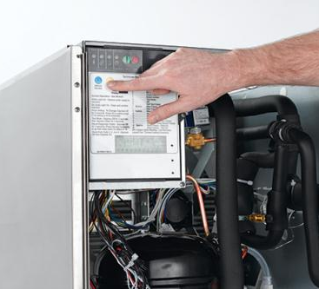
It’s Easy to Clean
One-Touch Cleaning
Scotsman makes ice head cleaning more efficient than ever with Prodigy Plus one-touch cleaning capability
Employees can start the cleaning process with a single push of a button
No additional selections or time-consuming oversight required; simply power machine back on after cleaning cycle is complete

Slide 10
It’s Easy to Clean
Built-In Antimicrobial Protection
Prodigy Plus units are designed to ensure customer safety at all times, even between cleanings
Scotsman products feature AquaArmor with AgION™, a silver-based antimicrobial compound molded directly into key components
Helps inhibit the growth of undesirable microbes, bacteria, mold and algae
AgION Antimicrobial
Moisture
Bacteria
Silver ion release

Slide 11
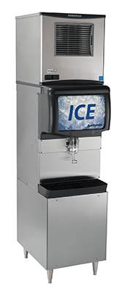
It’s Easy to Clean & Operate
Smaller operational footprint
Thanks to the newly relocated air filter, all Prodigy Plus 22” and 30” units now require minimal side clearance
Allows machine to be placed directly beside walls and other equipment, maximizing valuable kitchen space
Many Prodigy Plus models feature the smallest operational footprints in the industry
Front-located air filter
Ensures proper clearance and breathability for maximum energy efficiency
Easily rinsed and reused, and also dishwasher safe
Better visibility keeps regular cleaning top-of-mind for operators

Slide 12

It’s Easy to Operate
Patented Harvest Assist
Once ice cubes form within the evaporator plate, a patented process using a minimal amount of hot gas and an exclusive probe ensures that ice is easily and efficiently delivered to the bin
Uses minimal energy

Slide 13
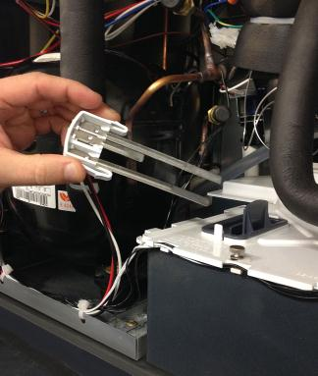
It’s Easy to Operate
Patented WaterSense Technology
Automatically adjusts based on water supply quality
Exclusive feature helps reduce scale buildup for more sanitary ice
Reliable sensor adjusts water purge at end of each cycle to flush excess minerals
Automatically flushes the system to extend time between cleanings
Operators can save water and energy where water conditions are better filtered by recirculating clean, pre-chilled water back into the ice-making process

Slide 14
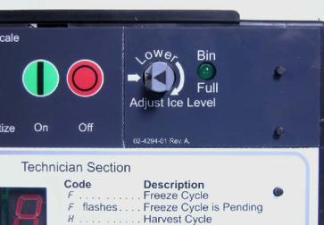
It’s Easy to Operate
Vari-Smart™ Ice Level Control
Optional ultrasonic ice level control sensor allows operators to manually adjust ice levels
Keeps just the right amount of freshly made ice in the bin
Helps save water and energy
Connects to existing controller
Ideal for seasonal changes in ice needs or if you’re planning to sanitize the bin
Also provides faster ice turnover or for operating your machine in
lower-cost energy periods

Slide 15
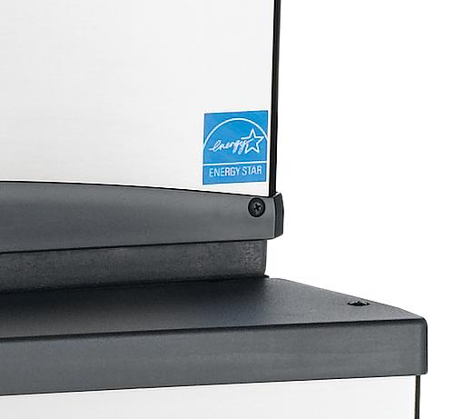



It’s Easy to Operate
ENERGY STAR-qualified models
Scotsman has always been committed to efficiency, specifically water and energy savings
Many Prodigy Plus units are ENERGY STAR-qualified
2012 & 2013 ENERGY STAR Partner of the Year, 2011 ENERGY STAR Excellence in Energy-Efficient Product Design Award

Slide 16
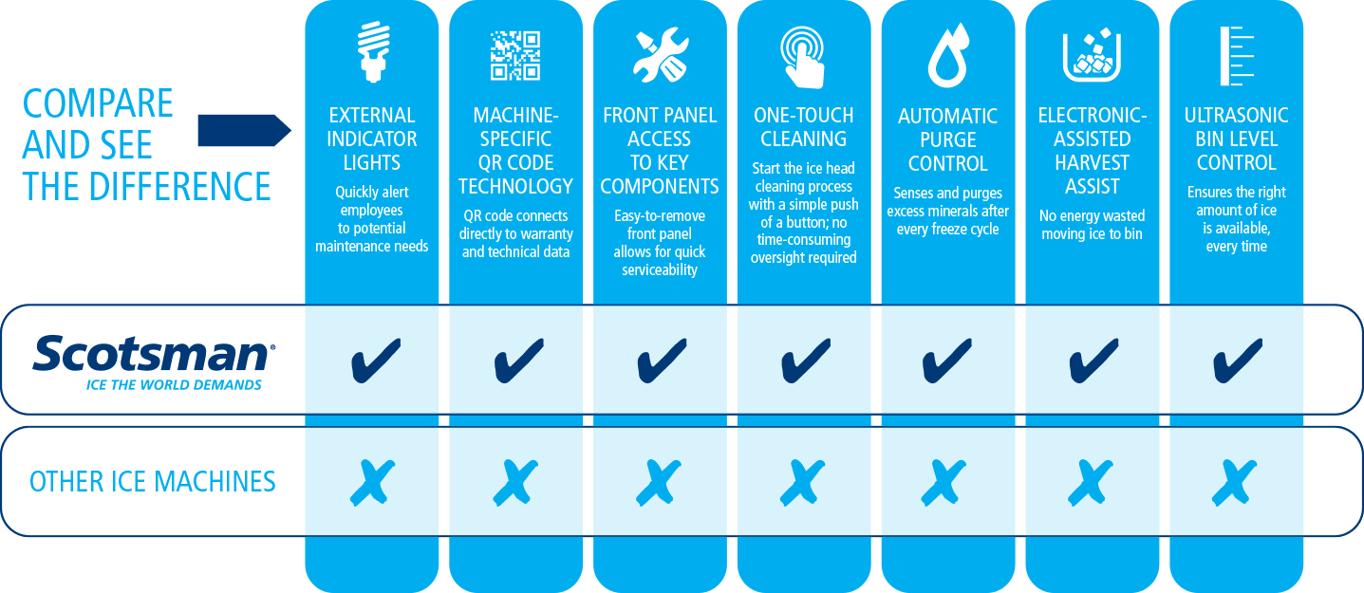
It’s the Complete Package

Slide 17
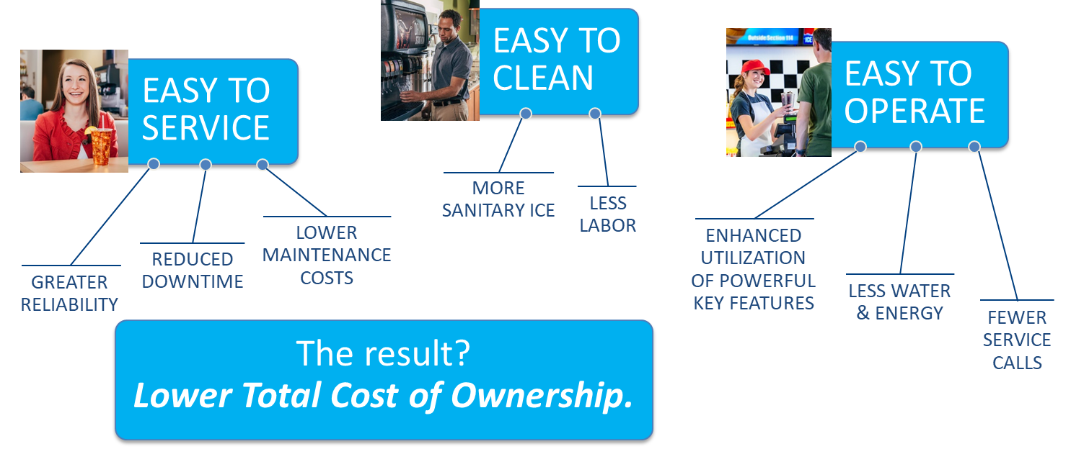
It’s All About Customer Satisfaction
Scotsman’s cube, flake and nugget ice machines are designed with one goal in mind: Total customer satisfaction

Slide 18



