Slide 1
INTRODUCING MODULAR BIG CUBE
PERFECTLY SQUARE, INDIVIDUAL, SLOW MELTING ICE CUBES.

Slide 2
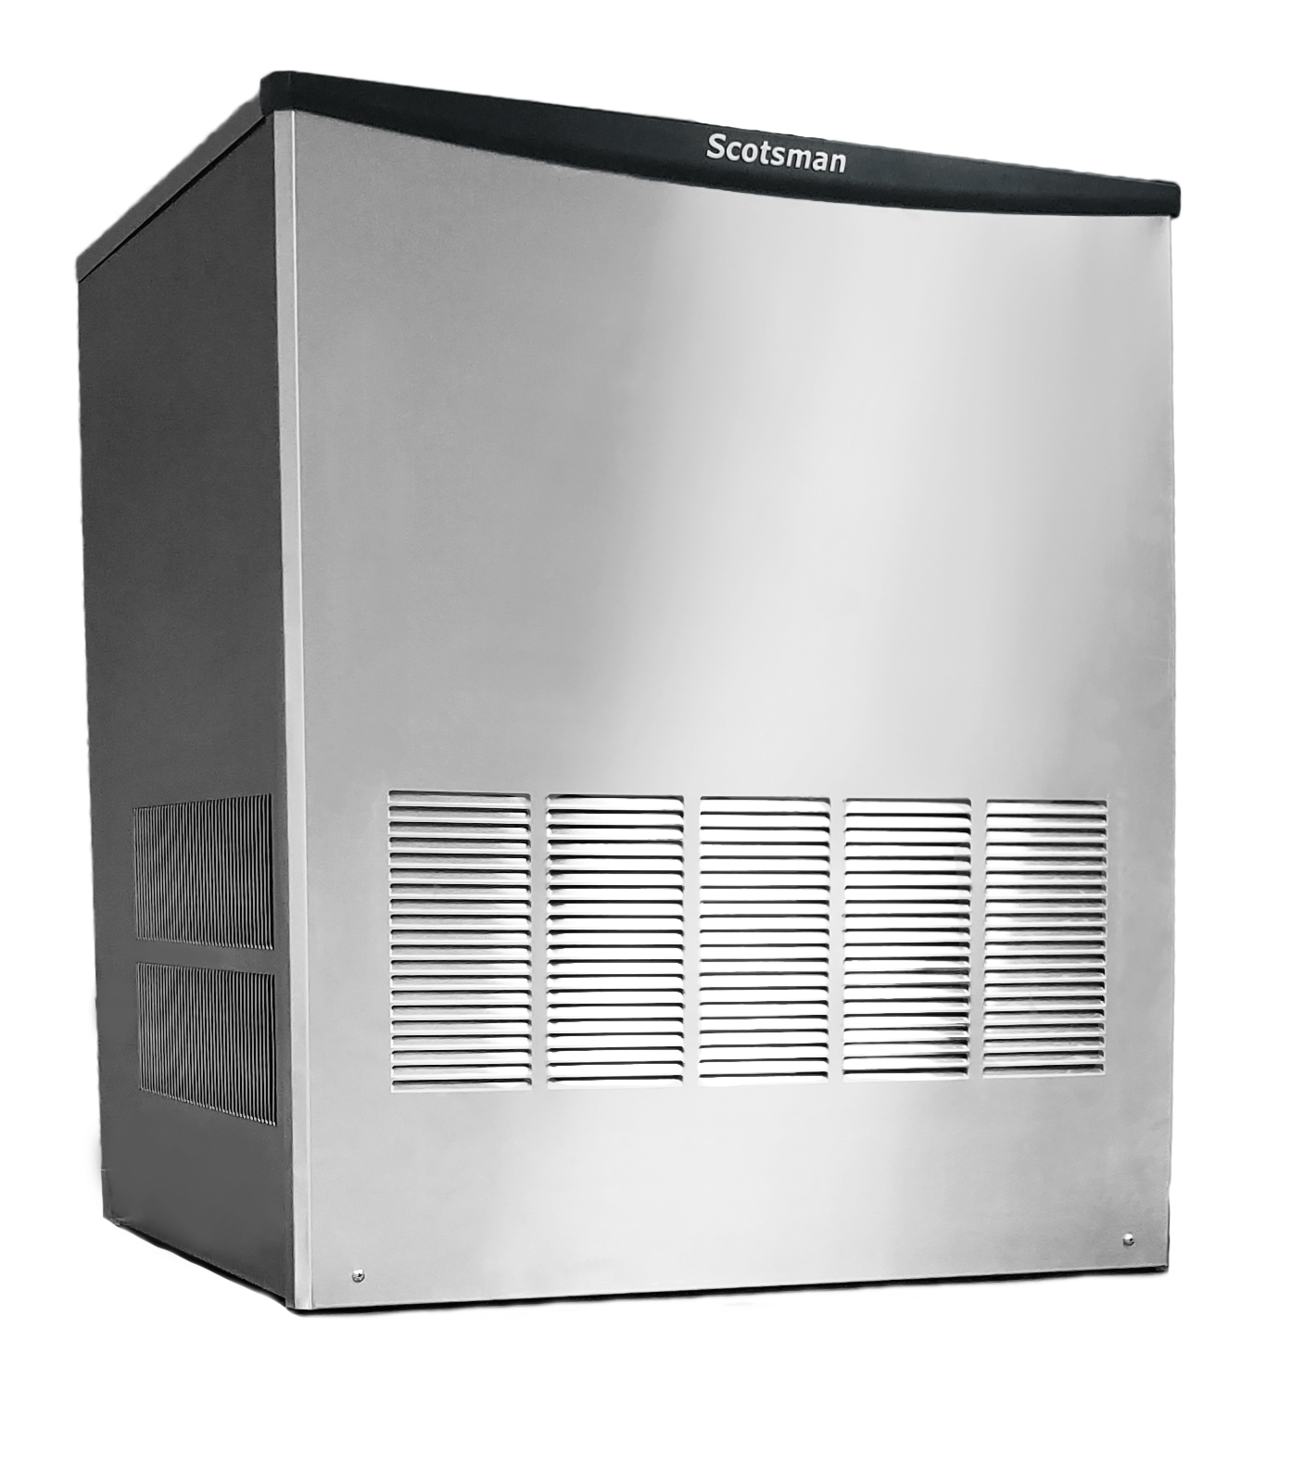
Modular Big Cube
NEW!
Big Cube: 30” wide modular unit now available
The new Modular Big Cube Ice Machine introduces the largest, slowest melting, most perfectly square, and clearest ice cube in Scotsman’s history. This big, individual cube is preferred by mixologists, bars, nightclubs, restaurants, and many others who seek the finest ingredients for their beverages.

Slide 3
New Product Launch Kit
Initial Content Package
Now available for download:
Resource Center -> Product Information
Contains:
Product Photography
Includes ice form images
Literature
Specification sheet
User manual
Service manual
List pricing & MSRP
A+ Enhanced Content
Visual based marketing graphics that are ideal for ecommerce
Cross Reference Document
Helps to link which files correspond to each model
Also includes easy to import specification information
More content/marketing materials may be released after launch date

Slide 4
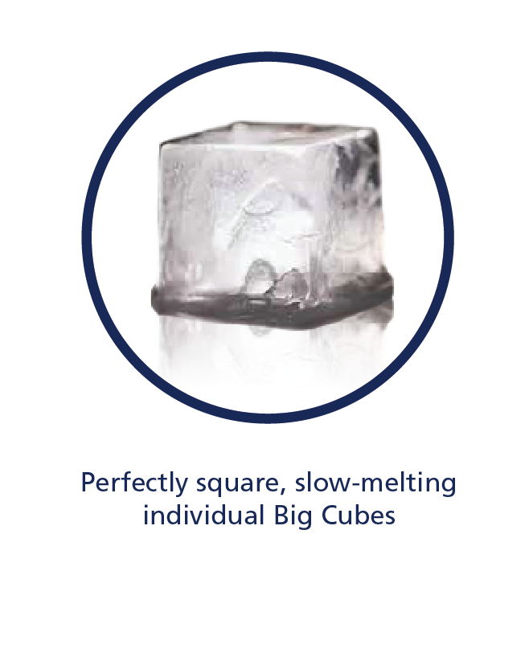
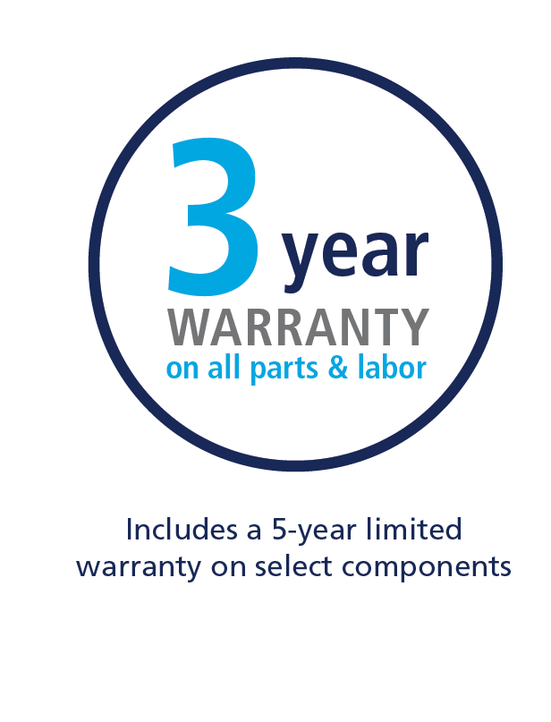
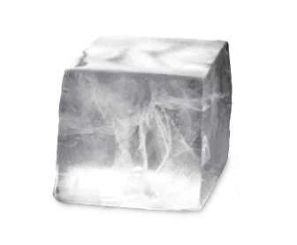
Modular Big Cube: Overview
BC0530
Air Cooled
115 V / 60 Hz
Optional KBCSTK30 stacking kit
Capacity: 383 @ 90°/70°
428 @ 70°/50°
Produces 108 cubes every harvest cycle
Dimensions: 30.7” x 25.8” x 33.7”
(W x D x H)

Slide 5
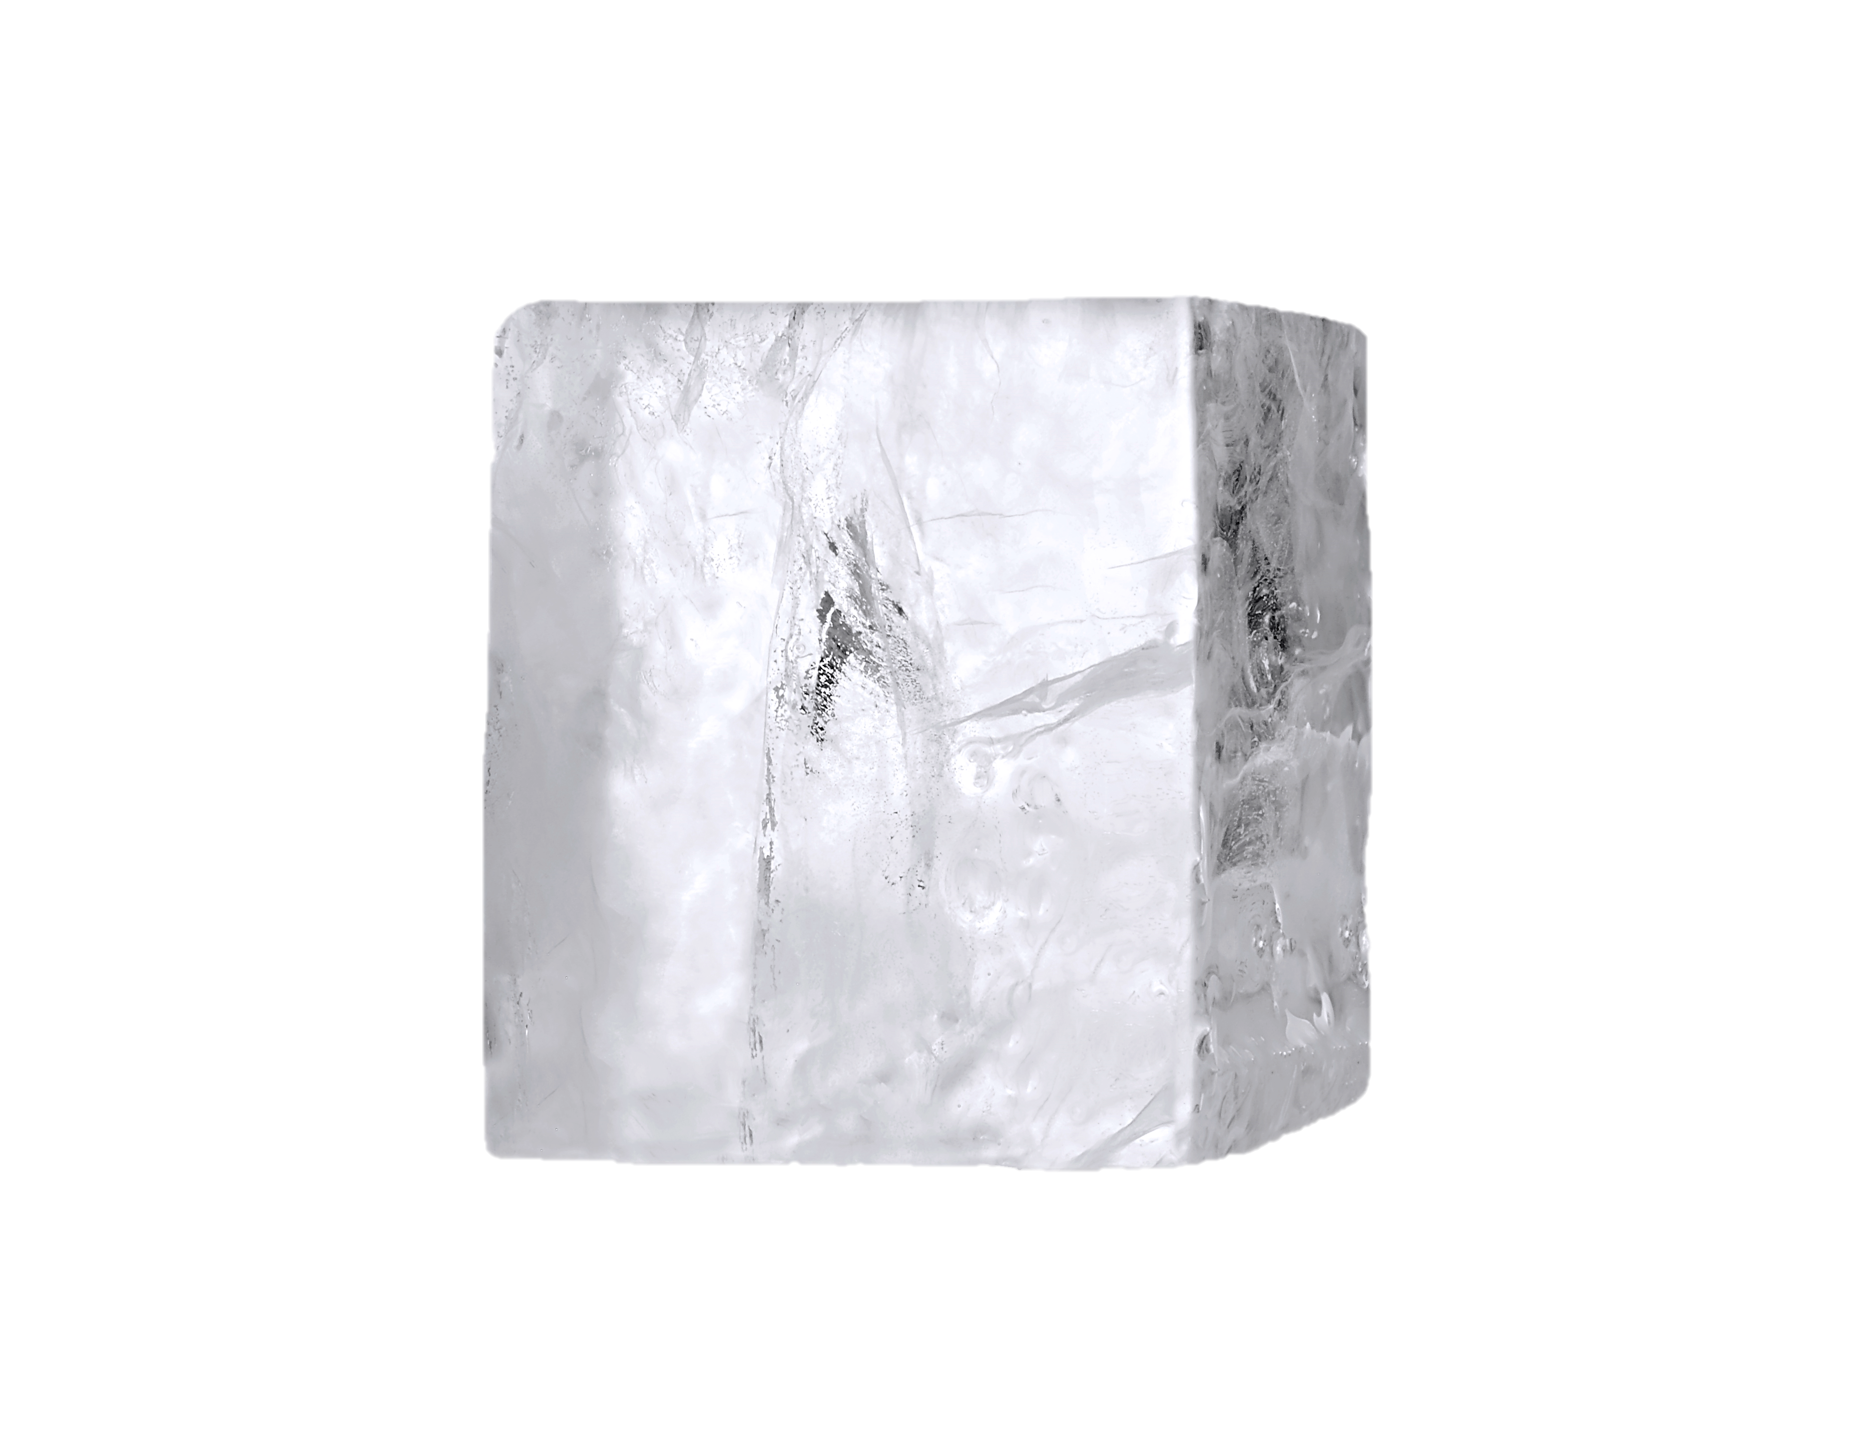
Modular Big Cube: About the Ice
A Premium Ingredient
Slowest melting; preferred by mixologists, banquet facilities, cocktail bars, construction crews, marinas, packaged ice users, and fine liquor aficionados
Unique evaporator design uses jet spray and gravity to remove air and minerals which results in:
Pure, crystal-clear cubes
Slower melting cubes
No waffling or bridging, each cube is formed individually and remains perfectly square
Scotsman’s biggest cube
191% larger than Scotsman’s Medium Cube*
39% larger than Scotsman’s Gourmet Cube*
Also 56% larger than Hoshizaki’s Square Cube*
Big Cube
1¼” x 1¼” x 1¼”
*Based on ice cube volume

Slide 6
Modular Big Cube: About the Ice
Broad Applications
Nightclubs
Cocktail Bars
Preferred ice form for mixologists
Restaurants
Casinos
Resorts
Golf Facilities
Construction Sites
Marinas
Slow melting cubes help cool drinks without diluting them
Uniquely large cube size offers a more “craft” and “artisan” experience
Perfectly clear, square, and individual cubes

Slide 7
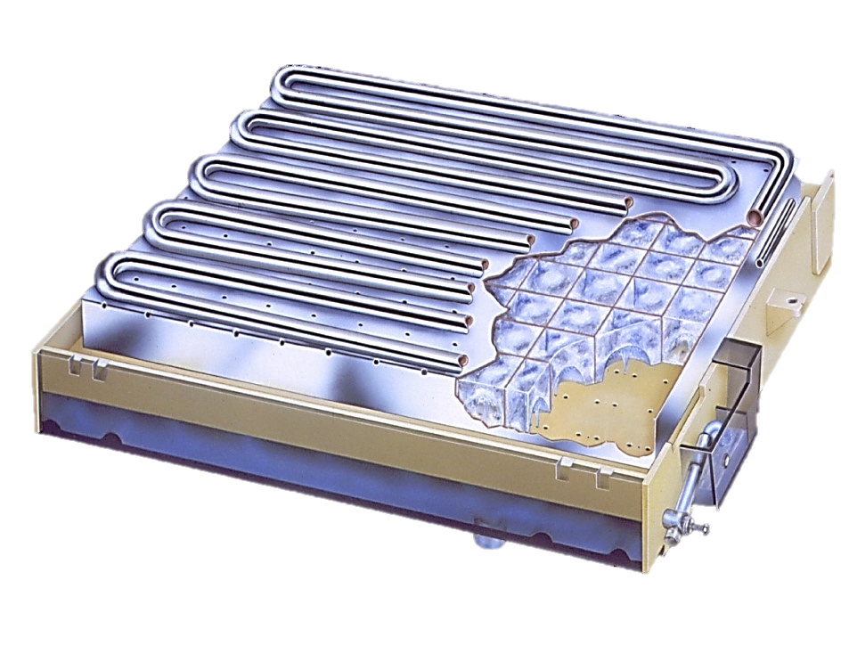
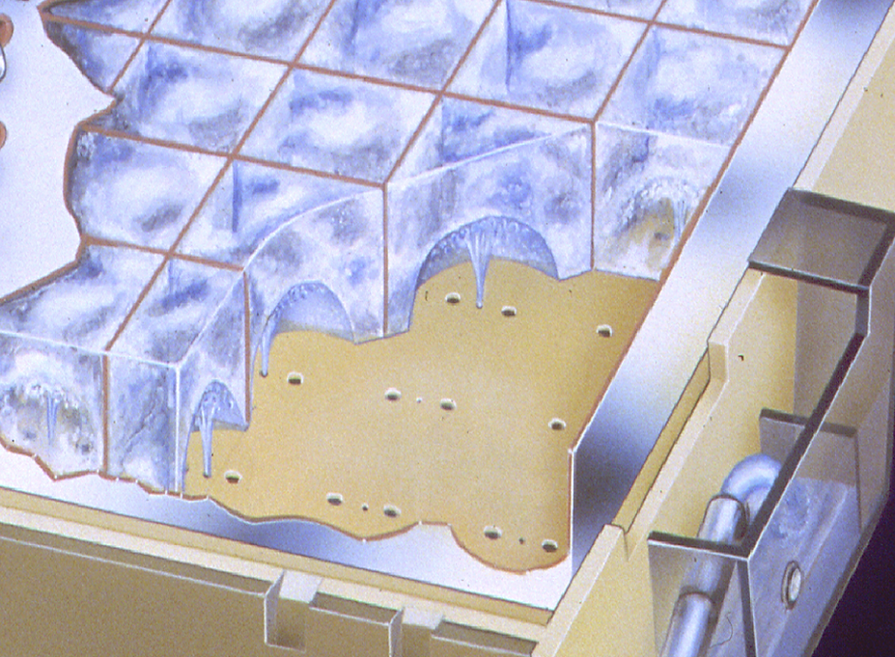
Modular Big Cube: About the Ice
Unique Horizontal Evaporator
Upside down freezing ensures that pure water is frozen first as gravity pulls away air and minerals
Beyond clearer and slower melting cubes, evaporator design provides consistency for cube size and density
Additionally, evaporator design reduces scale buildup between cleanings
Freeze/Harvest Cycle

Slide 8
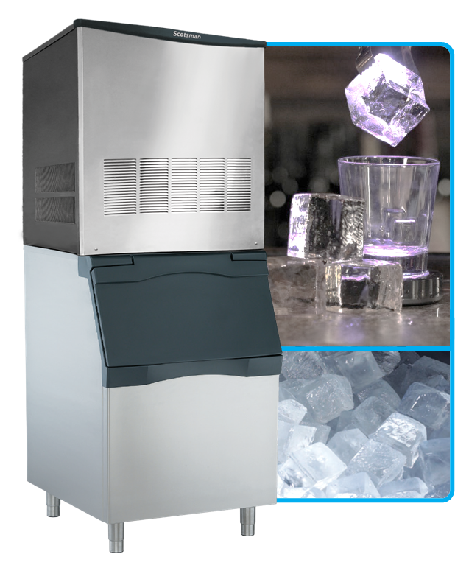
Modular Big Cube: Ease of Use
Features & Benefits
Adjustable Bin Level Probe
Automatically triggers production start/stop
Liquid Level Control
Evaporator thermostat and water level dual float switch ensure fully formed cubes
Harvest time adjustment
Ice thickness/dimple adjustment
Control Panel
Seven-segment display shows critical diagnostics for easy reference
“On/Off/Clean” switch
Durable Stainless-Steel Exterior Panels
Designed for maximum lifetime
Universal Bin Attachment Brackets Included
BC0530 recommended bins:
B330P, B530P, B530S
Notes:
Note: All ice cubes should have a small dimple on bottom side (size of pencil eraser)

Slide 9
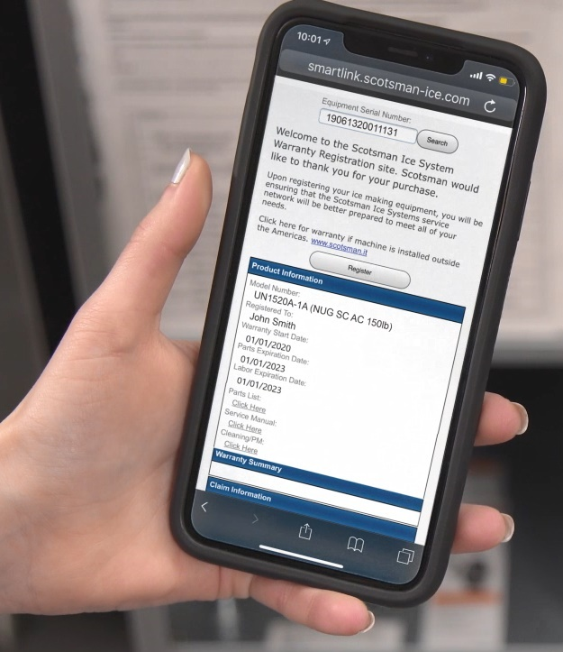
Modular Big Cube: Ease of Use
Quick Response (QR) Code
Each machine features a QR code that connects customers to vital unit specific information
Helps reduce downtime and frequency of service calls
QR code leads to a warranty registration page, auto-populated with the corresponding serial number
BC0530A-1A

Slide 10
Modular Big Cube: Ease of Use
Quick Response (QR) Code
Operators and service technicians can use their smart phone to scan the QR code to access instant warranty and technical information specific to that model
The product serial number will automatically populate the page
SCAN WITH YOUR SMART PHONE
Scanning Tip:
Many recent phone updates allow use of your phone’s built-in camera app to scan QR Code

Slide 11
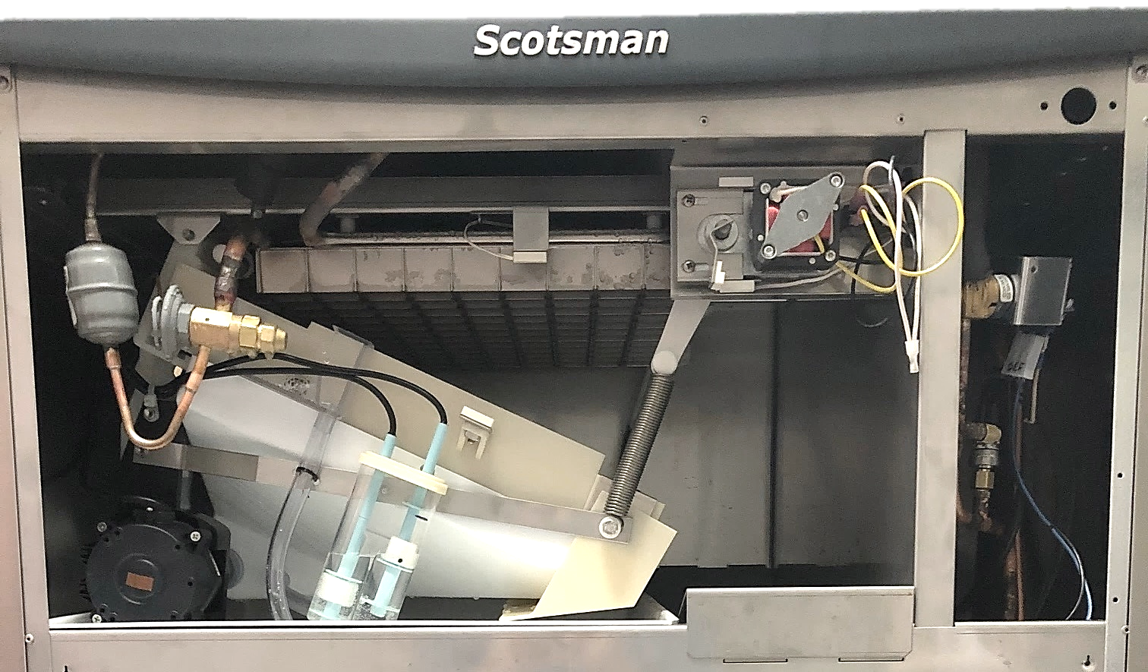
Modular Big Cube: Key Components
Evaporator
Actuator Motor
Water Pump
Easy front access for servicing
Water Level Float
Water Plate

Slide 12
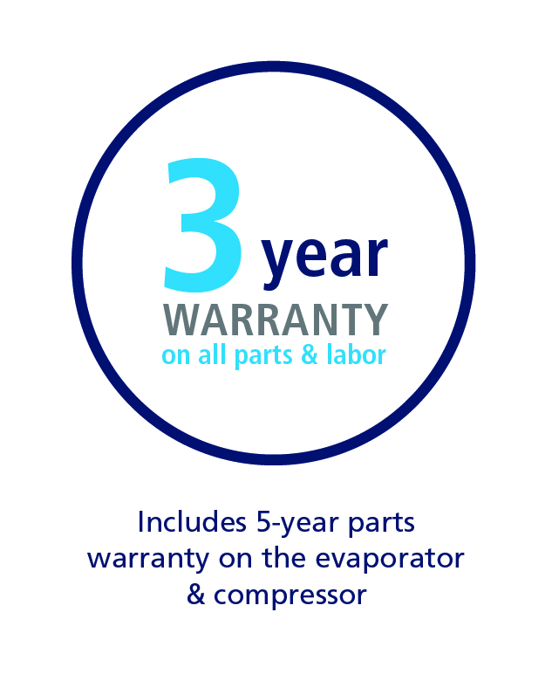
Modular Big Cube: Superior Reliability
Standing Behind Our Quality
Scotsman warranty for BC0530:
3-year parts and labor warranty on all components
5-year parts warranty on the evaporator and compressor
Warranty valid in North, South & Central America for commercial installations
Residential applications:
1-year parts and labor
BEST IN CLASS WARRANTY

