Slide 1


INTRODUCING
ICE & WATER DISPENSERS
SUPERIOR RELIABILITY, EASIER CLEANABILITY, ENHANCED SERVICEABILITY.

Slide 2
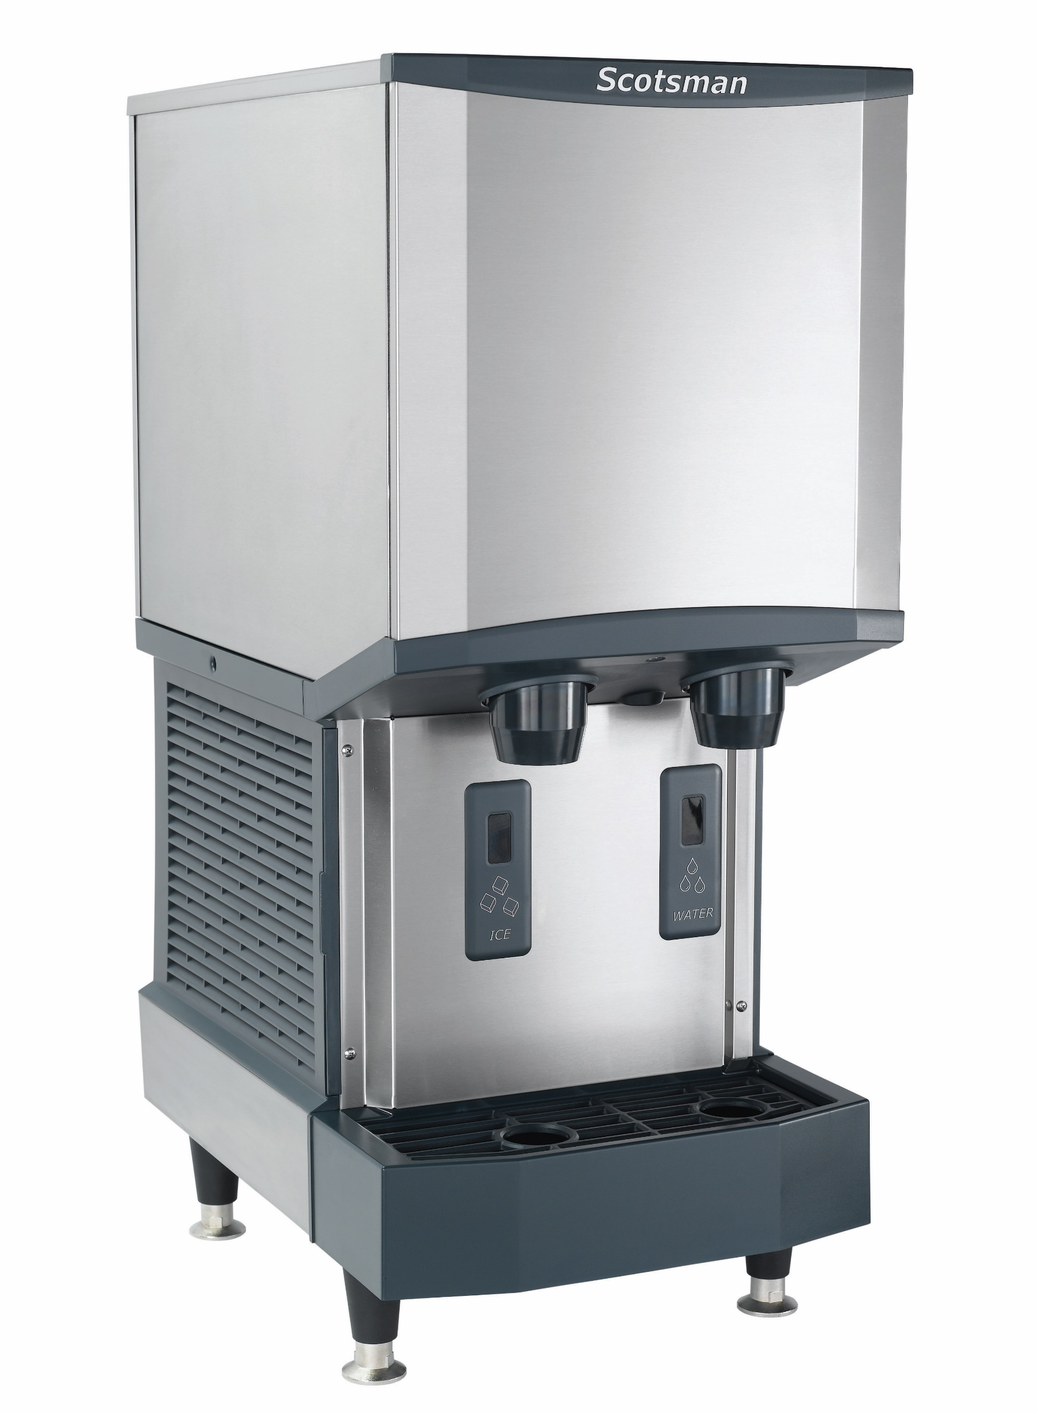
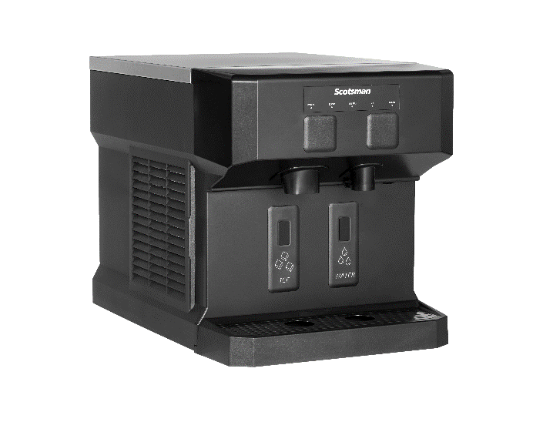
Meridian™ Ice & Water Dispensers
Reliable, Sanitary Operation:
Touch-Free and Push-Button models available
Born out of extensive market research, Meridian™ was developed with space, production and installation in mind — combining Scotsman’s trusted reliability, intuitive cleanability and time-saving serviceability with new innovations to deliver the softest, most satisfying ice on the market.

Slide 3

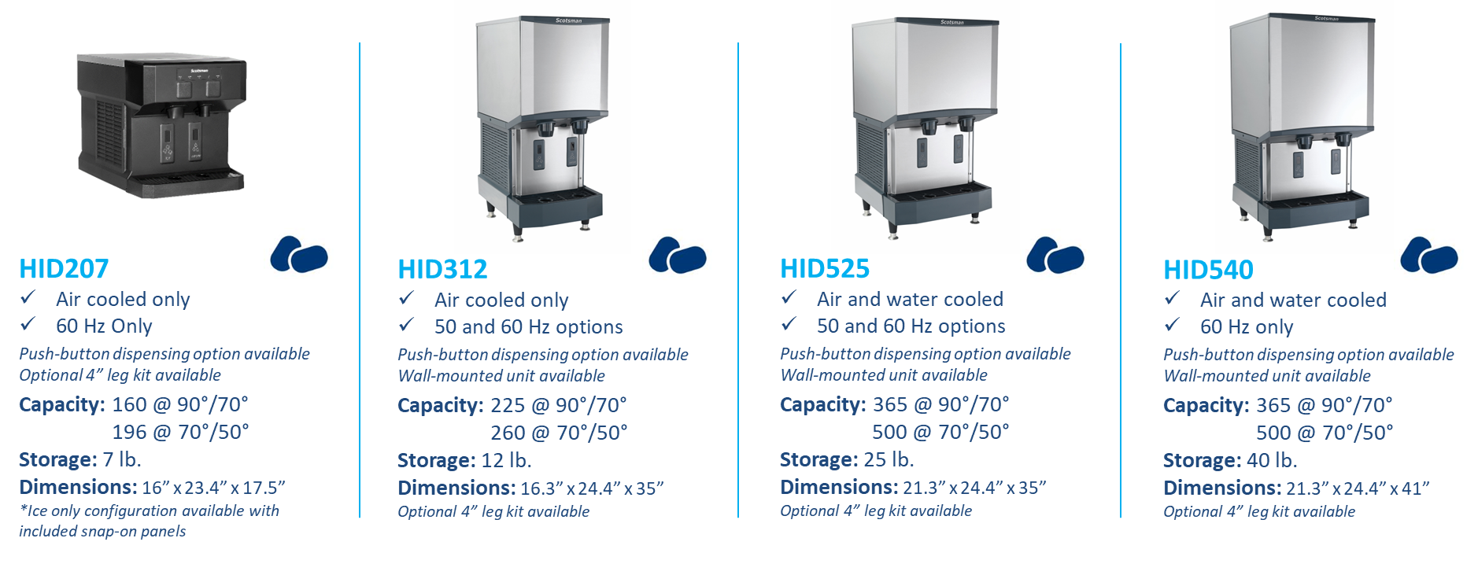
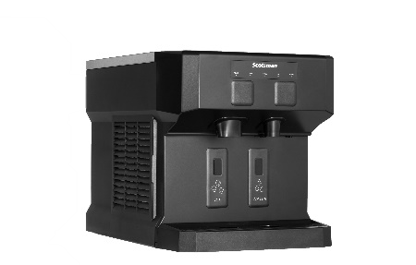

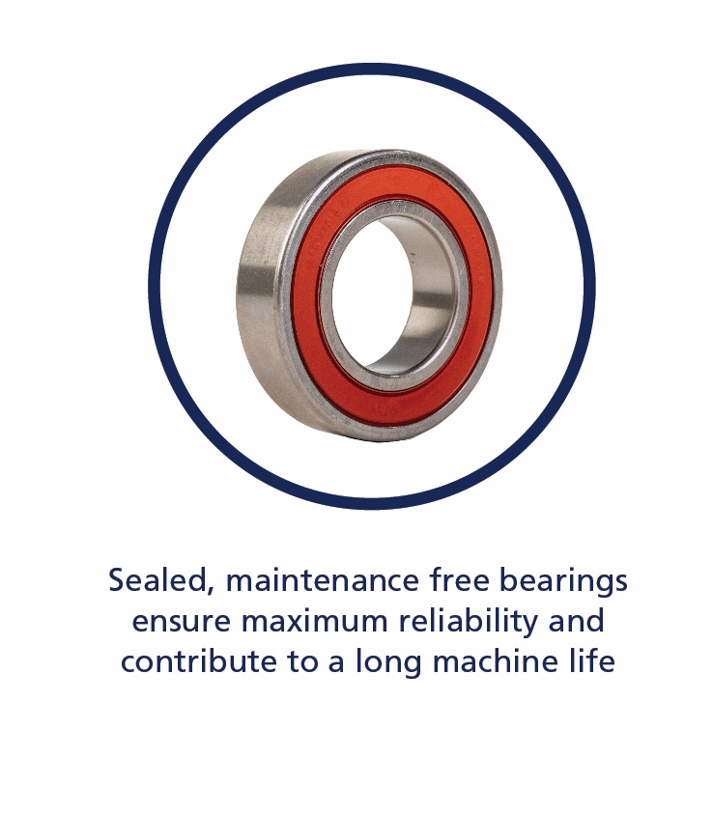


Ice & Water Dispensers: Overview
All models include power cord with NEMA 5-15P plug

Slide 4
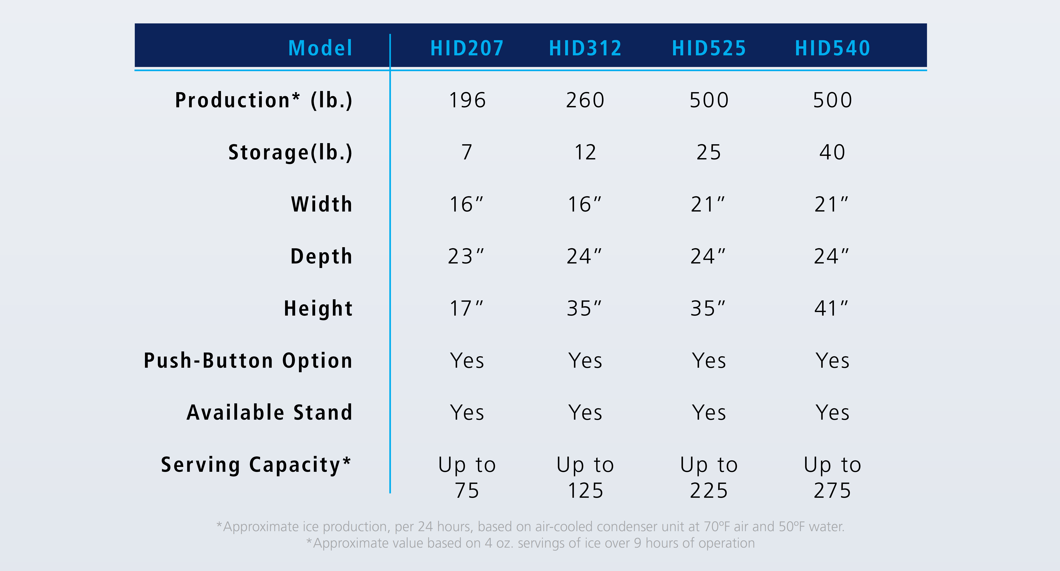
Ice & Water Dispensers: Overview
COMPACT
TRADITIONAL

Slide 5

INTRODUCING: HID207
COMPACT ICE & WATER DISPENSERS
VERSATILE, EMPHASIZING HEALTH & WELLNESS WITH SIMPLE OPERATION & SUPERIOR RELIABILITY.

Slide 6


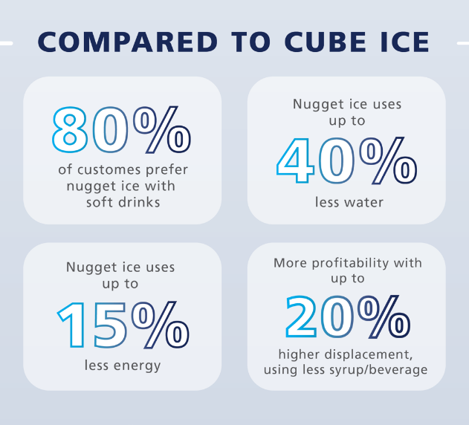


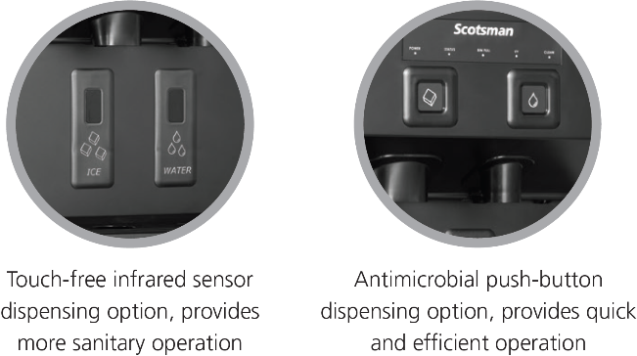

HID207: Overview
Operational Excellence
Dispenses Original, Chewable Nugget Ice
  Smallest, softest, most chewable nugget ice
  Up to 20% softer than competition for optimal mouthfeel
Environmental Responsibility
  Quiet operation for increased comfort in workplace or hospitality environments
    Due to improved condenser fan and elimination of noisy harvest cycles
  Uses R-290 refrigerant with zero ozone depletion potential, low GWP
HID207
Air-Cooled Only
60 Hz Only
*Ice only configuration available with included snap-on panels
Capacity: 160 @ 90°/70°
196 @ 70°/50°
Storage: 7 lb.
Dimensions: 16” x 23.4” x 17.5”
Optional 4” leg kit available
HID207AX-1
HID207ABX-1
Includes 6’ power cord with NEMA 5-15P plug

Slide 7
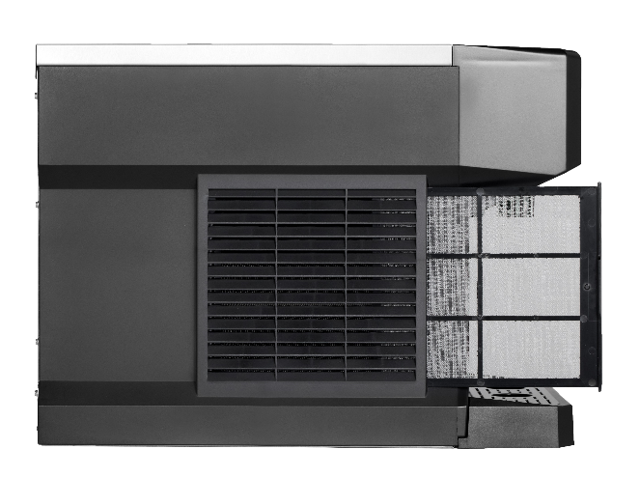
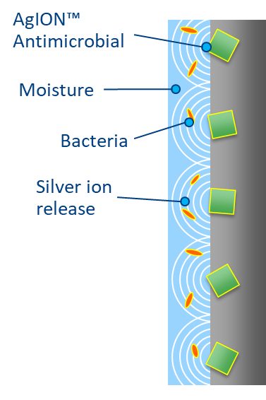
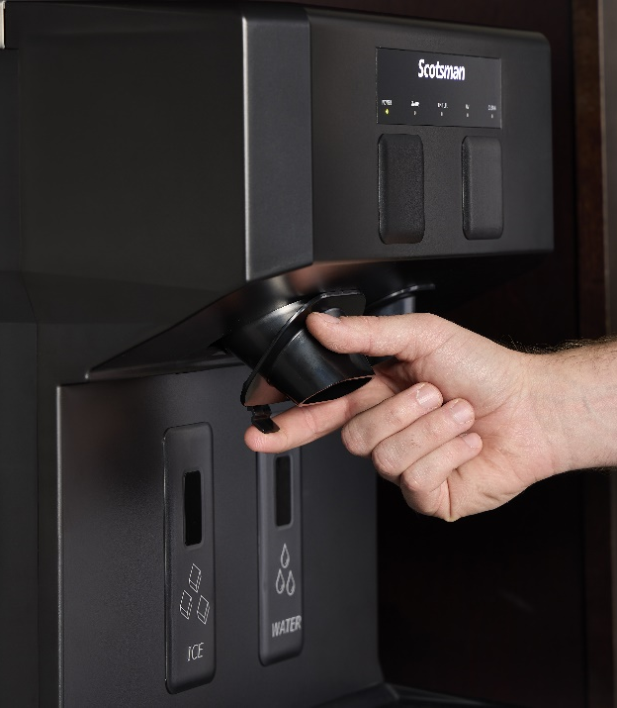
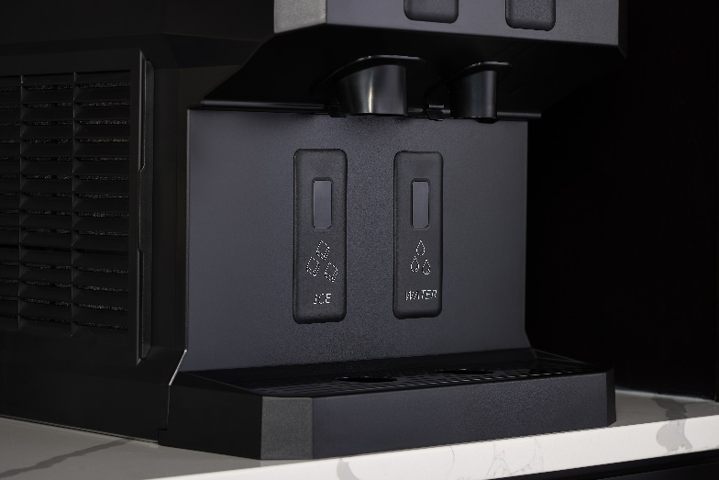
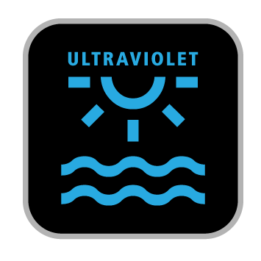
HID207: Health & Wellness
Health & Wellness
UV-LED Sanitation
  Internal UV module actively treats intake to ensure clean, refreshing ice and water
Sanitary Design
  AgION® antimicrobial technology is molded into key components to help inhibit the growth of microbes, bacteria, mold, and algae
  Sealed refrigeration system minimizes outside airborne contamination
Easily Removeable Components
  Fully removable air filter, chutes, sink, grill, and bin allow for easy cleaning and maintenance
Purpose-Built Spout Design
  Angled front housing provides visibility and easy access for cleaning of spouts and splash panel

Slide 8
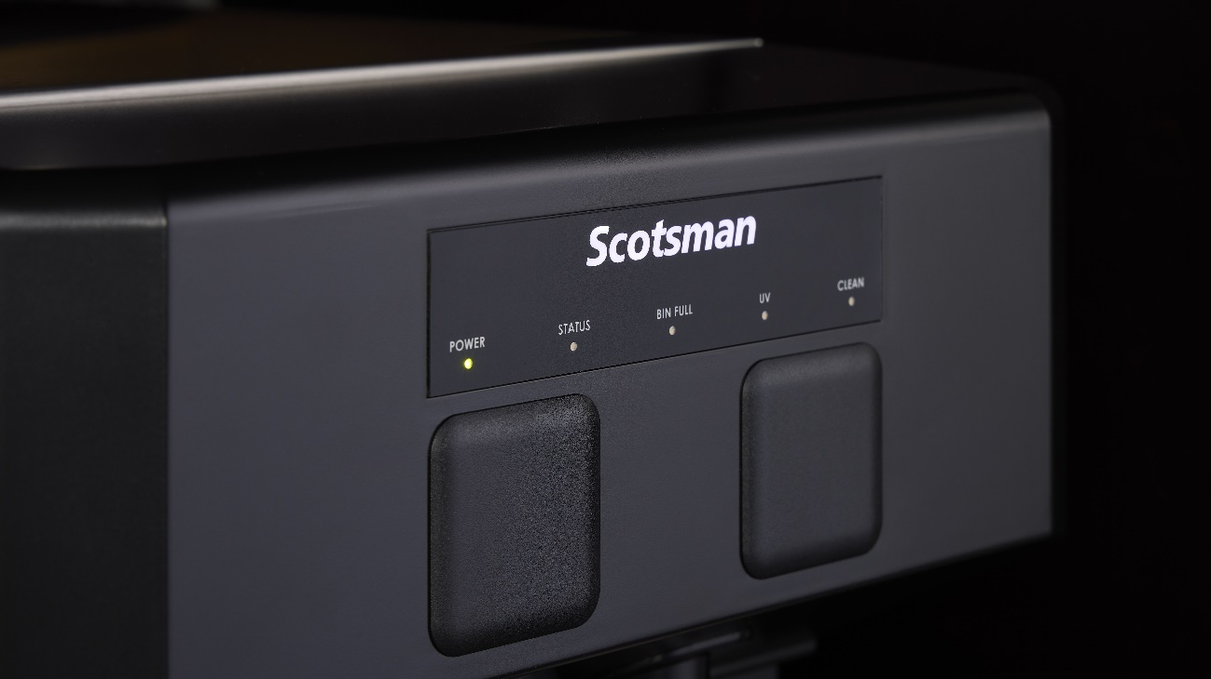
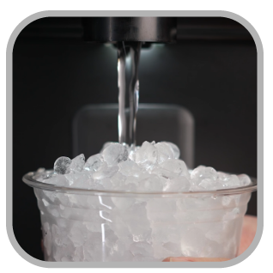
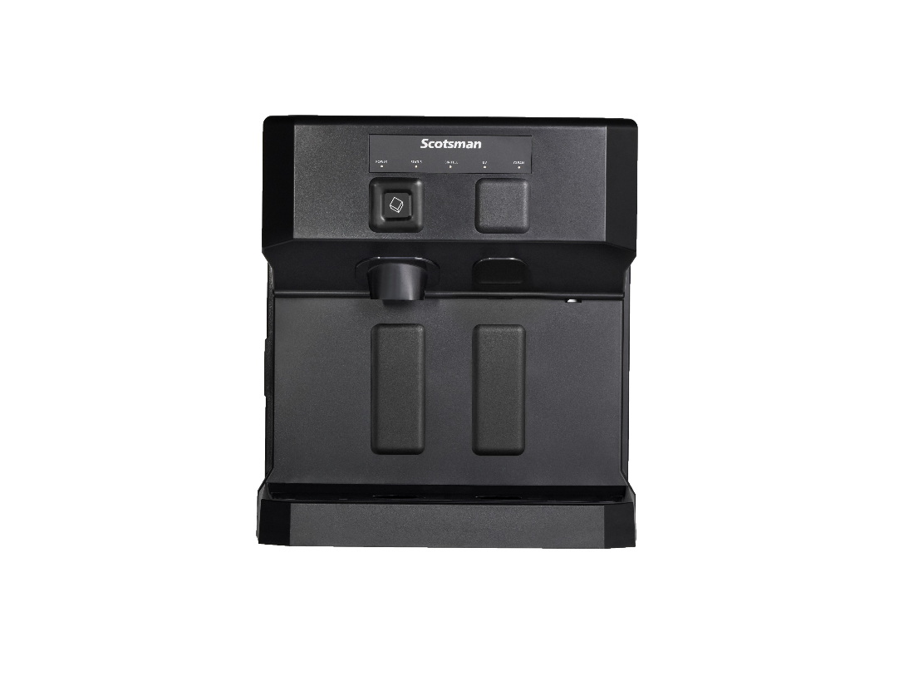
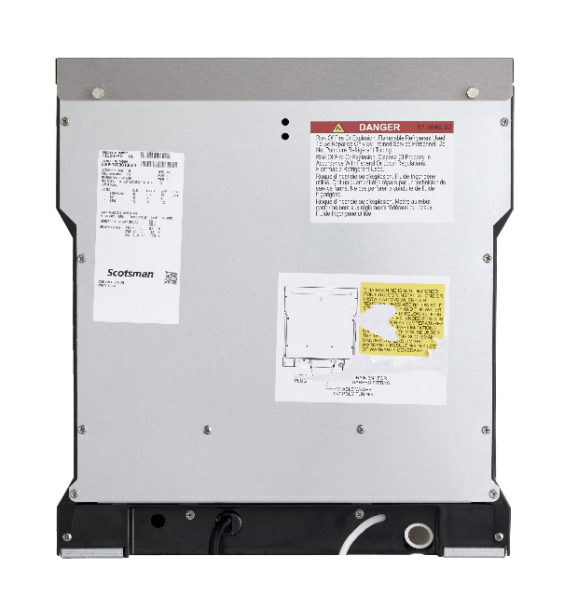

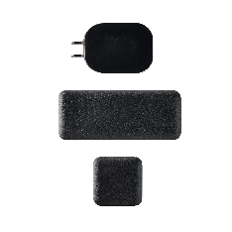
HID207: Ease of Use
Ease of Use
AutoAlert™ Indicator Panel
  Intuitively displays relevant machine status that is visible across the room
SmoothStream™ Water Dispensing Technology
  Combined with illuminated dispensing to reduce splashing while keeping the machine and surrounding areas clean
Compact Design
  Features unique contoured sides for enhanced breathability and tight installs
  Recessed utility chase for tight installs
ADA Compliant Dispensing Area
  Touch-free and push-button models meet ADA reach range requirements
Flexible Configuration
  Ice only configuration available with included snap-on panels

Slide 9
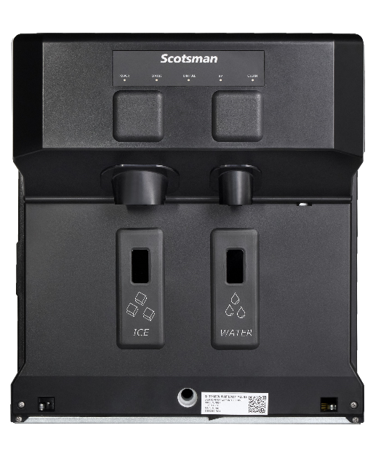
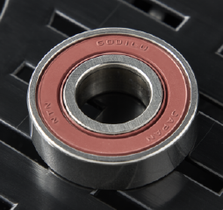
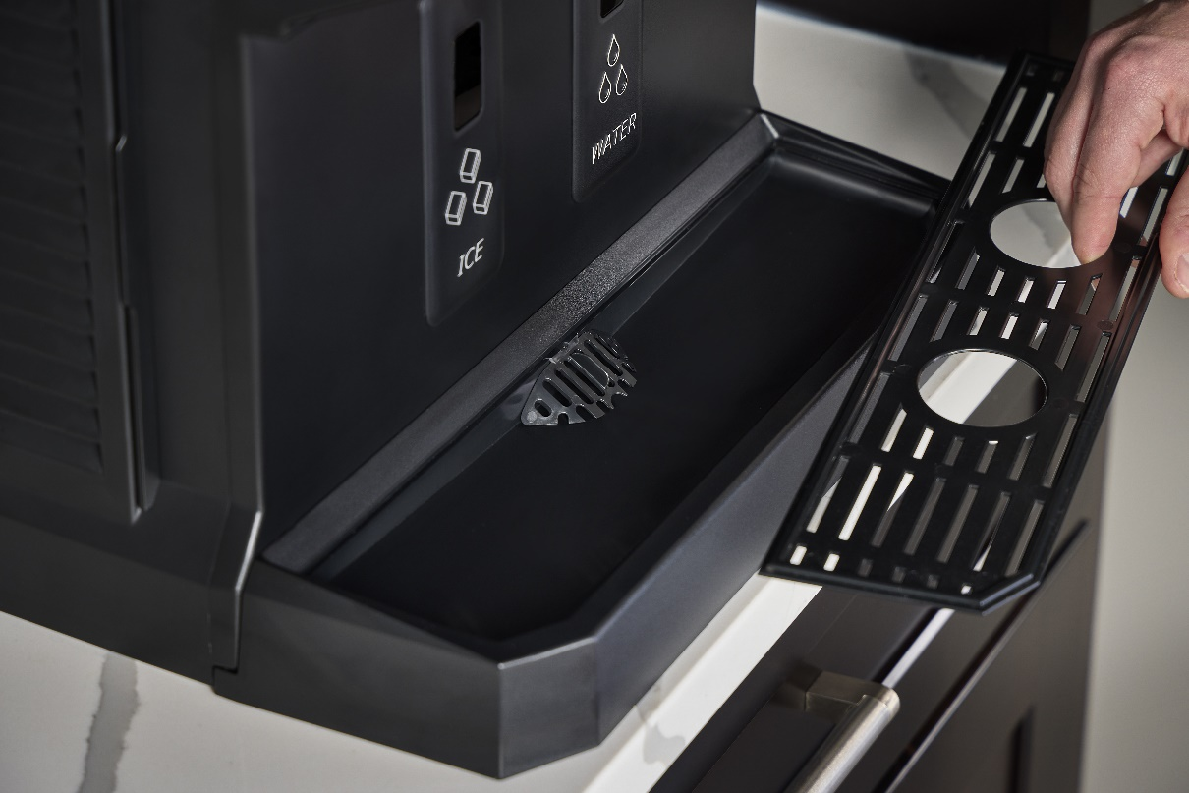

HID207: Enhanced Reliability
Enhanced Reliability
Sealed, Maintenance-Free Bearings
  Reduces preventative maintenance and extends unit longevity
Maximum Uptime
  Integrated drain cover and consolidated drain ensures reliable operation
  Unit-specific QR code for easy access to service manuals, cleaning instructions, warranty history, and other machine information
Heavy-Duty Internal Components
  Durable stainless-steel evaporator and auger
Category Best Warranty
  3-year parts and labor on all components
  5-year parts on compressor and condenser
  Designed, Engineered, Assembled in USA
    100% of machines are run tested before shipment

Slide 10
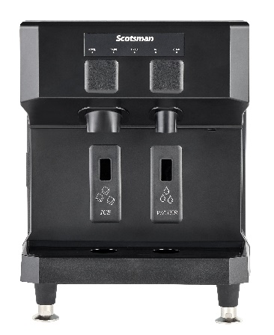
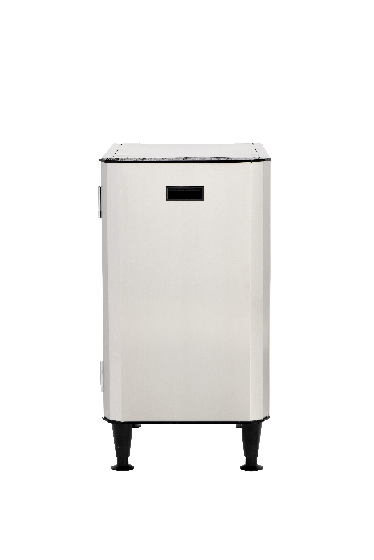
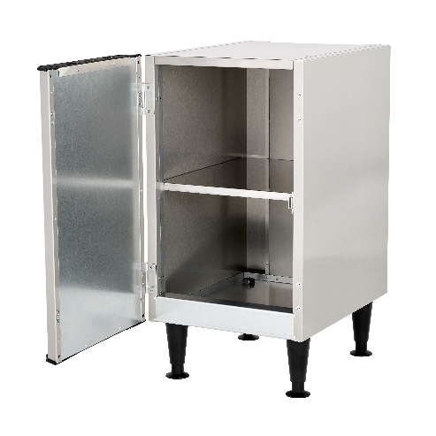
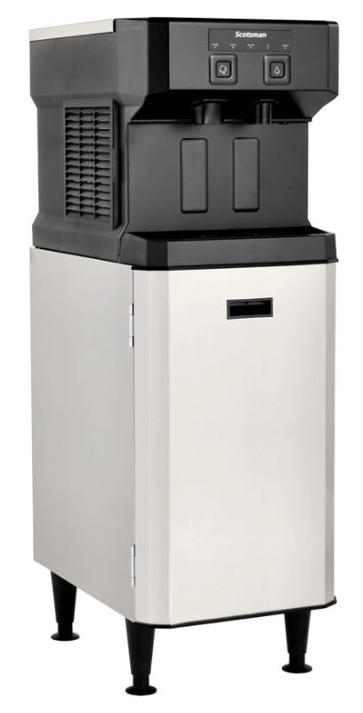
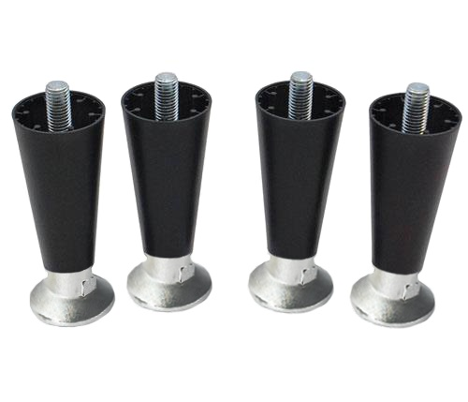
HID207: Accessories
KLP24A Adjustable Legs
Optional 4” adjustable legs for easy cleaning beneath unit
HSTCD16-A Machine Stand
Optional machine stand allows for freestanding configuration
“CD”: Compact Dispenser
Reversible Door + Storage Shelf
Includes 6” adjustable legs
Service Kits:
Touch-Free to Push-Button Conversion
Push-Button to Touch-Free Conversion

Slide 11
INTRODUCING: TRADITIONAL
ICE & WATER DISPENSERS
SPECIFIC FEATURES - HID312 | HID525 | HID540

Slide 12
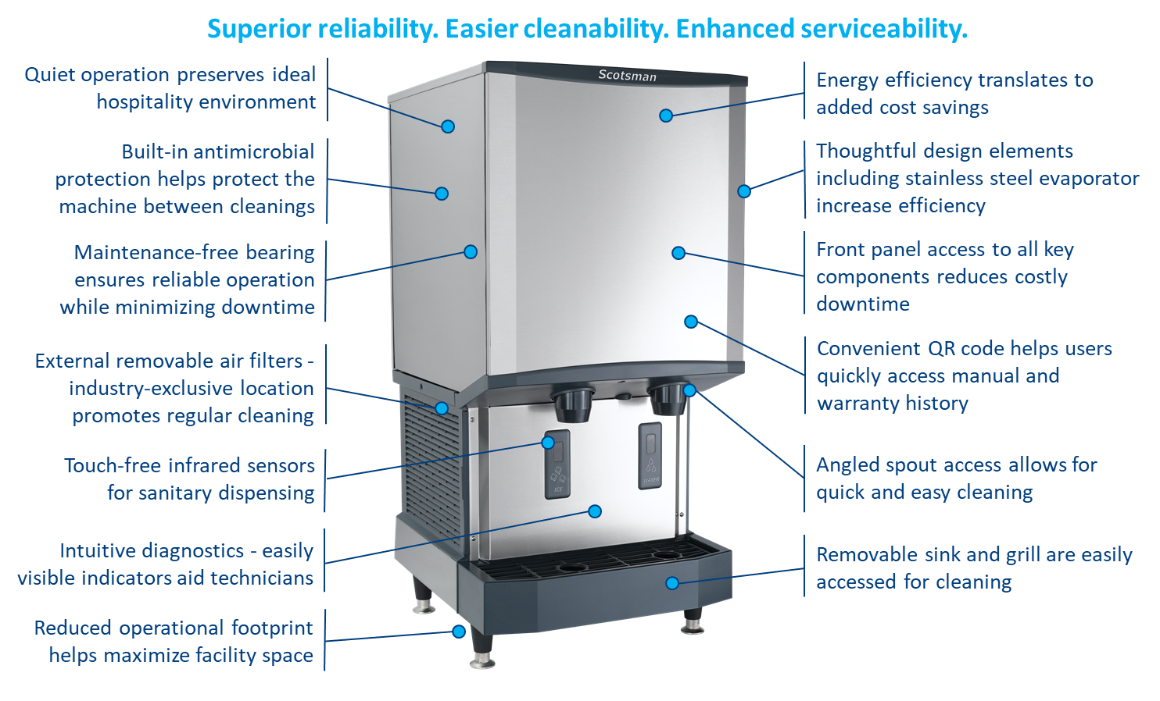
Meridian™ Series Difference

Slide 13
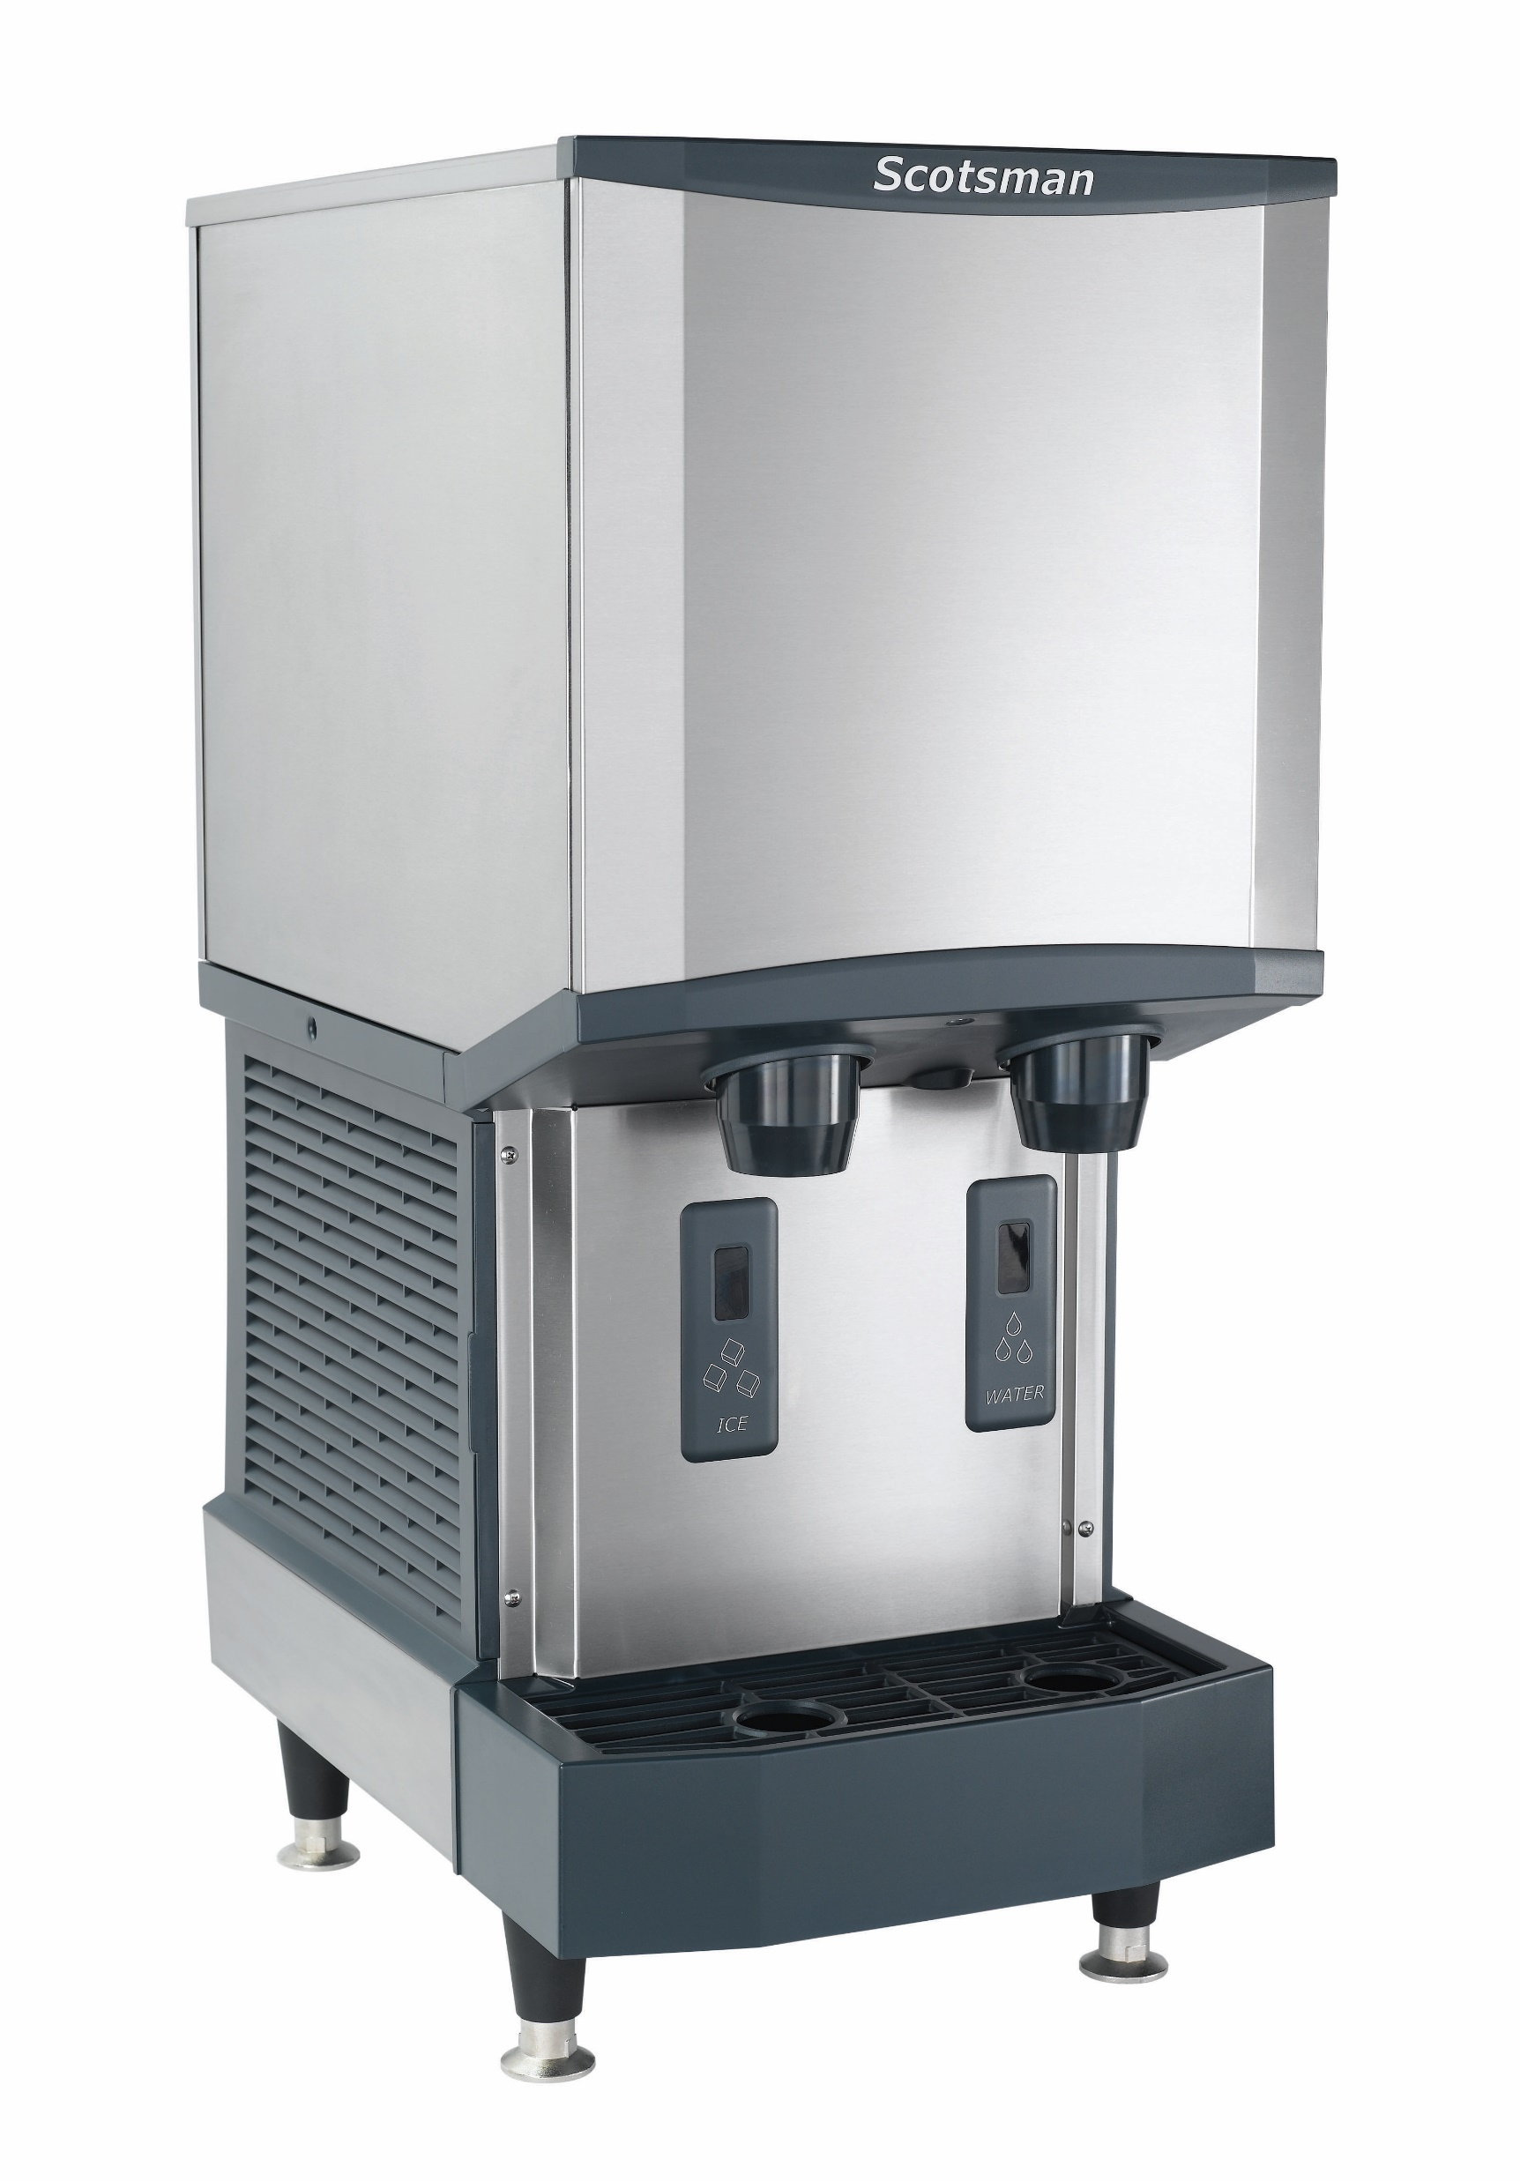
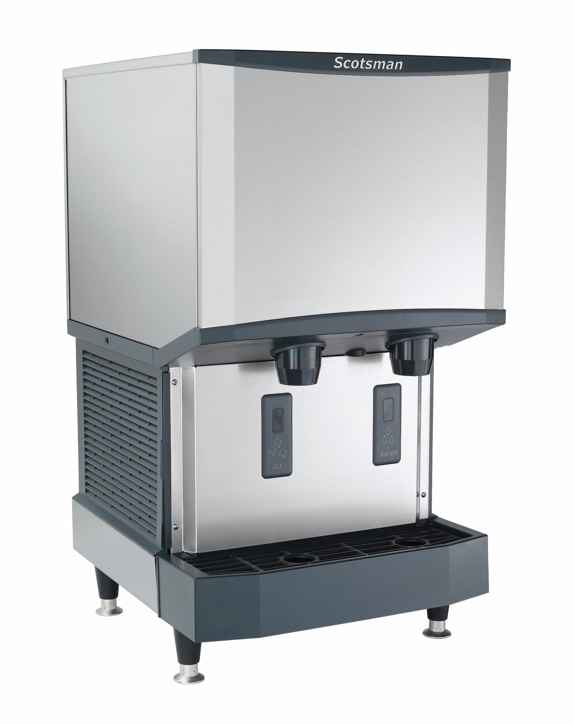
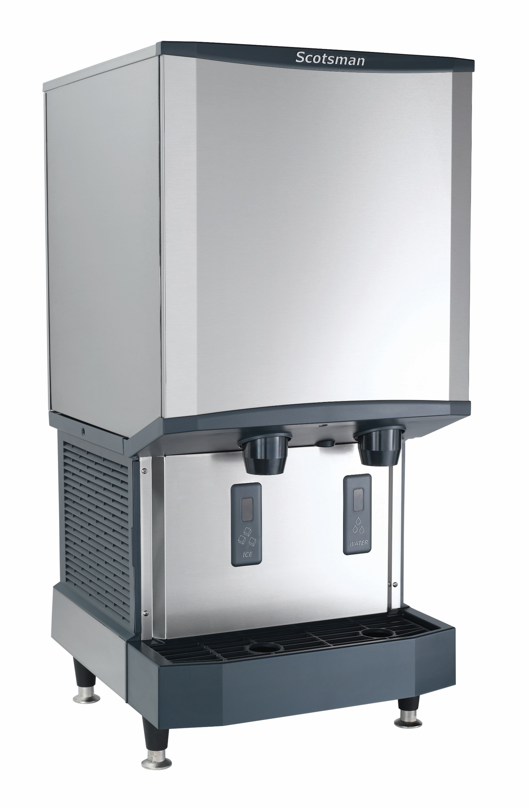
Ice & Water Dispensers: Overview
HID312
Air cooled only
50 and 60 Hz options
Push-button dispensing option available
Wall-mounted unit available
Capacity: 225 @ 90°/70°
260 @ 70°/50°
Storage: 12 lb.
Dimensions: 16.3” x 24.4” x 35”
Optional 4” leg kit available
HID525
Air and water cooled
50 and 60 Hz options
Push-button dispensing option available
Wall-mounted unit available
Capacity: 365 @ 90°/70°
500 @ 70°/50°
Storage: 25 lb.
Dimensions: 21.3” x 24.4” x 35”
Optional 4” leg kit available
HID540
Air and water cooled
60 Hz only
Push-button dispensing option available
Wall-mounted unit available
Capacity: 365 @ 90°/70°
500 @ 70°/50°
Storage: 40 lb.
Dimensions: 21.3” x 24.4” x 41”
Optional 4” leg kit available
All models include 7.5’ power cord with NEMA 5-15P plug

Slide 14
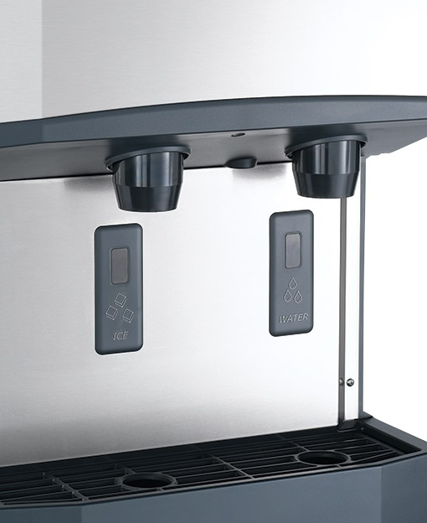
Meridian™ Series: Touch-Free Dispensing
Touch-Free Technology
Touch-free, infrared dispensing of ice and water eliminates the need to physically touch the dispenser for more sanitary operation
Scotsman’s infrared design was an industry first, eliminating levers and buttons while minimizing the possibility of cross-contamination
NSF-compliant

Slide 15
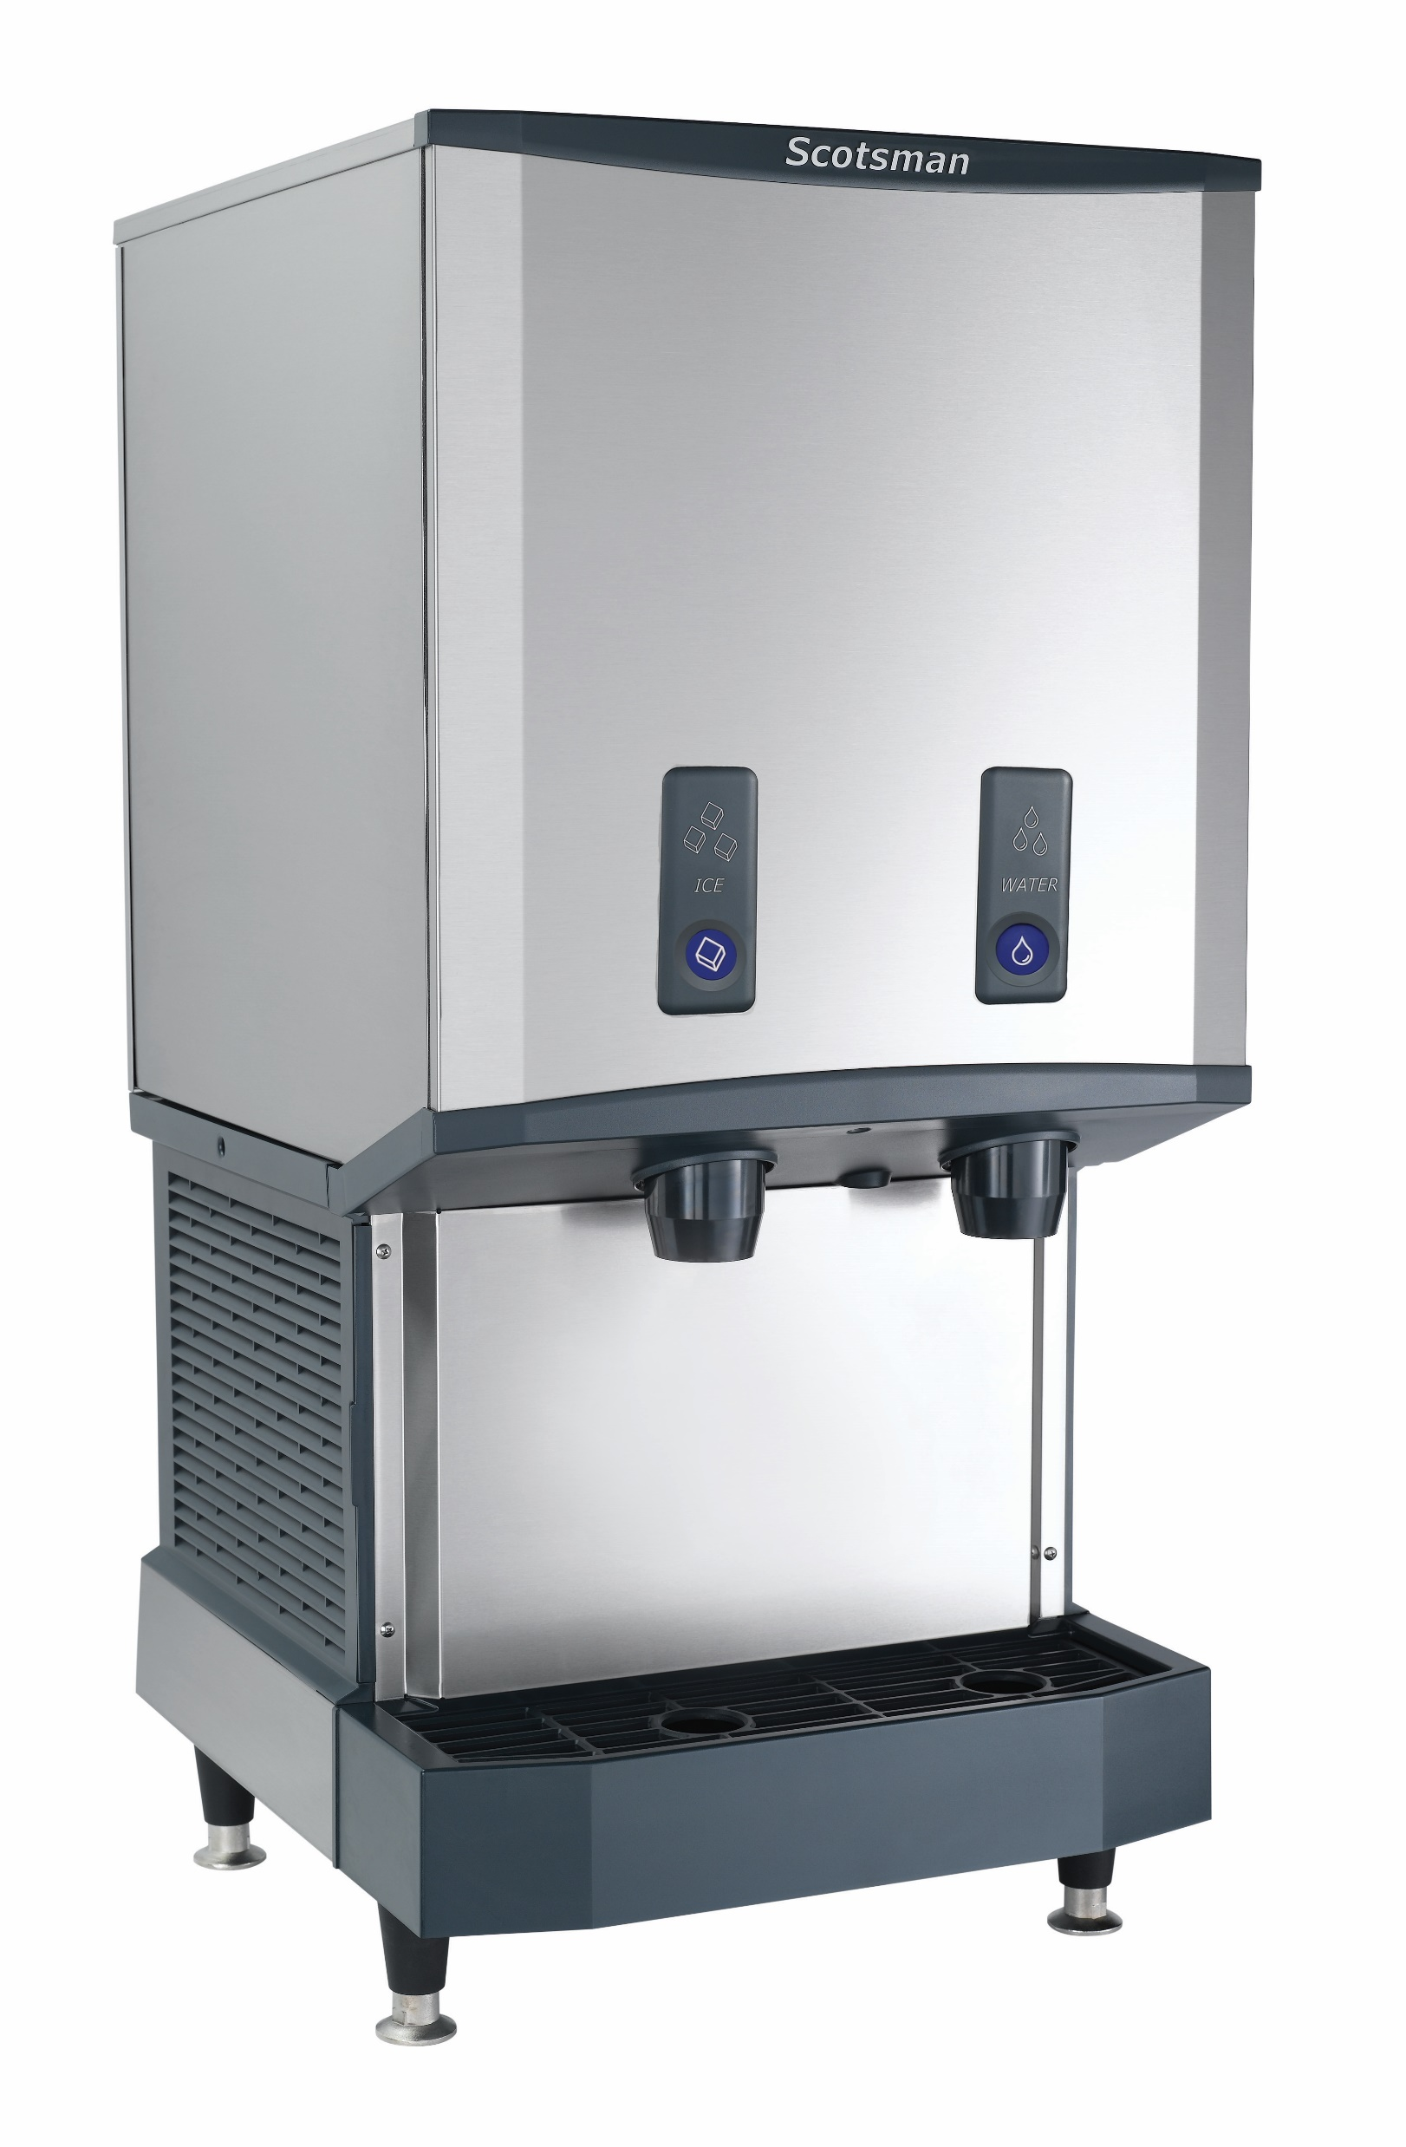
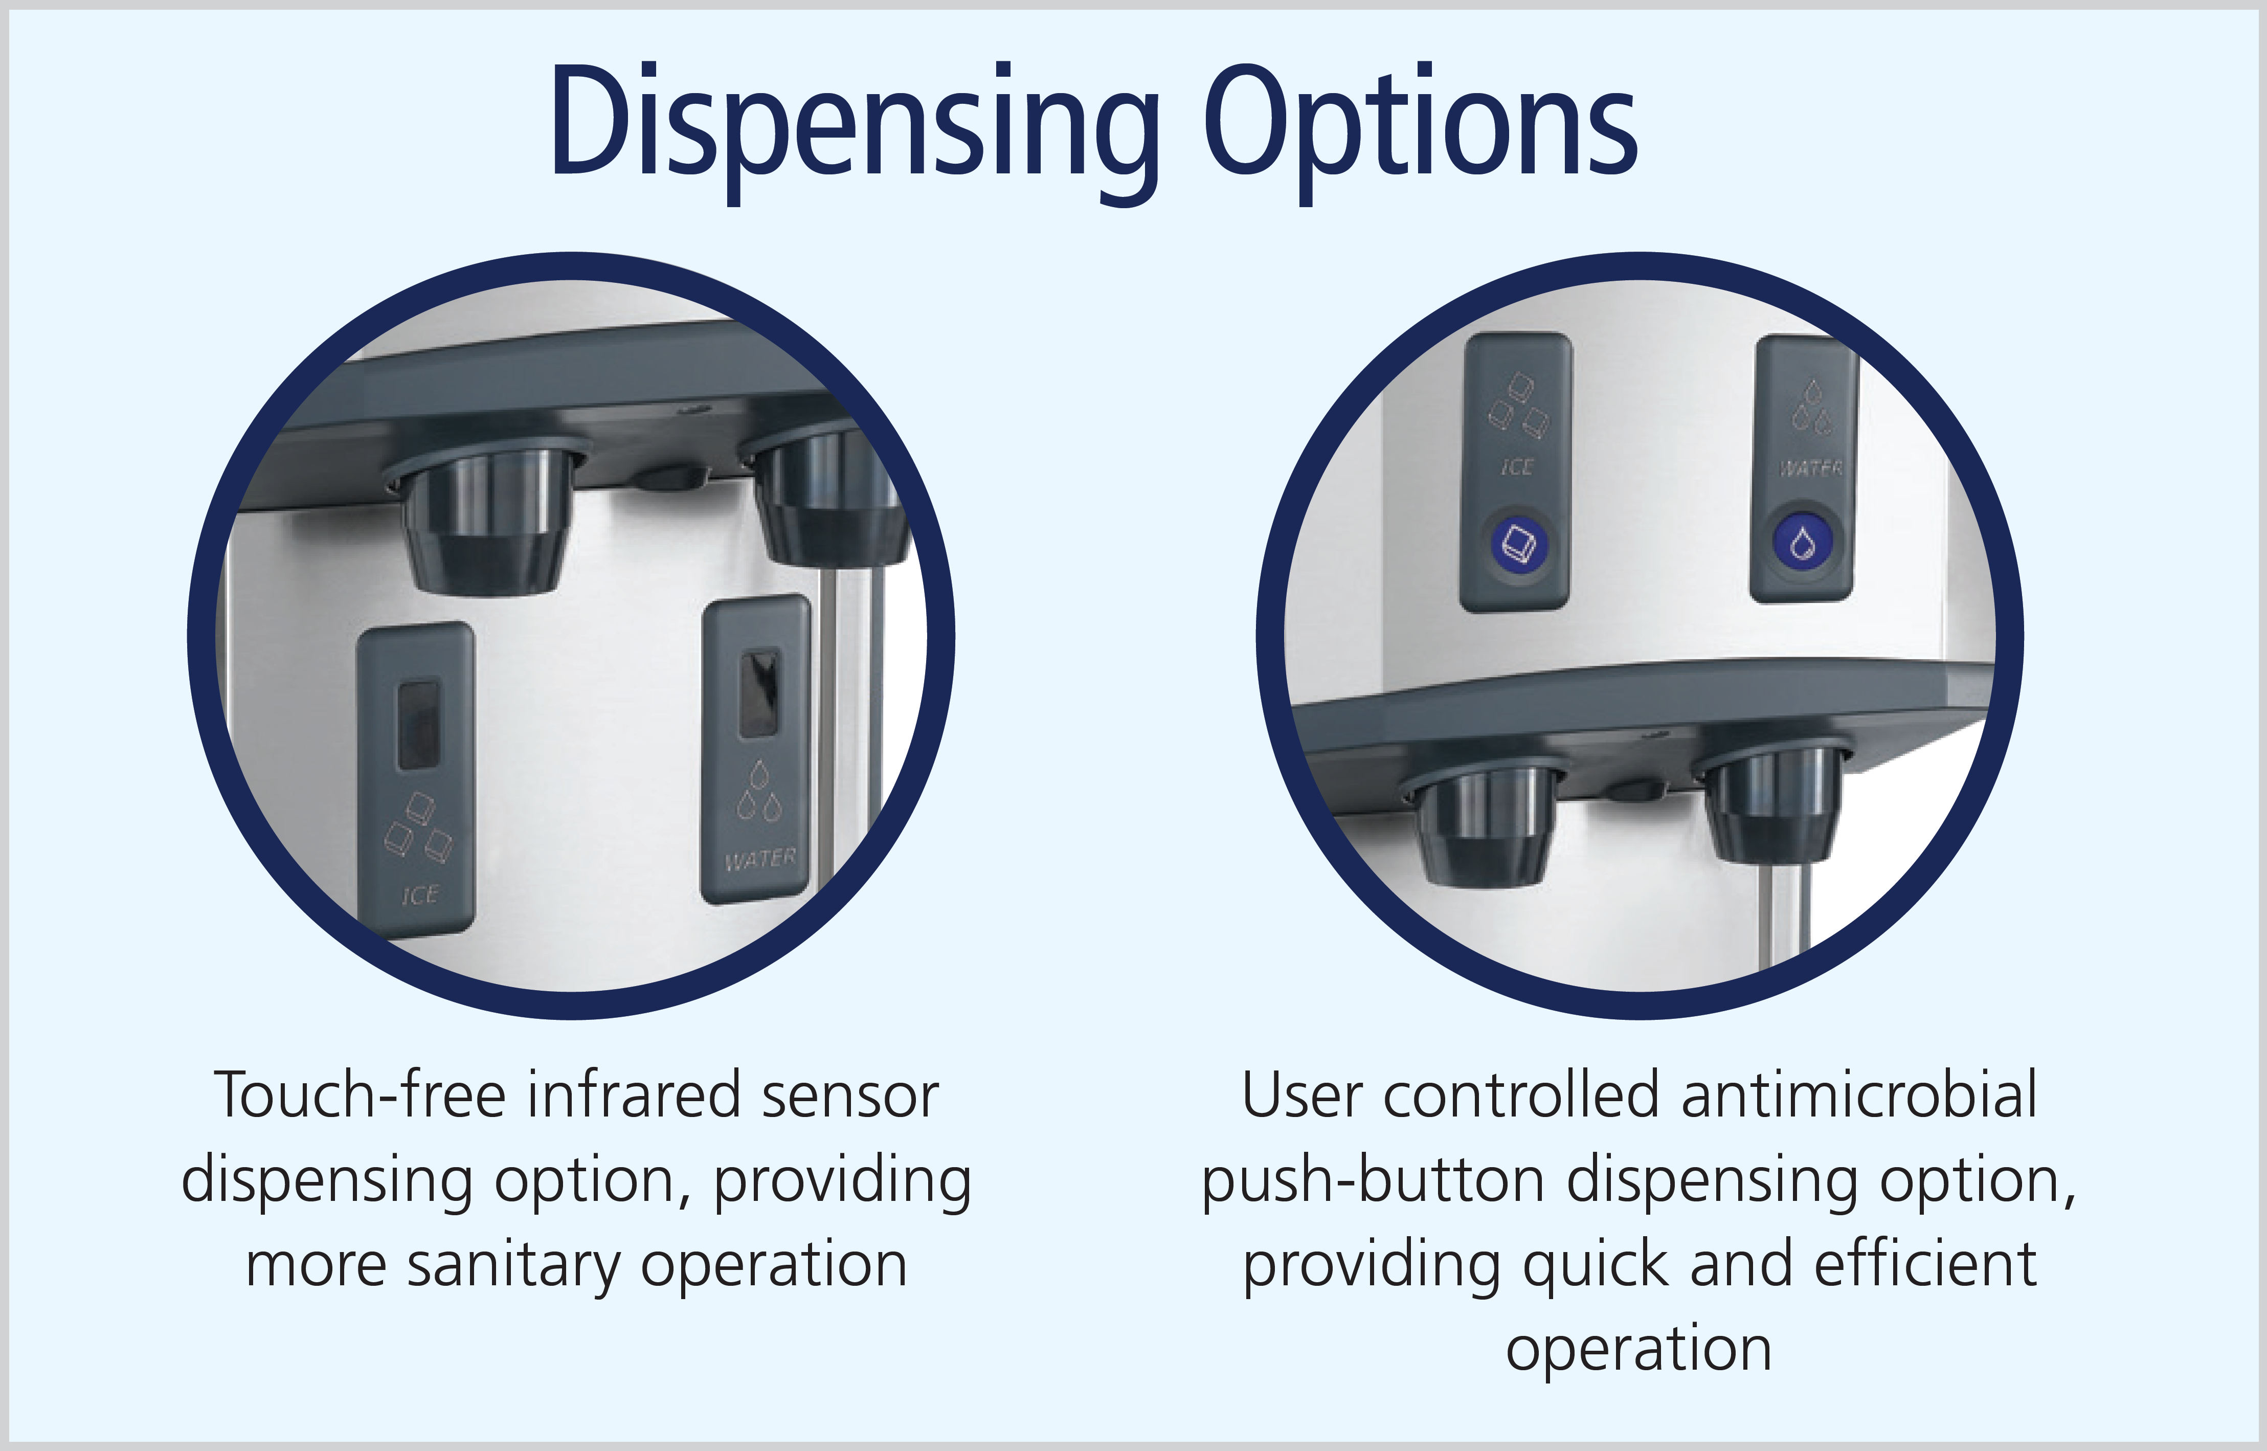
Meridian™ Series: Push-Button Option
Choice of Dispensing Method
Push-Button Models Available:
  HID312AB-1
  HID525AB-1, HID525WB-1
  HID540AB-1, HID540WB-1

Slide 16
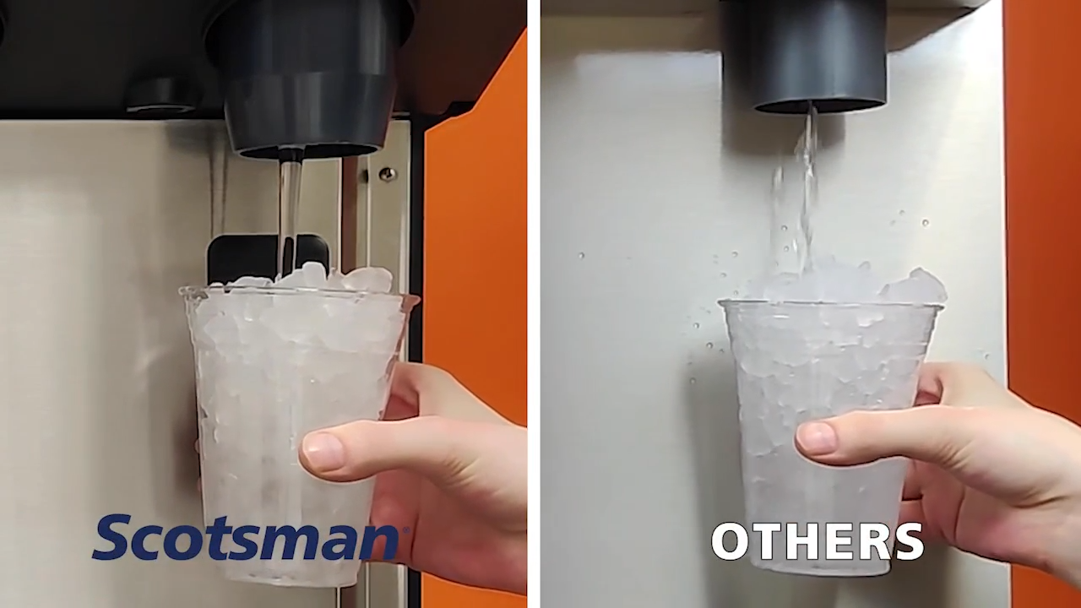

Meridian™ Series: SmoothStream™
SmoothStream™ Water Dispensing
Reduces splashing to keep the machine and surrounding areas clean
Produces a fast-filling, consistent stream
SmoothStream™ technology is now standard on all new units
  Kit available to convert existing units
OTHERS

Slide 17
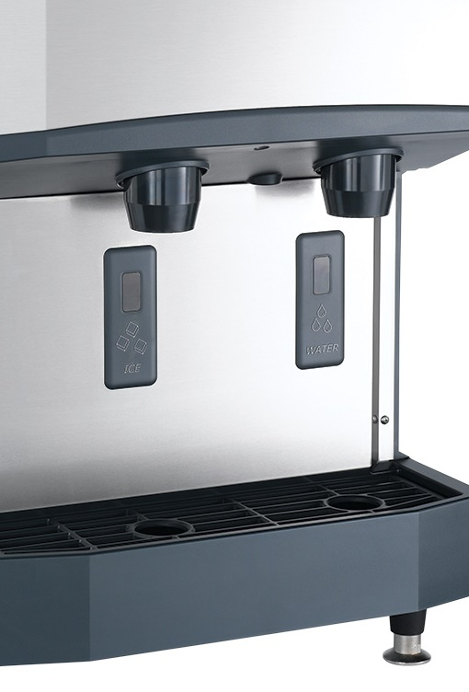
Meridian™ Series: Superior Reliability
Reliable Dispensing
Touch-free infrared sensors feature best-in-class technology to intuitively sense the start and duration of dispensing
11” enlarged dispensing envelope and offset placement of spouts optimizes space from spout to sink, easily accommodating a variety of container shapes and sizes — from small cups to large pitchers
Scotsman’s exclusive H² Nugget optimizes dispensability while providing the softest, most chewable ice form available

Slide 18
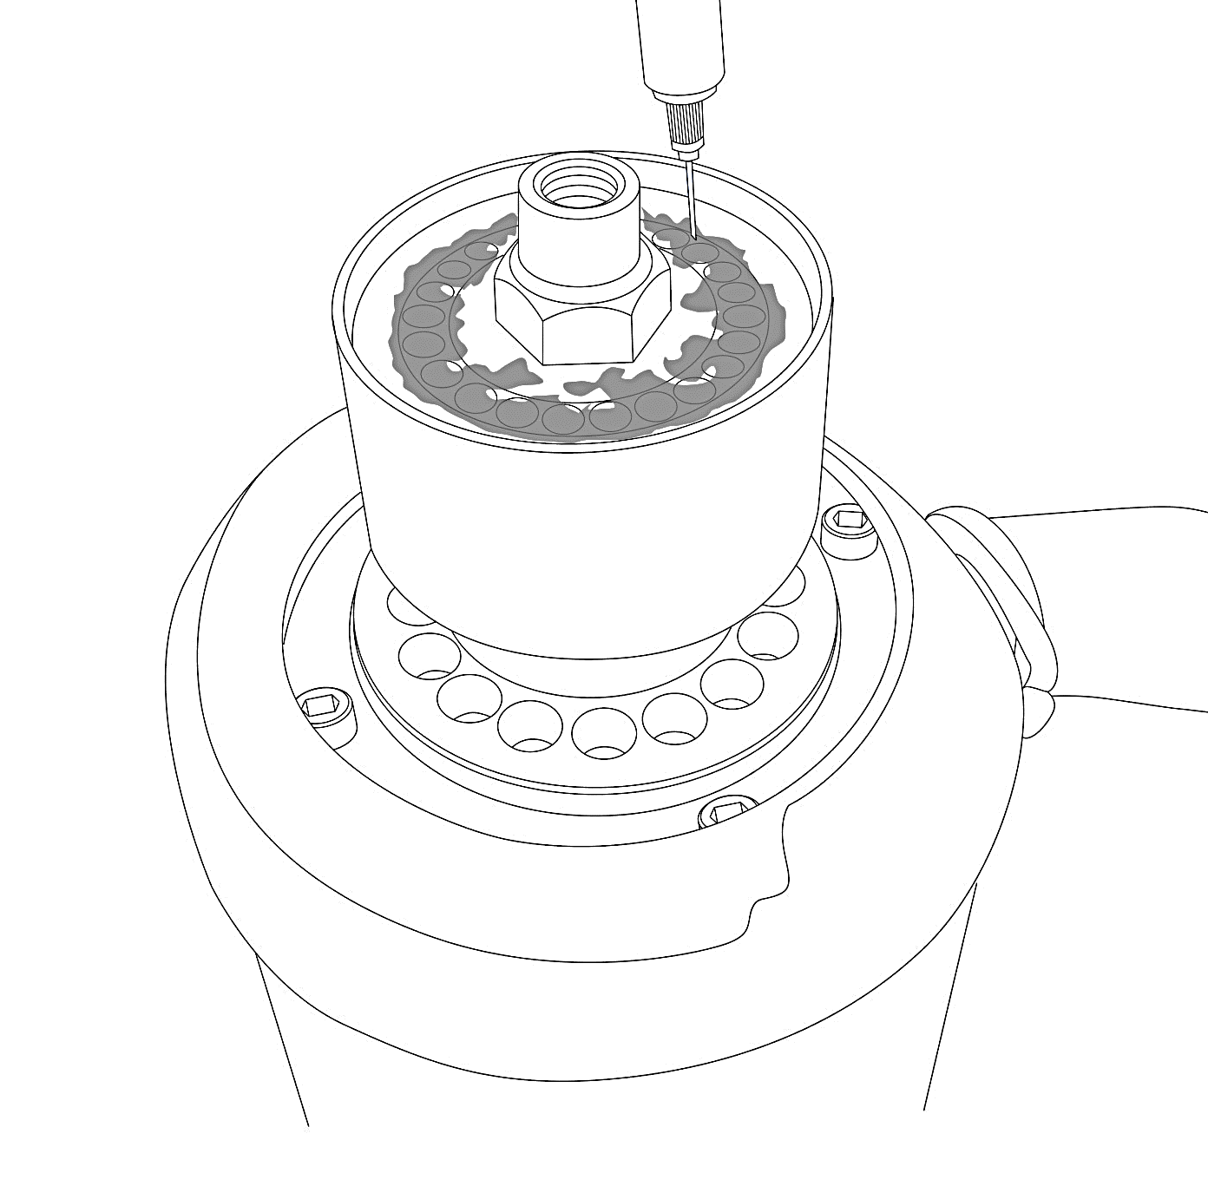
Meridian™ Series: Superior Reliability
Maintenance-Free Bearing
The Problem: Components used to create compressed ice require maintenance for routine checks, specifically with wearable parts like bearings or bushings
Innovation: All Meridian™ models feature proprietary, maintenance-free bearings, fully sealed with a high-tech polymer that lubricates and eliminates the need for greasing
Scotsman’s exclusive technology has no wearable parts or grease, which reduces preventative maintenance and ensures long-lasting performance
Eliminates the use of industry standard ball bearings/bushings, which require time consuming maintenance or replacement

Slide 19
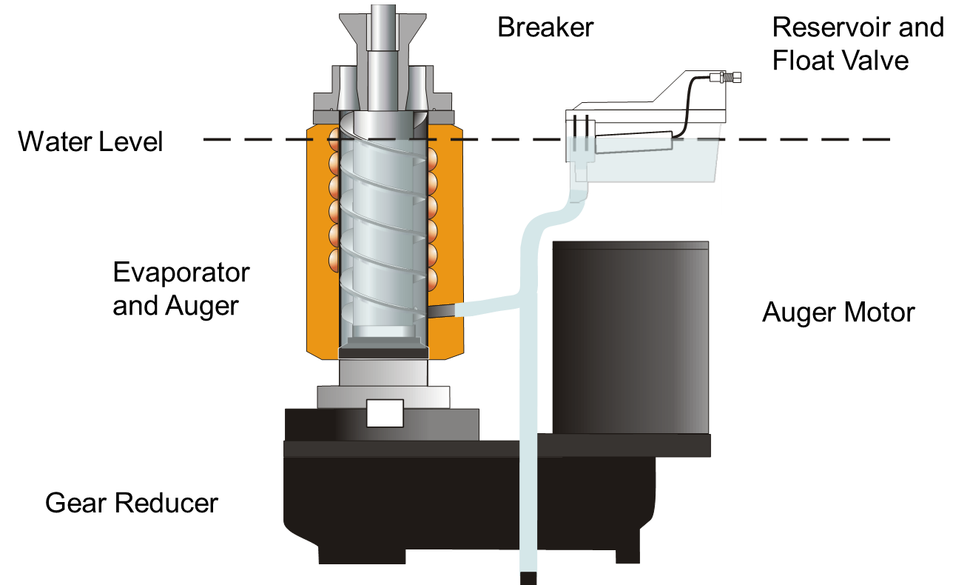
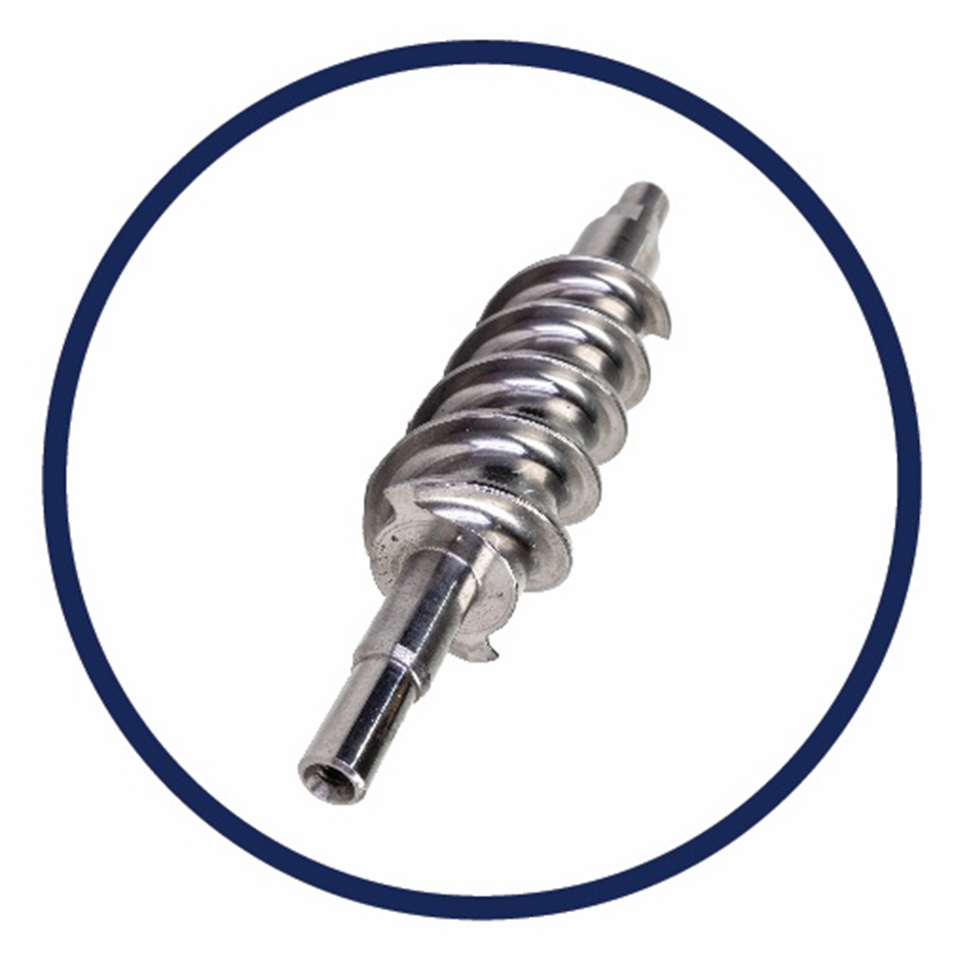
Meridian™ Series: Superior Reliability
Heavy-Duty Stainless-Steel Components
Scotsman’s Ice & Water Dispensers feature:
  An extremely reliable stainless-steel evaporator
  Durable stainless-steel auger
Ensures maximum durability and reliability for a long machine life

Slide 20
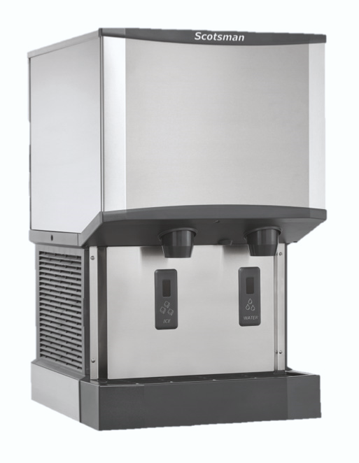
Meridian™ Series: Enhanced Sanitation
Built-In Antimicrobial Protection
Meridian™ units are designed to ensure sanitary operation, especially between cleanings
Sealed refrigeration system minimizes outside airborne contamination
AgION® and other antimicrobial compounds are molded into key internal and external components to help inhibit the growth of microbes, bacteria, mold and algae
AgION™ Antimicrobial
Moisture
Bacteria
Silver ion release

Slide 21
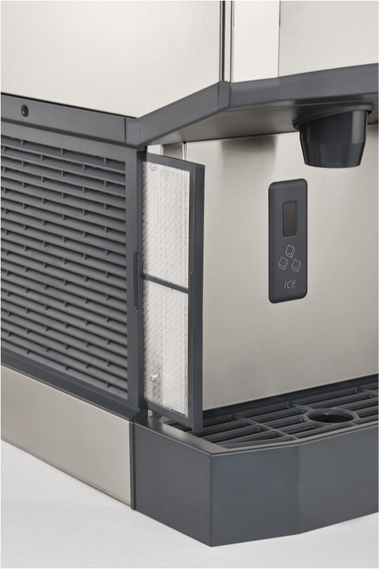
Meridian™ Series: Easier Cleanability
External Removable Air Filter
Industry-exclusive external filter location makes access, rinsing and reusing fast and easy
Better visibility keeps regular cleaning top of mind, ensuring maximum performance and optimal sanitation
No tools required for removal, unlike the competition

Slide 22
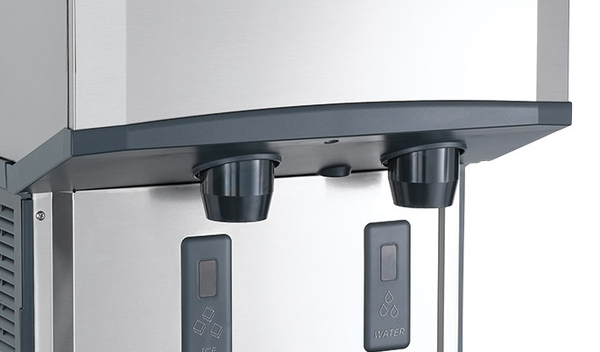
Meridian™ Series: Easier Cleanability
Purpose-Built Spout Design
Angled front housing provides visibility and access to spouts
Makes easier cleaning possible in order to prevent unsightly buildup
Fully removable spouts allow for easy cleaning and maintenance

Slide 23
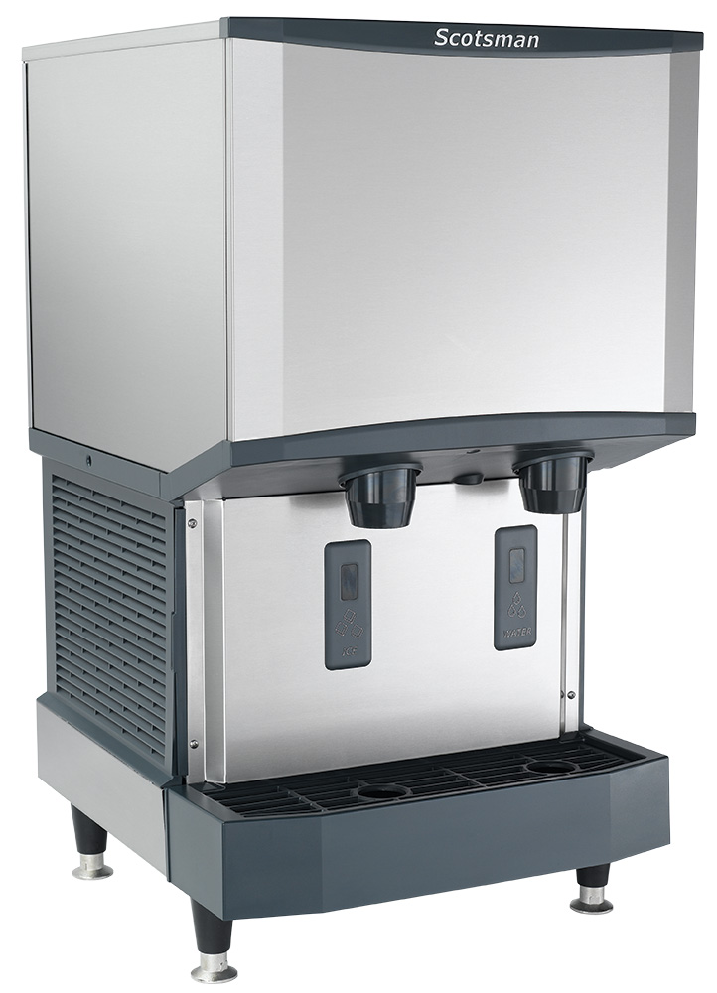
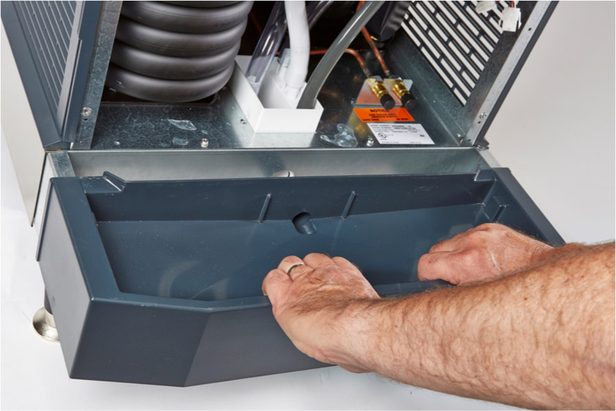
Meridian™ Series: Easier Cleanability
Removable Bin, Sink and Grill
Industry-exclusive sink designed to collect water and ice can be easily removed for washing and cleaning, as well as the bin and grill feature

Slide 24
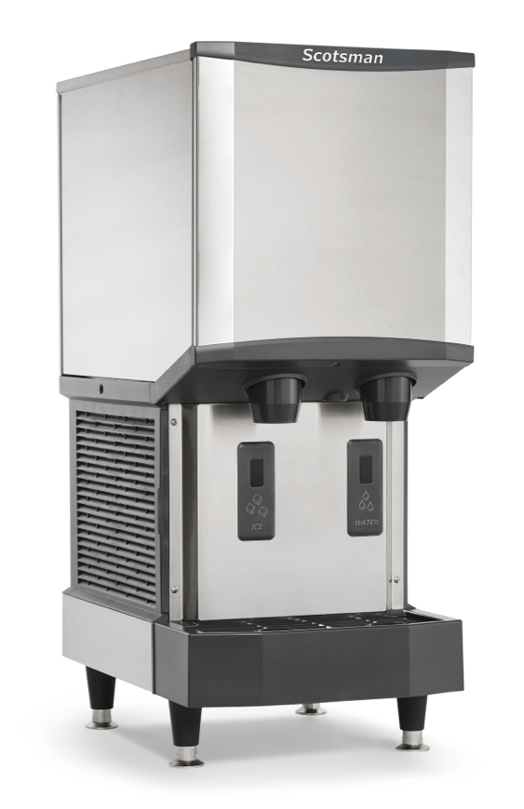
Meridian™ Series: Enhanced Serviceability
Reduced Operational Footprint
Contoured sides are designed to house external air filter while allowing for greater breathability
Less clearance is required around the sides of the unit
Recessed utility chase on backside of unit provides clearance for tight installs
Ideal for crowded nurse stations or any area where space is at a premium
Smallest operational footprint available on the market relative to capacity

Slide 25
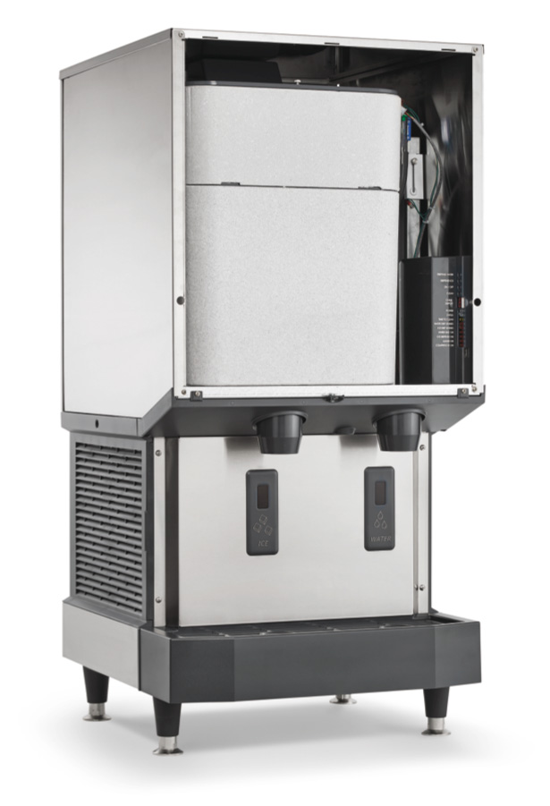
Meridian™ Series: Enhanced Serviceability
Front Access to Key Components
Removable front panel provides easy access for service technicians to instantly diagnose potential issues
Individual components designed for quick access, service and replacement, preventing lengthy, costly downtime
Storage bin can be removed for additional component access and cleaning

Slide 26
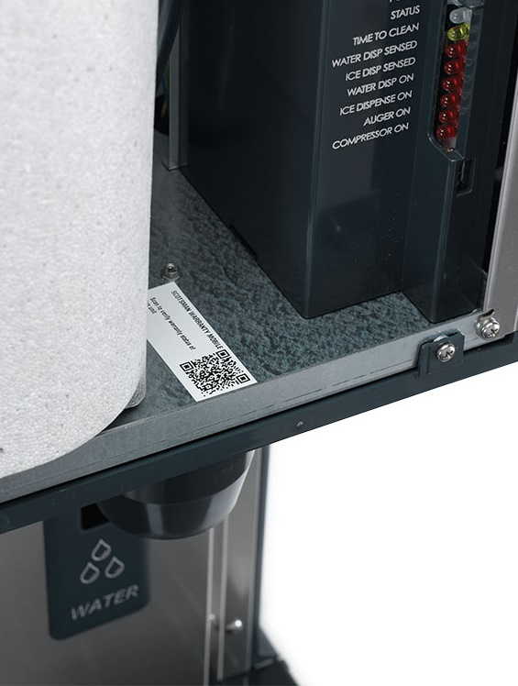
Meridian™ Series: Enhanced Serviceability
Quick Response (QR) Code Access
Unit-specific QR code for quick access to service manuals, warranty history, and other vital machine information
Helps reduce downtime and frequency of service calls
Convenient internal location allows service technicians to access the QR code while monitoring indicator lights and control board

Slide 27
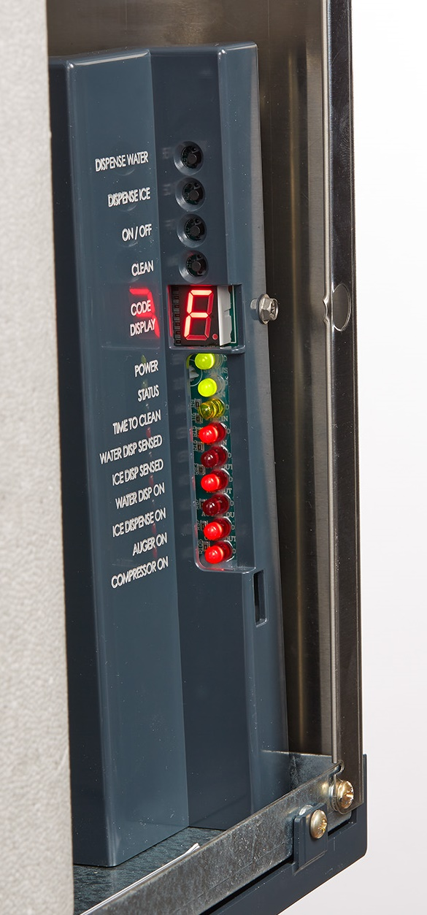
Meridian™ Series: Enhanced Serviceability
Intuitive Diagnostics
Internal LED indicator lights keep maintenance staff informed of unit’s current status to help reduce service time
Lights alert staff when descaling and sanitizing are needed
Warning lights feature a seven-segment display showing critical diagnostic readouts for easy reference
Test mode activates key components to check for potential issues
USB port allows for fast software updates

Slide 28
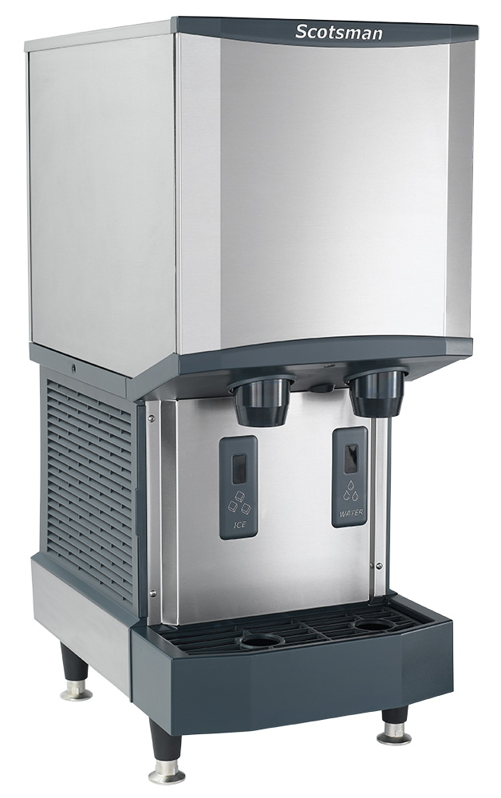
Meridian™ Series: Intelligent Design
Smart Construction & Design
Evaporator made of 100% stainless-steel for optimal heat transfer and enhanced durability
Larger sink drain opening with improved slope helps prevent clogging
Durable stainless-steel exterior panels
ADA-compliant dispensing area (applicable to touch-free configurations only)

Slide 29
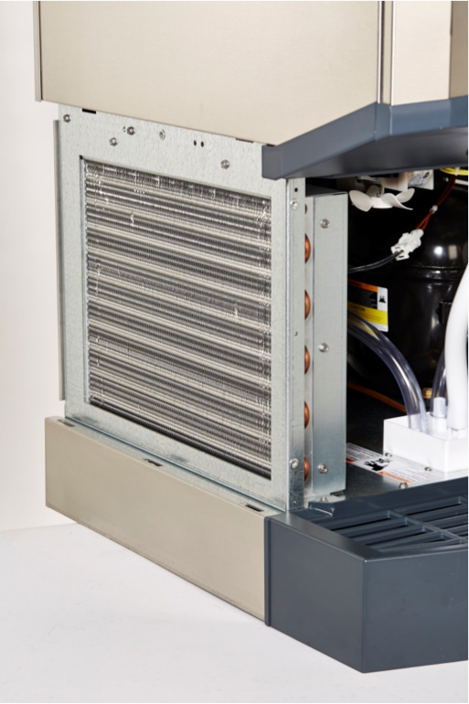

Meridian™ Series: Intelligent Design
Quiet Operation
Unnecessary equipment noise can negatively affect the patient care or hospitality environment
Meridian’s improved condenser fan function delivers quiet operation
Energy Efficient
Electronic controls and a highly efficient compressor translate to reduced energy consumption
All Meridian™ models are CEE Tier 2 certified and up to 15% more energy efficient than the competition

Slide 30




Meridian™ Series: Intelligent Design
High Quality Manufacturing
All Meridian™ units are manufactured and tested at our award-winning facility in South Carolina to ensure you get a reliable machine that works exactly like it should
Assembled in the USA
Award winning Fairfax, South Carolina Facility
ISO 9001:2015 accredited
100% of machines run tested before shipment

Slide 31



Meridian™ Series: Intelligent Design
Standing Behind Our Quality
Scotsman provides a 3-year parts and labor warranty on all components, and 5-year parts warranty on the compressor and condenser
3-year parts and labor warranty on all components
5-year parts warranty on compressor and condenser
Warranty valid in North, South & Central America for commercial installations
Residential applications:
  1-year parts and labor

Slide 32
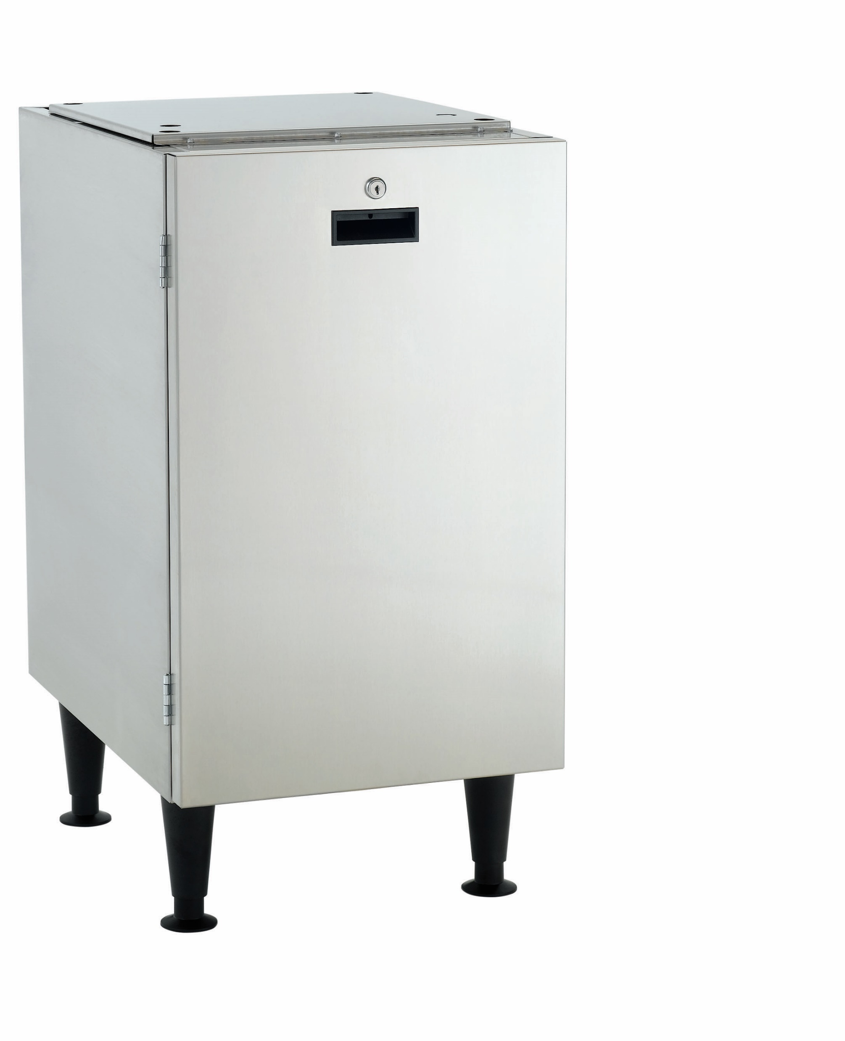


Meridian™ Series: Accessories
KLP24A Adjustable Legs
Optional 4” adjustable legs for easy cleaning beneath unit
HST16 & HST21 Machine Stands
Optional machine stands allow for freestanding configuration
Stainless-steel construction
Includes 6” adjustable legs
Models w/ Reversible Locking Door + Storage Shelf:
HST16-A (for HID312)
HST21-A (for HID525 & HID540)
Basic Models:
HST16B-A (for HID312)
HST21B-1 (for HID525 & HID540)

Slide 33


Meridian™ Series: The Best Choice

Slide 34



