Slide 1
ICE 101 MACHINE SIZING GUIDE
SELECTING THE RIGHT ICE MACHINE.

Slide 2
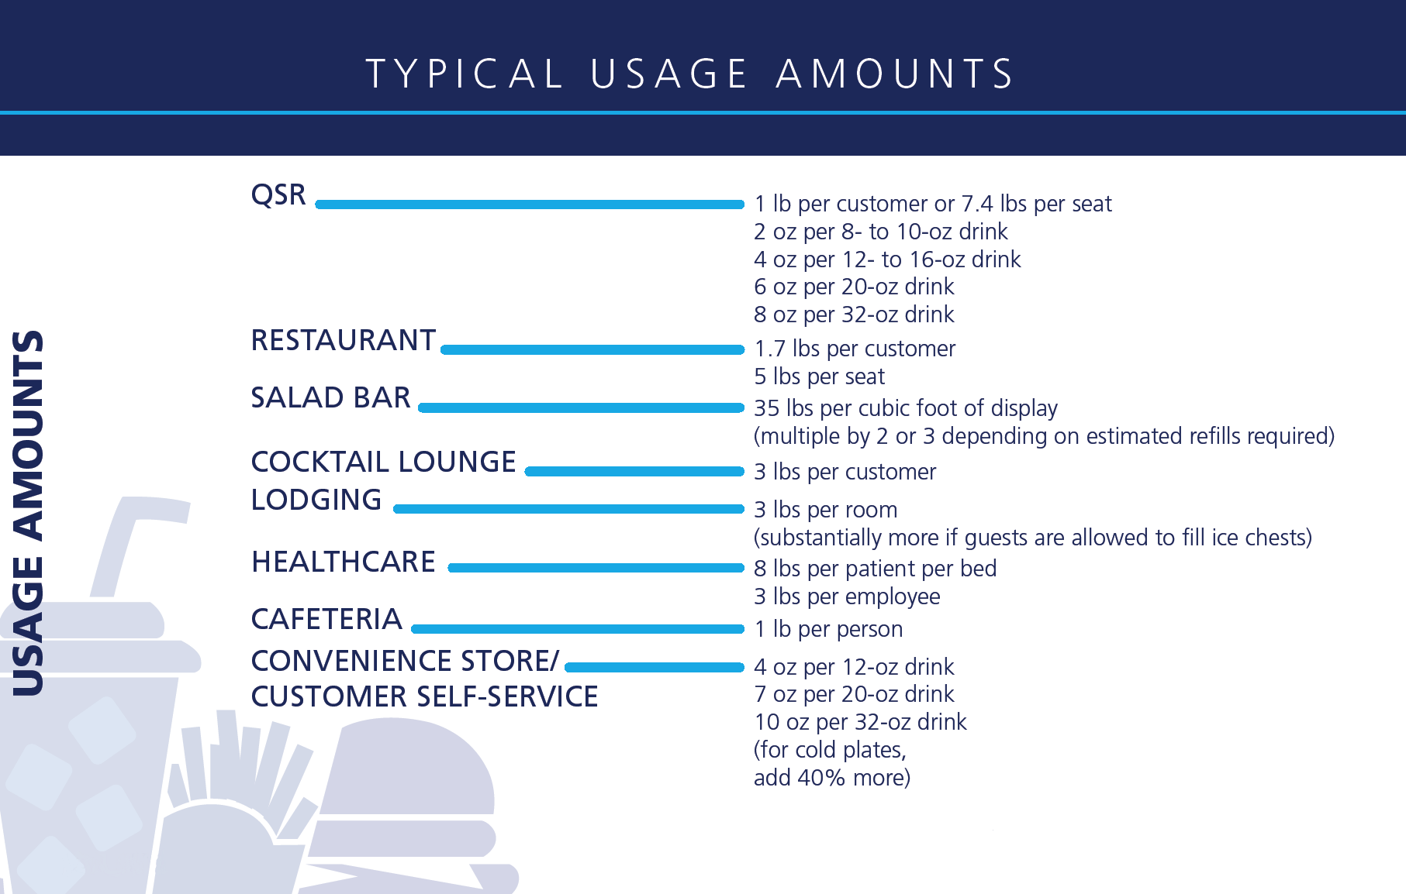
Quick Ice Usage Cheat Sheet

Slide 3
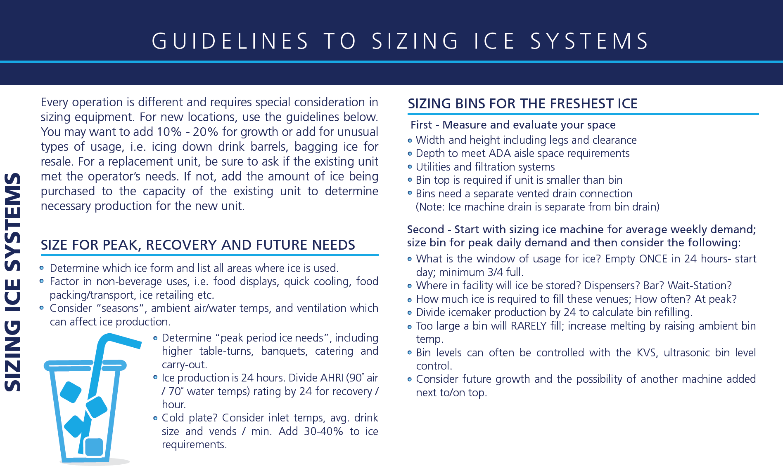
Quick Ice Usage Guidelines

Slide 4
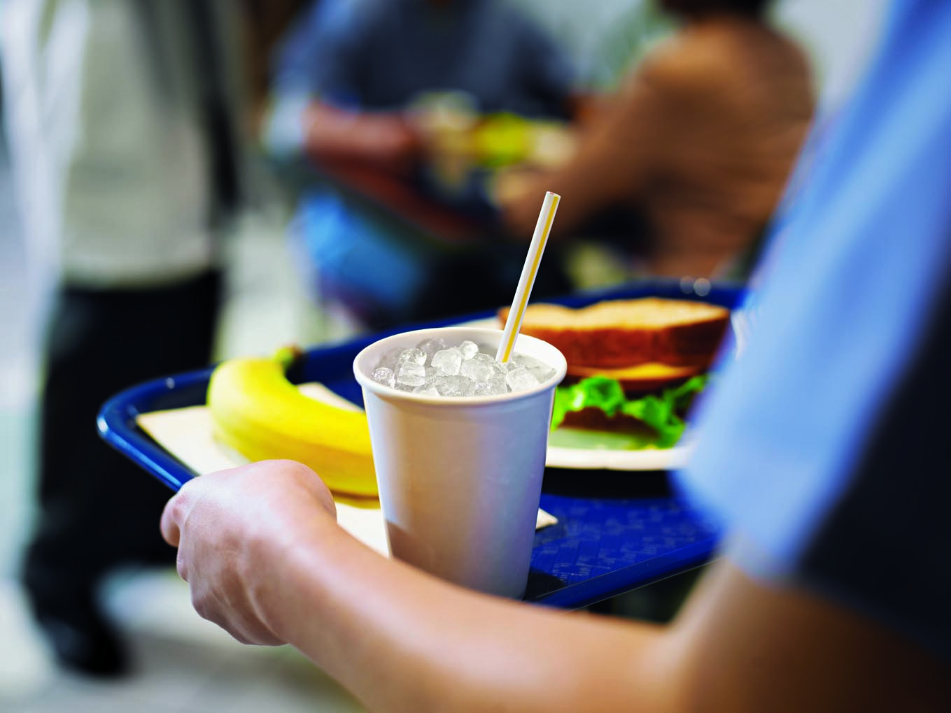
Sizing and Specification Steps
Determine Applicable Ice Form
FS, Retail, Intuitional, Hotel, Healthcare
Flake, Cube, Nugget
Mixed need?
Determine Demand
Consult sizing guidelines for each application
Hourly/Daily/Weekly demand
Lunch Crunch, Resort Area
Geographic or Seasonal demand
All other applications
Spot merchandizing (beer tubs, displays etc)
Brewed teas, Blended or Specialty drinks
Decanters, Champagne Holders, Coolers
Pre-chill for Kegs (fish, produce etc)

Slide 5
Initial Questions
Ice Application Considerations
Ask Customer About Application:
What do you have now and is it working?
How are you using the Ice?
Do you have to buy ice?
Are there “clandestine” ice users? ☺
Are there new drink programs involving ice?
Ask them about their capacity requirements
Ask about condenser preference
Ask about dimension constraints
Ask what voltage is available
Going on bin or dispenser?

