Slide 1

ICE 101
REFRIGERATION BASICS
HOW AN ICE MACHINE WORKS.

Slide 2
Basic Refrigeration Cycle
Compressor
Evaporator
Condenser
Expansion

Slide 3
Refrigeration “Rules of Thumb”
Heat Transfer
  Heat transfer always occurs from a region of high energy to another region of lower energy
  The greater the temperature difference, the faster energy will flow attempting to reach equilibrium
Temperature
  Indicates the velocity of molecules of a substance. As heat energy in a substance increases, its molecules vibrate faster
Pressure
  Pressure drops when volume increases

Slide 4
Refrigeration Definition
The removal of heat from one place (water) and depositing it to another (air/water) using an intermediate medium (vapor compression refrigeration system).
This transfer of heat from one place to another is done through the evaporation and condensing of refrigerant.

Slide 5
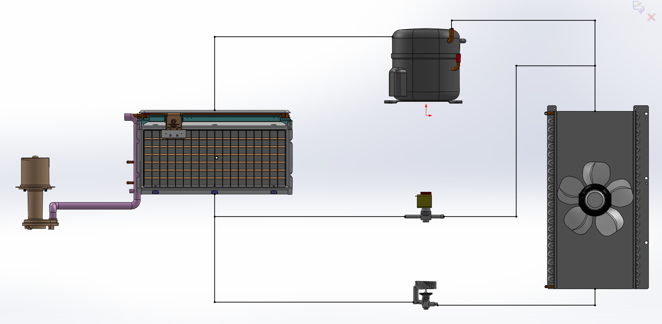
Vapor Compression System Components
Compressor
Evaporator
Hot Gas Valve
Condenser
Thermal Expansion Valve

Slide 6
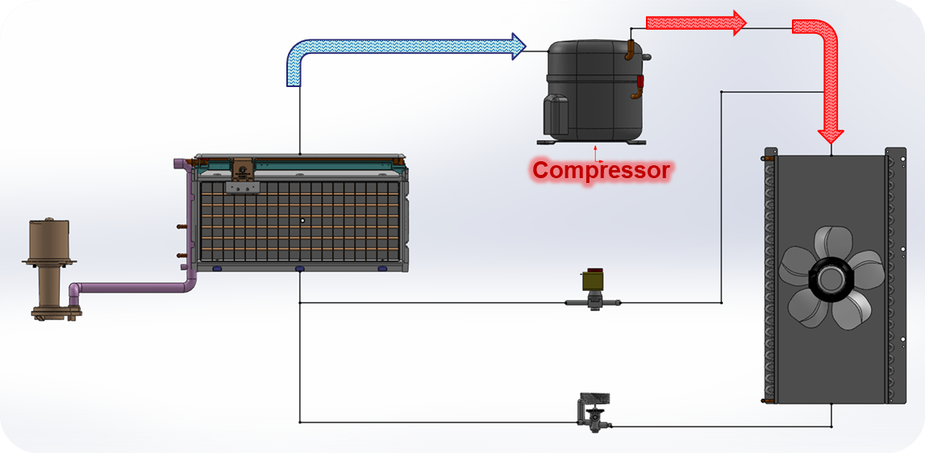
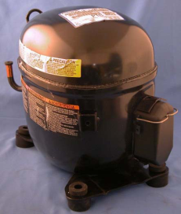
Vapor Compression System Components
Compressor - Performs two primary functions:
  Pulls low pressure vapor from the evaporator
  Compresses this vapor into a high temperature, high pressure gas so that it may be condensed

Slide 7
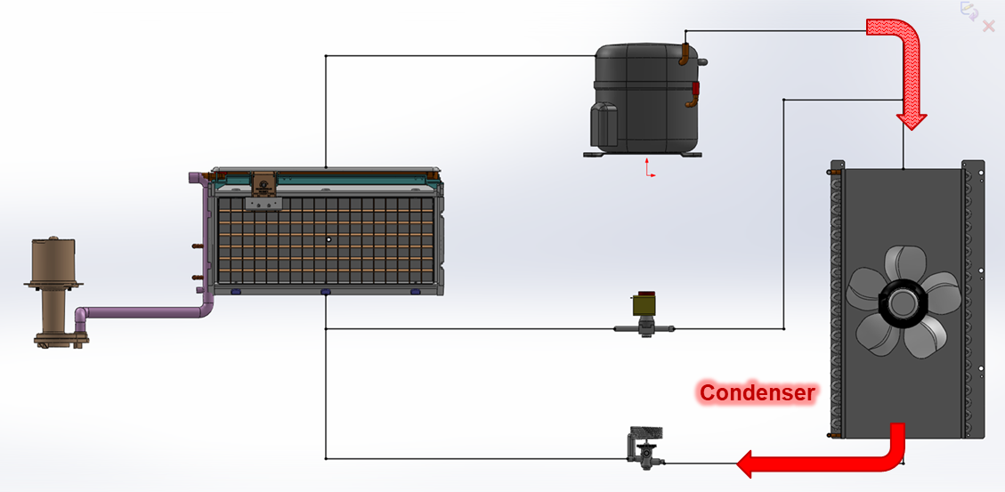
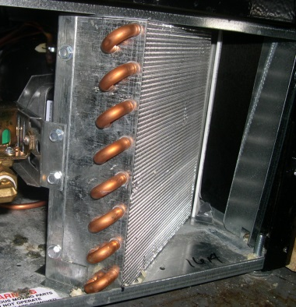
Vapor Compression System Components
Condenser - Removes heat from refrigerant by providing a medium at a lower temperature to which the heat may flow to be dissipated. Superheated gas is converted to a subcooled liquid.
Two sources of this heat:
  Heat absorbed by the evaporator
  Heat added to the refrigerant during compression

Slide 8
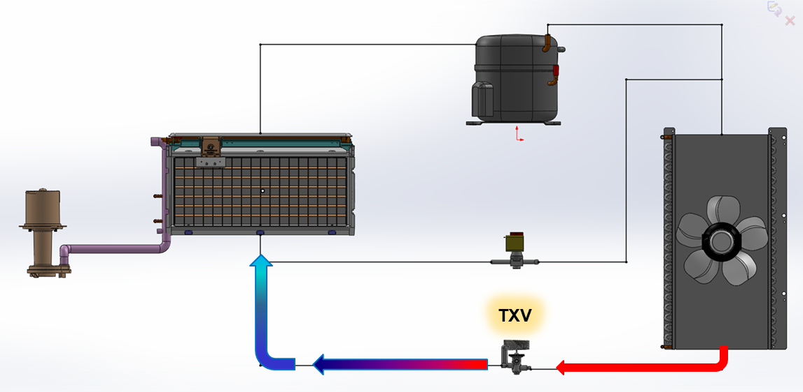
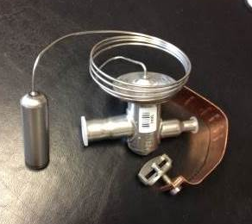
Vapor Compression System Components
TXV - An expansion device which “throttles” high pressure liquid to low pressure liquid (expands during this process). Meters refrigerant into the evaporator based on temperature measured at the evaporator outlet.

Slide 9
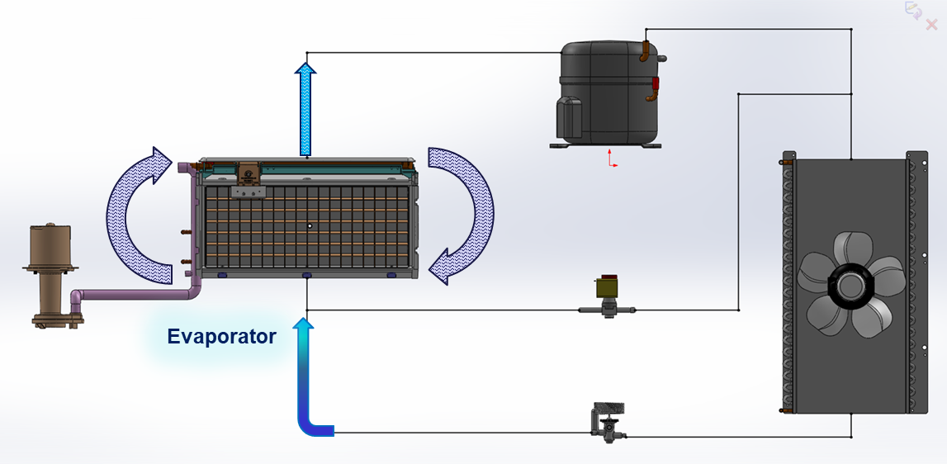
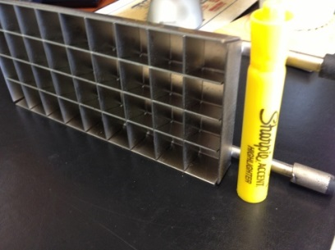
Vapor Compression System Components
Evaporator - The low pressure liquid from the TXV has a saturation temperature well below that of the surrounding medium.
This results in rapid boiling of the refrigerant with heat being absorbed from the surroundings – the desired cooling effect.

Slide 10
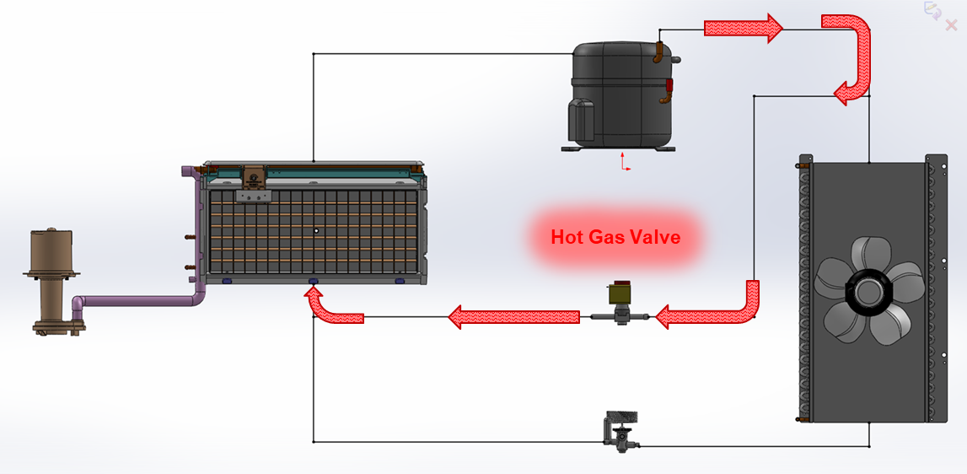
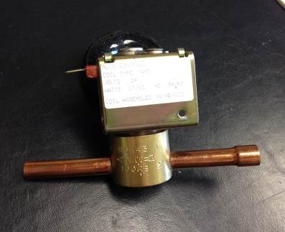
Vapor Compression System Components
Hot Gas Valve
Valve which is opened during the harvest cycle, allowing hot gas to flow from compressor to evaporator
Hot gas warms the evaporator, which assists in releasing the ice slab from the evaporator surfaces

Slide 11
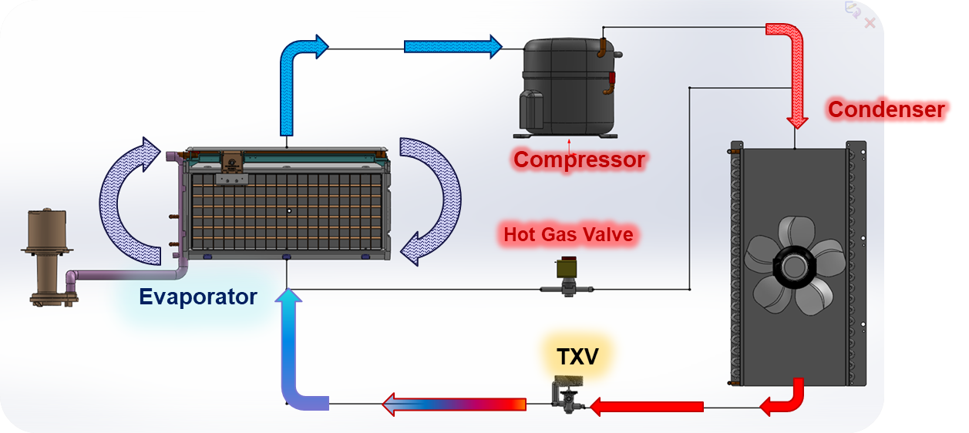
Ice Maker Vapor Compression Cycles
Freeze Cycle - Portion of the cycle where refrigerant absorbs heat (from water passing over the evaporator) at low temperature & pressure and gives up this heat (to air/water) by condensing at high temperature & pressure.

Slide 12
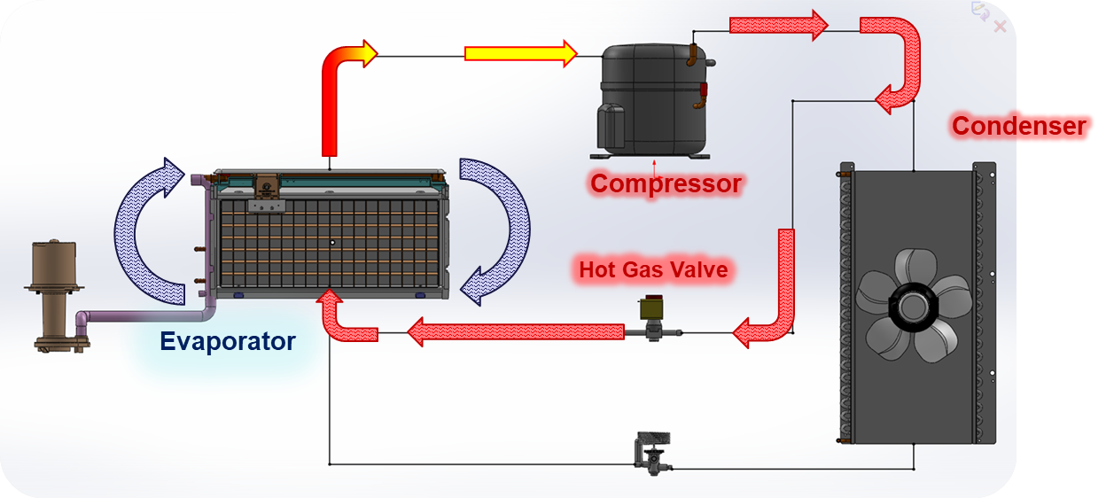
Ice Maker Vapor Compression Cycles
Harvest Cycle - Portion of the cycle where heat or mechanical force is added to the evaporator in order to remove the ice from the evaporator or where the ice is harvested.

Slide 13



