Slide 1
ICE 101 ICE FORMS
SELECTING THE RIGHT ICE TYPE.

Slide 2
Types of Ice
Batch Style
Continuous Style
Notes:
2
Cube is batch made ice. It’s just like the old fashion ice cube trays in your refrigerator. Nugget and Flake are continuous made ice.

Slide 3
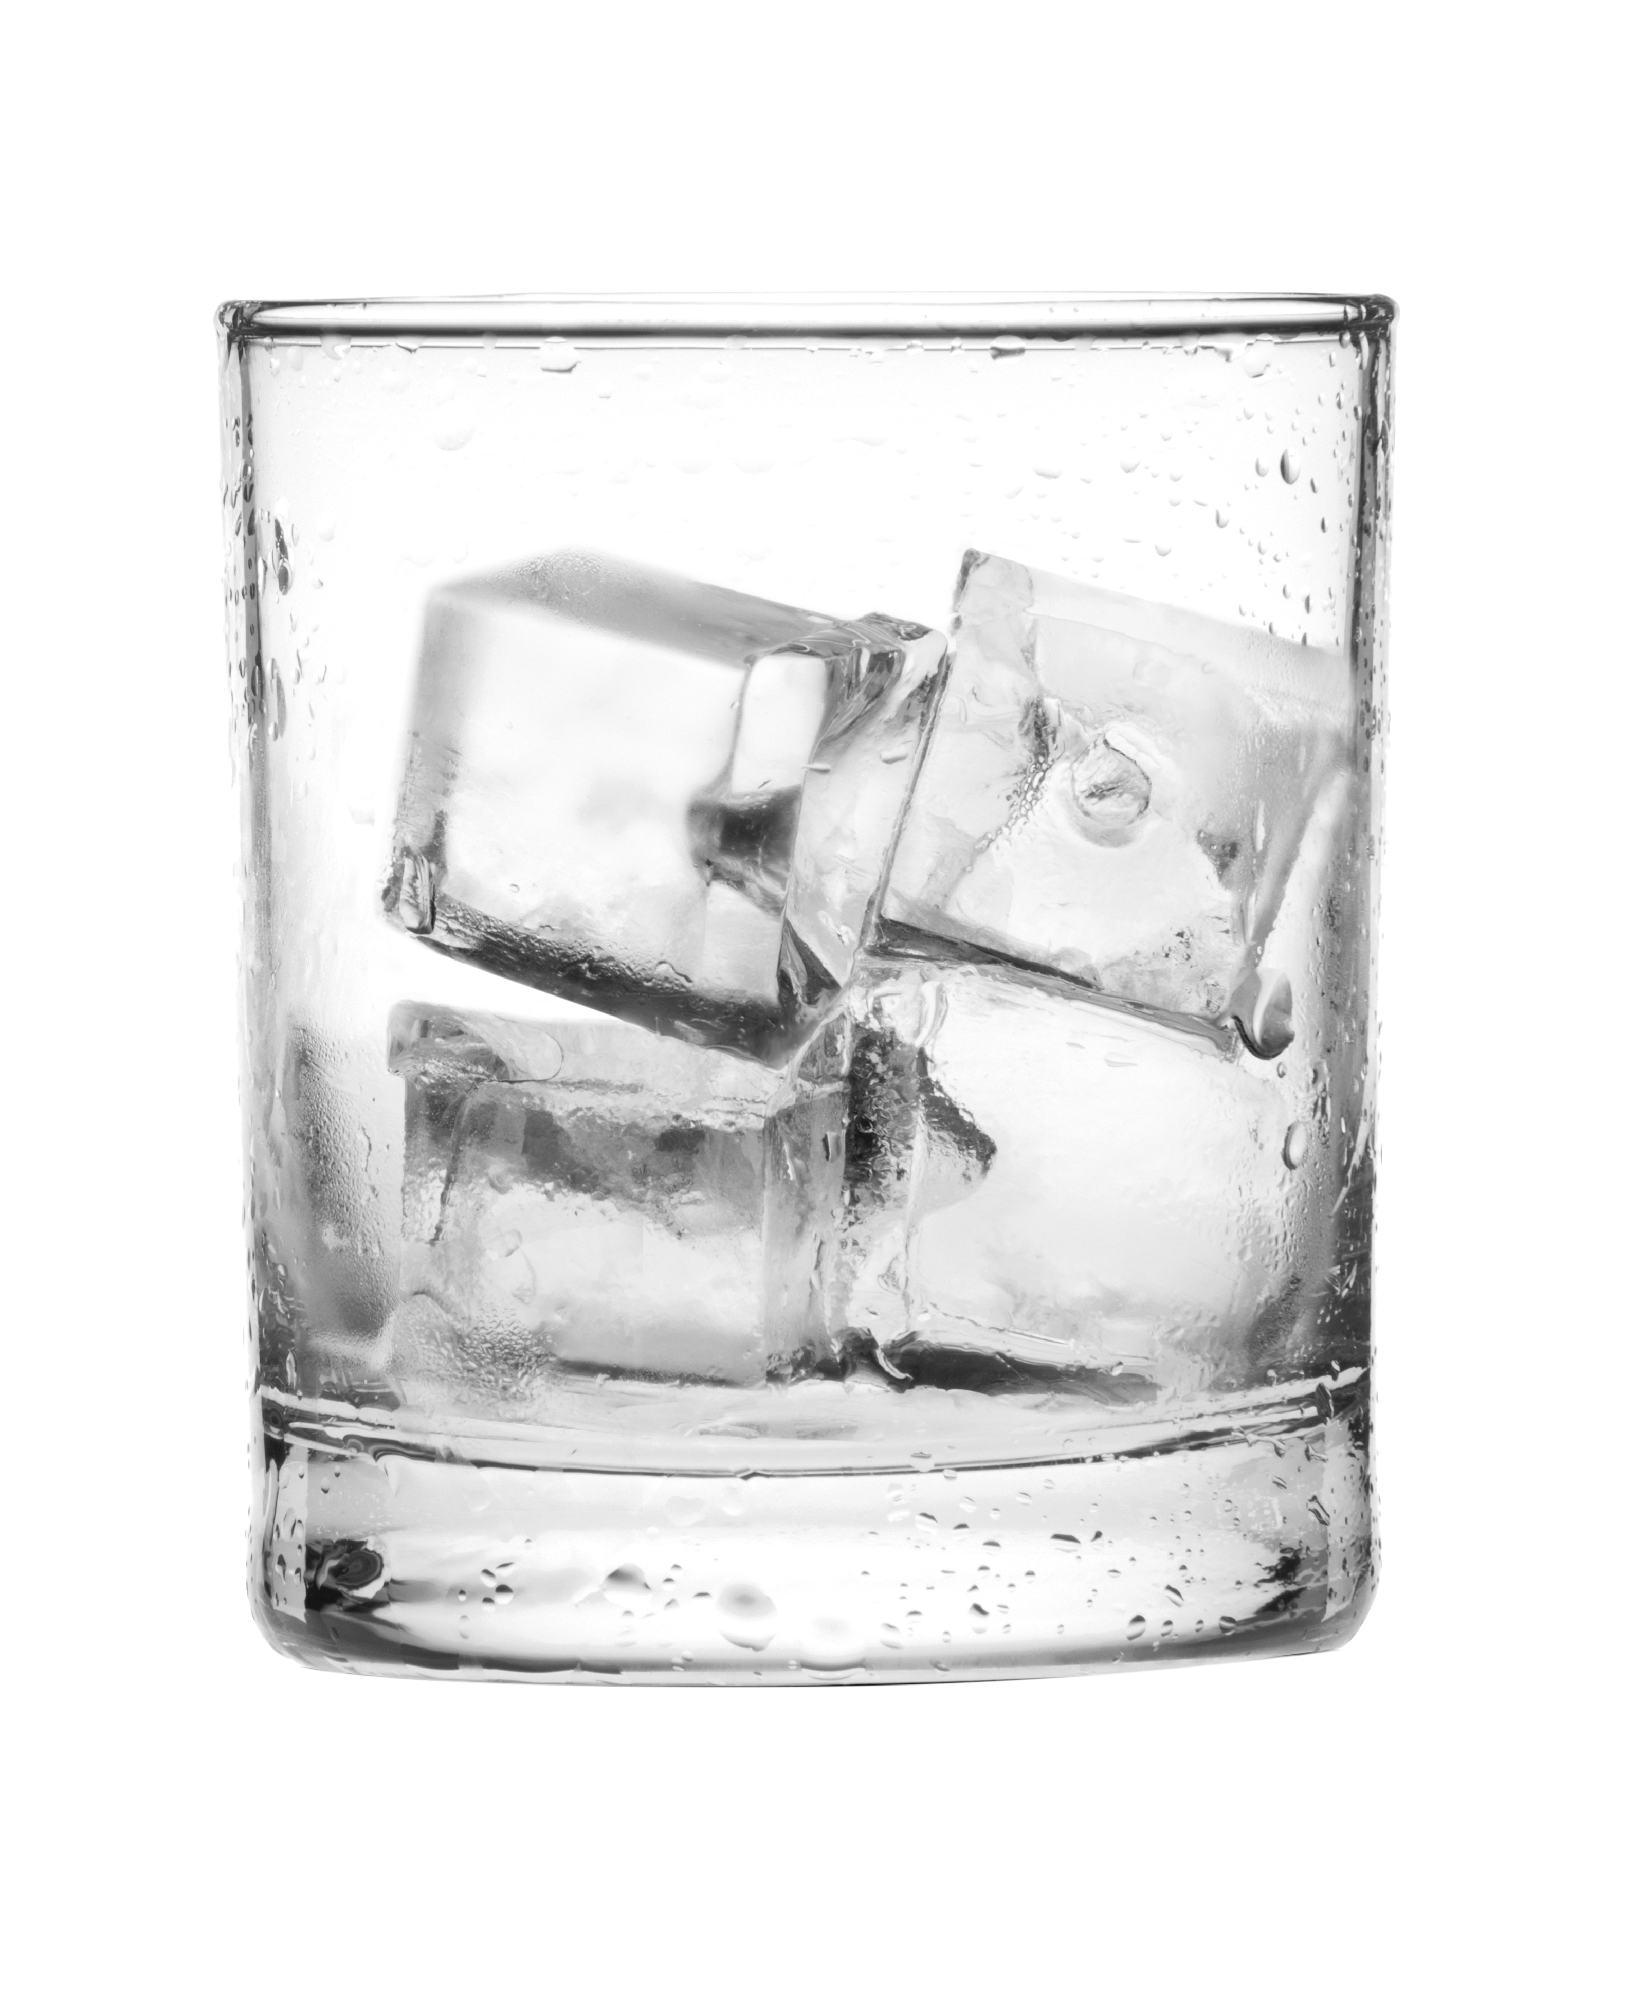
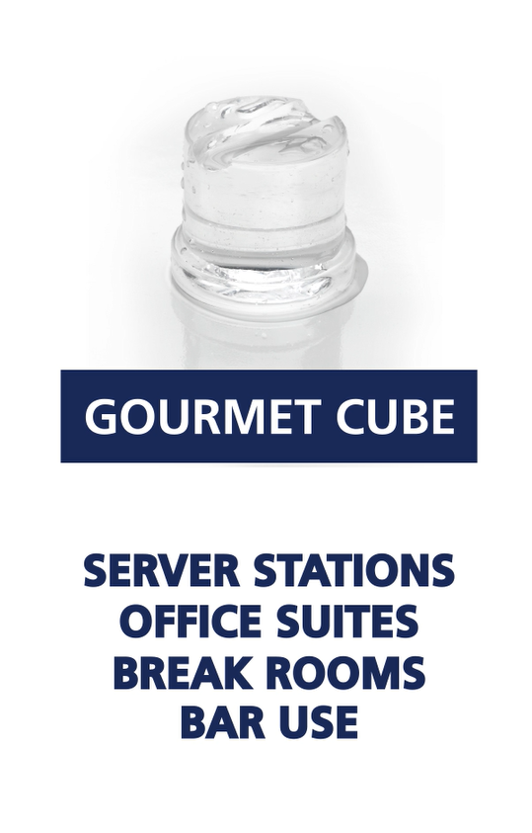
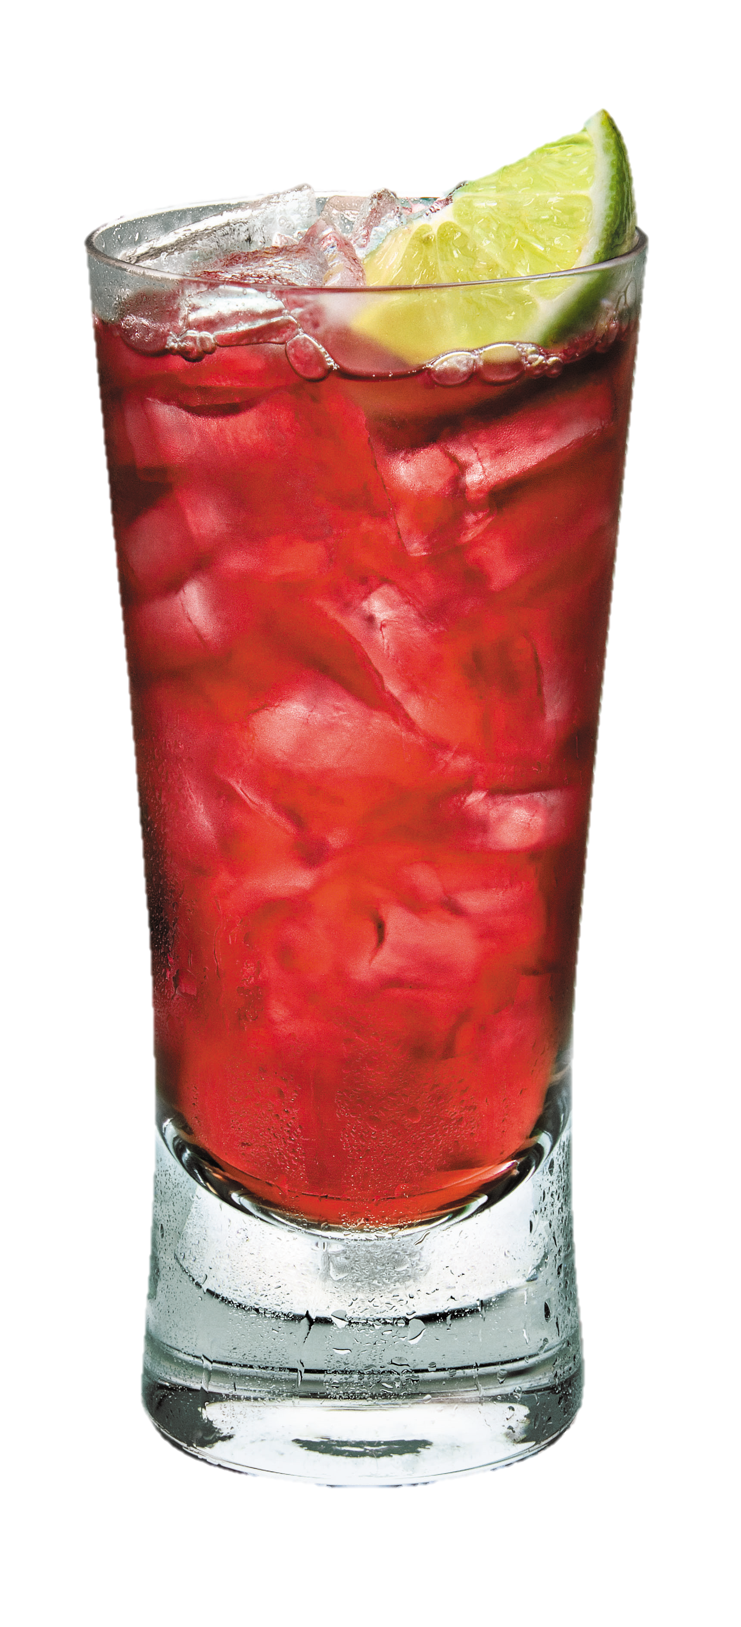
About The Ice: Cube
Broad Applications
Small Cube
Fast food
Beverage dispensing
Blending
Medium Cube
Cocktails
Hotel dispensers
Ice bagging

Slide 4
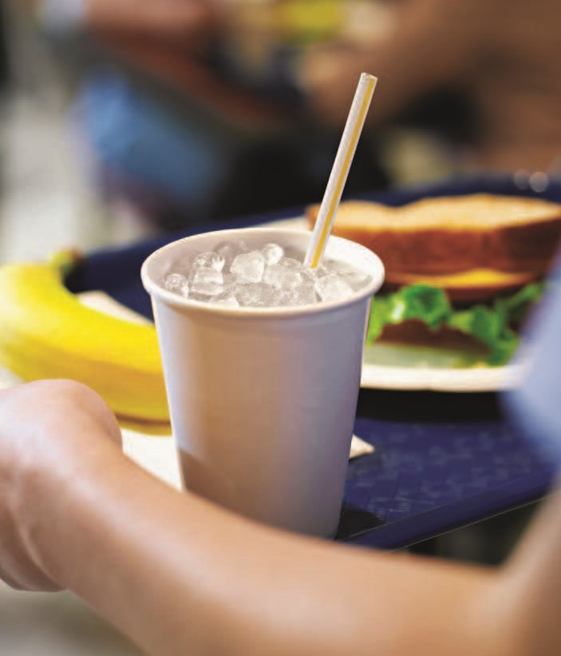
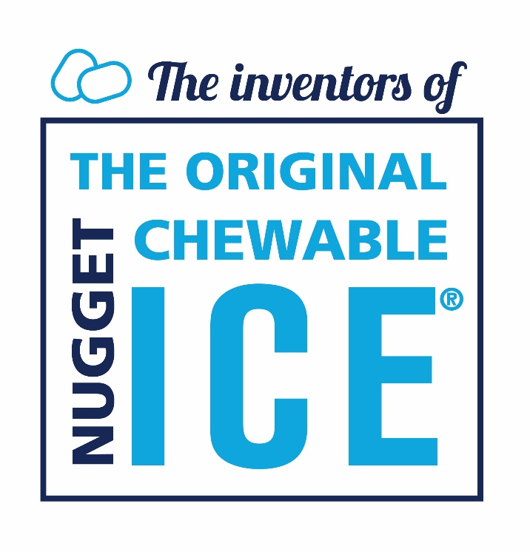
About The Ice: Nugget
Increased Profitability
Consumer preferred
Up to 80% of customers prefer with soft drinks
Lower cost by ⅓ per 100 lb. of ice
Uses 40% less water (vs. cube)
Uses 15% less energy (vs. cube)
Lower beverage costs
9% to 20% higher displacement, which results in using less syrup/beverage
Scotsman’s Nugget Ice:
Soft
Easy to chew
Rapid cooling
Slow-melting
Absorbs the flavor of beverages

Slide 5
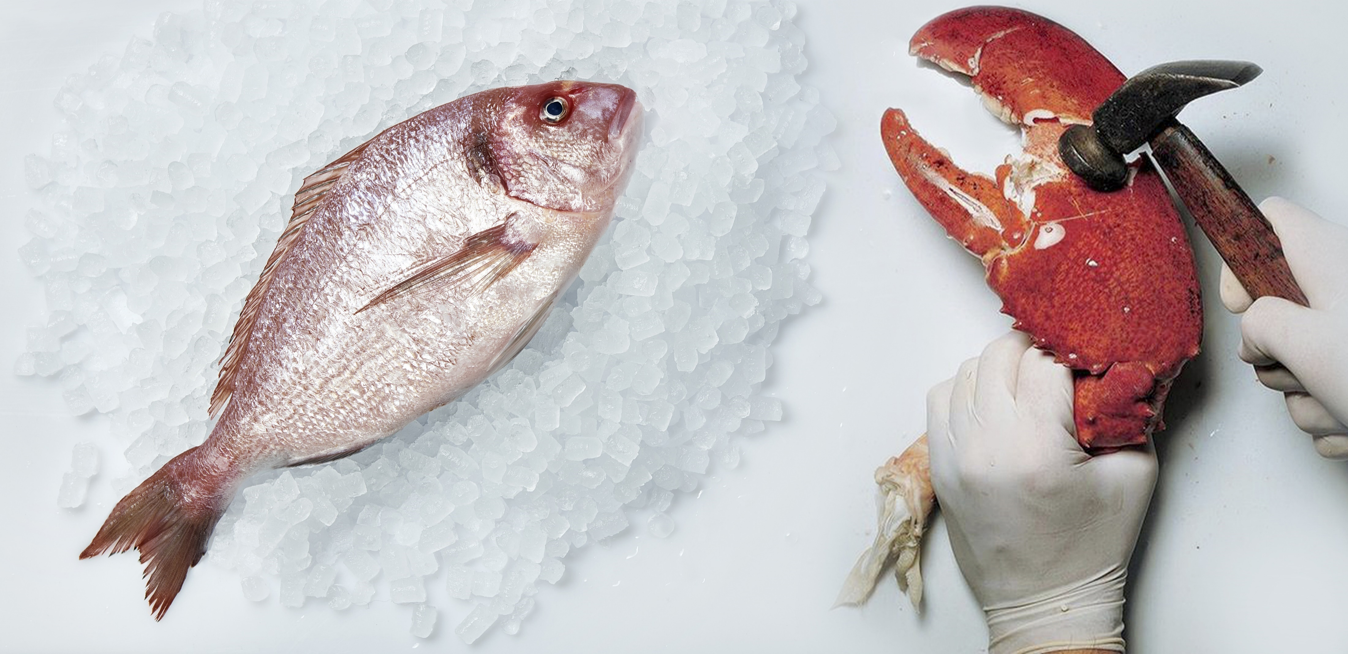
About The Ice: Nugget
Diverse Applications
Food Service
Carbonated and Non-Carbonated
Soda, Teas, and Juices
Blended Drinks
Smoothies, Margaritas, etc.
Chilled
Wine and Champagne
Food Preparation
Presentation & Preservation
Merchandizing & Display
Longer lasting and upscale appeal
Holding
Temperature transition
Hydration
Maintain texture, color and weight
Healthcare & Therapeutic
Swelling
Moldable for ice packs
Hydration
Soft and easy to chew
Physical Therapy
Recovery, cold compresses and ice baths
Notes:
5

Slide 6
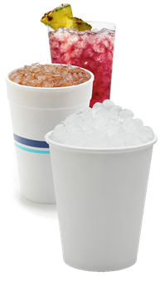
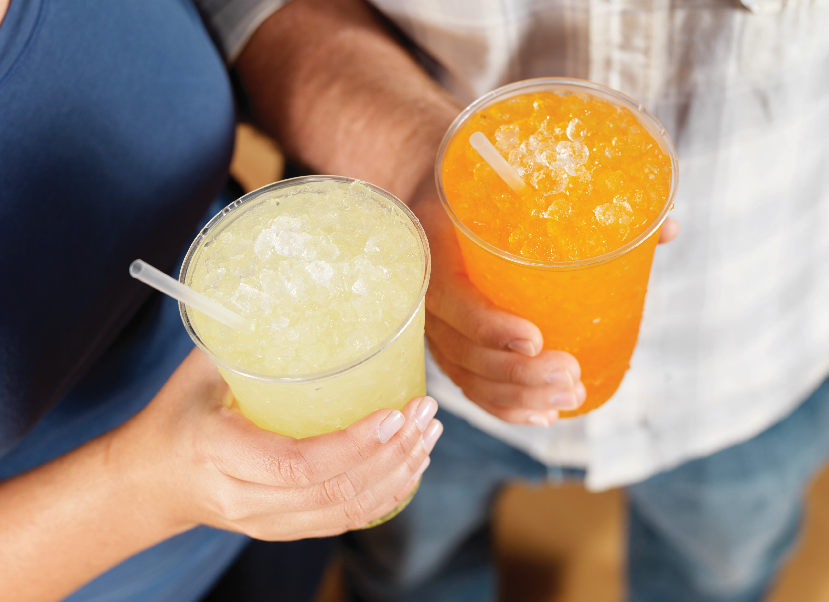
About The Ice: Nugget
Two Types Available
Softer - Original Chewable Nugget Ice (NS, UN0815, UN1215, UN1520 Models)
Smallest, softest and most chewable nugget ice
Same Original Chewable Ice® that Scotsman introduced in 1981
Ideal for traditional ice bin applications
However, can also be dispensed
Ice Hardness Rating: 74%*
Nugget Dimensions: ⁷⁄₁₆” x ⁵⁄₁₆” x ³⁄₈”
Harder - H² Nugget Ice (NH, HID, UN324 Models)
Slightly harder, slower melting nugget ice
First introduced with HID Meridian™ Ice & Water Dispensers
Ideal for dispensing applications
Can also be used with ice bin setup
Ice Hardness Rating: 85%*
Nugget Dimensions: ³⁄₄” x ⁵⁄₁₆” x ³⁄₈”
*Approximation, values may vary by model

Slide 7
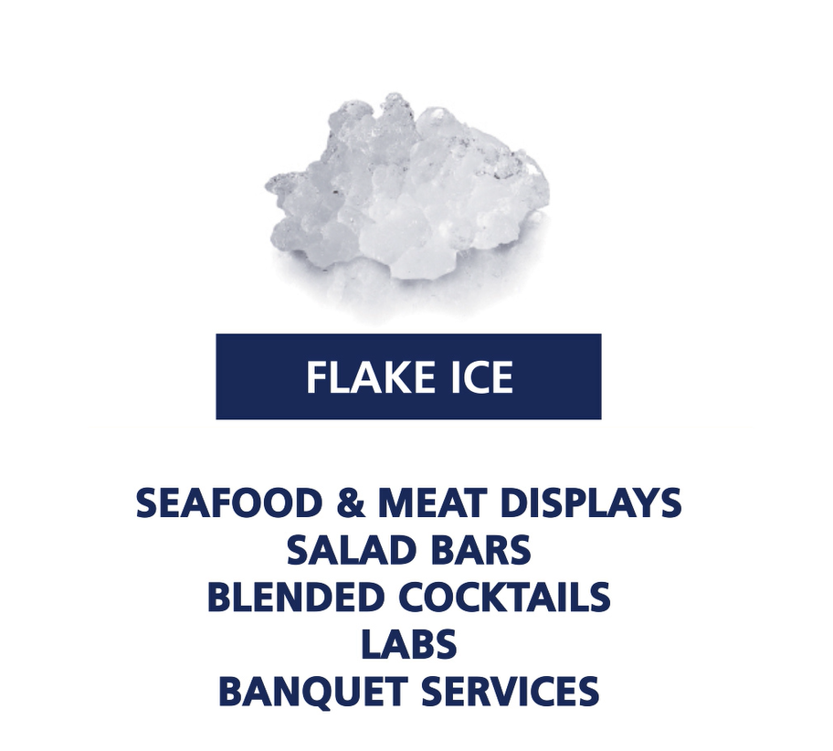
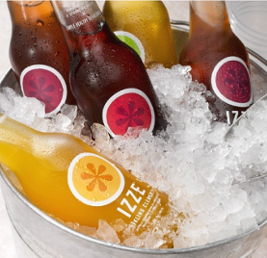
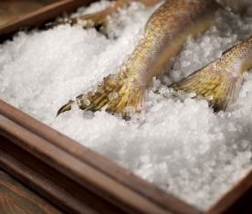
About The Ice: Flake
Presentation & Preservation
Flake Ice is a Smart Choice for:
Blended cocktails
Salad bars
Produce, seafood, and meat displays
Therapeutic use in healthcare facilities

Slide 8
About The Ice: Comparison Chart
 | Flake Ice [FS, UF, FME Models] | Original Chewable Nugget Ice [NS, UN 15”, UN 20” Models] | H² Nugget Ice [NH, HID, UN 24” Models]
Ice Hardness* | N/A | 74% (Softer) | 85% (Harder)
Ice Dimensions | Compressed | ⁷⁄₁₆” x ⁵⁄₁₆” x ³⁄₈” | ³⁄₄” x ⁵⁄₁₆” x ³⁄₈”
Description | Soft, moldable flake ice | Smallest, softest and most chewable nugget ice | Slightly harder, slower melting nugget ice
First Introduced | 1952 | The Original Chewable Ice® (1981) | HID Meridian™ Ice & Water Dispensers (2015)
Ideal Configuration | Traditional ice bin applications | Traditional ice bin applications | Dispensing applications
Alternate Configuration | N/A | Dispensing applications with additional kits/adapters | Traditional ice bin applications for those that may want slower melting nugget ice
Ice Applications | Seafood, meat, produce displays Salad bars Blended drinks Healthcare & therapeutic Laboratories | Carbonated and non-carbonated beverages Blended drinks Food displays Dispensing Healthcare & therapeutic
Sealed, Maintenance-Free Bearings | Yes | Yes | Yes
*Approximation, values may vary by model

Slide 9
Markets Served
Quick-Service Restaurants
Full-Service Restaurants
Hotels & Motels
Convenience Stores
Supermarkets & Seafood Shops
Break Rooms & Waiting Rooms
Recreation Facilities
Bars & Nightclubs
Business & Industry
Schools & Universities
Hospitals & Long-Term Care Facilities

