Slide 1
ICE 101 APPLICATION GUIDE
INTALLATION AND OPERATIONAL CONSIDERATIONS.

Slide 2
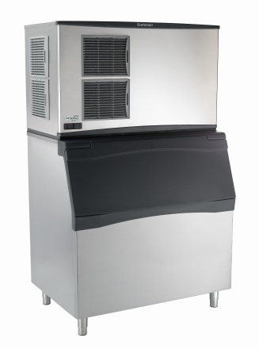
Selecting Ice Machines
Installation Requirements
Site Selection
Power, Water & Drain within 6 Feet
110, 208-230 Single or Three Phase
Drain and Water Supply
Minimum 20 PSI water pressure
Most local codes require 2 inch air gap for drains
Note: Always Specify Proper Utilities Within 6 Feet
Ice Machine Configuration (Continued on next slide)
Air-Cooled
Recommended clearance of 6 inches on side
Less side clearance required for front facing air filter
Avoid recirculation
600lbs is tipping point for remote consideration
Notes:
Three Phase is uncommon but uses cheaper wire. There is an up charge for installation.

Slide 3
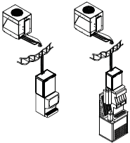
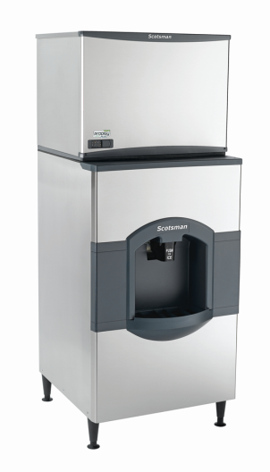
Selecting Ice Machines
Ice Machine Configuration
Water-Cooled
Generally prohibited by local code
Unless on recirculation system
Remote Ice Machine
Retro and new construction
Poorly ventilated areas
More efficient / consistent production
Typically 600 lbs and over
Roof access
Licensed contractor for roof penetration
Line set length and condenser placement
Maximum rise: 35 feet
Maximum drop: 15 feet
Note: Stay within max line set length when possible

Slide 4
Condenser Application Chart
Selecting Ice Machines
Environmental Conditions | Air Cooled | Water Cooled | Remote
Indoor Space Restricted |  | ✓ | ✓
Poor Ventilation |  | ✓ | ✓
Indoor Air Temp High |  | ✓ | ✓
Outdoor Air Temp High | ✓ | ✓
Water Supply Limited (High sewage cost or sewage limited) | ✓ |  | ✓
Seeking Low Installation Cost | ✓ | ✓
Indoor Air Conditioning Capacity Limited |  | ✓ | ✓
High Water Costs | ✓ |  | ✓
Noise Level is a Concern |  | ✓ | ✓

