Slide 1
Scotsman Ice Systems Essential Ice New Ice Maker Series

Slide 2
The Essential IceTM Series by Scotsman provides customers with the ice they need for their operation; Reliably, Intuitively and Cost Effectively. Scotsman fulfills those needs through Innovative Engineering and Quality Manufacturing that has defined Scotsman for the past 60 years.

Slide 3
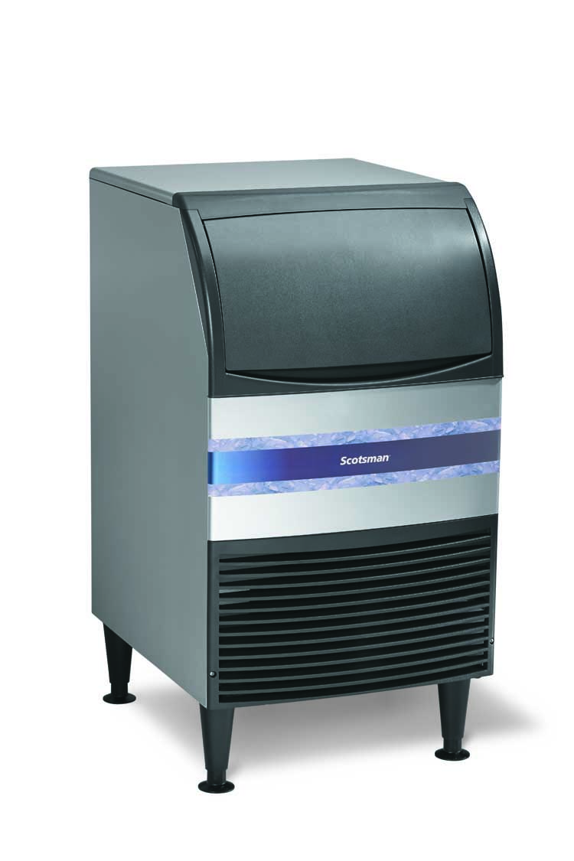
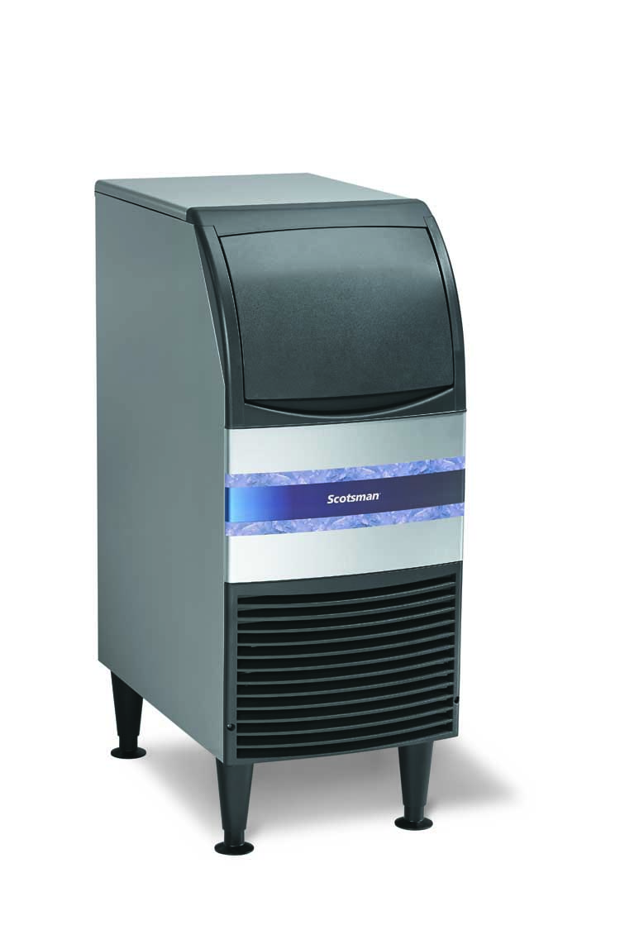
New Product Offering
CU0415MA-1: 115V /60Hz /1
CU0415MA-6: 220V /50Hz /1
Up to 58 lb ice per day
Stores 36 lb
15” Wide
CU0715MA-1: 115V /60Hz /1
CU0715MA-6: 220V /50Hz /1
Up to 80 lb ice per day
Stores 36 lb
15” Wide
CU0920MA-1: 115V /60Hz /1
CU0920MA-6: 220V /50Hz /1
Up to 100 lb ice per day
Stores 57 lb
20” Wide

Slide 4
Features and Benefits
Reliability
Ease of Use
Compact, Attractive Design
High Production
Clear Ice Cubes
Environmentally Friendly

Slide 5
Features and Benefits
Reliability- Essential Ice machines will last long and help reduce repair expense
Industry leading Warranty
3 year parts and labor on all components
Assembled in the USA
Award winning Fairfax, South Carolina Facility
ISO9001:2008 accredited
All machines run tested before shipment

Slide 6
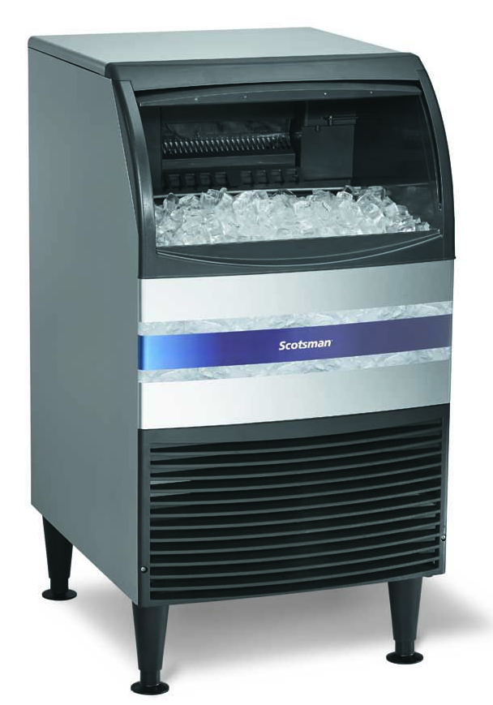
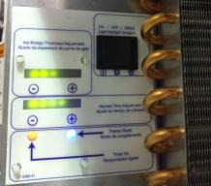
Features and Benefits
Ease of Use – Essential Ice allows operators to efficiently get ice they need
Slide Up Door
Large Access Area
Ice Scoop Included
Intuitive Control Panel
On/Off/Clean Switch
Ice Thickness Adjustment
Harvest Time Adjustment

Slide 7
Features and Benefits
Compact and Attractive Design- Essential Ice can fit in virtually any location
Only 15” or 20” cm wide
37.5” tall with 6” legs
32” tall with floor mount kit (KUFM15 or KUFM20)
For ADA Applications - Fits underneath a 34” counter
Durable hard plastic front with curved door
31.9”

Slide 8
Features and Benefits
Compact and Attractive Design
S3 Metallic Alloy side and top panels
Corrosion resistant
Easy to clean, smudge resistant
Durable hard plastic front with curved door

Slide 9
Features and Benefits
High Production – Essential Ice produces the right amount of ice for customer needs
 | CU0415 | CU0715 | CU0920
Production per day 70⁰F air /50⁰F water (lb) | 58 | 80 | 100
Production per day 90⁰F air /70⁰F water (lb) | 38 | 58 | 80
Storage capacity (lb) | 36 | 36 | 57

Slide 10
Features and Benefits
Clear Cubes – Essential provides ice that customers like to see
Made with innovative horizontal evaporator
Minerals don’t freeze in cube
Spray jets helps keep them washed away
Can be affected by harvest time

Slide 11
Features and Benefits
Environmentally Friendly – Essential Ice is designed responsibly and lowers energy costs
Uses R-134a refrigerant
Does not deplete ozone layer
Lower energy consumption
Recyclable aluminum alloy side panels
Same durability and corrosion resistance as stainless

Slide 12
Features and Benefits
Meets the following regulations:
ETL Safety
ETL Sanitation
Air Conditioning, Heating and Refrigeration Institute (AHRI)
CE (50 Hz)
InMetro (Brazil – 230/60/1)
Low Lead – Safe Drinking Water Act
United States Department Of Energy Federal Energy Efficiency Minimums

Slide 13
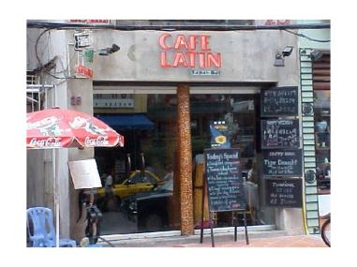
Applications
Restaurants
Café
Bar
Offices
Break Rooms
Cooler Filling – Construction, HVAC workers
Schools
Health Club/Spa

Slide 14
Product Data
Naming Process Example:
CU0920MA-1A
Cuber
Undercounter
09 : x10 = lb per day,
Medium cube
Air cooled
-1: 115V/60/1
-6: 230V/60/1
A: Revision level – not always published
CUR0920MA-32
R: InMetro certified – Portuguese, English labels, docs
-32: 220/60/1

Slide 15
Recommended Spare Parts
15 inch door
20 inch door
Door rollers
Curtain
Water pump – not new
Inlet water solenoid valve
Spray platform
Controller
Bin thermostat

Slide 16
The Essential IceTM Series by Scotsman provides customers with the ice they need for their operation; Reliably, Intuitively and Cost Effectively. Scotsman fulfills those needs through Innovative Engineering and Quality Manufacturing that has defined Scotsman for the past 60 years.

