Slide 1
SCOTSMAN ICE: C1030 – Air & Remote Condenser Units
HIGHLY EFFICIENT, SUPERIOR-PERFORMING ICE SYSTEMS

Slide 2
Condenser Application Chart
Selecting Ice Machines
Environmental Conditions | Air Cooled (C1030MA-32, C1030SA-32) | Remote (C1030MR-32, C1030SR-32)
Indoor Space Restricted |  | ✓
Poor Ventilation |  | ✓
Indoor Air Temp High |  | ✓
Outdoor Air Temp High | ✓
Water Supply Limited (High sewage cost or sewage limited) | ✓ | ✓
Seeking Low Installation Cost | ✓
Indoor Air Conditioning Capacity Limited |  | ✓
High Water Costs | ✓ | ✓
Noise Level is a Concern |  | ✓

Slide 3
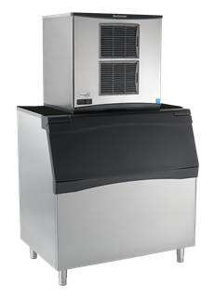
Installation Considerations
Air-Cooled
Recommended clearance of 6 inches on side
Avoid recirculation
600lbs. Is tipping point for remote consideration
Remote Ice Machine
Retro and new construction
Poorly ventilated areas
More efficient / consistent production
Typically 600 lbs. and over
Roof access
Licensed contractor for roof penetration
Line set length and condenser placement
Maximum rise: 35 feet
Maximum drop: 15 feet
Stay within max line set length when possible

Slide 4
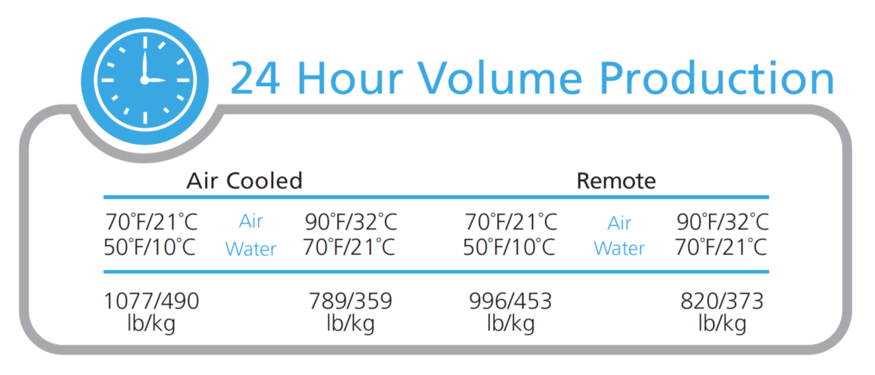
C1030 – Air & Remote Condenser Units
Installation & Start-Up Pricing Estimates (1000lb Unit)
Air Cooled (C1030MA-32, C1030SA-32) | Remote (C1030MR-32, C1030SR-32)
$675 | $1130*
*If needed, crane fees are in addition to the price listed: (+$500) ----- Exceptions: Union requirements, unique installation requirements such as penetrating walls/roofs, high rise buildings, restricted access, stores in malls or airports and other exceptions are not included and in addition to above costs. Additional costs may be incurred for required permits and/or the removal of existing equipment.
70°F
50°F
90°F
70°F
70°F
50°F
90°F
70°F
1077 lbs.
789 lbs.
996 lbs.
820 lbs.
Cube Size | Model Number | Condenser Unit | Energy Consumption kWh/100 lb. (45.4 kg)*
Medium | C1030MA-32 | Air | 4.83 | $ 10,571
 | C1030MR-32 | Remote | 4.99 | $ 10,471
Small | C1030SA-32 | Air | 4.83 | $ 10,571
 | C1030SR-32 | Remote | 4.99 | $ 10,471
*90°F (32°C) / 70°F (21°C)
2018 List Pricing

