Slide 1


INTRODUCING
UNDERCOUNTER FLAKE & NUGGET
SMALL IN STATURE, BIG ON PRODUCTION.

Slide 2
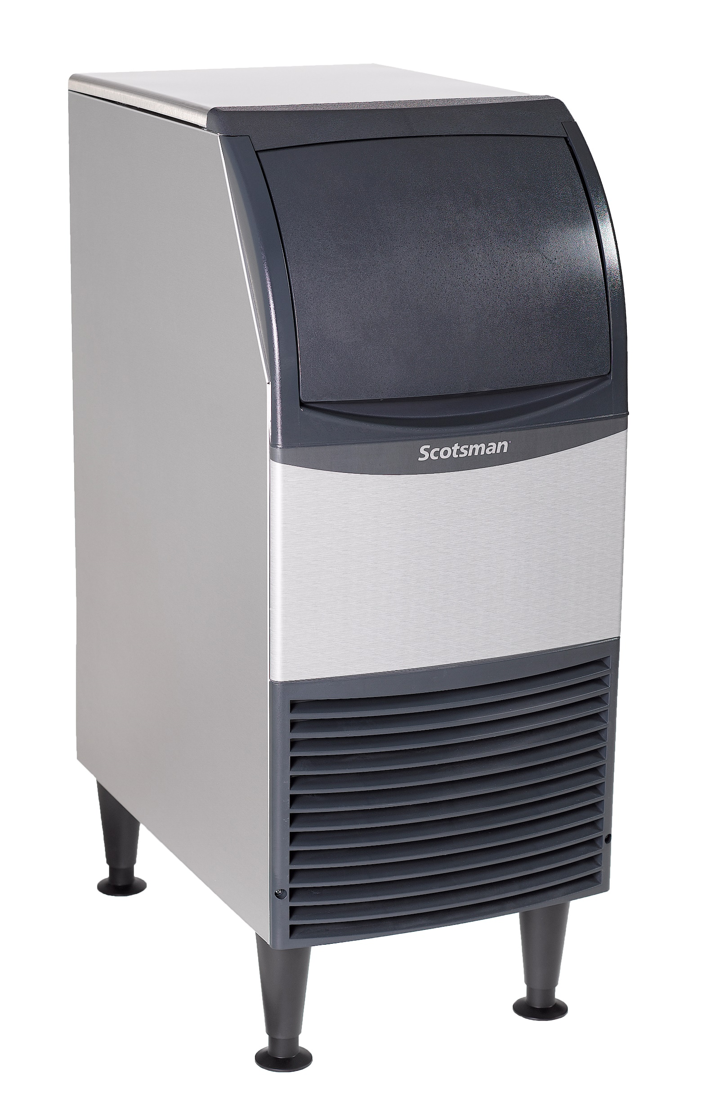

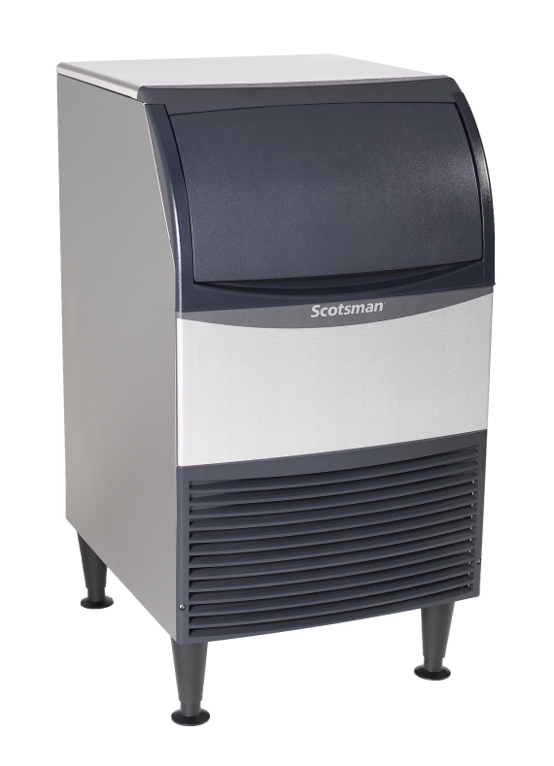

Undercounter Flake & Nugget Models
NEW!
Nugget & Flake Ice:
15”, 20”, & 24” wide units now available
Get the nugget and flake ice your customers love anywhere you need it with Scotsman’s new Nugget and Flake Undercounter Units. With a proven freezer design and sealed bearings—you’ll have everything your facility requires in a more compact design.

Slide 3

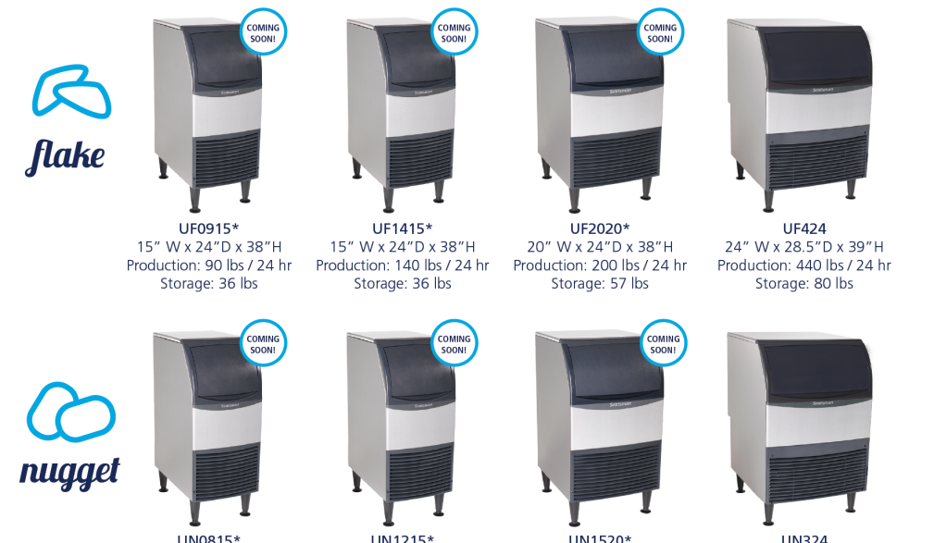

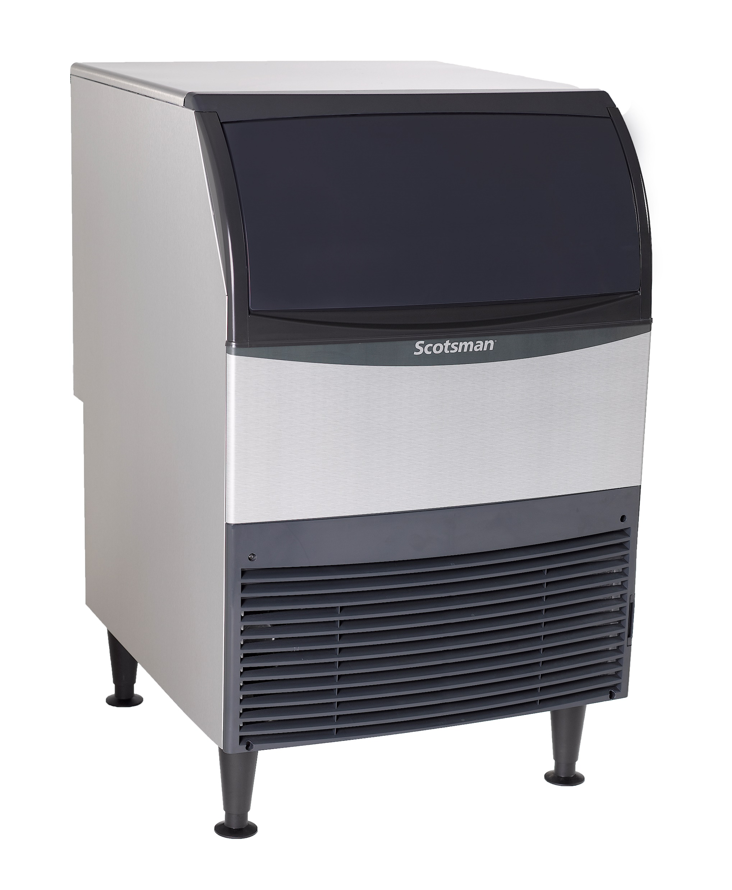

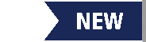

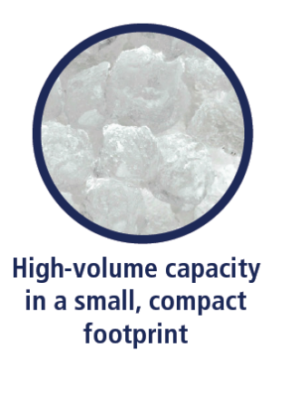

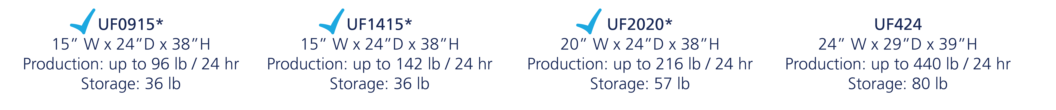



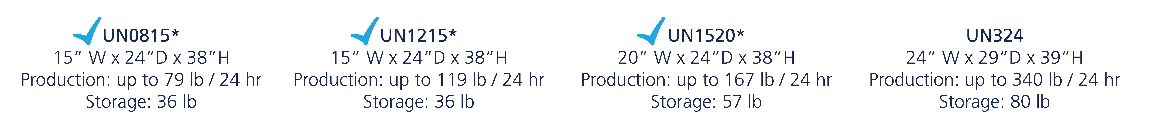
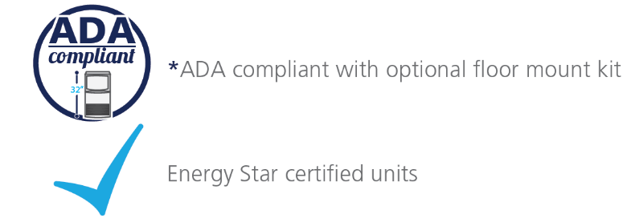
Undercounter Flake & Nugget: Overview

Slide 4

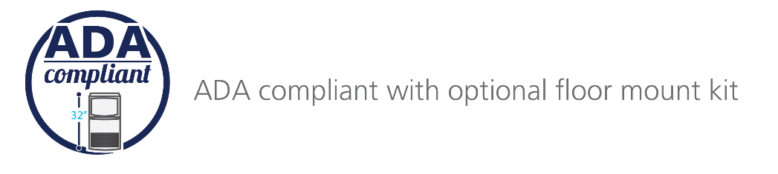
Undercounter Flake & Nugget: 15” Platform
UF0915
Air Cooled
115 V / 60 Hz
Energy Star® Certified
Optional KUFM15 floor mount kit
Capacity: 76 @ 90°/70°
96 @ 70°/50°
Storage: 36 lb.
Dimensions: 15” x 24” x 38”
Includes legs, scoop,
and 5.5’ power cord
UF1415
Air Cooled
115 V / 60 Hz
Energy Star® Certified
Optional KUFM15 floor mount kit
Capacity: 107 @ 90°/70°
142 @ 70°/50°
Storage: 36 lb.
Dimensions: 15” x 24” x 38”
Includes legs, scoop,
and 5.5’ power cord
UN0815
Air Cooled
115 V / 60 Hz
Energy Star® Certified
Optional KUFM15 floor mount kit
Capacity: 55 @ 90°/70°
79 @ 70°/50°
Storage: 36 lb.
Dimensions: 15” x 24” x 38”
Includes legs, scoop,
and 5.5’ power cord
UN1215
Air Cooled
115 V / 60 Hz
Energy Star® Certified
Optional KUFM15 floor mount kit
Capacity: 84 @ 90°/70°
119 @ 70°/50°
Storage: 36 lb.
Dimensions: 15” x 24” x 38”
Includes legs, scoop,
and 5.5’ power cord

Slide 5



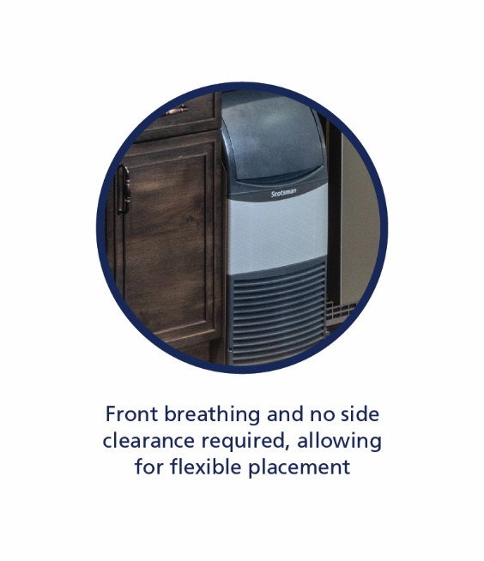

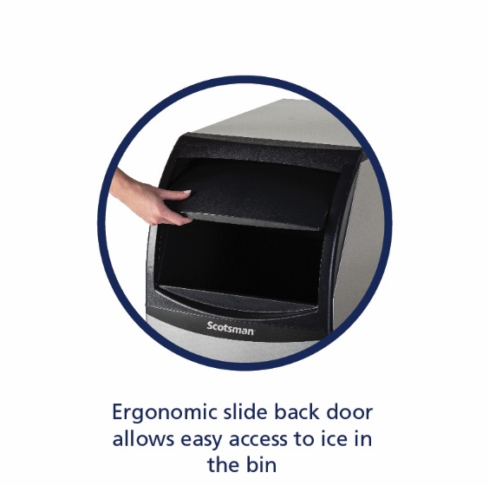
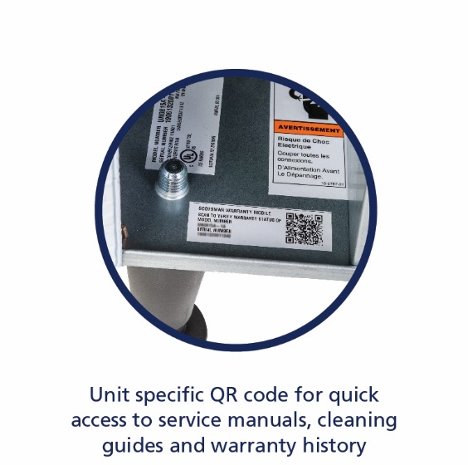
Undercounter Flake & Nugget: 20” Platform
UF2020
Air Cooled
115 V / 60 Hz
Energy Star® Certified
Optional KUFM20 floor mount kit
Capacity: 149 @ 90°/70°
216 @ 70°/50°
Storage: 57 lb.
Dimensions: 20” x 24” x 38”
Includes legs, scoop, and 5.5’ power cord
UN1520
Air Cooled
115 V / 60 Hz
Energy Star® Certified
Optional KUFM20 floor mount kit
Capacity: 125 @ 90°/70°
167 @ 70°/50°
Storage: 57 lb.
Dimensions: 20” x 24” x 38”
Includes legs, scoop and 5.5’ power cord

Slide 6
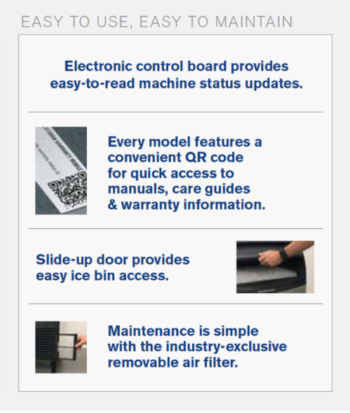
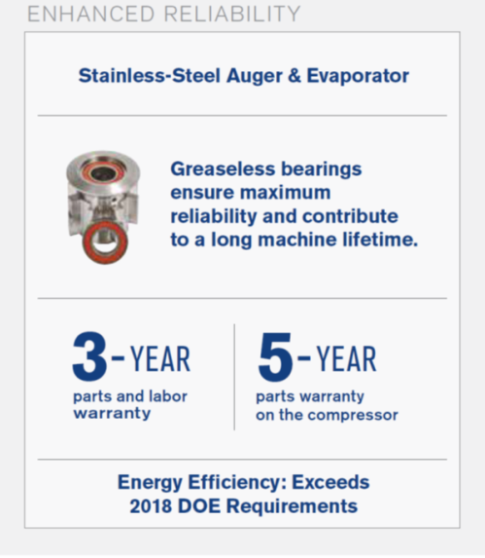
Undercounter Flake & Nugget: 24” Platform
UF424 (Replaced AFE424)
Air and water cooled
50 and 60 Hz options
Optional KUFM24 floor mount kit
Capacity: 310 @ 90°/70°
440 @ 70°/50°
Storage: 80 lb.
Dimensions: 24” x 28.5” x 39”
Includes legs, scoop, and 5.5’ power cord
UN324
Air and water cooled
50 and 60 Hz options
Optional KUFM24 floor mount kit
Capacity: 266 @ 90°/70°
340 @ 70°/50°
Storage: 80 lb.
Dimensions: 24” x 28.5” x 39”
Includes legs, scoop and 5.5’ power cord

Slide 7

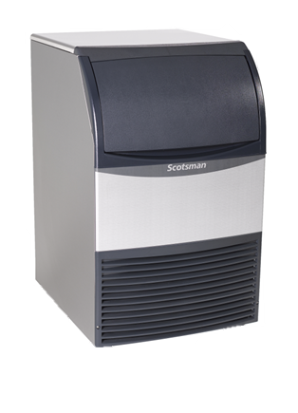
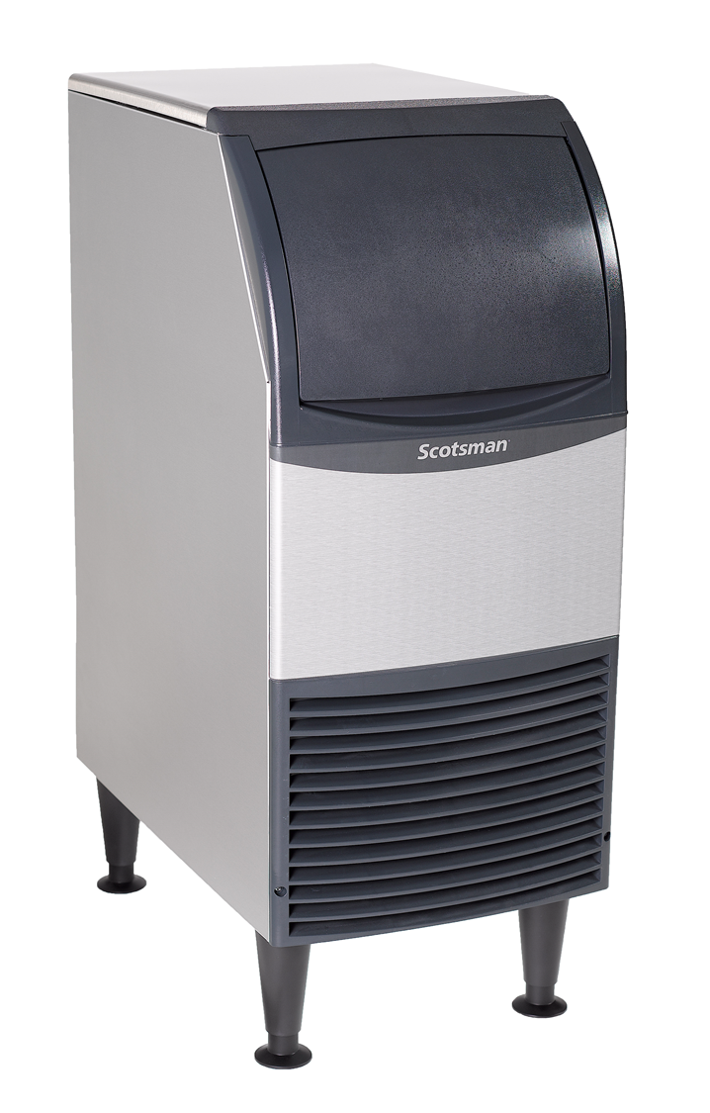
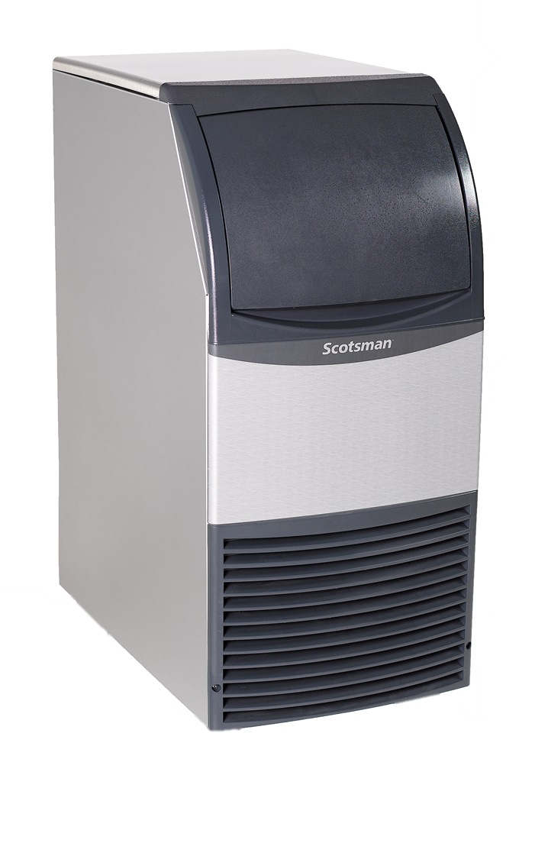
Space Saving Design: ADA Compliant
With legs
Without legs
15” Platform
38”
31.9”
With legs
Without legs
31.9”
With use of KUFM20 floor mount kit
38”
20”
20”
20” Platform
With use of KUFM15 floor mount kit
15”
15”

Slide 8
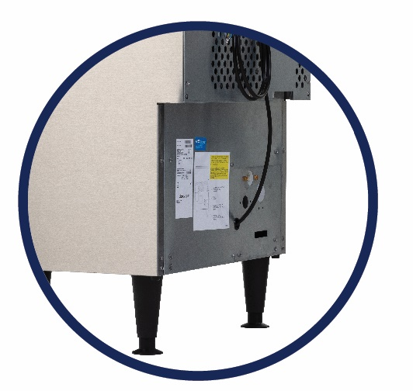
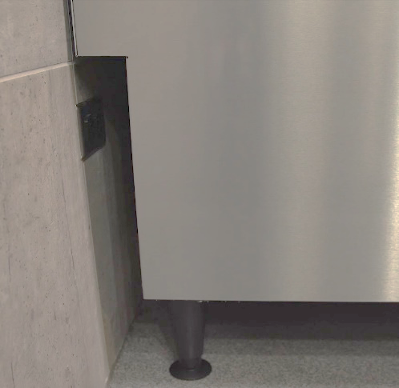
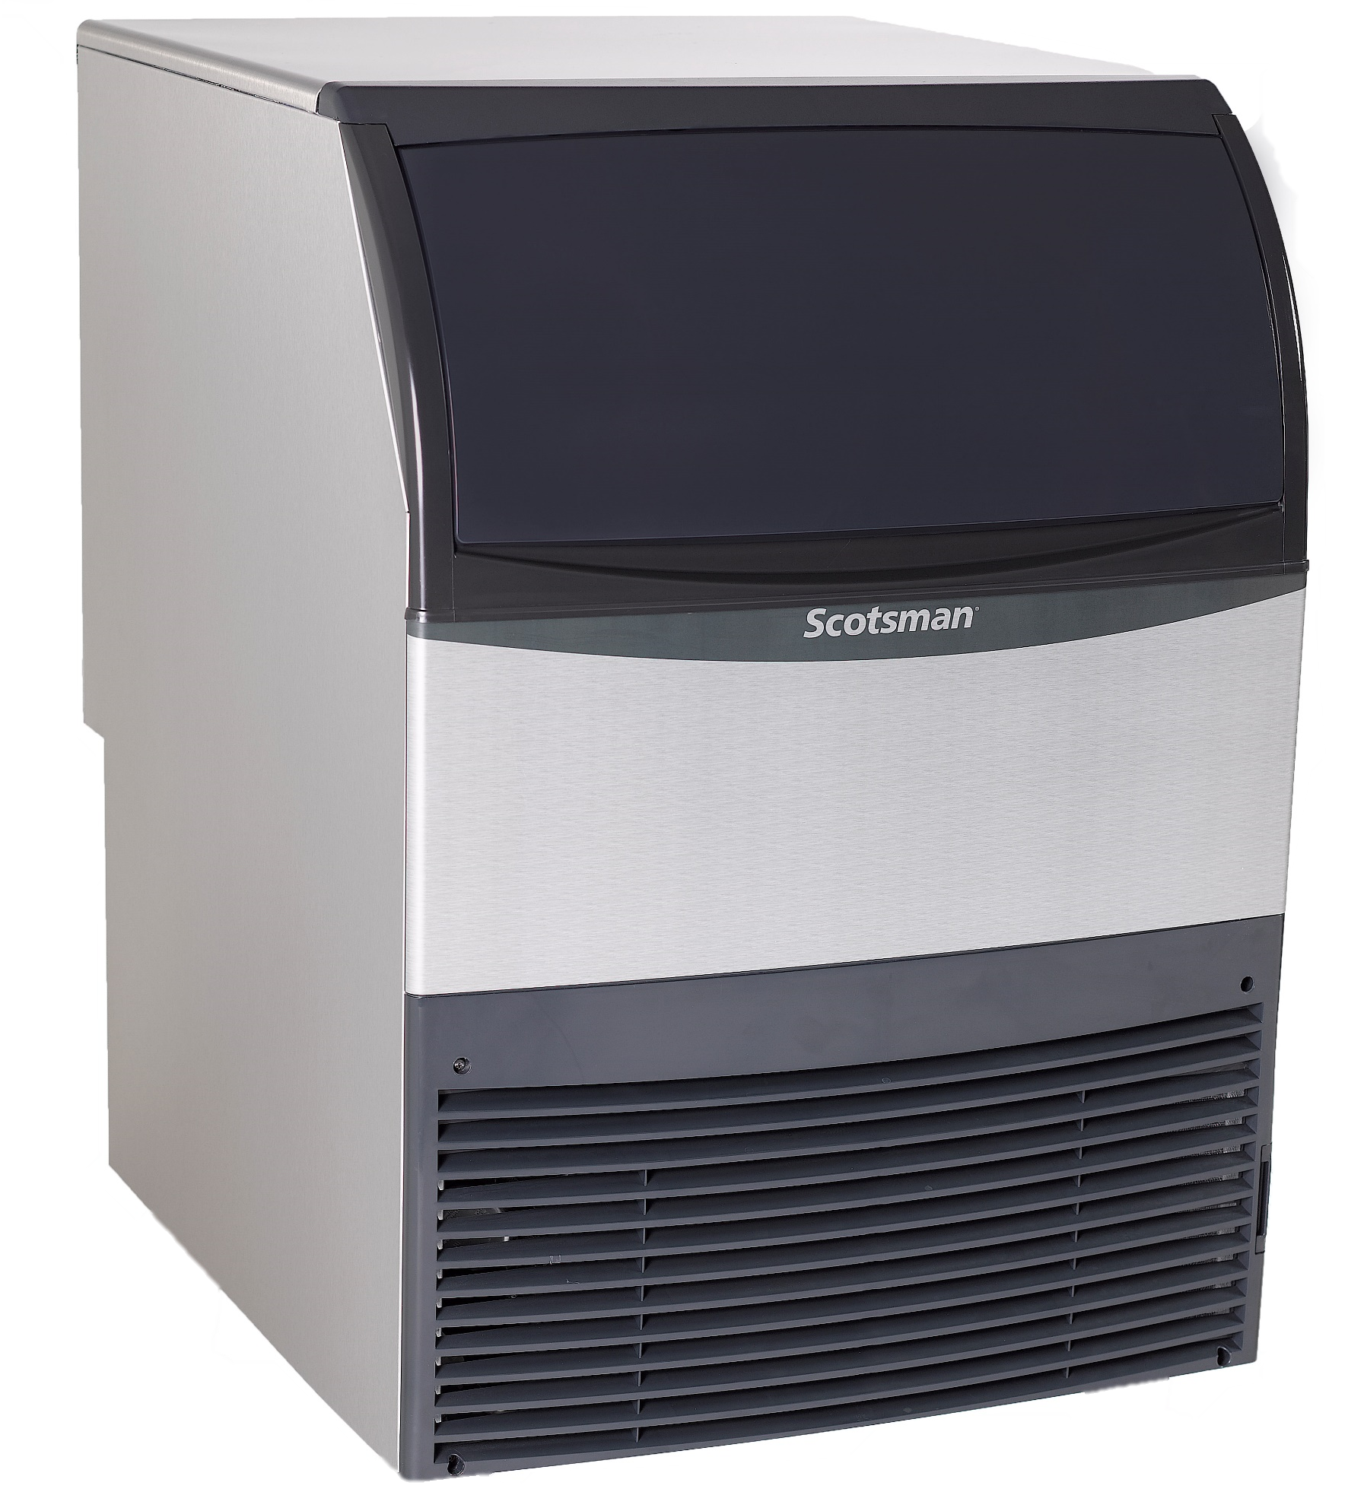
Space Saving Design: Recessed Utility Chase
24” Platform
With legs
Without legs
39”
33.5”
Recessed utility chase on backside of unit provides clearance along the wall for tight installs
With use of KUFM24 floor mount kit
24”
24”

Slide 9
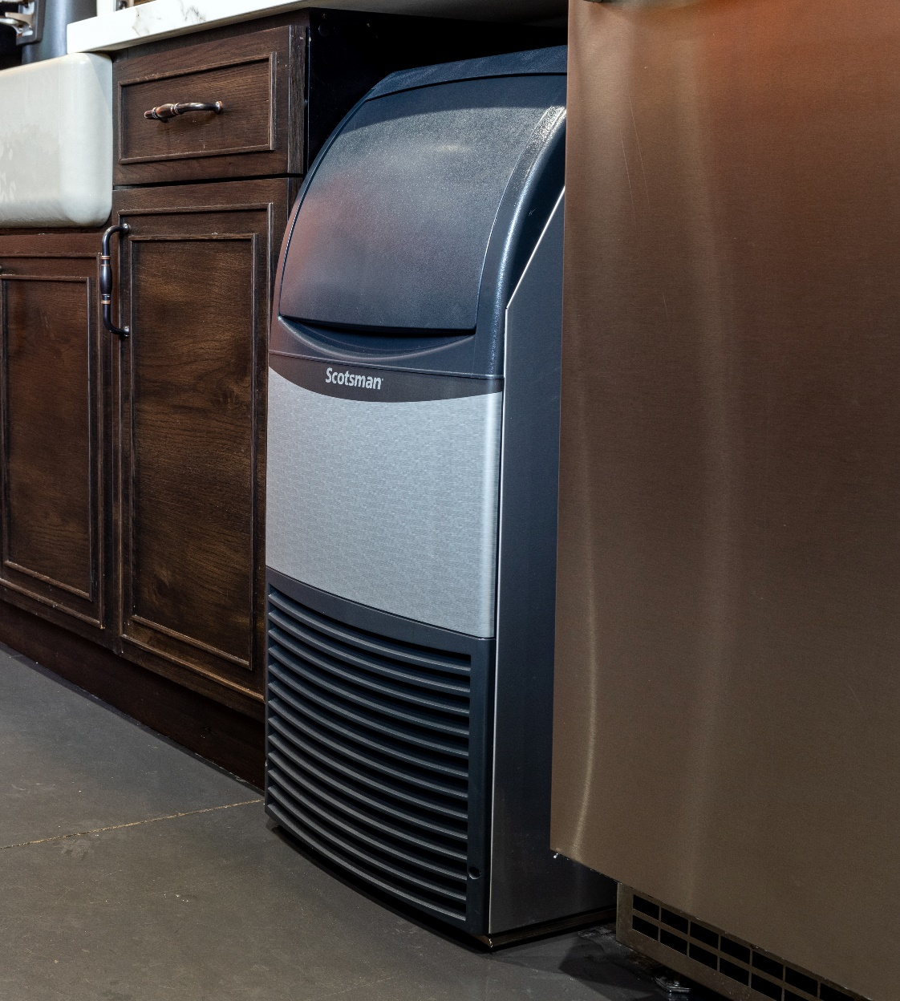
Space Saving Design: Front Breathing
No Side Clearance Required
Maximizing ice output despite a small footprint
Front air intake and exhaust
No side clearance required allowing for flexible placement in the tightest locations
Machine can be placed directly beside walls and other equipment

Slide 10
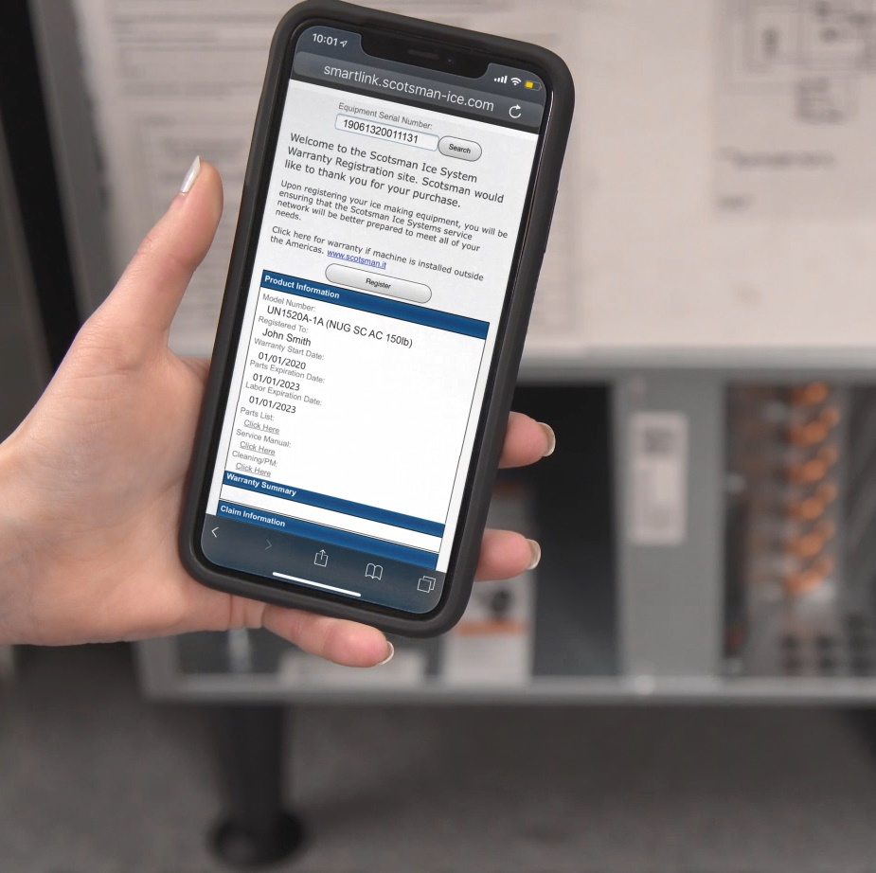
Ease of Use: QR Code
Quick Response (QR) Code
Every Essential machine features a QR code that connects customers to vital unit specific information
Helps reduce downtime and frequency of service calls
QR code leads to a warranty registration page, auto-populated with the corresponding serial number

Slide 11
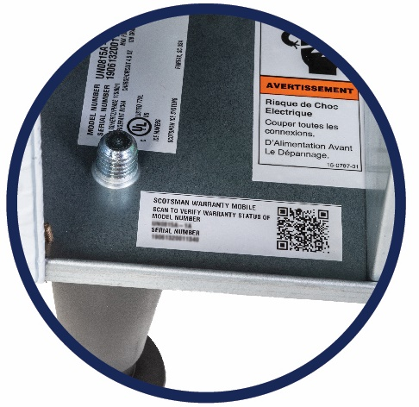


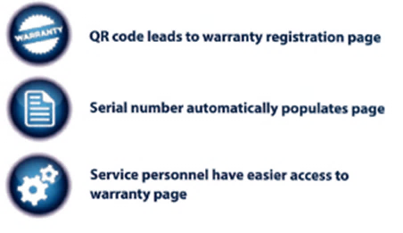
Ease of Use: QR Code
Quick Response (QR) code
Operators and service technicians can use their smart phone to scan the QR code to access instant warranty and technical information specific to that model
The product serial number will automatically populate the page
SCAN WITH YOUR SMART PHONE
Scanning Tip:
Some recent phone updates allow you to use your phone’s built-in camera app to scan QR Code

Slide 12
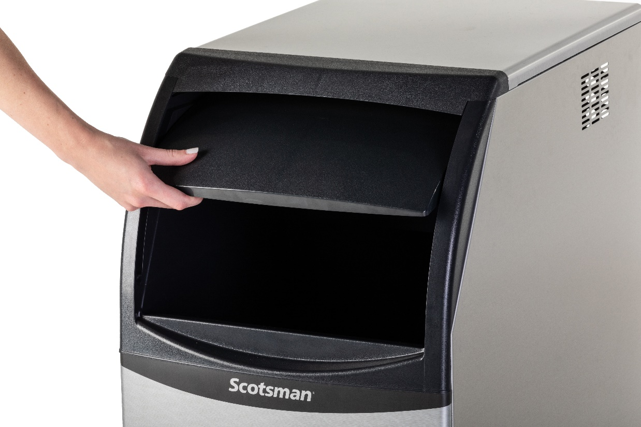
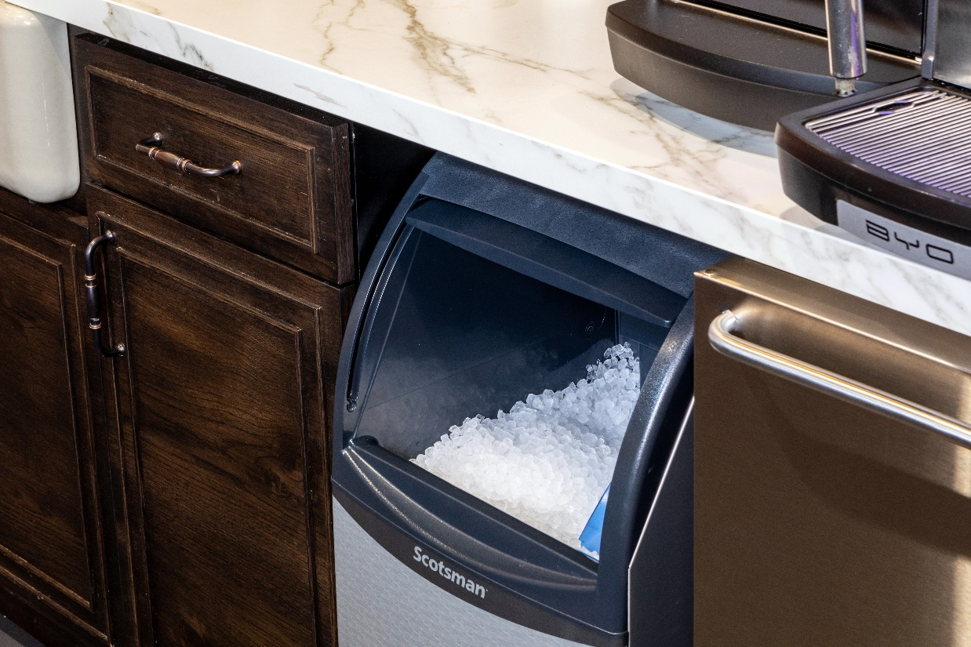
Ease of Use: Ergonomic Bin Door
Convenient Slide-Up Door
Machines feature a durable, slide-up door that provides convenient and easy access to the ice bin

Slide 13
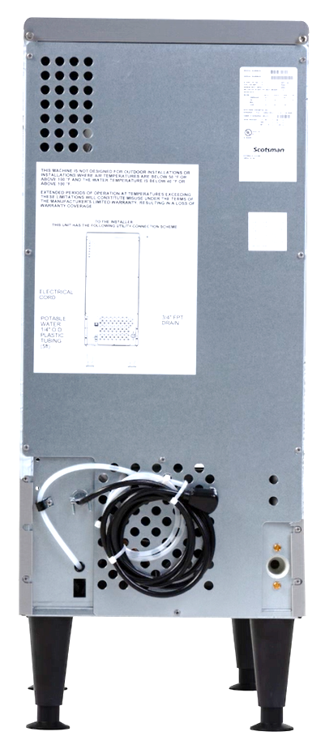
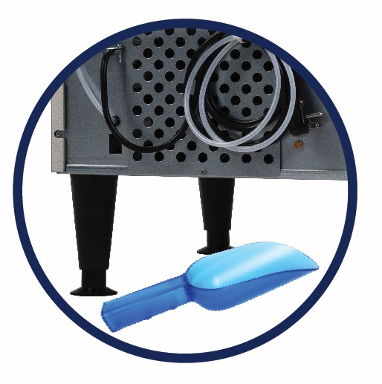
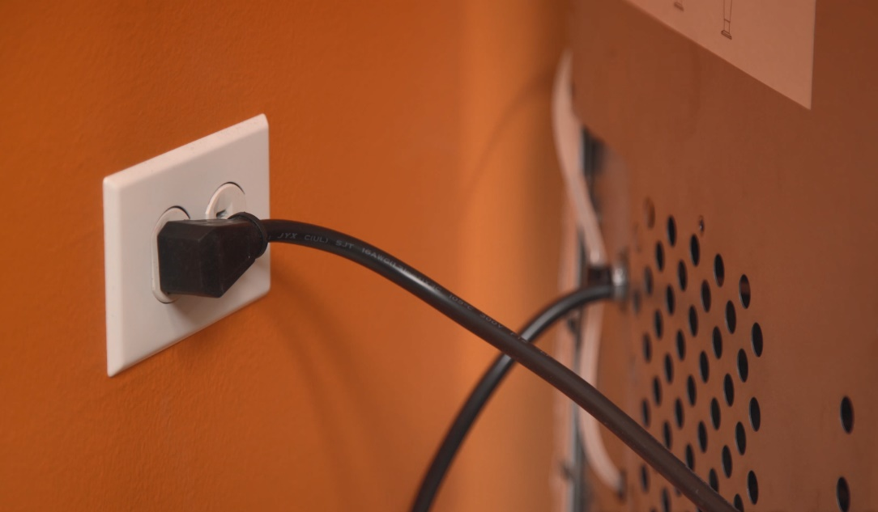
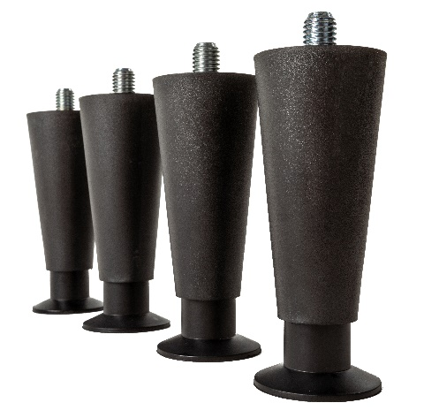
Ease of Use: Quick Installation
Included in the Box
5.5’ power cord with NEMA 5-15P plug
Ice scoop
6” adjustable legs

Slide 14
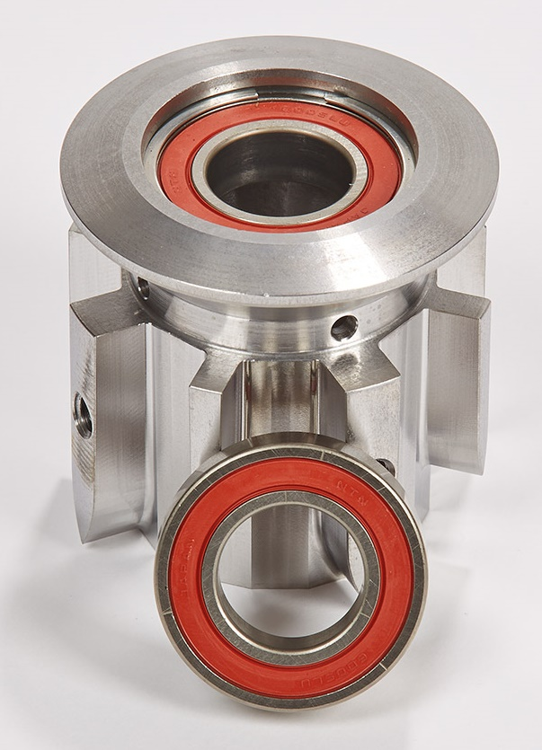
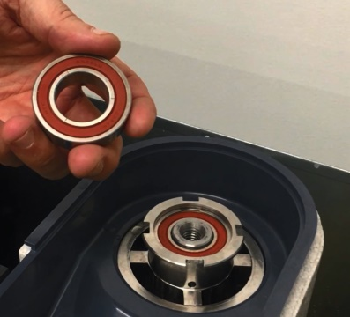
Flake & Nugget: Superior Reliability
Maintenance-Free Bearing
The Problem: Components used to create compressed ice require maintenance for routine checks, specifically with wearable parts like bearings
Innovation: All UF/UN models feature a proprietary, maintenance-free bearing, fully sealed with a high-tech polymer that lubricates and eliminates the need for greasing (launched in 2015)
Exclusive technology uses no wearable parts and no grease, which decreases potential service and maintenance issues

Slide 15
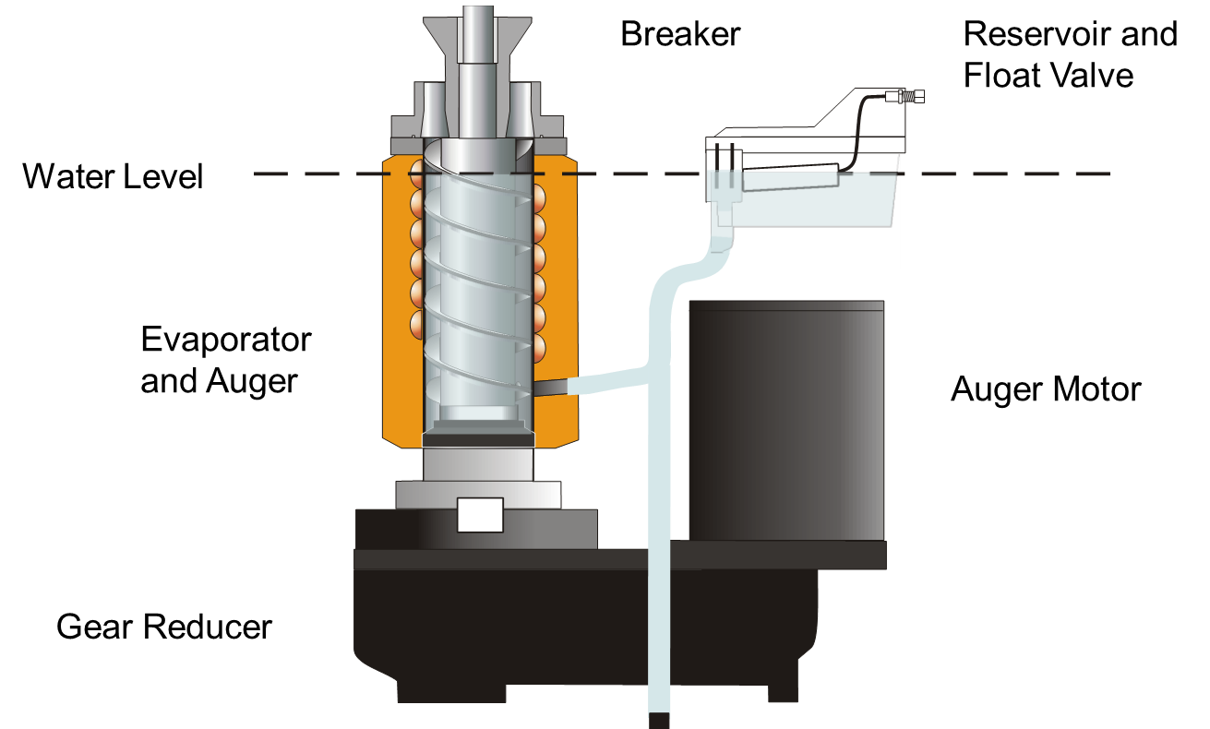
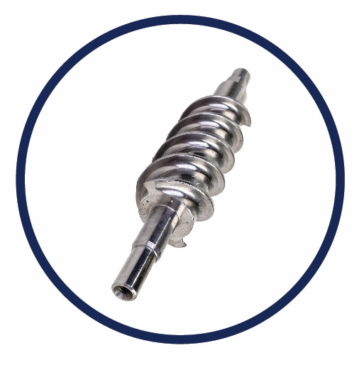
Flake & Nugget: Superior Reliability
Heavy-Duty Stainless-Steel Components
Scotsman Nugget and Flake undercounter units feature:
  An extremely reliable stainless-steel evaporator
  Durable stainless-steel auger
Ensures maximum durability and reliability for a long machine life

Slide 16
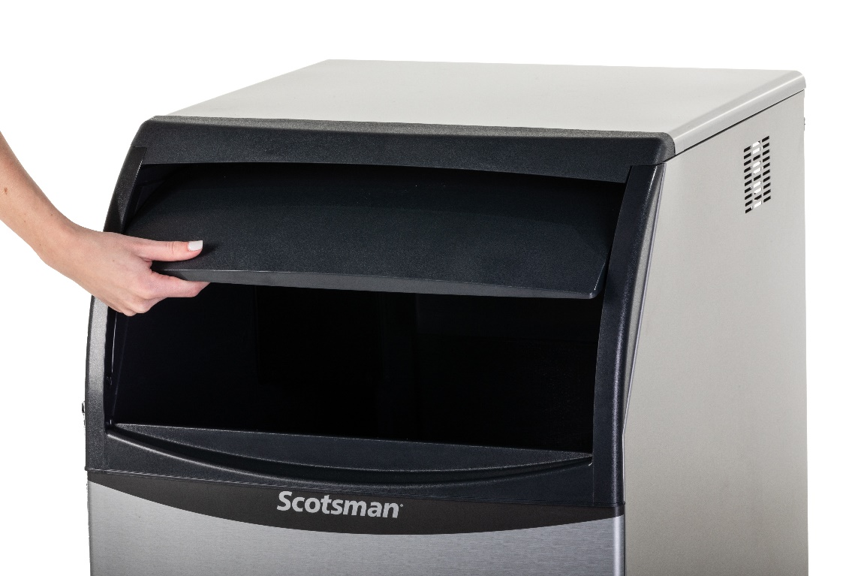
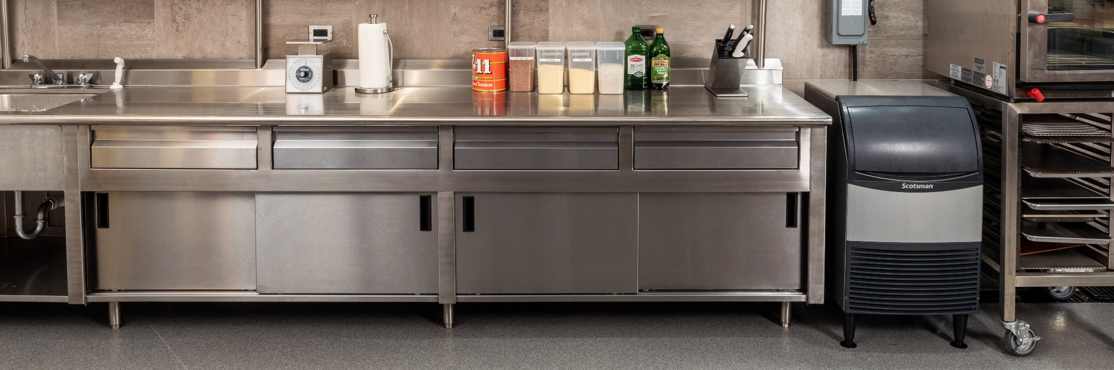
Flake & Nugget: Superior Reliability
Designed for Maximum Lifespan
Aluminum alloy side and top panels
  Corrosion resistant
  Easy to clean, smudge resistant
Hard plastic front panel
  Durable and rust-free

Slide 17




Flake & Nugget: Superior Reliability
High Quality Manufacturing
All Scotsman machines are manufactured and tested at our award-winning facility in South Carolina to ensure you get a reliable machine that works exactly like it should
Assembled in the USA
Award winning Fairfax, South Carolina Facility
ISO9001:2015 accredited
100% of machines run tested before shipment

Slide 18
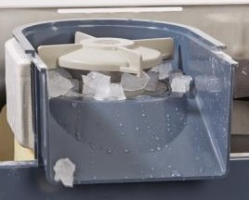

Flake & Nugget: Environmentally Friendly
Lower Operating Costs
Uses R-134a refrigerant
  Does not deplete ozone layer
Lower energy and water consumption compared to cube machines
Recyclable aluminum alloy side panels
  Same durability and corrosion resistance as stainless-steel
Meets US Safe Drinking Act low lead requirements

Slide 19
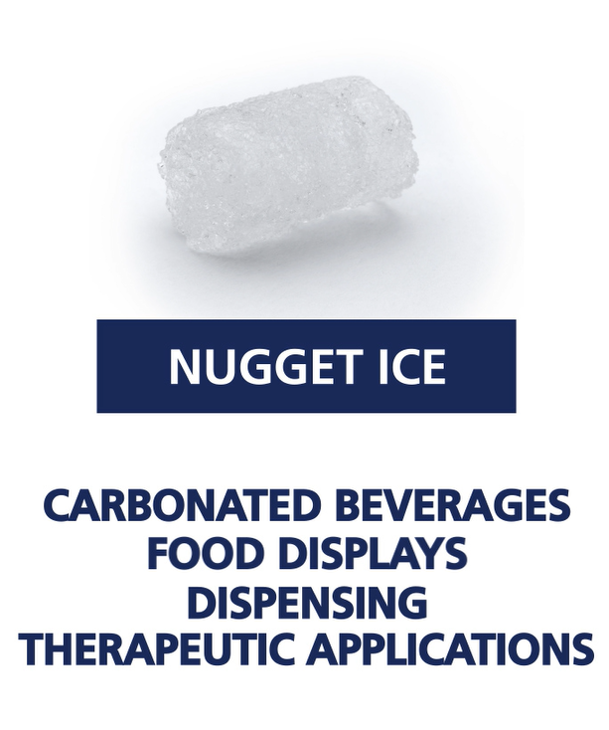


Undercounter Nugget: About The Ice
Increased Profitability
  Consumer preferred
  Lower cost by ⅓ per 100 lb. of ice
    Uses 40% less water (vs. cube)
    Uses 15% less energy (vs. cube)
  Lower beverage costs
    9% - 20% higher displacement
      Use less syrup/beverage
Scotsman’s Nugget Ice:
Soft
Easy to chew
Rapid cooling
Slow-melting
Absorbs the flavor of beverages

Slide 20
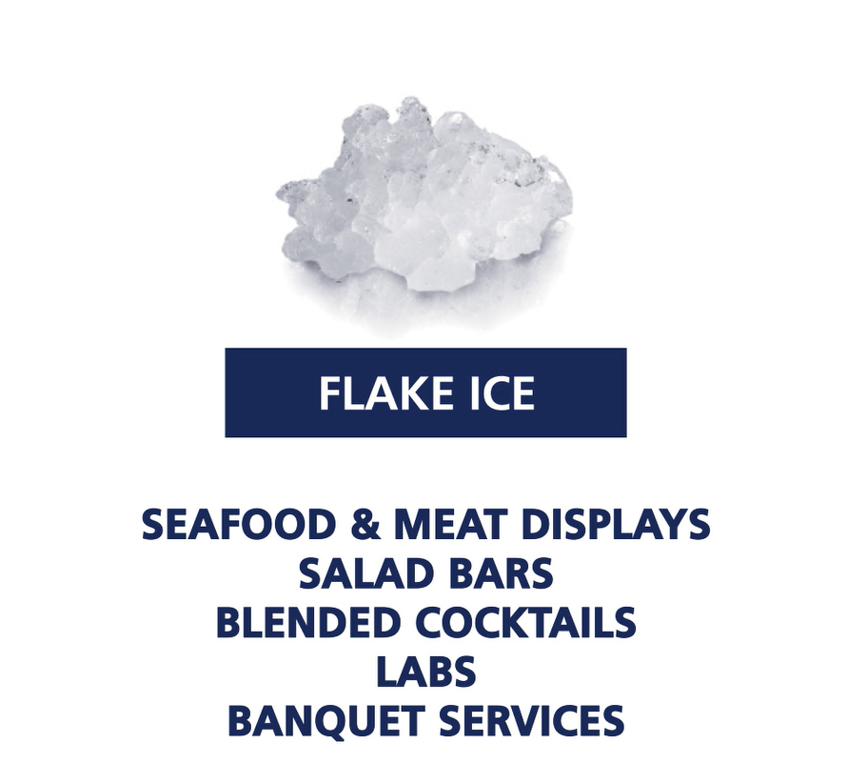
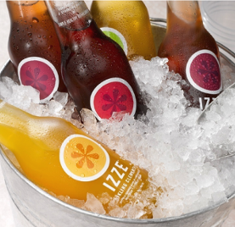

Undercounter Flake: About The Ice
Presentation & Preservation
Flake Ice is a Smart Choice for:
Blended cocktails
Salad bars
Produce, seafood, and meat displays
Therapeutic use in healthcare facilities

Slide 21
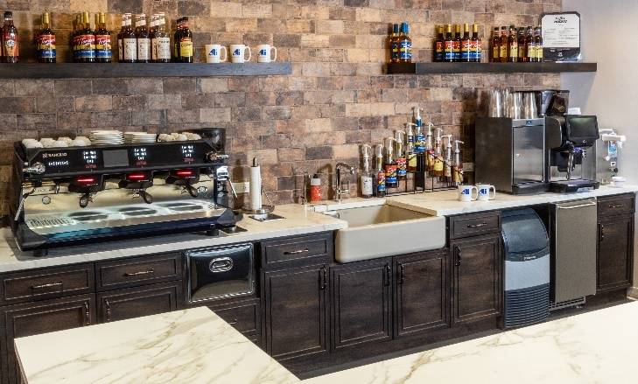
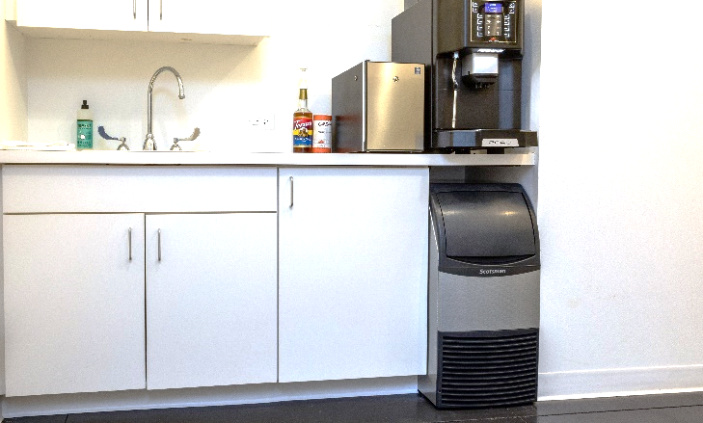
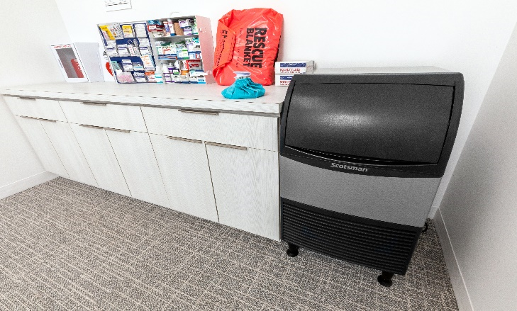

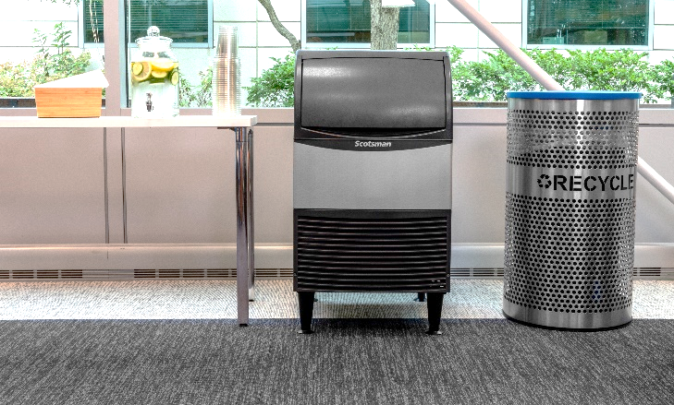
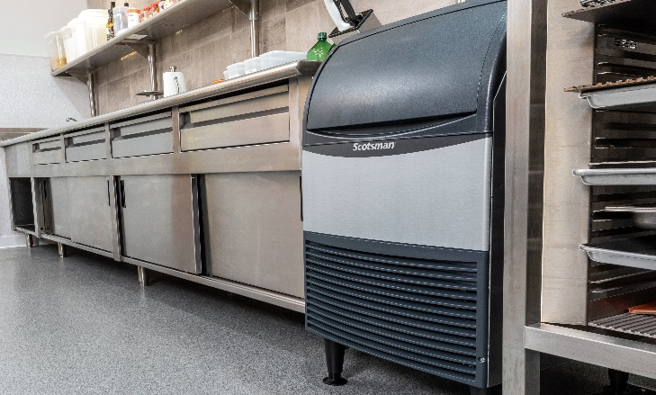
Undercounter Flake & Nugget: Applications
Ideal for Placement in:
Restaurants
Café
Bar
Offices
Break Rooms
Cooler Filling
  Construction, HVAC workers
Schools
Health Club/Spa
Laboratories

Slide 22
15” & 20” WIDTH
UNDERCOUNTER FLAKE & NUGGET
SPECIFIC FEATURES

Slide 23
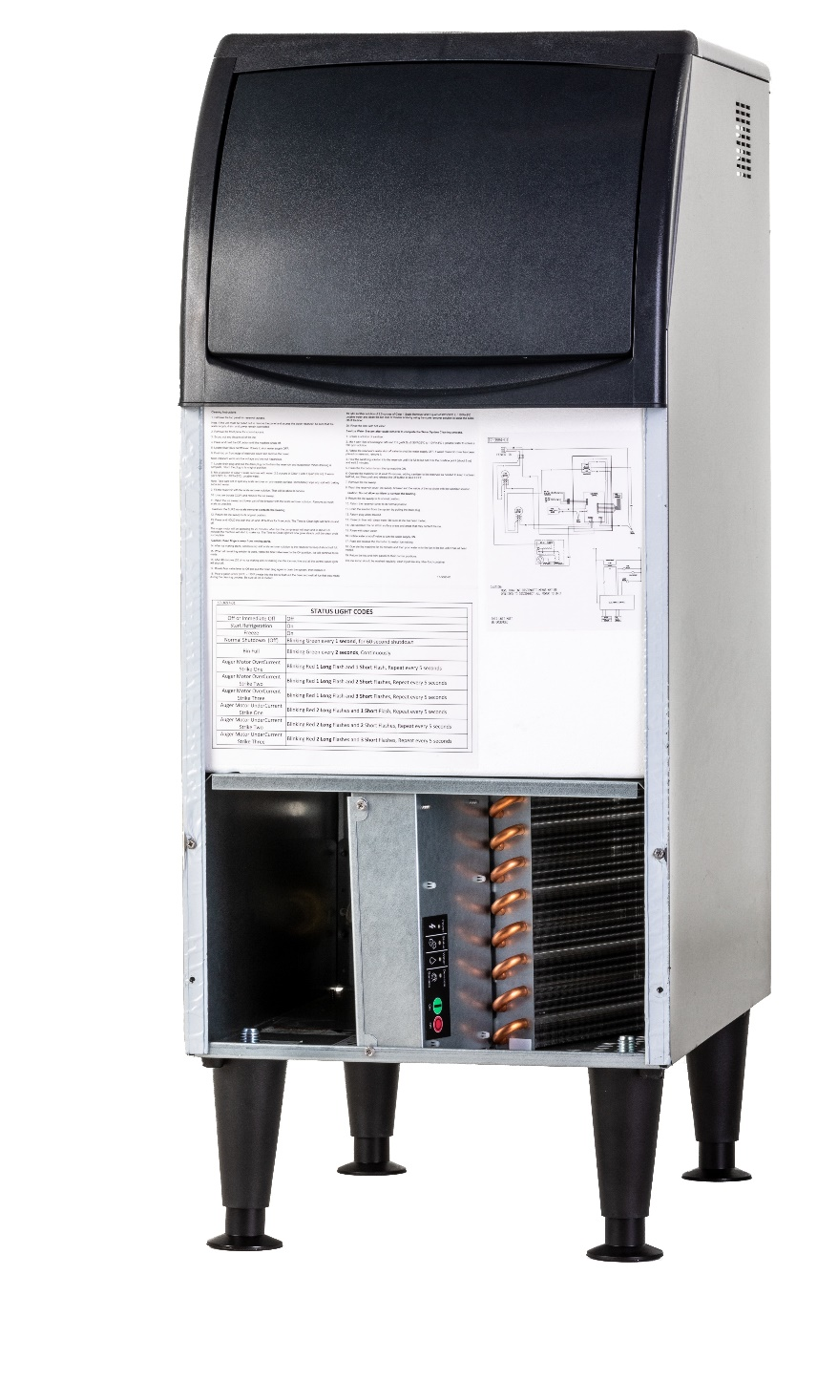
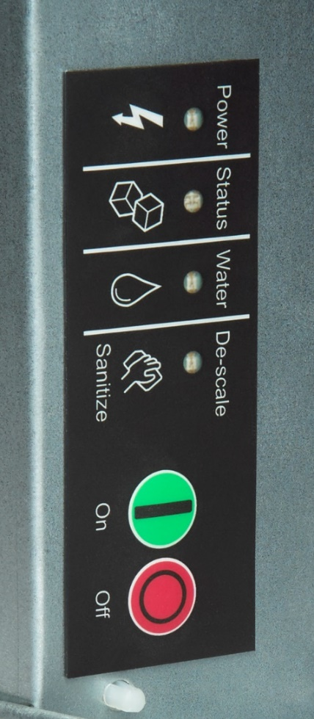
Ease of Use: Simple Servicing (15” & 20” Only)
AutoAlert™ Indicator Lights
Cleaning and service information can be conveniently found upon removing the front panel
Innovative LED indicator lights keep operators informed of unit’s status
Signals staff when it is time to descale, sanitize and more
Each of the 4 lights labeled with an easy-to-identify icon

Slide 24



Flake & Nugget: Superior Reliability (15” & 20” Only)
Standing Behind Our Quality
Scotsman provides a 3-year parts and labor warranty on all components for 15” and 20” units
3-year parts and labor warranty on all components
Warranty valid in North, South & Central America for commercial installations
Residential applications:
  1 year parts and labor

Slide 25
24” WIDTH
UNDERCOUNTER FLAKE & NUGGET
SPECIFIC FEATURES

Slide 26
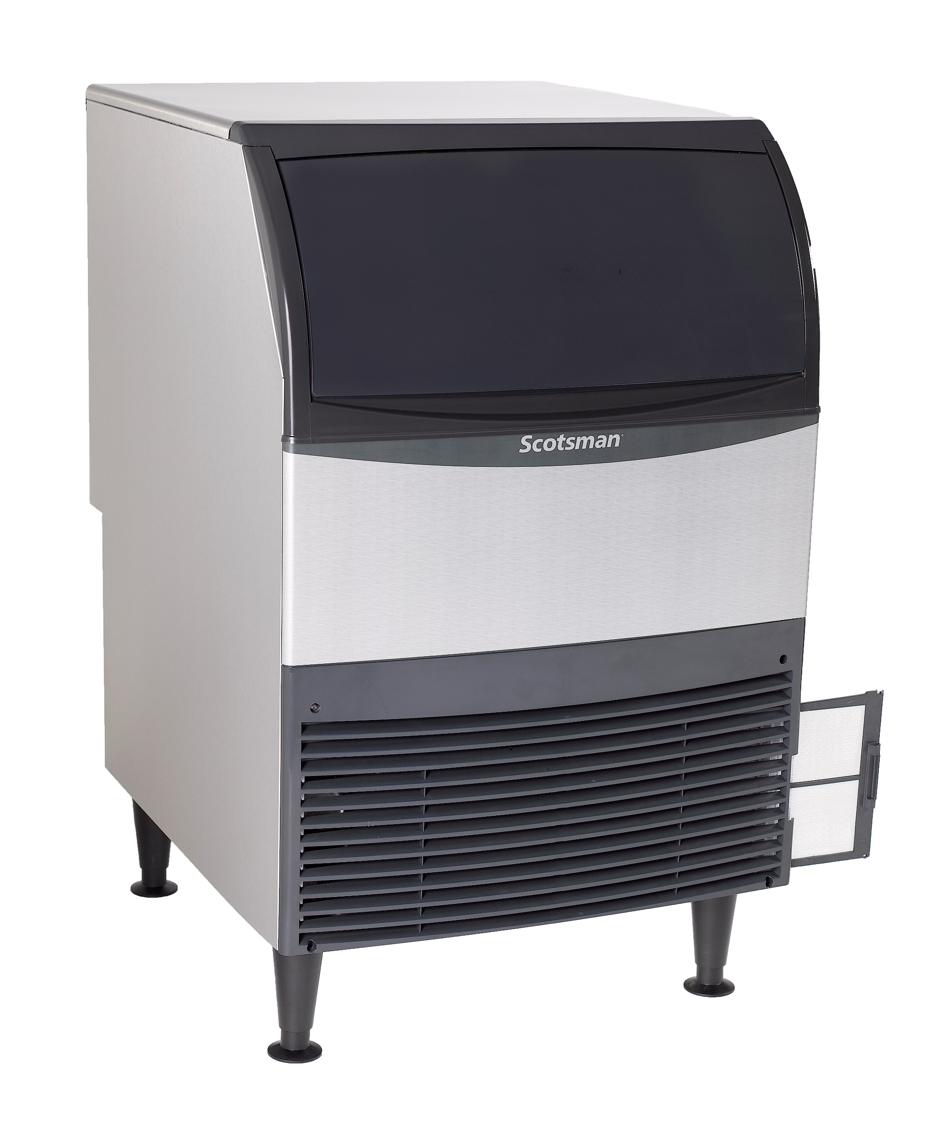
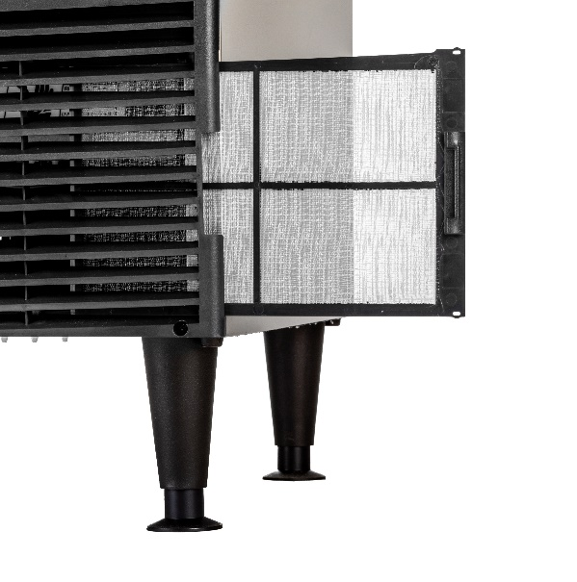
Ease of Use: Removable External Air Filter (24” Only)
Easy-to-Clean Air Filter
The removable, external filter makes cleaning easy for increased efficiency
Filter location makes accessing, rinsing, and reusing fast and easy
Better visibility keeps regular cleaning top of mind, ensuring maximum performance and optimal sanitation
No tools required for removal, unlike other manufacturers

Slide 27


Flake & Nugget: Easy to Operate (24” Only)
State of the Art Electronic Control Panel
Intuitive Diagnostics
Internal LED indicator lights alert staff when descaling and sanitizing are needed
Warning lights feature a seven-segment display that shows critical diagnostics for easy reference
Test mode activates key components to check for potential issues

Slide 28

Flake & Nugget: Easy to Operate (24” Only)
Easy Software Updates
The 24” Nugget and Flake undercounter machines feature a USB port that allows for easy software updates

Slide 29

Flake & Nugget: Compact Design (24” Only)
Recessed Utility Chase
The 24” Nugget and Flake undercounter machines feature a recessed utility chase on the backside of unit
Provides clearance along the wall for tight installs and a smaller footprint

Slide 30

Flake & Nugget: Superior Reliability (24” Only)
Standing Behind Our Quality
Scotsman provides a 3-year parts and labor warranty on all components, and 5-year parts warranty on the compressor for 24” units
3-year parts and labor warranty on all components
5-year parts warranty on compressor
Warranty valid in North, South & Central America for commercial installations
Residential applications:
  1 year parts and labor

Slide 31



