Slide 1
INTRODUCING UNDERCOUNTER CUBE
SMALL IN STATURE, BIG ON PRODUCTION AND RELIABILITY.

Slide 2
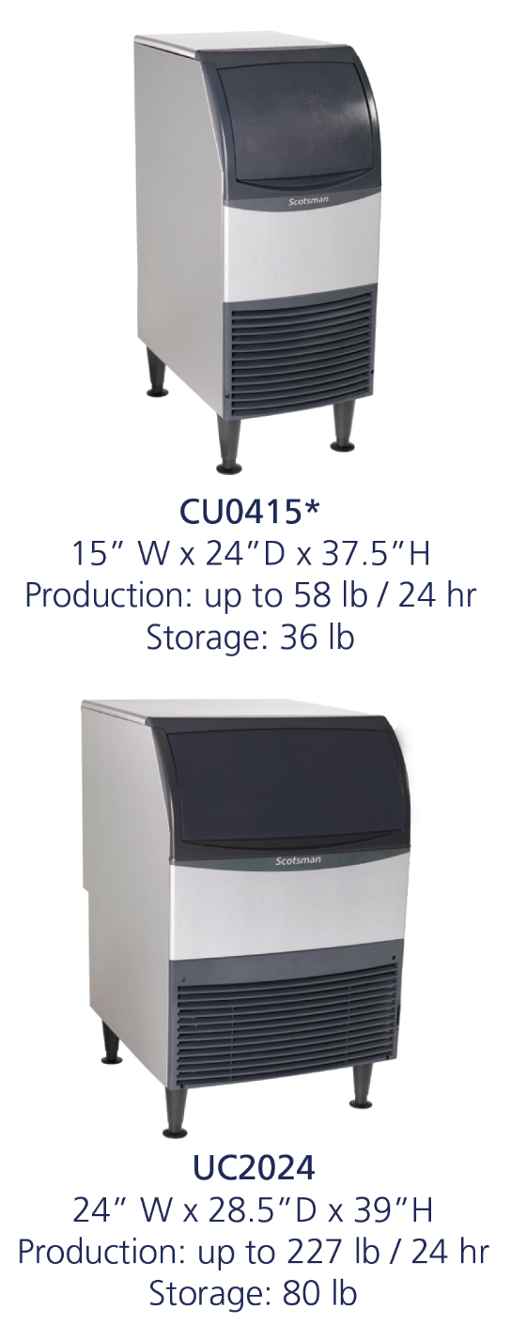
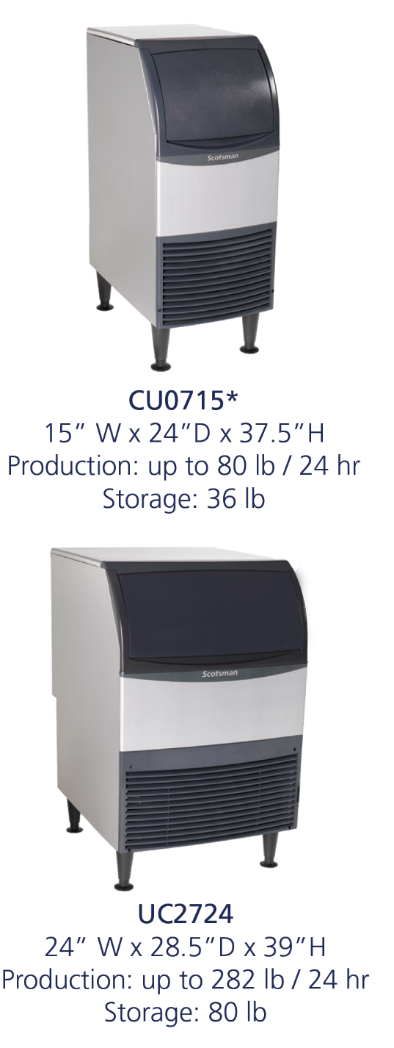
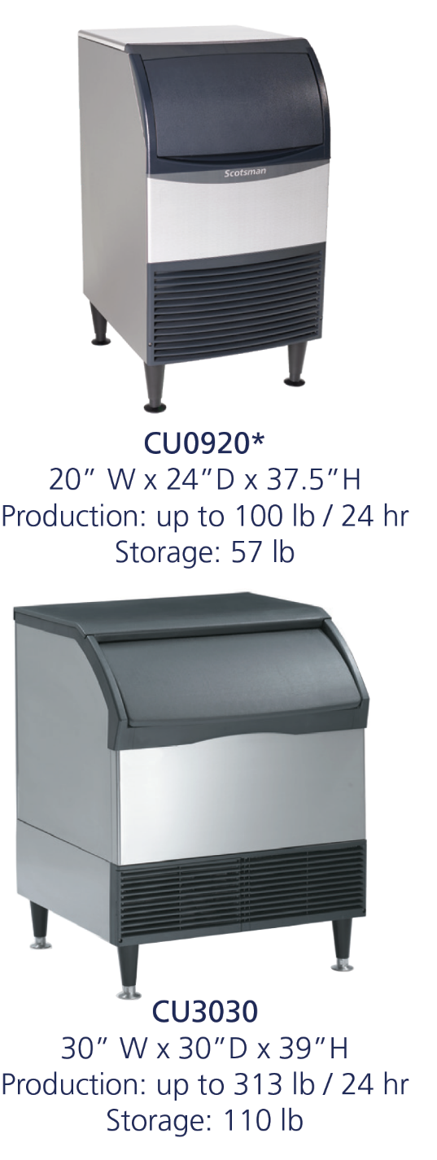
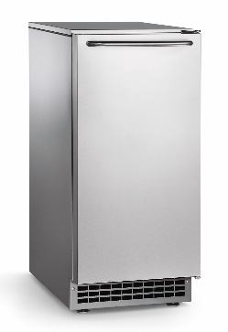
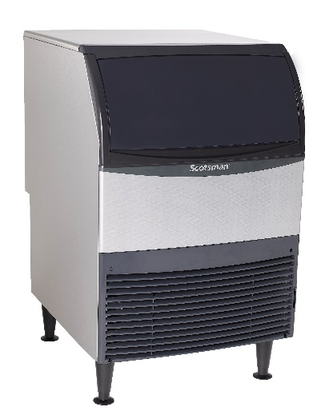
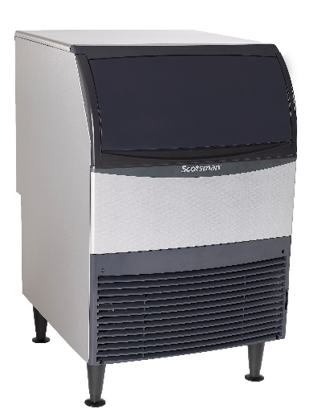
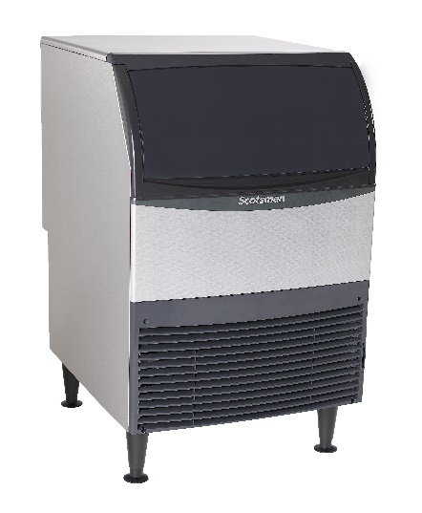
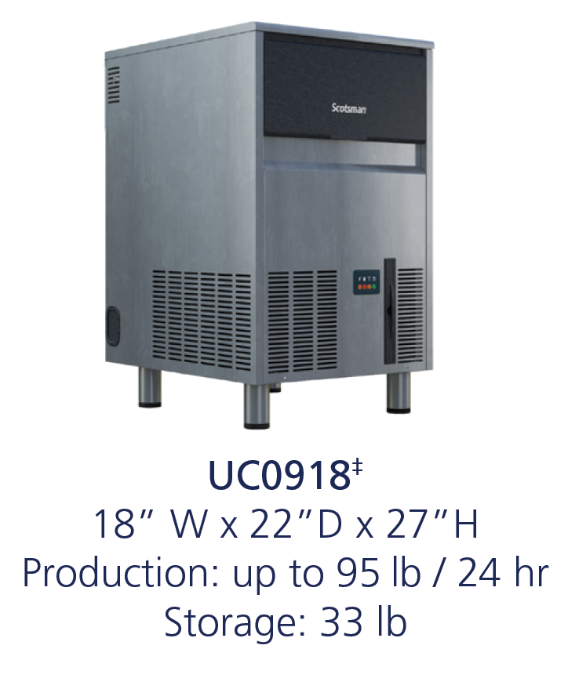
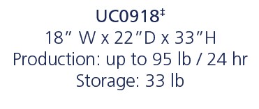
Undercounter Cube: Family Overview

Slide 3
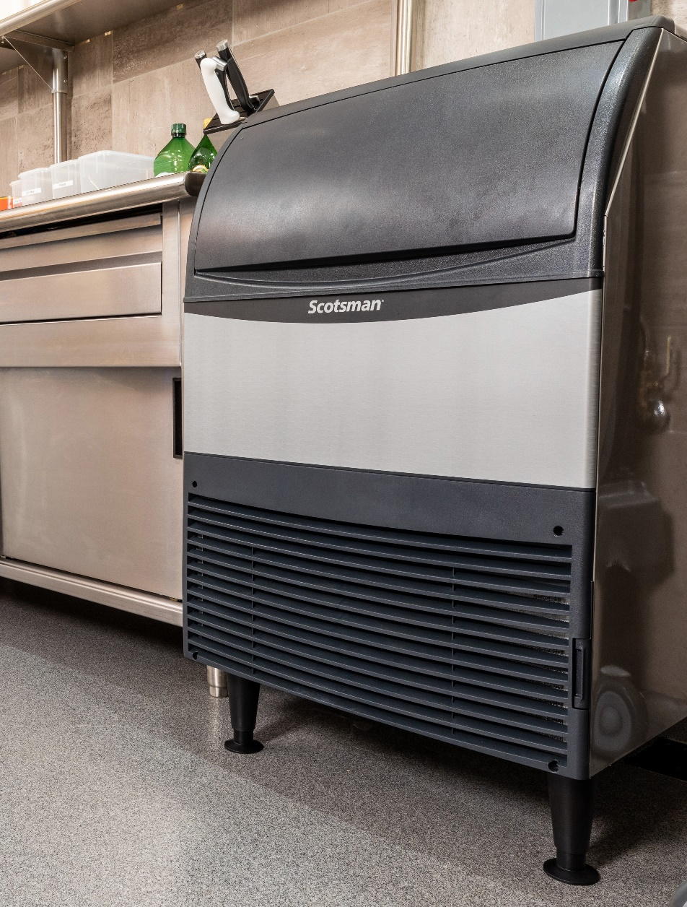
Space Saving Design: Front Breathing
No Side Clearance Required
Maximizing ice output despite a small footprint
Front air intake and exhaust
No side clearance required allowing for flexible placement in the tightest locations
Machine can be placed directly beside walls and other equipment

Slide 4
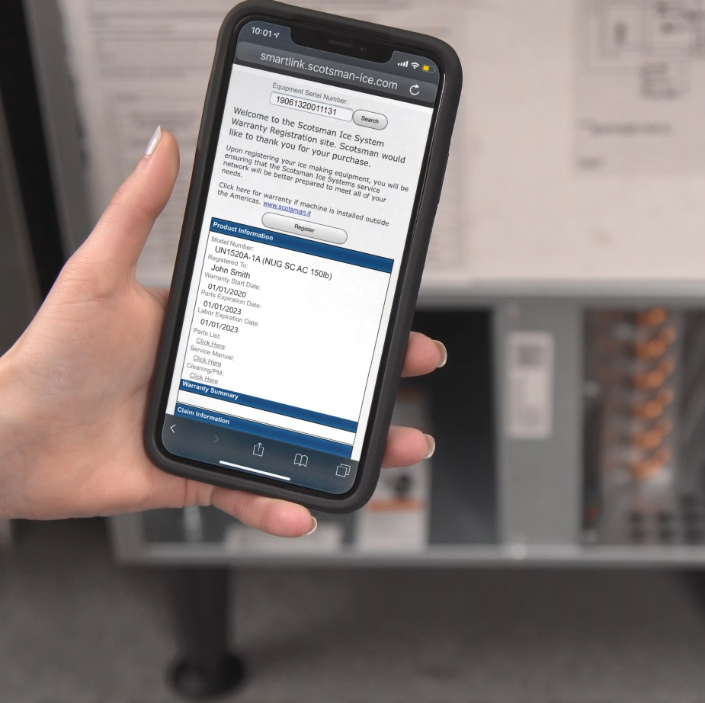
Ease of Use: QR Code
Quick Response (QR) Code
Every Essential machine features a QR code that connects customers to vital unit specific information
Helps reduce downtime and frequency of service calls
QR code leads to a warranty registration page, auto-populated with the corresponding serial number

Slide 5
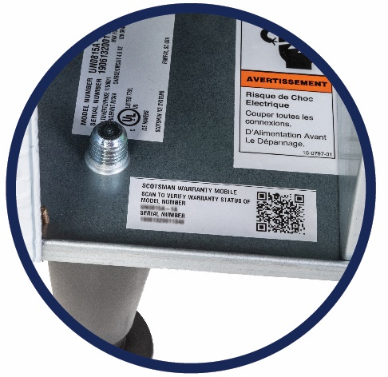
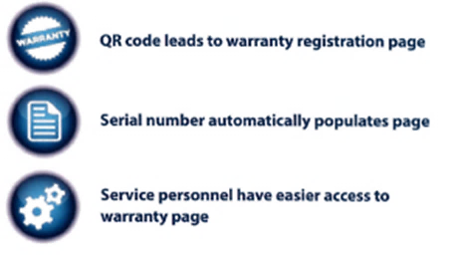
Ease of Use: QR Code
Quick Response (QR) code
Operators and service technicians can use their smart phone to scan the QR code to access instant warranty and technical information specific to that model
The product serial number will automatically populate the page
SCAN WITH YOUR SMART PHONE
Scanning Tip:
Some recent phone updates allow you to use your phone’s built-in camera app to scan QR Code

Slide 6
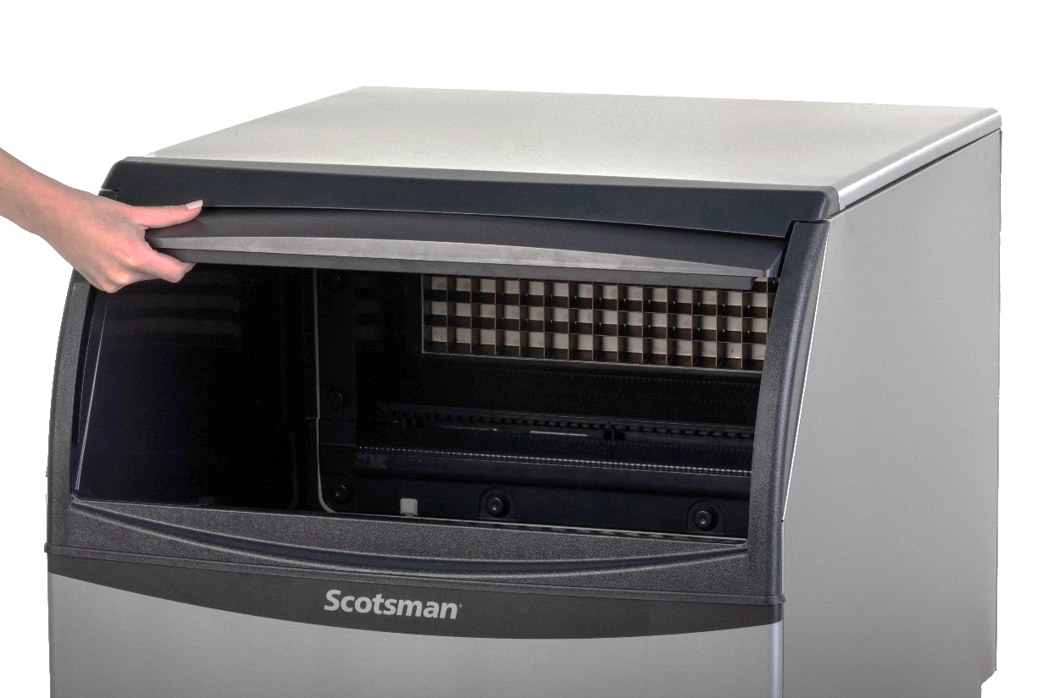
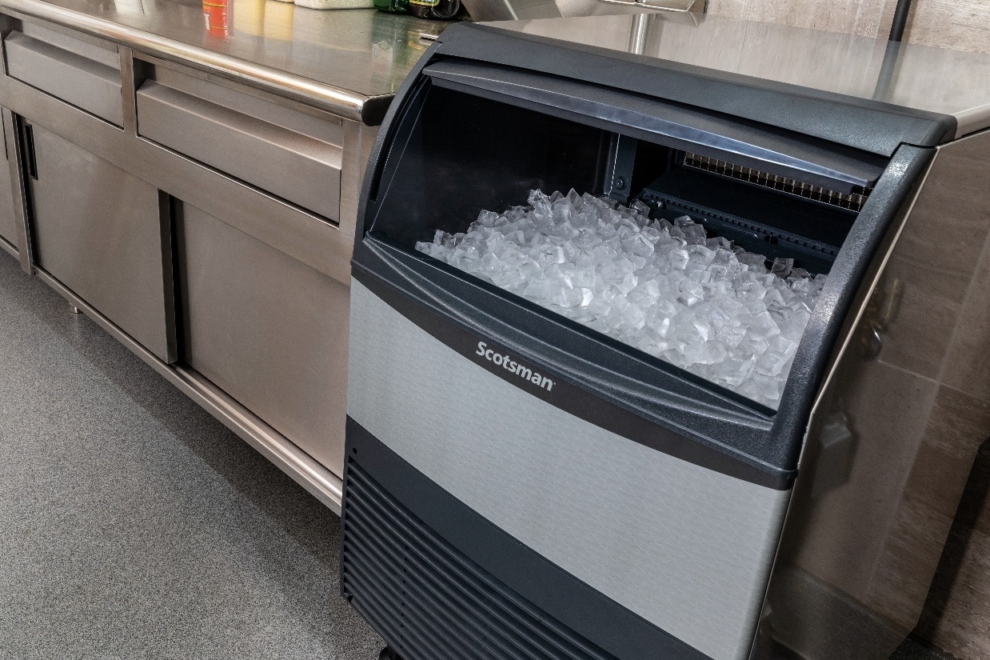
Ease of Use: Ergonomic Bin Door
Convenient Slide-Up Door
Machines feature a durable, slide-up door that provides convenient and easy access to the ice bin

Slide 7
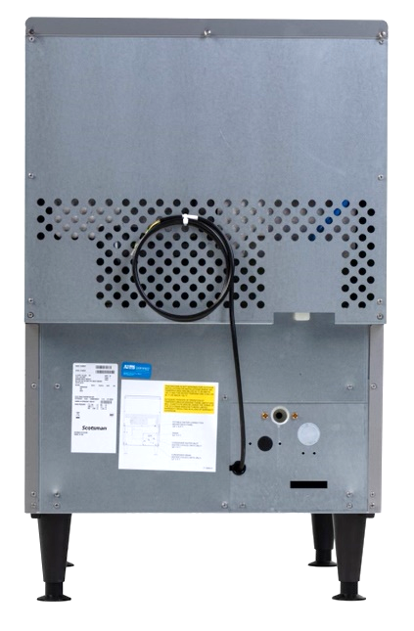
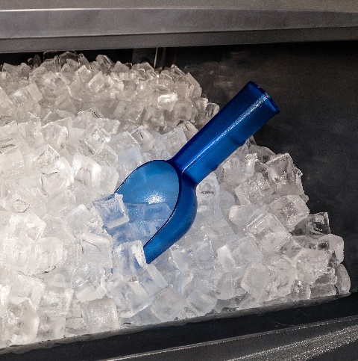
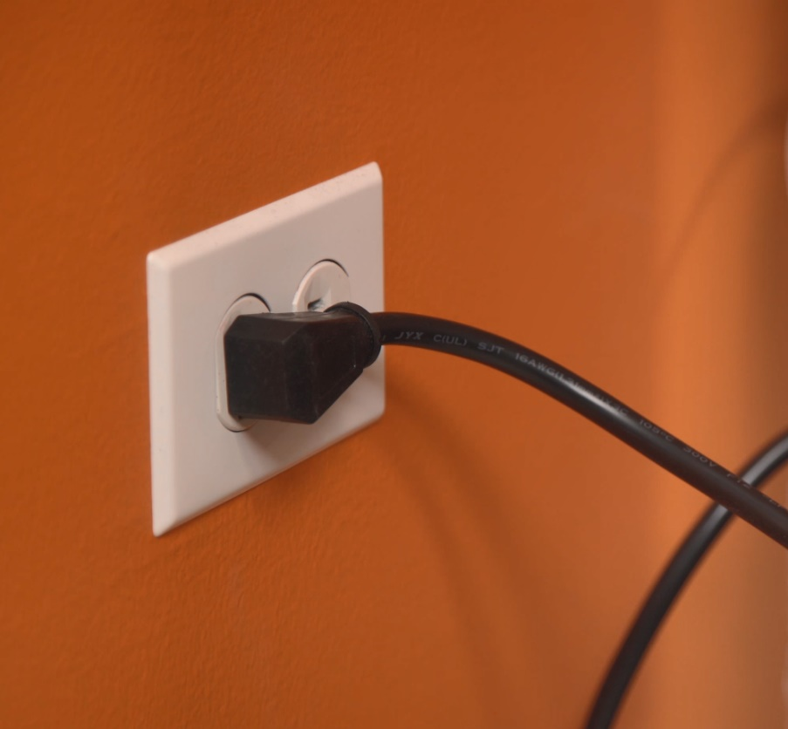
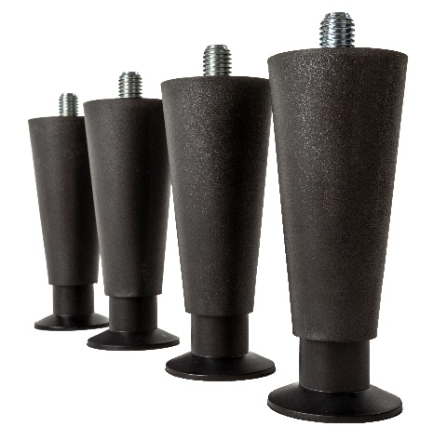
Ease of Use: Quick Installation
Included in the Box
5.5’ power cord with NEMA 5-15P plug
Ice scoop
6” adjustable legs

Slide 8
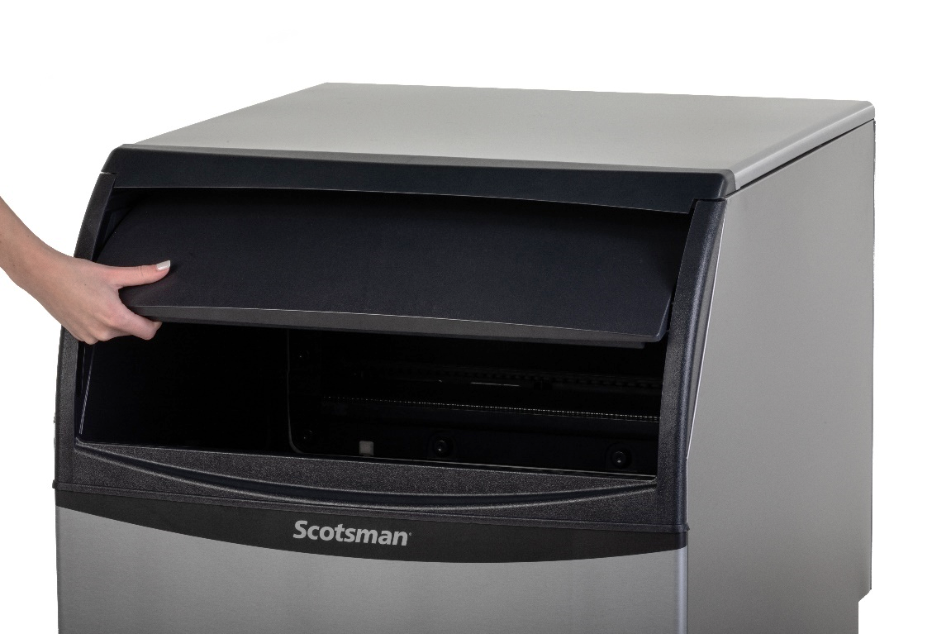
Undercounter Cube: Superior Reliability
Designed for Maximum Lifespan
Aluminum alloy side and top panels
Corrosion resistant
Easy to clean, smudge resistant
Hard plastic front panel
Durable and rust-free

Slide 9
Undercounter Cube: Superior Reliability
High Quality Manufacturing
All Scotsman machines are manufactured and tested at our award-winning facility in South Carolina to ensure you get a reliable machine that works exactly like it should
Assembled in the USA
Award winning Fairfax, South Carolina Facility
ISO9001:2015 accredited
All machines run tested before shipment

Slide 10
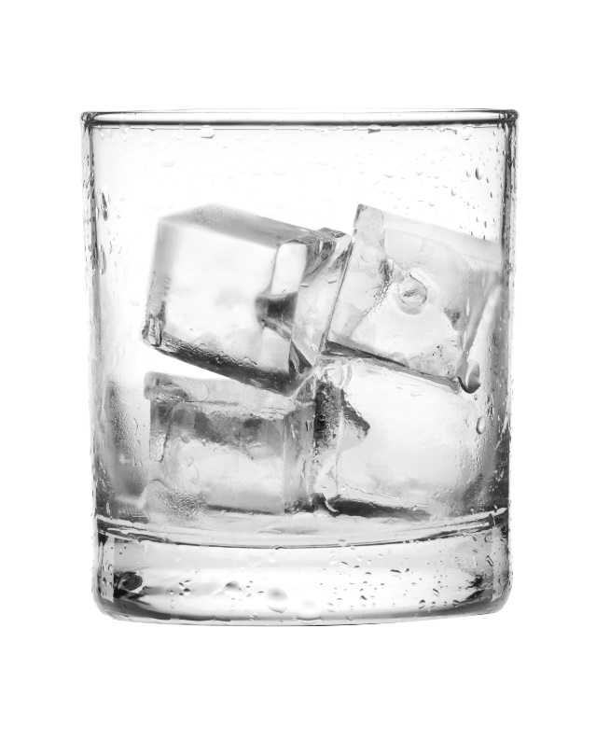
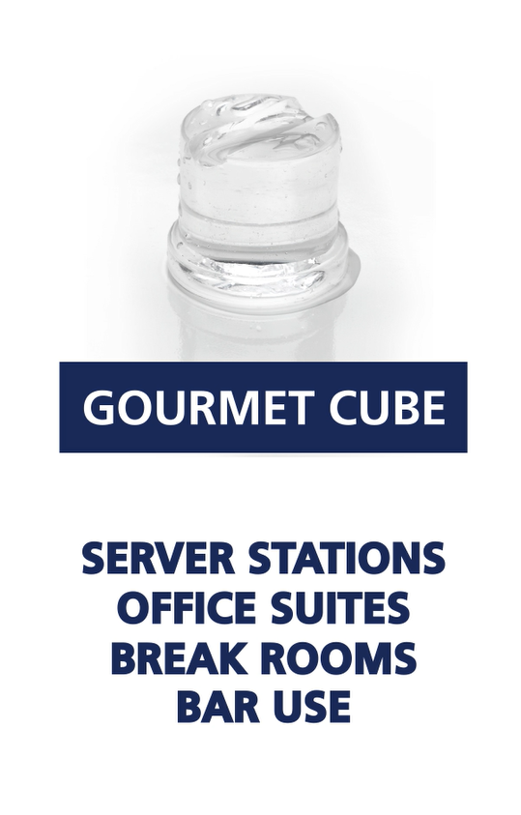
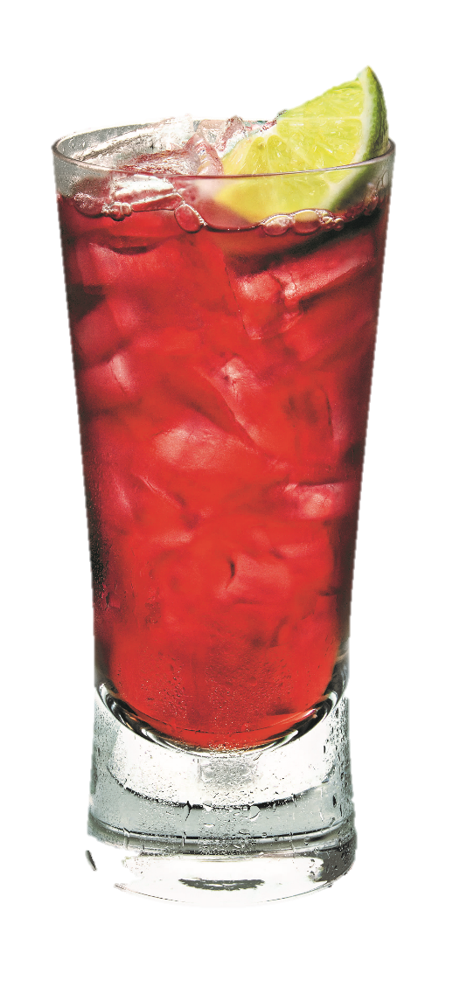
Undercounter Cube: About The Ice
Broad Applications
Small Cube
Fast food
Beverage dispensing
Blending
Medium Cube
Cocktails
Hotel dispensers
Ice bagging

Slide 11
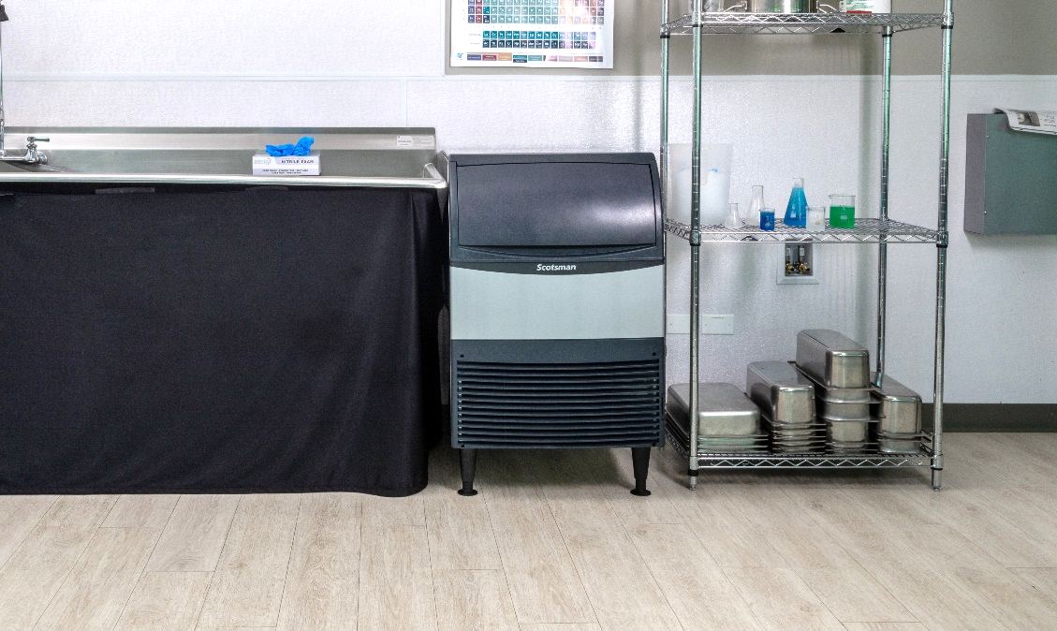
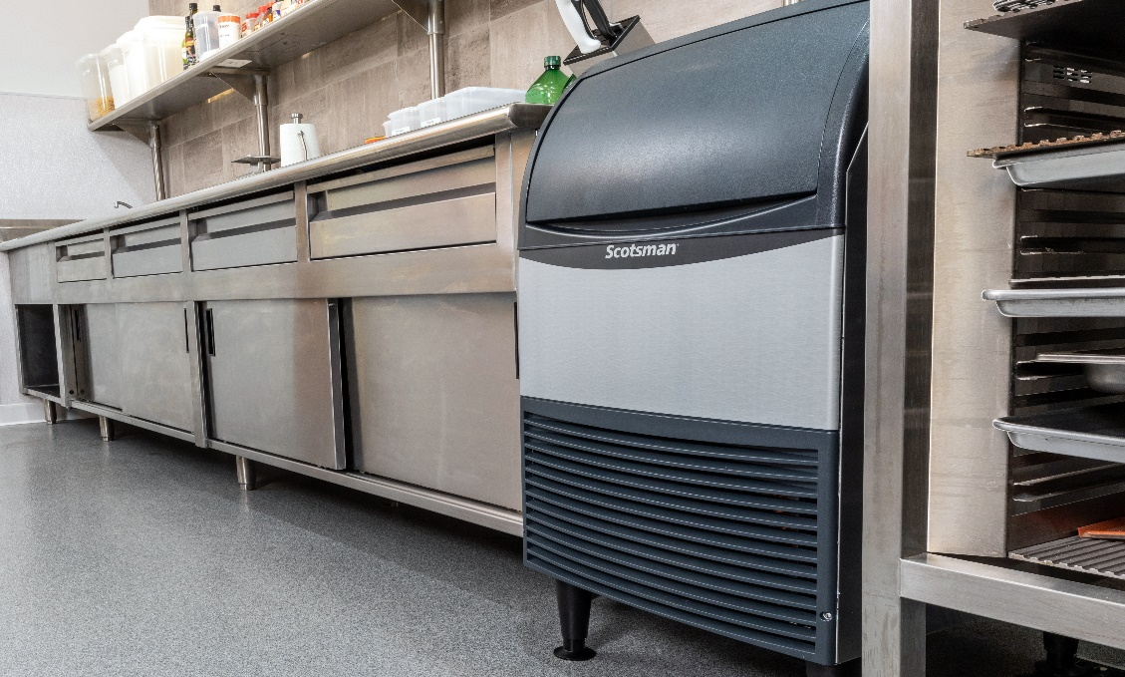
Undercounter Cube: Applications
Ideal for Placement in:
Restaurants
Café
Bar
Offices
Break Rooms
Cooler Filling
Construction, HVAC workers
Schools
Health Club/Spa
Laboratories

Slide 12
15” & 18” WIDTH UNDERCOUNTER GOURMET CUBE
SPECIFIC FEATURES – CU50 | UC0918

Slide 13
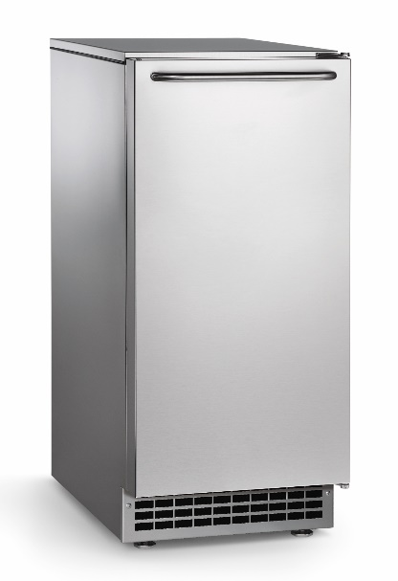
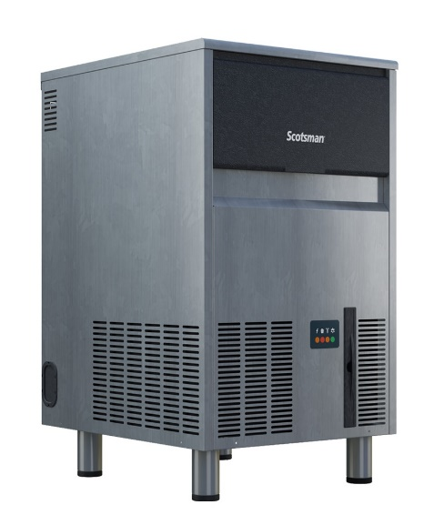
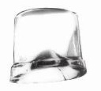
Undercounter Gourmet Cube
Individual Gourmet Cubes
Crystal clear
Slow melting
Ideal for cocktails
Cube Dimensions
1” x 1 ⅛” x 1 ¼”
Applications:
Break Rooms
Office Kitchens
Stadium Suites
Bar/Cocktail Lounges
CU50
Air Cooled
115 V / 60 Hz
Pump or gravity drain option
Capacity: 44 @ 90°/70°
64 @ 70°/50°
Storage: 26 lb.
Dimensions: 15” x 24” x 34.5”
(W x D x H)
Includes leveling feet, scoop, and power cord
UC0918
Air Cooled
115 V / 60 Hz
O
Capacity: 78 @ 90°/70°
95 @ 70°/50°
Storage: 33 lb.
Dimensions: 18” x 22” x 33”
(W x D x H)
Includes 6” adjustable legs, scoop, and power cord

Slide 14
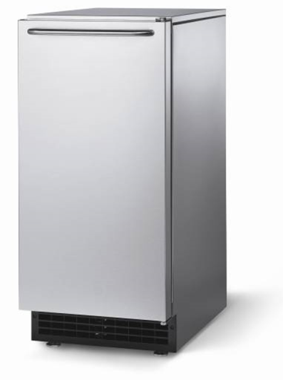
CU50 Undercounter Gourmet Cube
Available Models:
CU50PA-1
Cube Undercounter, 50 lb. production, Pump drain, Air cooled, 115V/60/1
CU50GA-1
Cube Undercounter, 50 lb. production, Gravity drain, Air cooled, 115V/60/1
Up to 64 pounds/day production
Up to 26 pounds of storage
Stainless steel finish
UL,NSF and AHRI certified
Approved for outdoor use with stainless steel kickplate

Slide 15
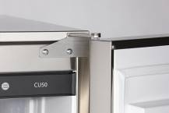
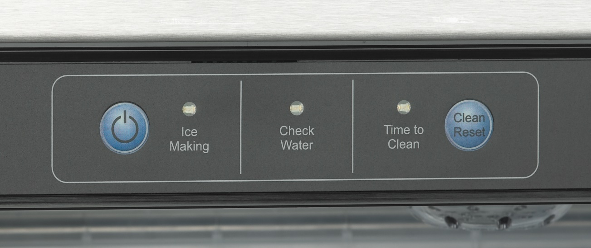
CU50 Undercounter Gourmet Cube
Features & Benefits
Small Footprint
1” Adjustable legs
15” x 24” x 34 ⅜” (W x D x H)
Attractive Aesthetics
Reversible door
Optional stainless steel kickplate
Available with built in drain pump
Water Efficient
Water sensor
Unique Gourmet Ice
Crystal clear, individual cube
Slow melting
User Friendly Control Panel

Slide 16
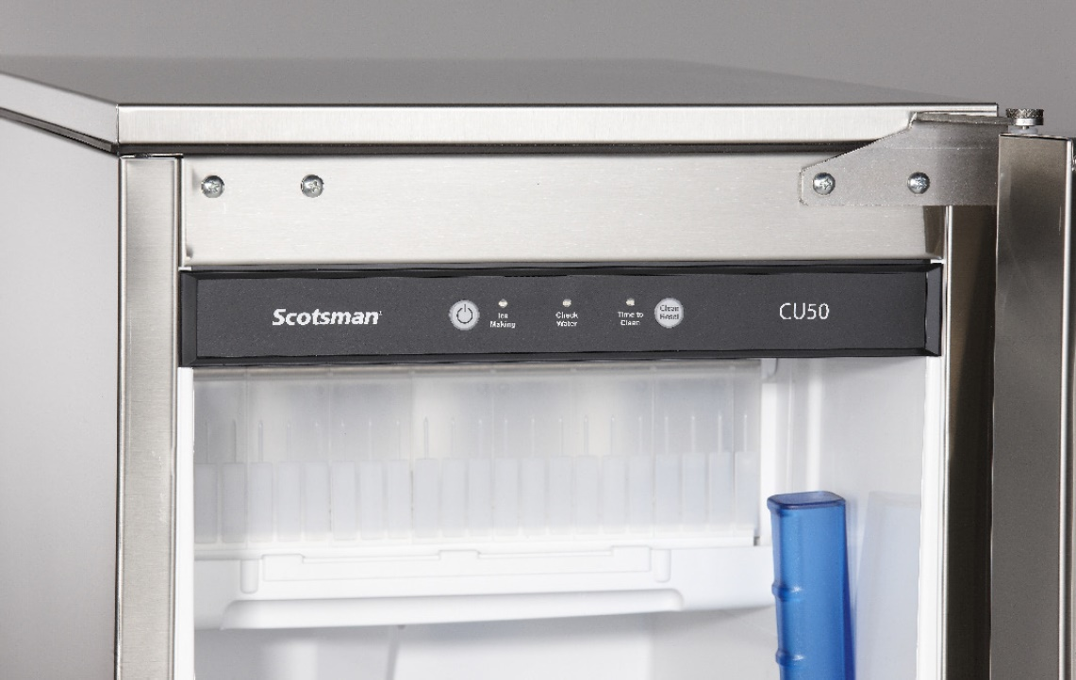
CU50 Undercounter Gourmet Cube
Features & Benefits
Electronic Control Board - Easy to use and understand
On/Off Button
Clean/Reset Button
Ice Making Indicator Light
Check Water Indicator Light
Time to Clean Indicator Light
Water Sensor
Measures water conditions
Automatically adjusts water purge
Extends time between cleanings

Slide 17
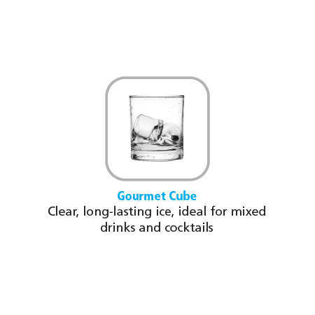
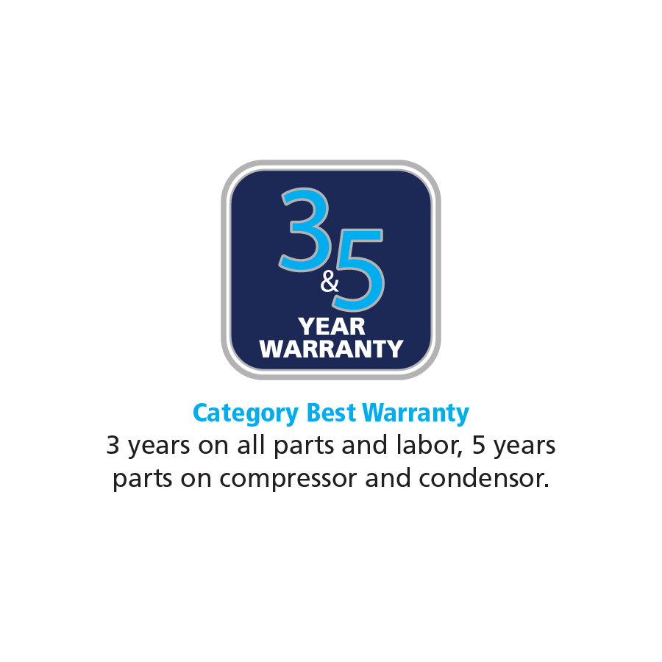
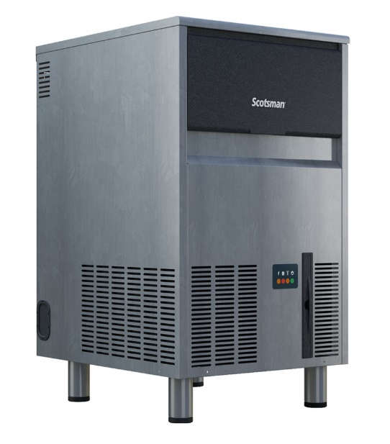
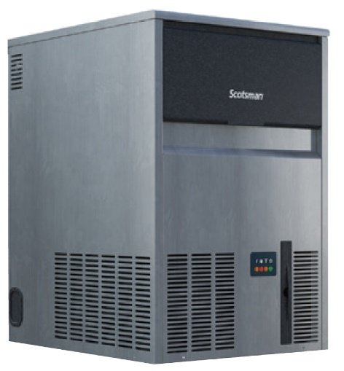
UC0918 Undercounter Gourmet Cube
Features & Benefits
High Production
Produces up to 95 lb. per day
Stores 33 lb. of ice
Unique evaporator makes crystal clear gourmet cubes
Uses environmentally responsible, R290A refrigerant (zero ozone depletion potential, low GWP)
Reliable Operation
Removable air filter for easy maintenance
Durable stainless steel construction
Slide back door allows easy access to ice bin
Small Footprint, Easy Installation
18” cabinet width for placement in tight locations
ADA Compliant without legs
Power cord, NEMA 5-15P plug, ice scoop, and 6" adjustable legs are included for quick installation
18” Platform
With legs
Without legs
33”
27”
*Local health code may require sealant
18”
18”

Slide 18
15” & 20” WIDTH UNDERCOUNTER CUBE
SPECIFIC FEATURES – CU0415 | CU0715 | CU0920

Slide 19
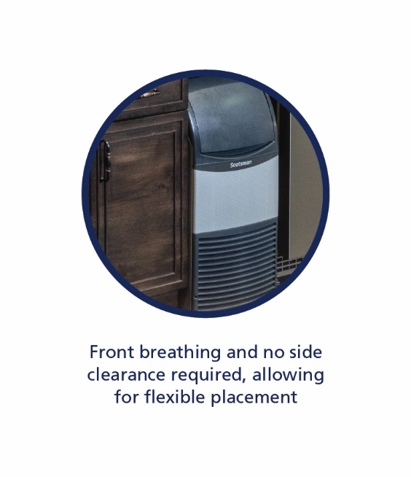
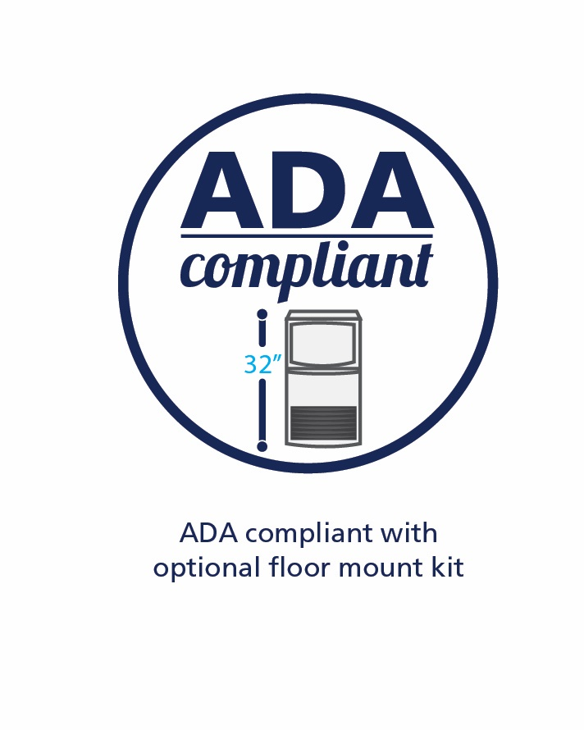
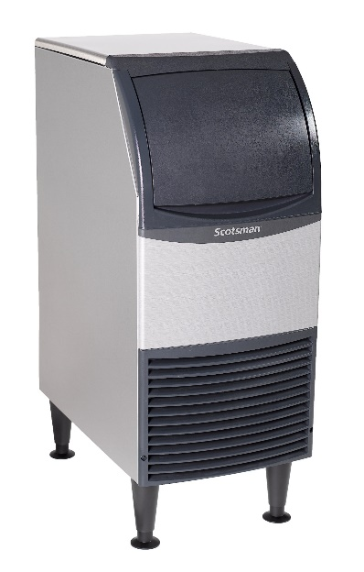
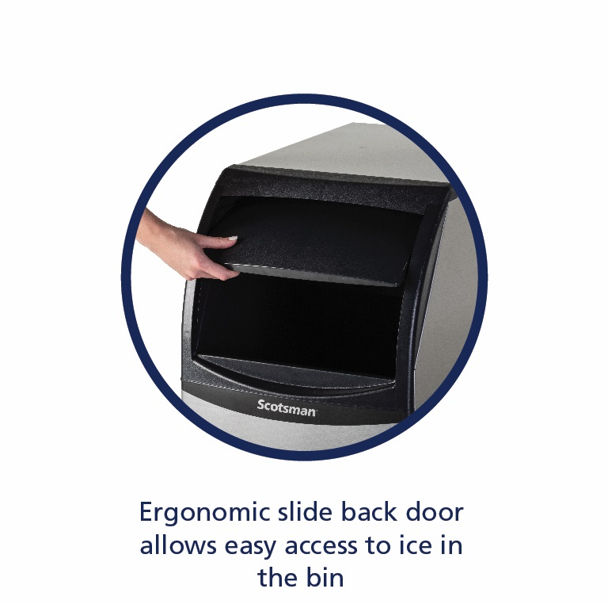
Undercounter Cube: 15” Platform
CU0415
Air Cooled
50 and 60 Hz options
Optional KUFM15 floor mount kit
Capacity: 38 @ 90°/70°
58 @ 70°/50°
Storage: 36 lb.
Dimensions: 15” x 24” x 38”
(W x D x H)
Includes 6” legs, scoop, and 5.5’ power cord
CU0715
Air Cooled
50 and 60 Hz options
Optional KUFM15 floor mount kit
Capacity: 58 @ 90°/70°
80 @ 70°/50°
Storage: 36 lb.
Dimensions: 15” x 24” x 38”
(W x D x H)
Includes 6” legs, scoop, and 5.5’ power cord

Slide 20
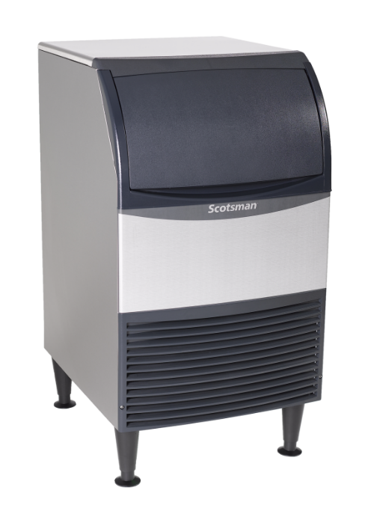
Undercounter Cube: 20” Platform
CU0920
Air Cooled
50 and 60 Hz options
Optional KUFM20 floor mount kit
Capacity: 80 @ 90°/70°
100 @ 70°/50°
Storage: 57 lb.
Dimensions: 20” x 24” x 38”
(W x D x H)
Includes 6” legs, scoop, and 5.5’ power cord

Slide 21
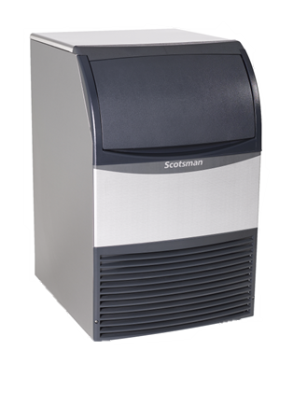
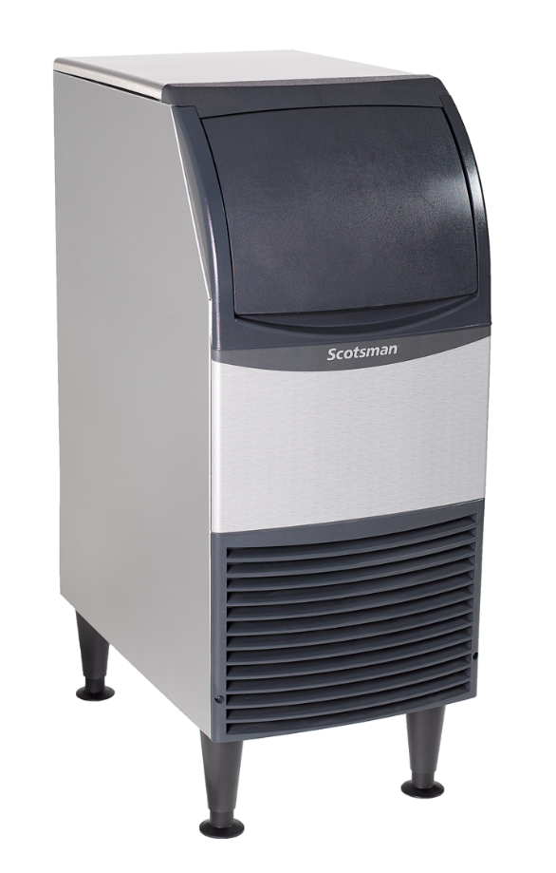
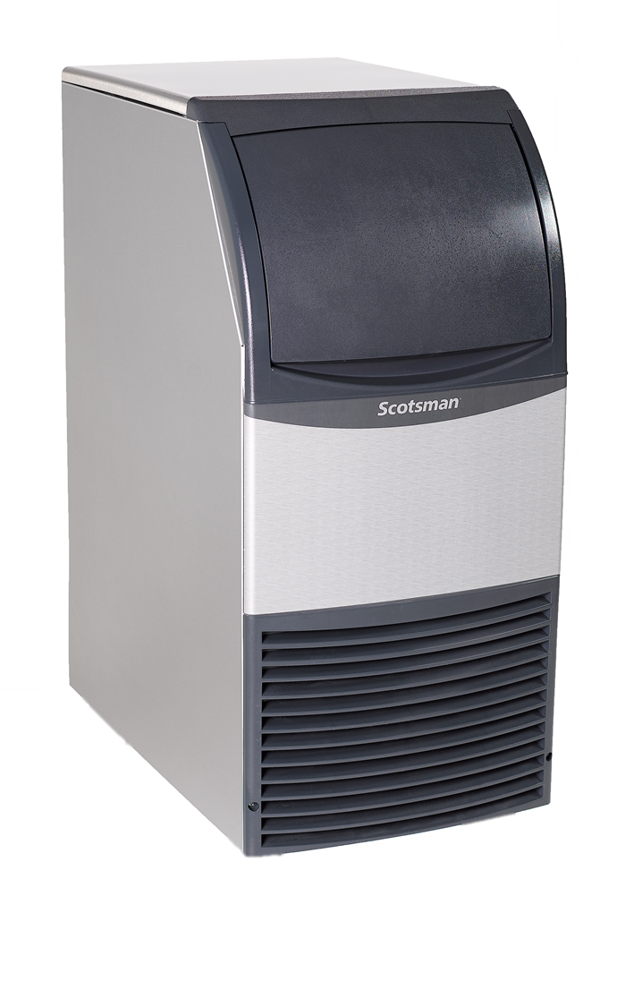
Space Saving Design: ADA Compliant
With legs
Without legs
15” Platform
38”
31.9”
With legs
Without legs
31.9”
With use of KUFM20 floor mount kit
38”
20”
20”
20” Platform
With use of KUFM15 floor mount kit
15”
15”

Slide 22
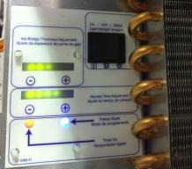
Undercounter Cube: Ease of Use (15” & 20” Only)
Features & Benefits
Ease of Use - Allows operators to efficiently get the ice they need
Slide Up Door
Large Access Area
Ice Scoop Included
Intuitive Controls
On/Off/Clean Switch
Ice Thickness Adjustment
Harvest Time Adjustment

Slide 23
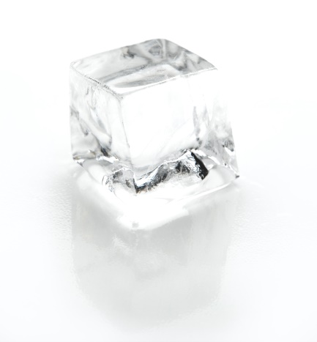
Undercounter Cube (15” & 20” Only)
Features & Benefits
Clear Cubes - Consumer preferred
Made with innovative horizontal evaporator
Minerals don’t freeze in cube
Spray jets helps keep them washed away
Environmentally Friendly - Designed responsibly, while focusing on lower utility costs
Uses R-134a refrigerant
Does not deplete ozone layer
Lower energy consumption
Recyclable aluminum alloy side panels
Same durability and corrosion resistance as stainless

Slide 24
Undercounter Cube (15” & 20” Only)
Meets the Following Regulations:
ETL Safety
ETL Sanitation
Air Conditioning, Heating and Refrigeration Institute (AHRI)
CE (50 Hz)
InMetro (Brazil – 230/60/1)
Low Lead – Safe Drinking Water Act
United States Department Of Energy Federal Energy Efficiency Minimums

Slide 25
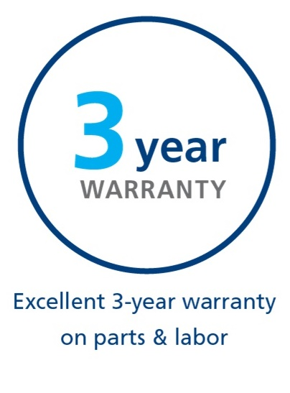
Undercounter Cube: Superior Reliability (15” & 20” Only)
Standing Behind Our Quality
Scotsman provides a 3-year parts and labor warranty on all components for 15” and 20” units
3-year parts and labor warranty on all components
Warranty valid in North, South & Central America for commercial installations
Residential applications:
1 year parts and labor

Slide 26
24” WIDTH UNDERCOUNTER CUBE
SPECIFIC FEATURES – UC2024 | UC2724

Slide 27
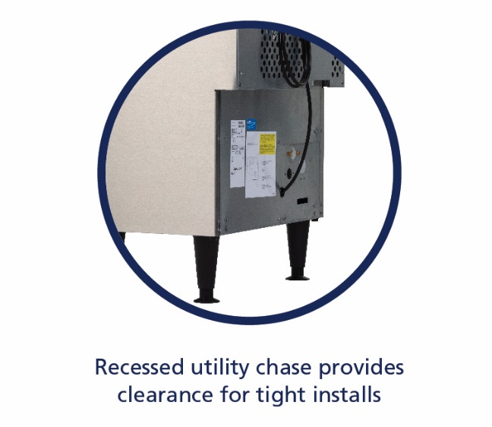
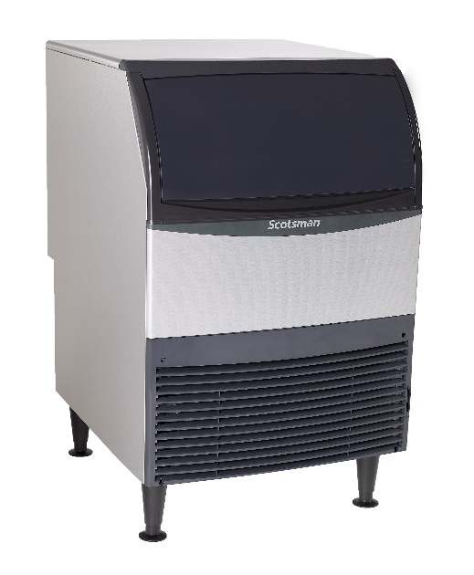
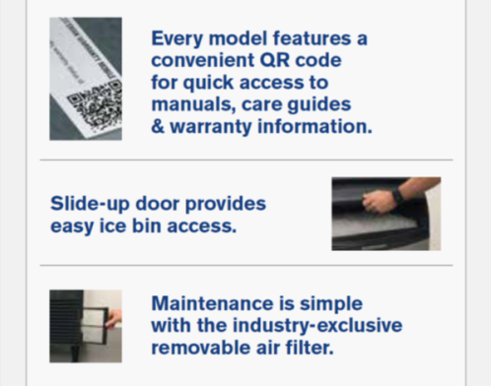
Undercounter Cube: 24” Platform
UC2024 (Replaces CU1526)
Air and water cooled
115 V / 60 Hz
Energy Star® Certified
Optional KUFM24 floor mount kit
Capacity: 166 @ 90°/70°
227 @ 70°/50°
Storage: 80 lb.
Dimensions: 24” x 28.5” x 39”
(W x D x H)
Includes 6” legs, scoop, and 5.5’ power cord
UC2724 (Replaces CU2026)
Air and water cooled
50 and 60 Hz options
Optional KUFM24 floor mount kit
Capacity: 202 @ 90°/70°
282 @ 70°/50°
Storage: 80 lb.
Dimensions: 24” x 28.5” x 39”
(W x D x H)
Includes 6” legs, scoop and 5.5’ power cord

Slide 28
Space Saving Design: Recessed Utility Chase
24” Platform
With legs
Without legs
39”
33.5”
Recessed utility chase on backside of unit provides clearance along the wall for tight installs
With use of KUFM24 floor mount kit
24”
24”

Slide 29
Ease of Use: Removable External Air Filter (24” Only)
Easy-to-Clean Air Filter
The removable, external filter makes cleaning easy for increased efficiency
Filter location makes accessing, rinsing, and reusing fast and easy
Better visibility keeps regular cleaning top of mind, ensuring maximum performance and optimal sanitation
No tools required for removal, unlike other manufacturers

Slide 30
Ease of Use: Simple Servicing (24” Only)
Intuitive Controls
Cleaning and service information can be conveniently found upon removing the front panel
Indicator lights keep operators informed of unit’s status
Electronic Control Board
“On/Off/Clean” switch
“Ice Thickness” adjustment
“Harvest Time” adjustment

Slide 31
Undercounter Cube: Superior Reliability (24” Only)
Standing Behind Our Quality
Scotsman provides a 3-year parts and labor warranty on all components for 24” units
3-year parts and labor warranty on all components
5-year parts warranty on the compressor
Warranty valid in North, South & Central America for commercial installations
Residential applications:
1-year parts and labor

Slide 32
Undercounter Cube: Environmentally Friendly (24” Only)
Lower Operating Costs
Uses R-134a refrigerant
Does not deplete ozone layer
6-35% more energy efficient than previous models
Recyclable aluminum alloy side panels
Same durability and corrosion resistance as stainless-steel
Meets US Safe Drinking Act low lead requirements

Slide 33
30” WIDTH UNDERCOUNTER CUBE
SPECIFIC FEATURES – CU3030

Slide 34
Undercounter Cube: 30” Platform
Includes 5-year limited warranty on select components
CU3030
Air and water cooled
50 and 60 Hz options
Optional KPUFM30 floor mount kit
Capacity: 224 @ 90°/70°
313 @ 70°/50°
Storage: 110 lb.
Dimensions: 30” x 30” x 39”
(W x D x H)
Includes 6” legs, scoop, and 5.5’ power cord

Slide 35
CU3030 Undercounter Cube
Features & Benefits
AutoAlert™ control board communicates operating status for easy diagnostics and maintenance
Patented WaterSense adaptive purge control delivers maximum reliability by reducing scale buildup for a longer time between cleanings
Manufactured in Fairfax, South Carolina
Best in class warranty:
3 years parts and labor on all components
5 years parts and labor on evaporator
5 years parts on compressor and condenser
Certified by AHRI, UL and NSF

Slide 36
CU3030 Undercounter Cube
Patented WaterSense Technology
Automatically adjusts based on water supply quality
Exclusive feature helps reduce scale buildup for more sanitary ice
Reliable sensor adjusts water purge at end of each cycle to flush excess minerals
Automatically flushes the system to extend time between cleanings
Operators can save water and energy where water conditions are better filtered by recirculating clean, pre-chilled water back into the ice-making process

